Slide 1

Creating Validity and Extremity Metrics for Yelp Reviews
Ying Han
Brainstation

Slide 2
OUTLINE
Project Overview
Problems
Solutions
Introduction to the Dataset
EDA

Slide 3
Project Overview
According to Nielsen, 92% of customers read Yelp review before they make a purchase. Why do we ever need crowd-sourced review/rating systems, like Yelp and Google review?
Consumer
The only source where consumers can obtain a priori information before they decide to explore a new business/service that they have never been to.
Business
Very good way to promote, for both small and large businesses. On average, each additional one-star Yelp rating causes a 9 percent increase in business revenue.

Slide 4
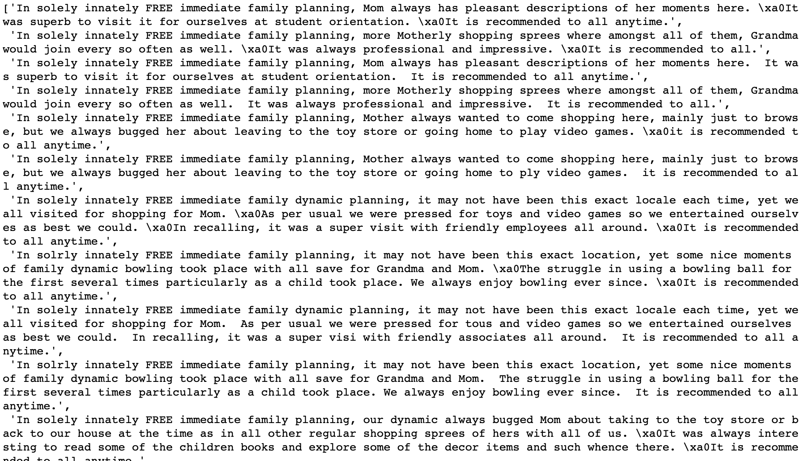
Problems - Fake Reviews/Ratings
Takes up about 20%
Positive (more common) and negative fake reviews
In most cases, fake reviews are paid to create by business owners for promoting own business or tainting reputations of competitors
Let’s see an example!

Slide 5
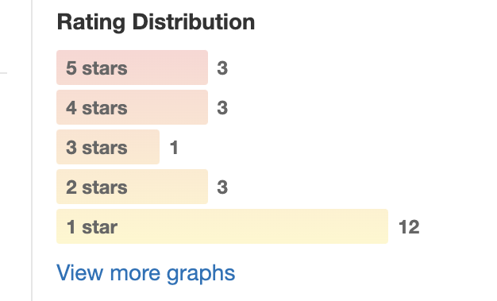
Problems - Extreme/Inconsistent Reviews/Ratings
Example : Restaurant A = [ 4, 4, 4, 4, 4] vs. Restaurant B = [ 5, 5, 5, 2, 3]
Which one will you pick?
What if we know that 2 stars of Restaurant B was given by a yelper X whose distribution of ratings are like this.
Can we conclude that yelper X is too nitpicky?
What if the average ratings of the business yelper X has reviewed range from 2-3.5 stars?

Slide 6
Solutions
Extremity Problem
Evaluate a reviewer's rating pattern and extremity
Use reviewer's of reviews/ratings distribution and the reviews/rating distribution of the business the reviewer has reviewed
Extremity metric will be computed based on quantiles.
E.g., if a reviewer is always in the lowest 5% of the rating distribution, across different business => “strict” reviewer
Further thought: Using similar logic, an extremity score can be generated for each business. If people tend to give more extreme ratings compared to their average level, the business can be considered as “love or hate” type.
Fake Review
Screening methodology
Several screening standards (from the least strict to the most strict level)
Each standard developed based on the review, user and business relevant variables.
A validity score will be computed, with low validity score suggesting a high chance of being a fake review

Slide 7
Data
Provided by Yelp for academic research
Business data: 150,346 business and 14 business-relevant variables
Review data: 6,990,280 reviews and 9 review-relevant variables
User data: 1,987,897 users and 22 user-relevant information
Tip data: 908,915 tips and 5 tip-relevant variables
Check-in data: 131,930 check-in records (business ID and check-in date.

Slide 8
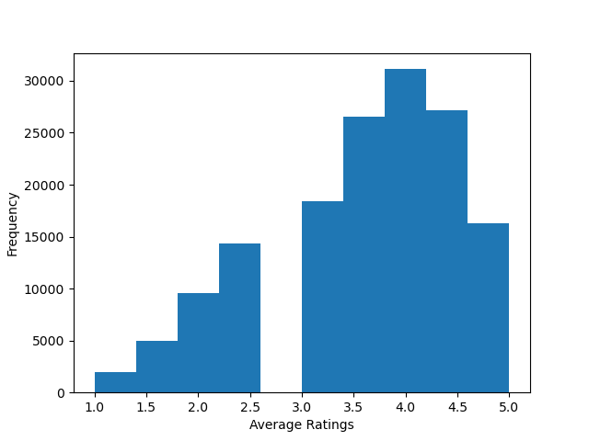
Basic EDA – Business
Review Counts | Percent
5-10 | 28%
11-20 | 22%
21-50 | 20%
51-100 | 9.5%
101-500 | 8.7%
501-1000 | 0.7%
Above 1001 | 0.2%
The distribution is skewed toward left and peaking at 4 star, meaning more higher rating. The ratings are aggregated results but not strictly average. Because ratings are in a incremental scale of 0.5 from 1-5.

Slide 9
Basic EDA – Business
Top 10 categories:
Restaurants, Food, Shopping, Home Service, Beauty & Spa, Nightlight, Health& Medical, Local Services, Bar
Top 10 cities:
Philadelphia, Tucson, Tampa, Indianapolis, Nashville, New Orleans, Reno, Edmonton, Saint Louis, Santa Barbara
Top 10 states:
PA, FL, TN, IN, MO, LA, AZ, NJ, NV, AB

Slide 10
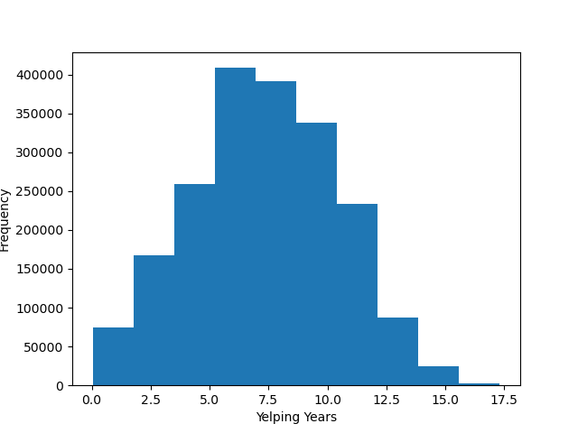
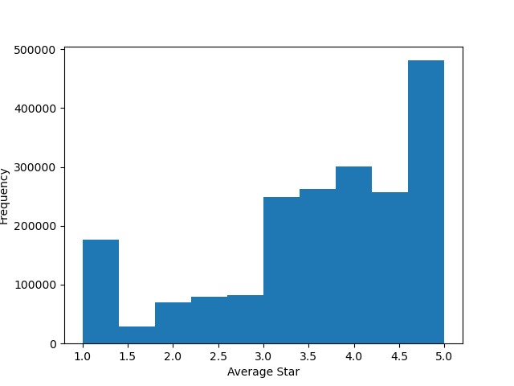
Basic EDA – User

Slide 11
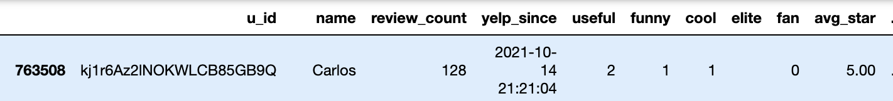
Basic EDA – User
Total Reviews | Percent
0-5 | 50%
6-10 | 15%
11-50 | 25%
51-100 | 5%
101-500 | 4%
Above 500 | 1%
Interesting observation:
I Filtered users that started their yelp account less than a year and sorted by the counts. Among these newest yelper, Yelper Carlos stood out, who wrote 128 reviews in 109 days, comparing to the overall average of yelp community, 3 posts per year. Then I extracted all the reviews wrote by this yelper and found out all of them are duplicated reviews posted for different business.

Slide 12
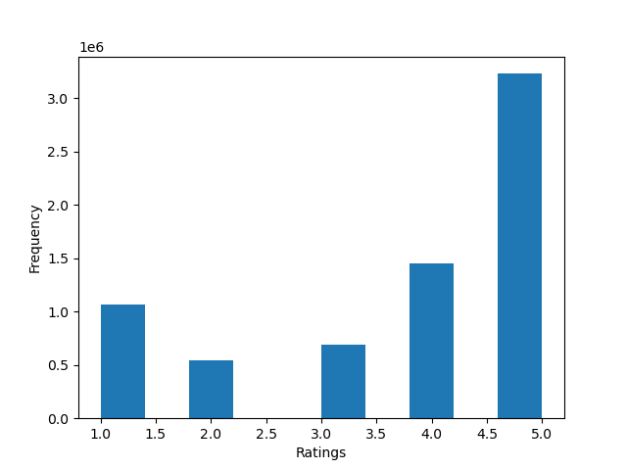
Basic EDA – Review
Matches the distribution of average ratings of users
Distribution of number of reviews over the years
file:///Users/yhan/Desktop/Capstone/review_over_year.html

Slide 13
Some Thoughts and Future Plan
One potential signal of fake reviews is excessive amount of reviews in a short period of time (as in the case observation). The other straightforward signal is duplicated reviews.
Other signals need to be tested: the time gap between the time account was created and the time of review posted; the time gap between the time business account was created and the time of review posted; location difference of reviewer and business, ect.
Other potential approaches:
Sentiment analysis of review text
Unsupervised learning

