Slide 1
Beyond 5-Star Rating: RAS and EmoPolarity Analysis of Yelp Reviews
Ying Han
Brainstation

Slide 2
OUTLINE
Project Overview
Dataset & Preprocessing
Model Building Approaches
Future Directions

Slide 3
Project Overview
According to Nielsen, 92% of customers read Yelp review before they make a purchase. Although Yelp tried to create a community vibe for their review platform and add many features to assist customers to better evaluate a business, most people focus on two things when they use review & rating system like Yelp.
An aggregated rating of a business on a 5-point scale
Review text
Three problems:
Fake reviews
Ratings that are distorted by personal bias
Inconsistency between reviews and ratings

Slide 4
Solutions to the Problems
Fake reviews => Authenticity score (RAS)
Ratings that are distorted by personal bias => Reliability score (RAS)
Inconsistency between reviews and ratings => Emotion polarity score

Slide 5
Dataset & Preprocessing
Provided by Yelp for academic research:
Business data: 150,346 business and 14 business-relevant variables
Review data: 6,990,280 reviews and 9 review-relevant variables
User data: 1,987,897 users and 22 user-relevant information
Note: For model building stage, 30 business labeled with business categories of ‘Vietnamese’ and ‘Restaurants’ were selected. 3696 reviews of these Vietnamese restaurants were subset for the analysis of text reviews.

Slide 6
Model Building Approach 1: Unsupervised KMeans Clustering
Model 1
Preprocessing of text: Tokenizing using customized tokenizer with max feature of 500.
Including review text and user-relevant & business-relevant features, 512 features in total.
Standardized scaling
Hyperparameter tuning using inertia & Silhouette score => K = 2
Evaluating & interpreting clusters using heatmap of average scores of features of two clusters.
Result: Impossible to interpret!

Slide 7
Model Building Approach 1: Unsupervised KMeans Clustering
Model 2
Preprocessing of text: Tokenizing using customized tokenizer with max feature of 500.
Only including review text, 500 features in total.
Standardized scaling
Hyperparameter tuning using inertia & Silhouette score => K = 6
Evaluating & interpreting clusters using heatmap of average scores of non-text features of two clusters.

Slide 8
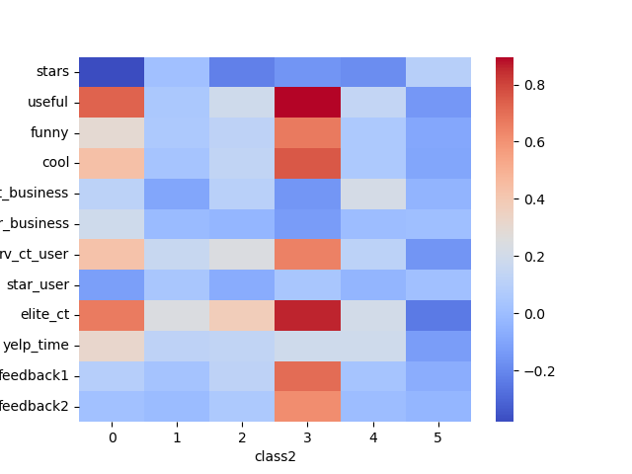

Slide 9
Some example reviews - cluster 3
"In a city where the best Vietnamese food can often be found outside of a restaurant, pho cam ly strives to change the norm. Right away one might think that this is just another pho restaurant that caters to Americans because it is nestled on the beautiful Magazine street in uptown. I sure did. But I was pleasantly surprised to be proven wrong. First, the menu isn't by any means limited. Along with offering a wide variety of pho and com dishes, I was delighted to see bun bo hue on the menu (though I admit I haven't tried it yet). I've been disappointed too many times to see the dish not included on other menus, so that was a plus. Second, the dish I ordered, pho chin gan, was very delicious. Not only were they generous with their meat portion, the soup wasn't too oily. Too often I've left pho restaurants too full of oil that I end up being a couch potato the rest of the day. However, I did have a bite of my girlfriend's pho ga and the chicken was disappointing. It was quite dry and made her meal less satisfying.\nAnother reason I enjoy pho cam ly is the excitement of the pho challenge. A whopping bowl consisting of two pounds of meat and another two pounds of noodles awaits anyone with nerves of steel, four stomaches and 40 bucks (plus tax). I took on the challenge and failed terribly but the waiters were quite encouraging and made my failure a little less saddening.\nI encourage anyone to come here. Not only do you get a good meal, there's always a chance you'll get a show too.",
"Yay, a restaurant that is open on Monday!\n\nI was craving pho and I didn't want to drive all the way to the West Bank. I wanted something on my route to home from work, and I found Pho Cam Ly on Yelp.\n\nI ordered the small Pho Tai and a Grilled Pork Bahn Mi. The small pho was a pretty good sized bowl. I was almost too full to eat any of my Bahn Mi, but I am greedy and ate half of it any way. I got the other half to go.\n\nI really enjoyed the pho. I didn't even put any sriracha in the broth until I was 2/3 of the way done (I love sriracha in my pho but I was savoring the broth in its original flavors before I added anything to it later). The grilled pork in the bahn mi was less exciting than some other Vietnamese restaurants, but it was a decent sandwich by all means.\n\nI will surely be returning."

Slide 10
Some example reviews - cluster 1
'The only thing I order here is Pho, Its just so good..... One thing you should know is that its pork broth. They have no other options. I went to another place and had veggie or chicken broth and its just not the same. My other half ordered summer rolls that was just ok, but the peanut sauce it came with was fantastic. FYI I do not like peanut sauce... Go and try the PHO!!!',
'Our go to place for chicken pho, it is delicious! We sre not big fans of the fried egg rolls but the pho is great. We will be exploring more of the menu on our next trip. We go at least one a week or bi-weekly =)',
"I've been to Nam Phuong a few times and have never been disappointed with my meal. I usually end up here when I'm in the mood for Pho, but whom ever I'm with isn't. \n\nThey have a pretty extensive menu offering several vegetarian and non-vegetarian options, all your regular Pho varieties, and of course a menu of bubble teas. \n\nThe restaurant has always been clean and service has always been prompt.",

Slide 11
Model Building Approach 2: Classification with Labels
Model 3
30 fake reviews were generated from ChatGPT with minimum instructions such as ‘please write a review for Vietnamese restaurant’.
From 3000+ sample reviews, 300 reviews that received the most ‘useful’ counts were selected as ‘real’ reviews.
Train-test split, vectorizing text data and standardized scaling were applied.
Hyperparameter tuning for C parameter, optimal C = 0.4
Highest train & test accuracies = 1

Slide 12
Next Step
Semi-supervised clustering
Instead of determine fake/real, compute quality score for reviews(similarity to high quality reviews)
Compute EmoPolarity & Reliability score (do not require modeling)

