Slide 1

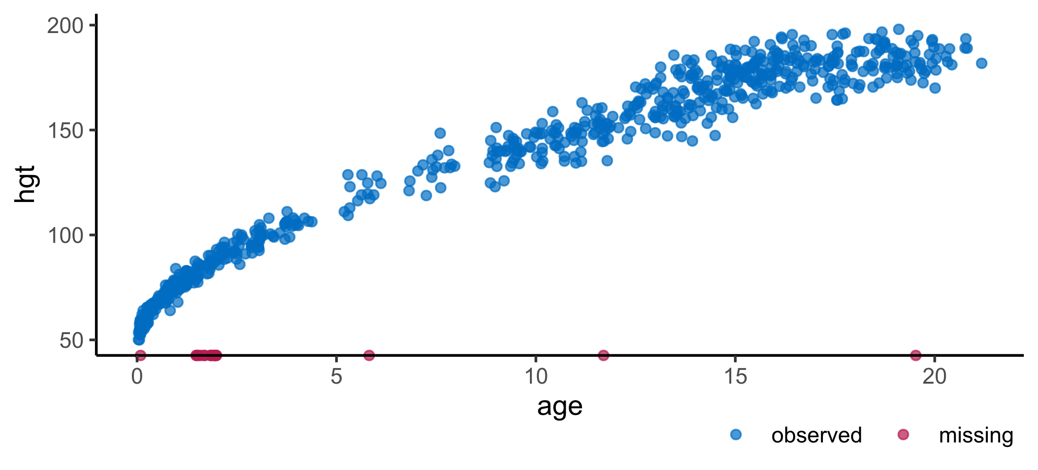
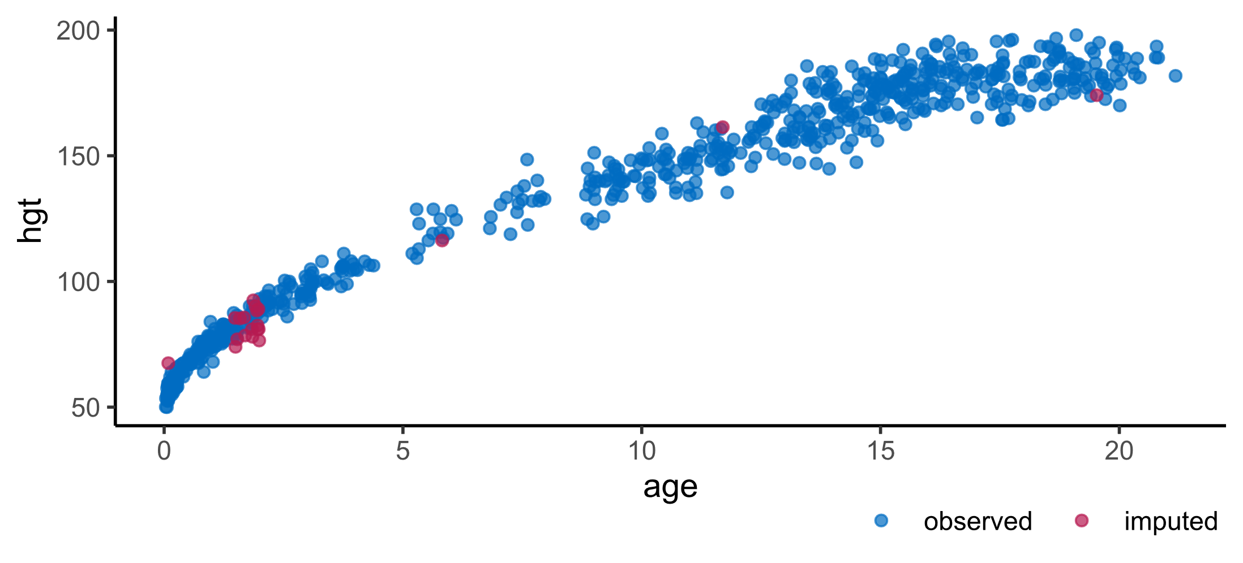

Hanne Oberman
Visualization of incomplete and imputed data
With the R package ggmice
H. I. Oberman
Using mice for missing data
The R package mice has become the de facto standard to handle the ubiquitous problem of incomplete data. With mice, missing data points are ‘imputed’ (i.e. filled in) to obtain several completed data sets. Filling in the missing data multiple times allows for a valid representation of the uncertainty due to missingness.¹
Visualizations for mice with ggplot2
Enhance a mice imputation workflow with ggmice for visualizations of incomplete and/or imputed data. The resulting ggplot objects may be easily manipulated or extended. Use ggmice to inspect missing data, develop imputation models, evaluate algorithmic convergence, or compare observed versus imputed data. ²
Get started with ggmice
The ggmice package can be installed from CRAN with install.packages(‘ggmice’). Subsequently, the packages vignettes may be retrieved with ??ggmice. More extensive documentation can be found on the package website: amices.org/ggmice. Package contributions and bug reports are welcome through the development repository. ²
Code chunk 1
Set-up the environment with packages for imputation and visualization.
library(mice)
library(ggplot2)
library(ggmice)
Figure 1
Scatterplot of height (in cm) by age (in years) in the incomplete boys data set. Missing values in the height variable are visualized with ggmice on the x-axis.
Code chunk 2
Visualize the incomplete boys data set from the mice package with ggmice.
ggmice(
boys,
aes(age, hgt)) +
geom_point()
Code chunk 3
Impute the missing values in the boys data set with mice.
imp <- mice(
boys,
m = 1)
Figure 2
Scatterplot of height (in cm) by age (in years) in the imputed boys data set. Missing values in the height variable are filled in with mice and visualized with ggmice.
Code chunk 4
Visualize the imputed boys data set with ggmice.
ggmice(
imp,
aes(age, hgt)) +
geom_point()
The information has been compiled with the utmost care but no rights can be derived from its contents.
References
Van Buuren, S. (2018). Flexible imputation of missing data. Chapman and Hall/CRC. stefvanbuuren.name/fimd
Oberman, H. I. (2022). ggmice: Visualizations for “mice” with “ggplot2”. doi.org/10.5281/zenodo.6532702
Acknowledgements
The ggmice package is developed with guidance and feedback from Gerko Vink, Stef van Buuren, and others. This project has received funding from the European Union’s Horizon 2020 research and innovation programme under ReCoDID grant agreement No 825746.
amices.org/ggmice
Notes:
Missing data are ubiquitous in the social and human data sciences. Computational pipelines that accommodate incomplete data require exploration and evaluation of the missingness. The R package [ggmice](amices.org/ggmice) enables data analysts to visualize incomplete and imputed data.

