Slide 1
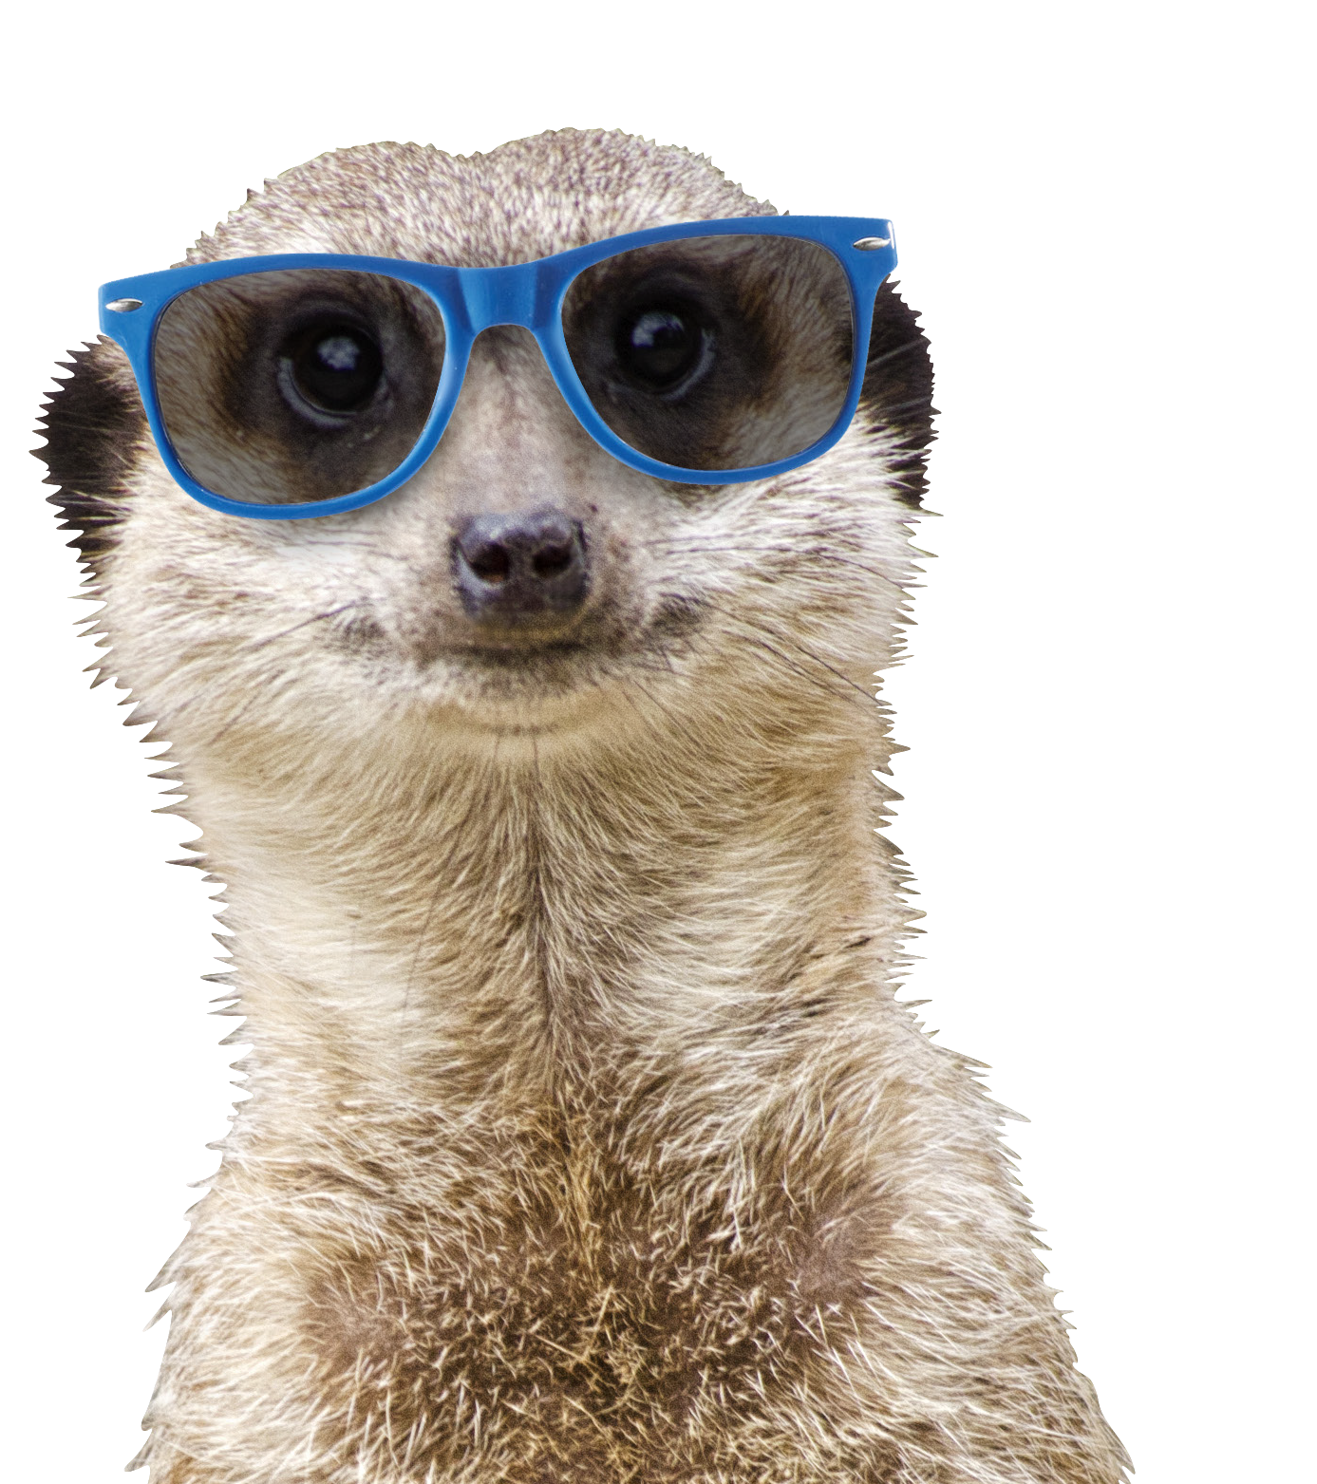

SHAPING CULTURAL CHANGE TOGETHER
my community is open!

Slide 2




Open Science is not a movement anymore:
University Open Science programmes
NL
governmental policy
EU
policy
UNESCO
ratified

Slide 3
Open Science is not a movement anymore:
University Open Science programmes
NL
governmental policy
EU
policy
UNESCO
ratified
Open Science is not yet considered the norm by the wider academic communities.

Slide 4
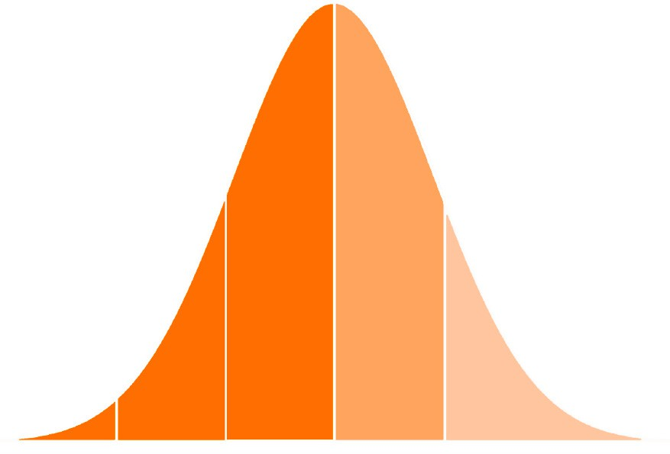
EARLY MAJORITY
LATE MAJORITY
EARLY ADOPTERS
LAGGARDS
INNOVATORS
The Innovation Adoption Lifecycle (Rogers, 2003)

Slide 5
EARLY MAJORITY
LATE MAJORITY
EARLY ADOPTERS
LAGGARDS
INNOVATORS
}
Infrastructure: make it possible
User experience: make it easy
Communities: make it normative
INTERVENTIONS
Incentives: make it rewarding
Policy: make it required
(Nosek, 2021)

Slide 6
EARLY MAJORITY
LATE MAJORITY
EARLY ADOPTERS
LAGGARDS
INNOVATORS
}
Infrastructure: make it possible
User experience: make it easy
Communities: make it normative
INTERVENTIONS
Incentives: make it rewarding
Policy: make it required
(Nosek, 2021)

Slide 7
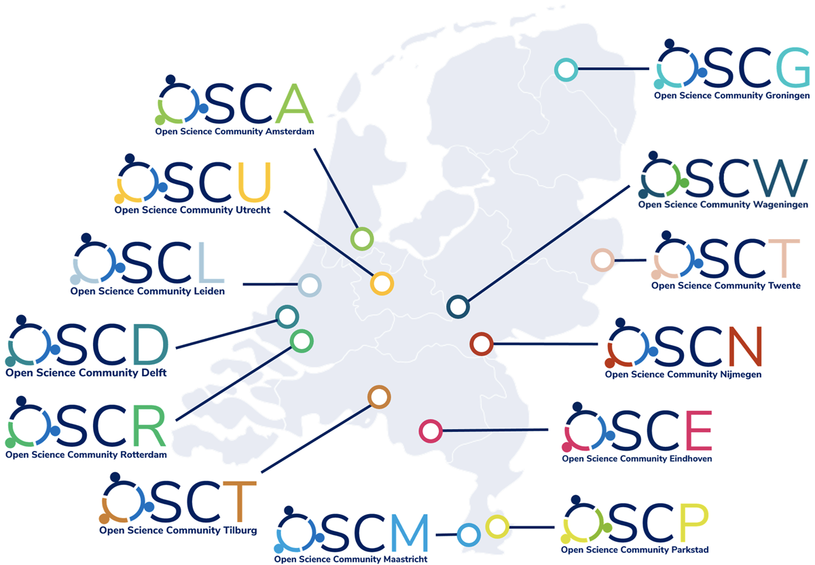
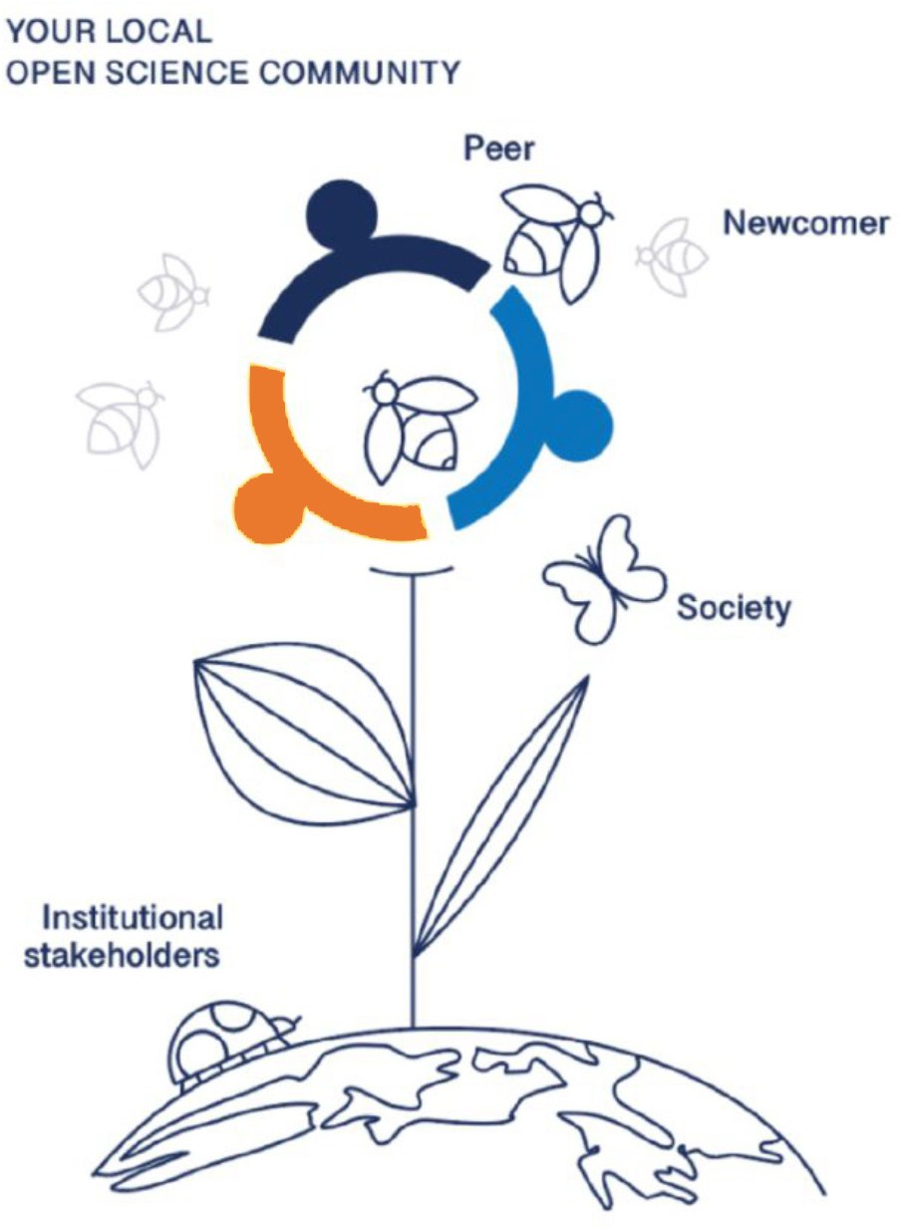
Top-down needs bottom-up!
Institutional OS Programme
OSC
Open Science Communities NL
bottom up, community-led
started by researchers in Utrecht
12 local hubs in NL
and many more beyond
over 2000 members in NL
A place where researchers and scholars, educators, support staff, students, and citizens learn from each other how to put Open Science to practice.
Shared goal
+
Sense of belonging +
Opportunity
=
Action!

Slide 8
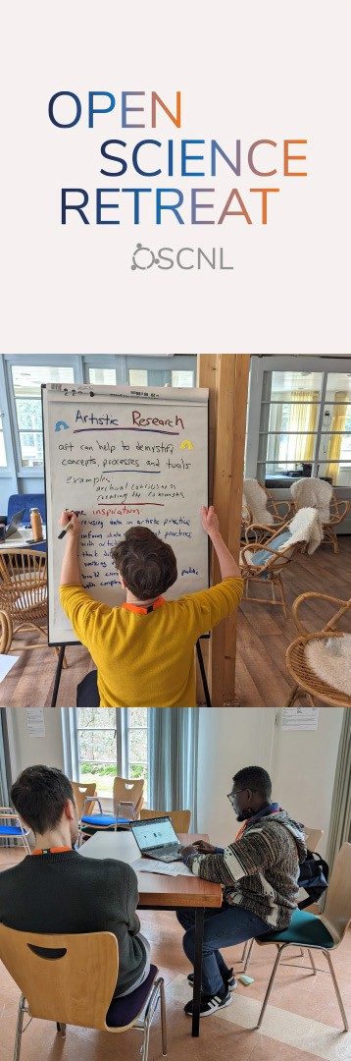
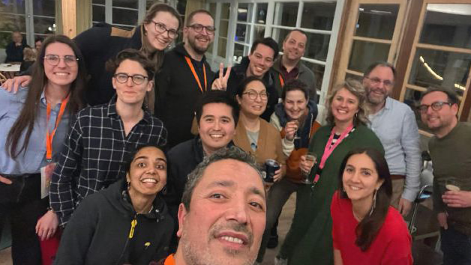
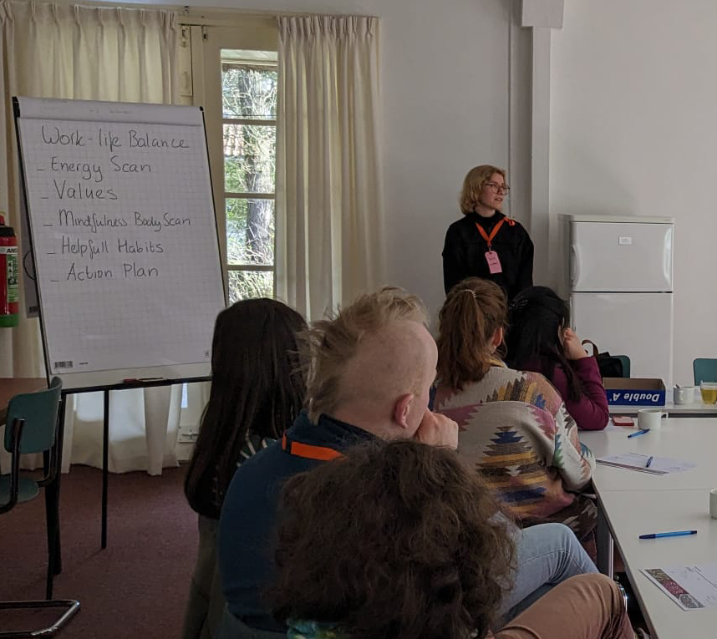
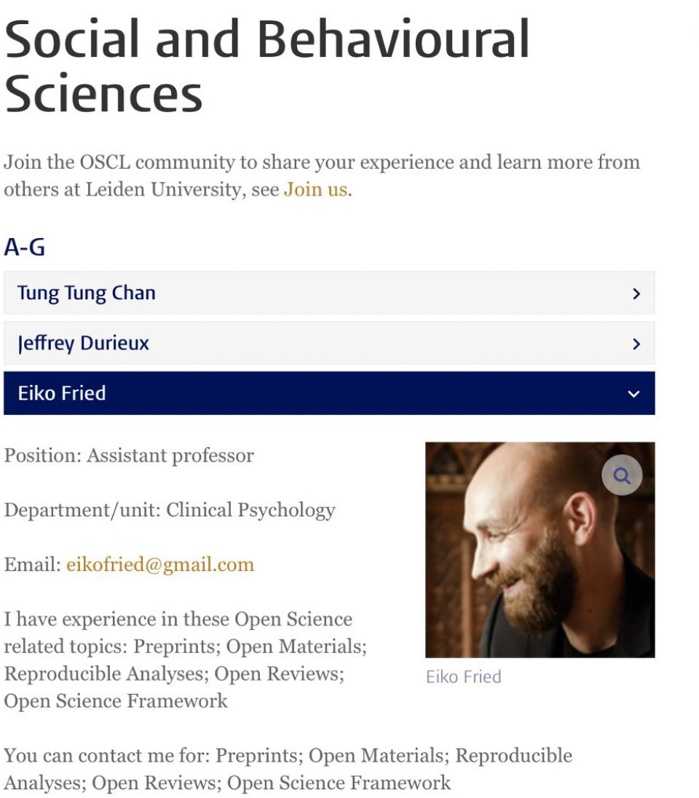
How?
Reach & engage
Local events like OSCoffees, OSC Lunches,
Open Science Awards
Inspire & enable adoption of new practices
Online member profiles tagged with OS topics,
Online toolkits for specific practices
Empower & support
Input on national or local policy
(Inter)national events: OS Retreat, OS Barcamp

Slide 9
















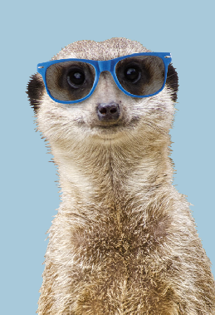



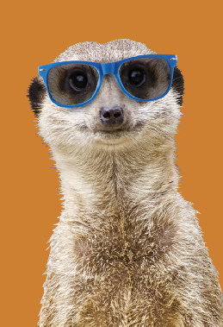

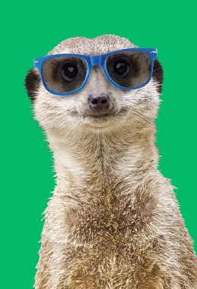









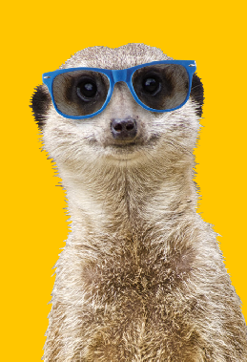

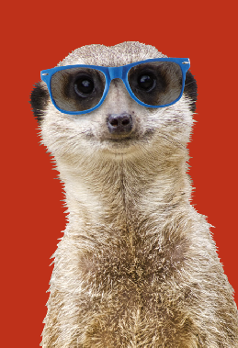



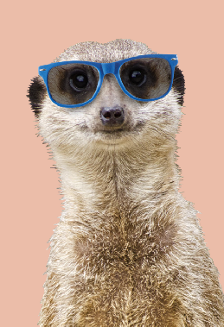










Get involved!
Become a member of your local Open Science Community www.osc-nl.com

