Slide 1
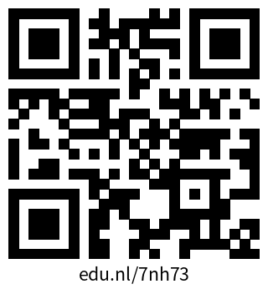
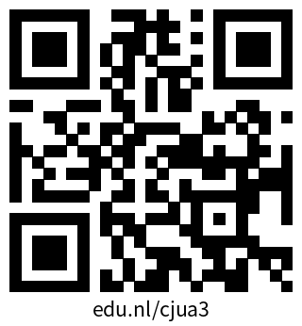
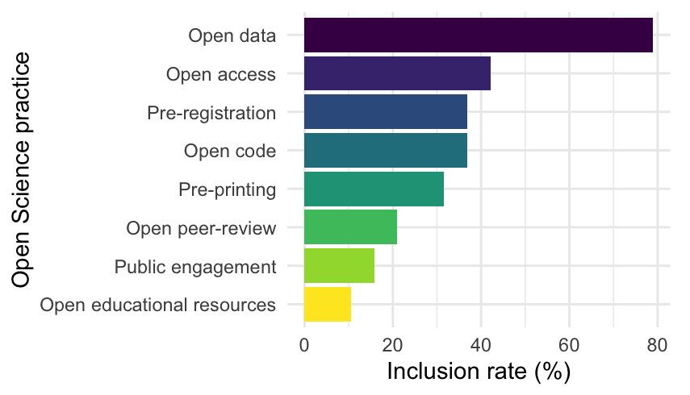
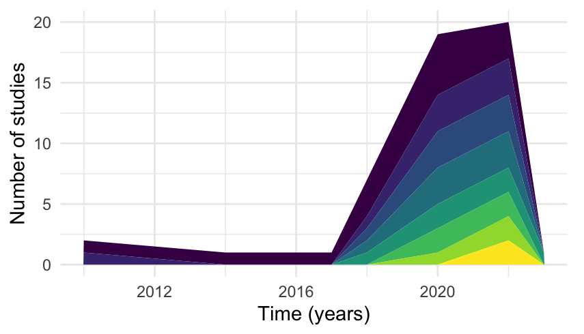
Hanne Oberman
Methodology & Statistics, Utrecht University
Open Science Community Utrecht
Utrecht, The Netherlands
hanneoberman.github.io
What is ‘Open Science’?
Operationalisation of Open Science in Survey Research
Lotte van Burgsteden, Tanya van Goch, Bogdana Huma, Anne Marie Meijer, Iris Smal, & Hanne Oberman
Literature review
What is measured in surveys investigating the uptake of Open Science? While many investigators would include 'open data' in the operationalization of Open Science as a concept, other relevant practices such as pre-printing may be overlooked. We present results from a literature study on the operationalization of Open Science practices in survey research.
The literature study was conducted by a team of research support professionals, qualitative researchers and quantitative researchers, at the Open Science Retreat 2024.¹ Together, we collected, reviewed, and analysed the questionnaire items in survey studies about open science practices. Our study materials are openly available, with the literature list on Zotero,² and a research report on ResearchEquals.³
Quantitative & qualitative analyses
We categorized which Open Science practices were included in the operationalization of ‘Open Science’, and inventoried how the studies formulated the questionnaire items. All of the studies that we identified in the literature search were analysed quantitatively (see Figure 1 & 2), but only studies with open materials could be analysed qualitatively (see Table 1).
The main categories of Open Science practices we encountered were 'Open data', ‘Open access’, ‘Pre-registration’, and 'Open code’. The definition of Open Science seems to broaden from 2017 onwards.
Qualitative analysis identified seven question domains: 1) awareness, 2) attitudes, 3) intention, 4) behaviour, 5) barriers, 6) benefits and 7) conditions. Table 1 shows questionnaire items corresponding to some of these domains.
Explore, reuse, & contribute to our materials
We developed an interactive overview of the studies we identified.⁴
Via this online dashboard, you can browse the literature study data and findings. The dashboard code is available on GitHub,⁵ with a persistent identifier on Zenodo.⁶ The dashboard may be used e.g. to reuse questionnaire items in future research.
Check out our interactive dashboard!
Figure 1. Open Science is more than just open data.
Figure 2. Gradual inclusion of more Open Science practices.
Table 1. Some typical survey questions.
Domain | Questionnaire item
Attitudes | “How desirable do you think [Open Science practice] is for your research field?”
Behaviors | “How likely are you to use [Open Science practice] for your next paper?”
Barriers | “[Open Science practice] is too time consuming for me.”
Benefits | “What do you see as the greatest benefit of [Open Science practice]?”
References
Open Science Retreat 2024. (2024). URL: openscienceretreat.eu. DOI: 10.53962/mrhg-9r
Zotero group ‘osr24nl’. (2024). Zotero. URL: zotero.org/groups/5464665/osr24nl
Measuring Open Science. (2024). ResearchEquals. DOI: 10.53962/tn38-4q91
Open Science Surveys. (2024). Shiny. URL: hanneoberman.shinyapps.io/os-surveys
oscutrecht/OpenScienceSurveys. (2024). GitHub. URL: github.com/oscutrecht/OpenScienceSurveys
oscutrecht/OpenScienceSurveys. (2024). Zenodo. DOI: 10.5281/zenodo.10932819

