Slide 1

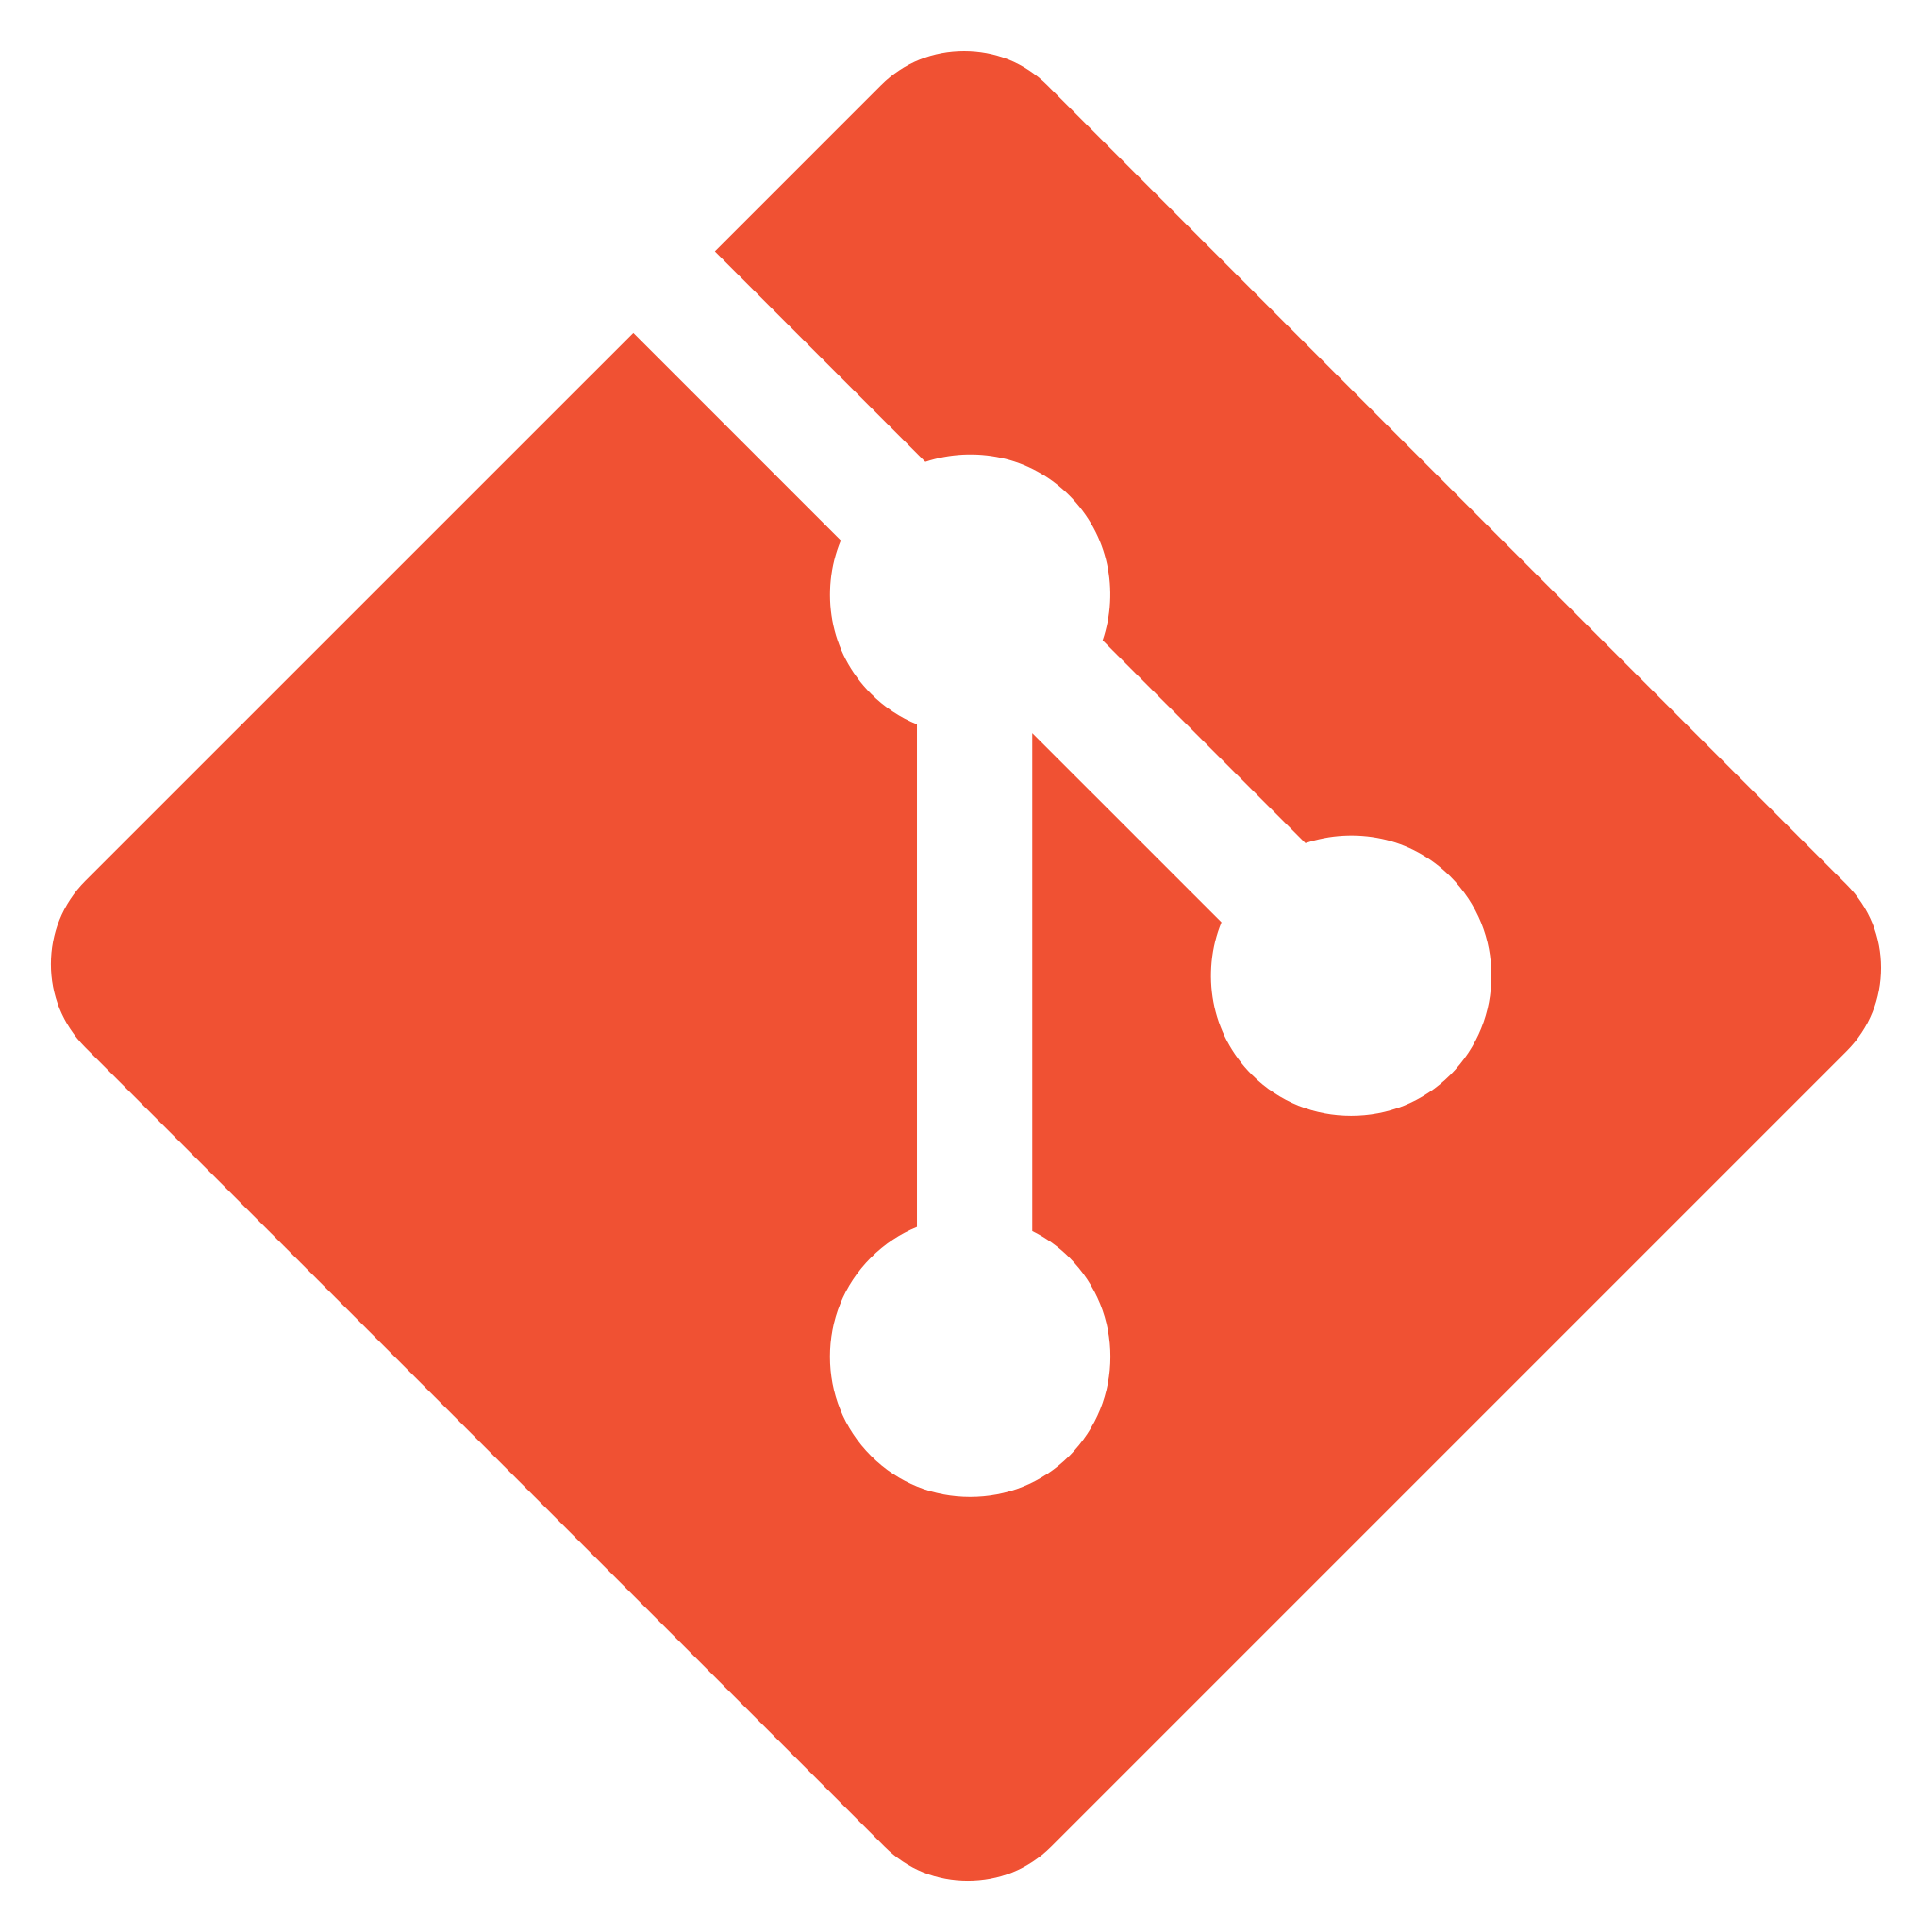

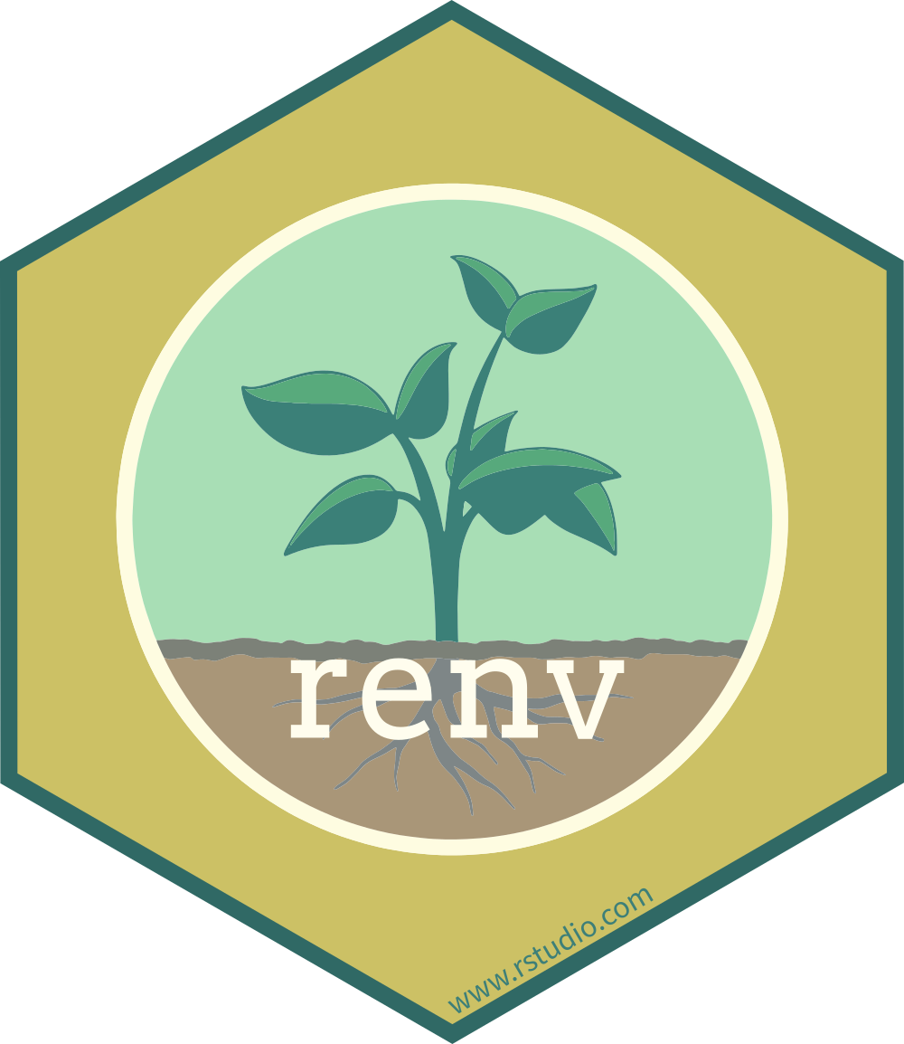

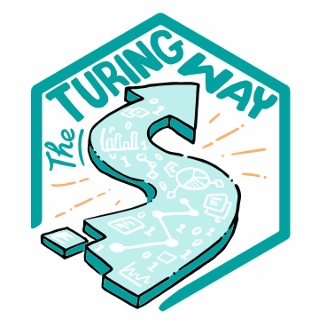
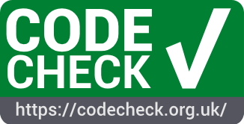




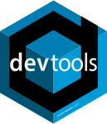





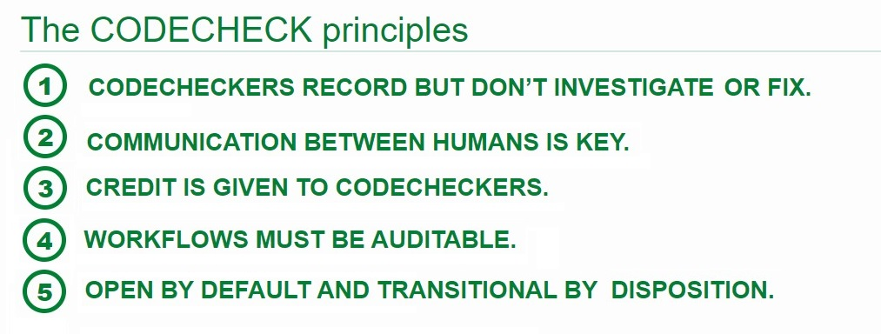
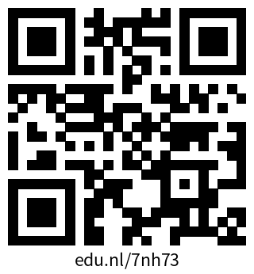
Methodology & Statistics
Teaching Reproducibility to Research Master's Students
What resources to use? And which tools/elements are domain agnostic?
HI Oberman
Our course
We teach ‘Markup Languages and Reproducible Programming in Statistics’ in the second year of the Master’s programme ‘Methodology and Statistics for the Behavioural, Biomedical and Social Sciences’ at Utrecht University (UU).^{1, 2}
Course aims include the development of a publication-ready reproducible research compendium that contains:
a typeset manuscript following a markup language,
data and code,
everything that allows for successful reproduction and reuse of the materials (e.g. a license).
In our course, students are taught various tools and languages, such as Quarto markdown, version control with git, and reproducible environments for R with renv.
Reusable course elements
Our course materials draw from resources about the tools and languages that we teach, e.g. software manuals. In principle, these materials are reusable by others who teach reproducibility. But, of course, this is heavily reliant on the specific software framework: in our case, the statistical programming language R.
A more domain agnostic resource that we use is The Turing Way. The Turing Way is a handbook for reproducible, ethical and collaborative data science, developed by the Turing Way community.³ We also use teaching materials from the research data management support workshops offered by the UU library.^{4, 5} But… we might be missing some discipline-independent resources for teaching and testing reproducibility for graduate students.
Missing element(s)?
We do not yet make use of many domain agnostic initiatives for reproducible research. Just to name a few relevant collections: FORRT, Project TIER, and the Carpentries. But more importantly, we could implement CODECHECK-ing in our course to teach about computational reproducibility.
A CODECHECK is an attempted reproduction of research outcomes by independent execution of the analysis code. The CODECHECK initiative appoints codecheckers to CODECHECK (peer-reviewed) research articles.⁶
In our course, we could teach students how to do a CODECHECK. We could even use CODECHECK-ing as an assessment tool to evaluate whether students meet the learning objectives. Should we?
Figure 1
Elements in the UU course ‘Markup Languages and Reproducible Programming in Statistics’. What do you think is missing? What could you reuse?
Figure 2
Resources not yet utilized in our course. Should they?
Licensing
Concept version/work in progress
Markup languages
Version control
Licensing
Sharing R code
Research compendiums
The principles underlying a CODECHECK:
Codecheckers record but don’t investigate or fix.
Communication between humans is key.
Credit is given to codecheckers.
Workflows must be auditable.
Open by default and transitional by disposition.
References
Markup Languages and Reproducible Programming in Statistics team (2024). Course materials. URL: www.gerkovink.com/markup
Utrecht University (2024). Course description. URL: https://osiris-student.uu.nl/#/onderwijscatalogus/extern/cursus?cursuscode=202000010&taal=en&collegejaar=huidig
The Turing Way Community (2022). The Turing Way: A handbook for reproducible, ethical and collaborative research (1.0.2). DOI: 10.5281/ZENODO.3233853
References
Utrecht University (2023). Best Practices for Writing Reproducible Code. URL: utrechtuniversity.github.io/workshop-computational-reproducibility
Utrecht University (2023). Writing Reproducible Manuscripts in R & Python. URL: utrechtuniversity.github.io/workshop-reproducible-manuscripts
Eglen, S., & Nüst, D., (2024). CODECHECK. URL: codecheck.org.uk
hanneoberman.github.io/presentations

