Slide 1
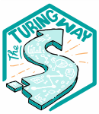


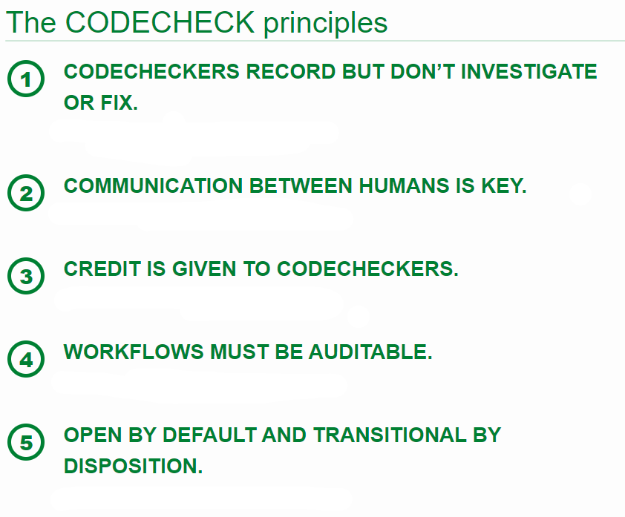





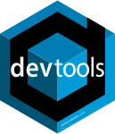
Methodology & Statistics
Teaching Reproducibility to Research Master's Students
What resources to use? And which course elements are domain agnostic?
HI Oberman
Our course
We teach ‘Markup Languages and Reproducible Programming in Statistics’ in the second year of the Master’s programme ‘Methodology and Statistics for the Behavioural, Biomedical and Social Sciences’ at Utrecht University (UU).
Course aims include the development and publishing of a reproducible research compendium that contains:
reproducible code,
data,
a typeset manuscript following a markup language.
Reusable resources
Our teaching materials draw from resources such as The Turing Way handbook to reproducible, ethical and collaborative data science. The Turing Way materials are developed by a community and shared under open licensing. The research data management support team at Utrecht University offers workshops for UU staff, but the teaching materials are CC BY.
CODECHECK
The CODECHECK initiative offers independent execution of computations underlying research articles.
The principles underlying a CODECHECK:
Codecheckers record but don’t investigate or fix.
Communication between humans is key.
Credit is given to codecheckers.
Workflows must be auditable.
Open by default and transitional by disposition.
Concept version/work in progress
Figure 1
Elements in the course ‘Markup Languages and Reproducible Programming in Statistics’. What do you think: Do the elements in the course match or clash with the principles of a CODECHECK?
References
Name author
Name author
References
Name author
Name author
hanneoberman.github.io/presentations

