Slide 1

Source: https://lingojam.com/StephenHawkingVoiceGenerator

Slide 2

Final Presentation of Advanced Seminar
Hannes Bohnengel
Technical University of Munich
TUM Department of Electrical and Computer Engineering
Chair of Real-Time Computer Systems
Munich, 21 July 2017

Slide 3
The Impact of Deep Learning on Speech
Synthesis with Mobile Devices

Slide 4
Outline
Content of Paper
Speech Synthesis in General
Introducing Deep Learning Models
Speech Synthesis on Mobile Devices
Conclusions

Slide 5
Content of Paper
Introduction
Conventional Speech Synthesis
Motivation and Approaches
HMM-based Synthesis → Black et al. (2007), ICASSP ’07
Speech Synthesis with Deep Learning Models
One Specific Approach for Improvement → Zen et al. (2013), ICASSP ’13
Other Ways for Improvement → Hashimoto et al. (2015), ICASSP ’13
Speech Synthesis on Mobile Devices
Motivation and Challenges
Optimized HMM-based Synthesis → Tóth et al. (2012), JACIII ’12
Deep Learning-based Synthesis → Boroş et al. (2015), MEDES ’15
Conclusions

Slide 6
Outline
Content of Paper
Speech Synthesis in General
Introducing Deep Learning Models
Speech Synthesis on Mobile Devices
Conclusions

Slide 7
Typical Applications of Speech Synthesis
Navigation Systems
Telephone-based Dialogue Systems
Reading Aid
Speech-to-Speech Translation
Voice Communication Aid
(Stephen Hawking)
Virtual Assistants
Voice cloning
Public Announcements
Communication in Air Traffic

Slide 8
Types of Speech Synthesis
Speech Synthesis
Canned Speech
Context-to-Speech (CTS)
Text-to-Speech (TTS)
Playback of
prerecorded speech
Speech is generated of linguistic descriptions
Arbitrary text is converted to speech
No flexibility
Independent of text
Natural language processing required
Source: Own visualization
Notes:
CTS: the waveform is generated out of a linguistic description without any information of the respective text.
→ No natural language processing is required, but nevertheless CTS has not made any important impact yet

Slide 9
Text-to-Speech – Overview
Front-end
Back-end
Natural Language
Processing
Part-of-speech tagging
Text normalization
Phonetic transcription
Syllabification
Stress prediction
Prosodic analysis
Digital Signal
Processing
Depends on synthesis model
Parametric
Concatenative
Statistical parametric
Source: Boroș et al. (2015) Robust deep-learning models for text-to-speech synthesis support on embedded devices, MEDES’15
Notes:
Prosody is concerned with those elements of speech that are not individual phonetic segments (vowels and consonants) but are properties of syllables and larger units of speech. (e.g. pitch, loudness, length of sounds)
Text normalization is the process of transforming text into a single canonical form that it might not have had before.
The first text processing task we consider is syllabification: the decomposition of words into their phonological units.
The phonetic transcription task refers to the process of “translation” from letters to phonemes, an essential step in any TTS synthesis pipeline (also known as letter-to-sound or grapheme-to-phoneme translation)
Part-of-speech (POS) tagging is the process of assigning each word in a sentence its uniquely interpretable tag - its part of speech. A word’s POS (among other features) is used as a feature in the synthesis model, determining how the word is spoken. → choose the correct pronunciation for a homophone word
Lexical stress prediction: Certain syllables inside a word have a higher prominence compared to its neighboring syllables, giving the word a specific sound. Lexical stress prediction is essential in prosody generation, as it allows TTS systems to correctly choose pronunciations of homographs

Slide 10
Text-to-Speech – Function blocks
Text
Utterance
Phrase
Word
Front-end
Text Analysis
Syllable
Context Features
Phoneme
Acoustic Model
Spectral Parameters
Acoustic Features
Excitation Parameters
Back-end
Parameter Generation
Speech Parameters Trajectories
Waveform Synthesis
Speech
Source: Own visualization
Notes:
Context Features:
phoneme:
current phoneme
preceding and succeeding two phonemes
syllable:
- numbers of phonemes within preceding, current, and succeeding syllables
stress and accent of preceding, current, and succeeding syllables
word:
- guess at part of speech of preceding, current, and succeeding words
- numbers of syllables within preceding, current, and succeeding words
phrase:
- numbers of syllables within preceding, current, and succeeding phrases
- position of current phrase in major phrases
utterance:
- numbers of syllables, words, and phrases in utterance
Acoustic Features:
Spectral parameters: Mel-cepstral coefficients and their dynamic features
Excitation parameters: log F0 values and their dynamic features
mel-frequency cepstrum (MFC) is a representation of the short-term power spectrum of a sound, based on a linear cosine transform of a log power spectrum on a nonlinear mel scale of frequency.

Slide 11
Text-to-Speech – Synthesis Models
Table 1: Comparison of different speech synthesis techniques
Technique | Advantages | Drawbacks
Formant-based (Parametric) | Very small footprint | Very artificial and metallic voice
Unit-selection (Concatenative) | Very high voice quality possible | Large database required
HMM-based (Statistical parametric) | Adjustable voice and small footprint | Voice sounds muffled
Source: Own visualization
Notes:
The model is parametric because it describes the speech using parameters, rather than stored exemplars.
It is statistical because it describes those parameters using statistics (e.g., means and variances of probability density functions) which capture the distribution of parameter values found in the training data.
We can easily change voice characteristics, speaking styles, and emotions in statistical parametric synthesis by transforming its model parameters.
Four major techniques to accomplish this: adaptation, interpolation, eigenvoice, and multiple regression.

Slide 12

Sample of HMM-based speech
Source: http://flite-hts-engine.sp.nitech.ac.jp/index.php

Slide 13
Outline
Content of Paper
Speech Synthesis in General
Introducing Deep Learning Models
Speech Synthesis on Mobile Devices
Conclusions

Slide 14
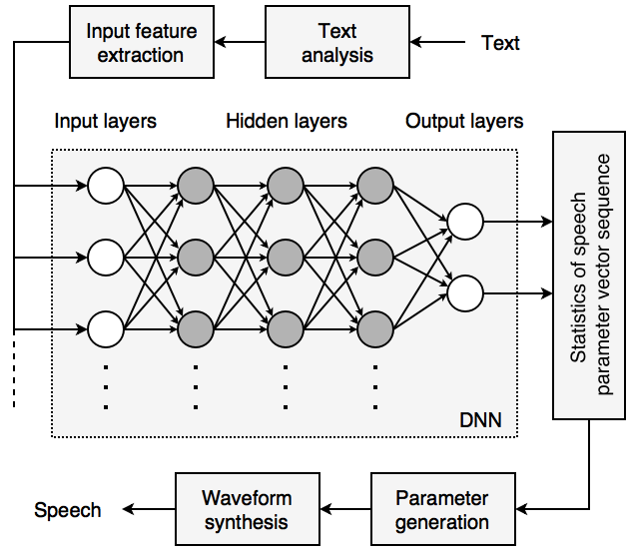
Introducing Deep Learning Models
Zen et al. (2013), ICASSP ’13
Acoustic Model
Figure 1: DNN as acoustic model
Context
Features
Acoustic
Features
Source: Zen et al. (2013) Statistical parametric speech synthesis using deep neural networks, ICASSP’13
Notes:
Using a Deep Neural Network (DNN) as acoustic model
Only modification in Back-end

Slide 15
Results of Experiments
Objective evaluation
DNN-based systems have less distortion
HMM-based systems have a lower error rate in some cases
Subjective evaluation
→ DNN-based systems are preferred
→ Described as less muffled
Table 2: Subjective scores
HMM-based (scaling factor) | DNN-based (neurons per layer) | Neutral
15.8 % (16) | 38.5 % (256) | 45.7 %
16.1 % (4) | 27.2 % (512) | 56.8 %
12.7 % (1) | 36.6 % (1024) | 50.7 %
Source: Zen et al. (2013) Statistical parametric speech synthesis using deep neural networks, IEEE International Conference on Acoustics, Speech and Signal Processing
Notes:
The DNN-based systems consistently outperformed the HMM-based ones in voiced/unvoiced classification and aperiodicity prediction. The DNN-based systems with many layers were similar to or better than the HMM-based ones in Mel-cepstral distortion. On the other hand, the HMM-based systems outperformed the DNN-based ones in log F0 prediction in most cases.
the DNN-based systems were preferred significantly to the HMM-based ones in all three model sizes. The subjects reported that the DNN-based systems were less muffled.
The authors expect that better prediction of Mel-cepstral coefficients by the DNN-based systems contributed to the preference.

Slide 16
Outline
Content of Paper
Speech Synthesis in General
Introducing Deep Learning Models
Speech Synthesis on Mobile Devices
Conclusions

Slide 17
Speech Synthesis on Mobile Devices
Boroş et al. (2015), MEDES ’15
→ Introducing a DNN into the front-end of a TTS-System to decrease the model size
Front-End
Syllabification (SYL)
Phonetic transcription (PT)
Part-of-speech tagging (POT)
Lexical stress prediction (LSP)
Context Features
Syllables
Phonemes
Unified tags
Stress on syllable
Text
Multiple DNNs
Speech
Back-End
Source: Own visualization
Notes:
Syllabification: the decomposition of words into their phonological units.
Phonetic transcription: the process of “translation” from letters to phonemes (also known as letter-to-sound or grapheme-to-phoneme translation)
Part-of-speech (POS) tagging is the process of assigning each word in a sentence its uniquely interpretable tag - its part of speech.
choose the correct pronunciation for a homophone word
N: Nouns V: Verbs A: Adjectives R: Adverbs
feminine/maskular, singular/plular, cases
Lexical stress prediction: Certain syllables inside a word have a higher prominence compared to its neighboring syllables, giving the word a specific sound.
→ choose the correct pronunciation for a homophone word

Slide 18
Results of Experiments
Table 3: Resulting accuracy and footprint size
 | SYL |  | PT |  | POT |  | LSP
 | Con. | DNN | Con. | DNN | Con. | DNN | Con. | DNN
Accuracy | 99.01 % | 98.23 % | 96.29 % | 96.16 % | 98.19 % | 95.16 % | 98.80 % | 97.67 %
Size | 9.4 MB | 36.7 KB | 1.4 MB | 43.4 KB | 96 MB | 178 KB | 6 MB | 110 KB
Source: Boroș et al. (2015) Robust deep-learning models for text-to-speech synthesis support on embedded devices, MEDES ’15
Overall reduction of model size by ~ 60 %
Con. = Conventional
Notes:
Tremendous reduction of footprint size
Accuracy not significantly decreased
As reference system, the Margin Infused Relaxed Algorithm (MIRA) is used.

Slide 19
Outline
Content of Paper
Speech Synthesis in General
Introducing Deep Learning Models
Speech Synthesis on Mobile Devices
Conclusions

Slide 20
Conclusions
Speech synthesis is an important technology
Huge research volume
Practical relevance with many application
Deep learning models have emerged in the last decade
Strength: Mapping complex input features to simple output features
Deep learning can be used to improve speech synthesis
Huge number of mobile devices
Need for robust and resource-efficient implementations
Deep learning models can be used to achieve this
Source: https://text-to-speech-demo.mybluemix.net/

Slide 21
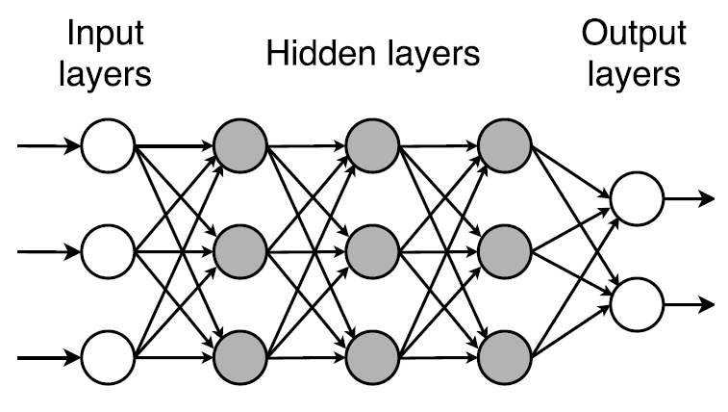
Basics of Deep Learning
Class of machine learning techniques
→ Emerged in the last decade due to increasing processing abilities
Advantages:
Outperforms shallow networks
Hierarchical structure
Drawbacks:
Large amount of training data required
Computational effort for training
Source: Own visualization
Notes:
Drastically increased chip processing abilities (e.g., GPU units)
Significantly lowered cost of computing hardware
Recent advances in machine learning and signal/information processing research
Used for feature extraction and pattern analysis
Examples:
Deep Belief Network (DBN)
Deep Neural Network (DNN)
Deep Boltzmann Machine (DBM)
Advantages
Has best-in-class performance on problems that significantly outperforms other solutions in multiple domains. This includes speech, language, vision, playing games like Go etc. This isn’t by a little bit, but by a significant amount.
Reduces the need for feature engineering, one of the most time-consuming parts of machine learning practice.
Is an architecture that can be adapted to new problems relatively easily (e.g. Vision, time series, language etc using techniques like convolutional neural networks, recurrent neural networks, long short-term memory etc.
Disadvantages
Requires a large amount of data
Is extremely computationally expensive to train.
Successes of deep learning in diverse applications of
computer vision
phonetic recognition
voice search
conversational speech recognition
speech and image feature coding
semantic utterance classification
hand-writing recognition
audio processing
visual object recognition
information retrieval
analysis of molecules

Slide 22
Speech Synthesis on Mobile Devices
Mobile devices
Real-time responsiveness
Memory constraints
Power consumption
Notes:
Speech as extension
Speech as main output
Help visually impaired or blind people

Slide 23
HMM-based Speech Synthesis Model
Source: Black et al. (2007) Statistical Parametric Speech Synthesis, ICASSP ’07

Slide 24
Context Features
phoneme:
- current phoneme
- preceding and succeeding two phonemes
- position of current phoneme within current syllable
syllable:
- numbers of phonemes within preceding, current, and succeeding syllables
- stress and accent of preceding, current, and succeeding syllables
- positions of current syllable within current word and phrase
- numbers of preceding and succeeding stressed syllables within current phrase
- numbers of preceding and succeeding accented syllables within current phrase
- number of syllables from previous stressed syllable
- number of syllables to next stressed syllable
- number of syllables from previous accented syllable
- number of syllables to next accented syllable
- vowel identity within current syllable
word:
- guess at part of speech of preceding, current, and succeeding words
- numbers of syllables within preceding, current, and succeeding words
- position of current word within current phrase
- numbers of preceding and succeeding content words within current phrase
- number of words from previous content word
- number of words to next content word
phrase:
- numbers of syllables within preceding, current, and succeeding phrases
- position of current phrase in major phrases
- ToBI endtone of current phrase
utterance:
- numbers of syllables, words, and phrases in utterance
Source: Black et al. (2007) Statistical Parametric Speech Synthesis, ICASSP ’07

Slide 25
Acoustic Features
Spectral parameters: Mel-cepstral coefficients and their dynamic features
Excitation parameters: log Fo values and their dynamic features

Slide 26
HMM-based Speech Synthesis
Instance of Statistical Parametric Speech Synthesis (SPSS)
Context-dependent Hidden Markov Models (HMMs) as acoustic model
Decision-tree-based mapping from context features to acoustic features
Adjustable voice characteristics
Best trade-off between footprint size and voice quality
Voice still sounds muffled → Further improvement necessary
Notes:
Training and Synthesis Part
generating the average of some sets of similarly sounding speech segments.
(Decision Trees / (Maximum Likelyhood Parameter Generation) )
Training:
both spectrum (e.g., mel-cepstral coefficients and their dynamic features) and excitation (e.g., log F0 and its dynamic features) parameters are extracted from a database of natural speech and modeled by a set of multi-stream context-dependent HMMs
linguistic and prosodic contexts are taken into account in addition to phonetic ones
Synthesis:
word sequence is converted into a context dependent label sequence
utterance HMM is constructed by concatenating the context-dependent HMMs according to the label sequence
the speech parameter generation algorithm generates the sequences of spectral and excitation parameters from the utterance HMM
speech waveform is synthesized from the generated spectral and excitation parameters using excitation generation and a speech synthesis filter

