Slide 1


Slide 2

Final Presentation of Advanced Seminar
Hannes Bohnengel
Technical University of Munich
TUM Department of Electrical and Computer Engineering
Chair of Real-Time Computer Systems
Munich, 21 July 2017

Slide 3
The Impact of Deep Learning on Speech
Synthesis with Mobile Devices

Slide 4
Outline
Conventional Speech Synthesis
Introducing Deep Learning Models
Speech Synthesis on Mobile Devices
Conclusions

Slide 5
Types of Speech Synthesis
Speech Synthesis
Text-to-Speech (TTS)
Context-to-Speech (CTS)
Canned Speech

Slide 6
Text-to-Speech - Overview
Front-end
Back-end
Natural Language Processing
Part-of-speech tagging
Text normalization
Phonetic transcription
Syllabification
Stress prediction
Prosodic analysis
Digital Signal
Processing
Different Synthesis Models
Parametric
Concatenative
Statistical parametric

Slide 7
Text-to-Speech – Function blocks
Text
Text Analysis
Context Features
Front-end
Back-end
Acoustic Model
Acoustic Features
Speech Parameters
Trajectories
Parameter Generation
Waveform Synthesis
Speech
Notes:
Context Features:
phoneme:
current phoneme
preceding and succeeding two phonemes
syllable:
- numbers of phonemes within preceding, current, and succeeding syllables
stress and accent of preceding, current, and succeeding syllables
word:
- guess at part of speech of preceding, current, and succeeding words
- numbers of syllables within preceding, current, and succeeding words
phrase:
- numbers of syllables within preceding, current, and succeeding phrases
- position of current phrase in major phrases
utterance:
- numbers of syllables, words, and phrases in utterance
Acoustic Features:
Spectral parameters: Mel-cepstral coefficients and their dynamic features
Excitation parameters: log Fo values and their dynamic features

Slide 8
HMM-based Speech Synthesis
Instance of Statistical Parametric Speech Synthesis (SPSS)
Context-dependent Hidden Markov Models (HMMs) as acoustic model
Adjustable voice characteristics
Best trade-off between footprint size and voice quality
Voice still sounds muffled → Further improvement necessary
Notes:
Different Approaches -> Advantages and Drawbacks
Training and Synthesis Part
generating the average of some sets of similarly sounding speech segments.
(Decision Trees / (Maximum Likelyhood Parameter Generation) )
The model is parametric because it describes the speech using parameters, rather than stored exemplars.
It is statistical because it describes those parameters using statistics (e.g., means and variances of probability density functions) which capture the distribution of parameter values found in the training data.
Training:
both spectrum (e.g., mel-cepstral coefficients and their dynamic features) and excitation (e.g., log F0 and its dynamic features) parameters are extracted from a database of natural speech and modeled by a set of multi-stream context-dependent HMMs
linguistic and prosodic contexts are taken into account in addition to phonetic ones
Synthesis:
word sequence is converted into a context dependent label sequence
utterance HMM is constructed by concatenating the context-dependent HMMs according to the label sequence
the speech parameter generation algorithm generates the sequences of spectral and excitation parameters from the utterance HMM
speech waveform is synthesized from the generated spectral and excitation parameters using excitation generation and a speech synthesis filter

Slide 9
Outline
Conventional Speech Synthesis
Introducing Deep Learning Models
Speech Synthesis on Mobile Devices
Conclusions

Slide 10
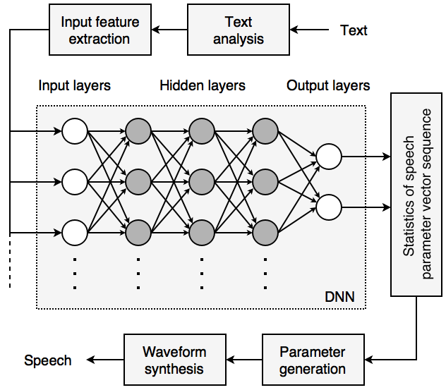
Introducing Deep Learning Models
Acoustic Model
Context
Features
Acoustic
Features
Source: …
Notes:
Using a Deep Neural Network (DNN) as acoustic model
Only modification in Back-end

Slide 11
Evaluation of Experiments
Objective evaluation
Distortion (Mel-cepstral distortion, Aperiodicity distortion)
Error rate (Voiced/Unvoiced Error Rate, Root mean squared errors (RMSE) in log F0)
Subjective evaluation
Played back speech samples of conventional and DNN-based system to different listeners, who chose their preferred system (or „Neutral“)

Slide 12
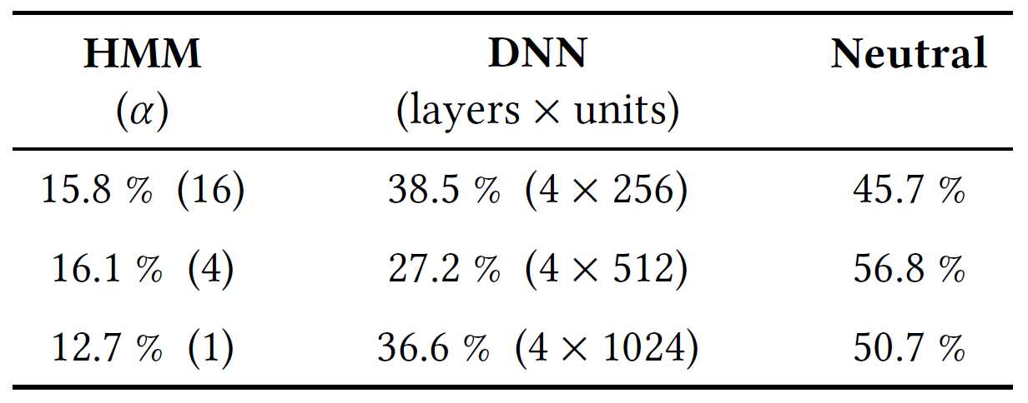
Results of Experiments
Objective evaluation
DNN-based systems consistently have less distortion
HMM-based systems have a lower error rate in most cases
Subjective evaluation
→ DNN-based systems are preferred
→ Described as less muffled
Source: …
Notes:
The DNN-based systems consistently outperformed the HMM-based ones in voiced/unvoiced classification and aperiodicity prediction. The DNN-based systems with many layers were similar to or better than the HMM-based ones in Mel-cepstral distortion. On the other hand, the HMM-based systems outperformed the DNN-based ones in log F0 prediction in most cases.
the DNN-based systems were preferred significantly to the HMM-based ones in all three model sizes. The subjects reported that the DNN-based systems were less muffled.

Slide 13
Outline
Conventional Speech Synthesis
Introducing Deep Learning Models
Speech Synthesis on Mobile Devices
Conclusions

Slide 14
Speech Synthesis on Mobile Devices
Motivation and Challenges
2.1 billion smartphone users worldwide in 2016
in 2016 about 1.5 billion new smartphones were sold
Mobile devices
Real-time responsiveness
Memory constraints
Power consumption

Slide 15
Speech Synthesis on Mobile Devices
Introducing a DNN into the front-end of a TTS-System
1. Syllabification (SYL)
2. Phonetic transcription (PT)
3. Part-of-speech tagging (POT)
4. Lexical stress prediction (LSP)

Slide 16
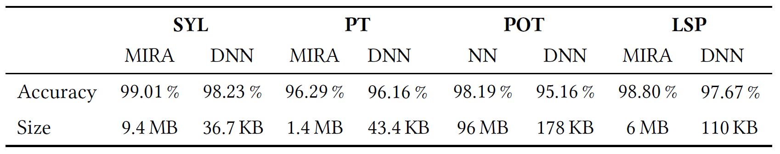
Speech Synthesis on Mobile Devices
Results:
Performance
Voice quality
Source: …

Slide 17
Outline
Conventional Speech Synthesis
Introducing Deep Learning Models
Speech Synthesis on Mobile Devices
Conclusions

Slide 18
Conclusions
The Impact of Deep Learning on Speech Synthesis with Mobile Devices
Low-Latency
Increased prediction performance
Smaller memory footprint

Slide 19
Thank you for your attention!

Slide 20
Context Features
phoneme:
- current phoneme
- preceding and succeeding two phonemes
- position of current phoneme within current syllable
syllable:
- numbers of phonemes within preceding, current, and succeeding syllables
- stress and accent of preceding, current, and succeeding syllables
- positions of current syllable within current word and phrase
- numbers of preceding and succeeding stressed syllables within current phrase
- numbers of preceding and succeeding accented syllables within current phrase
- number of syllables from previous stressed syllable
- number of syllables to next stressed syllable
- number of syllables from previous accented syllable
- number of syllables to next accented syllable
- vowel identity within current syllable
word:
- guess at part of speech of preceding, current, and succeeding words
- numbers of syllables within preceding, current, and succeeding words
- position of current word within current phrase
- numbers of preceding and succeeding content words within current phrase
- number of words from previous content word
- number of words to next content word
phrase:
- numbers of syllables within preceding, current, and succeeding phrases
- position of current phrase in major phrases
- ToBI endtone of current phrase
utterance:
- numbers of syllables, words, and phrases in utterance

Slide 21
Acoustic Features
Spectral parameters: Mel-cepstral coefficients and their dynamic features
Excitation parameters: log Fo values and their dynamic features

Slide 22
To Do:
Sources
Sounds as Intro and Outro ?!
Handouts?!

