Slide 1

Computational Haptics Labratory Project Presentation
Naina Dhingra, Ke Xu, Hannes Bohnengel
Technical University of Munich
TUM Department of Electrical and Computer Engineering
Chair of Media Technology
Munich, 07 July 2017

Slide 2

Haptics Showroom
Aim:
Enable any user to interact with different haptic experiences within one virtual room.
Implementation:
Create a virtual room with different haptic objects, where the user can walk through, like in an ego shooter game.
Oculus Rift for extra realistic sensation
Two haptic devices as ‘‘hands‘‘ (optional)
Haptics Showroom

Slide 3
Possible objects to be included
Dedicated areas on the wall with different properties
Simple objects (boxes, spheres) lying on the floor
More complex objects (chair, table, etc.)
Properties of objects
Temperature (heating or cooling with Peltier element)
Texture (realistic feeling due to use of voice coil)
Friction
Stiffness
Magnetism
Haptics Showroom

Slide 4
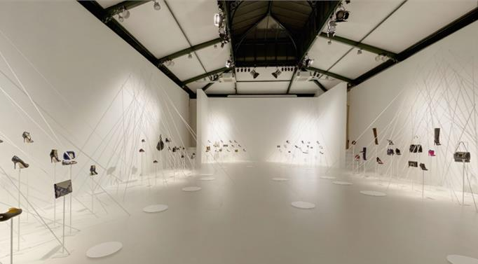

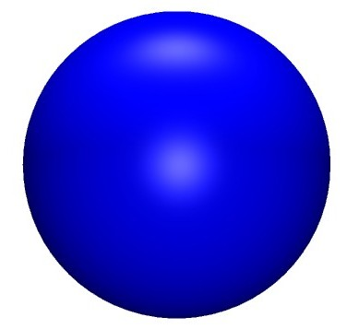
Haptics Showroom
Source: http://www.stylus.com/rzgspq
Haptics Showroom

Slide 5
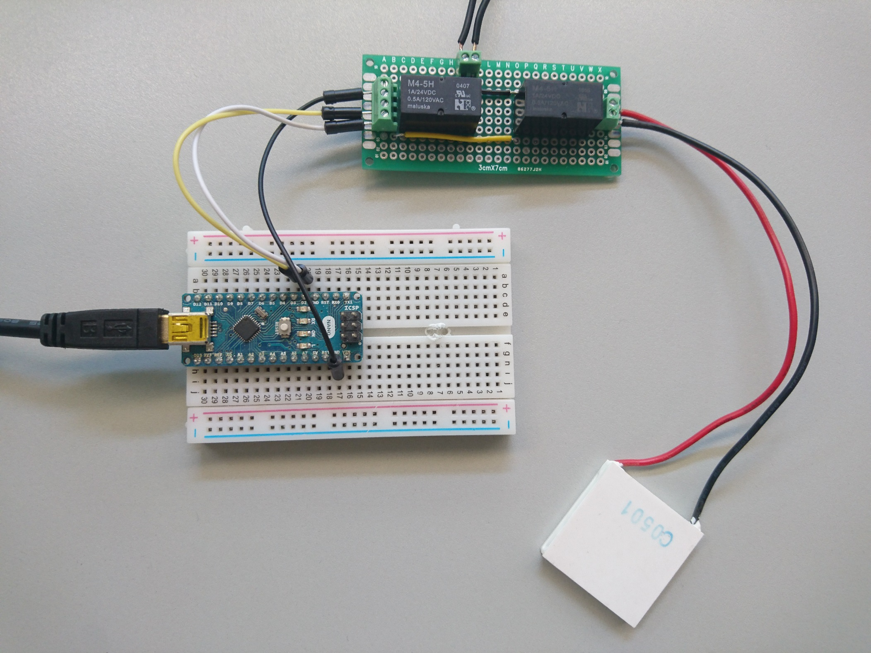
Heating or cooling
External Power Supply
2 GPIOs + GND
Switching Circuit
USB to Computer
Peltier
element
Arduino Nano
Source: Hannes Bohnengel
Haptics Showroom

Slide 6
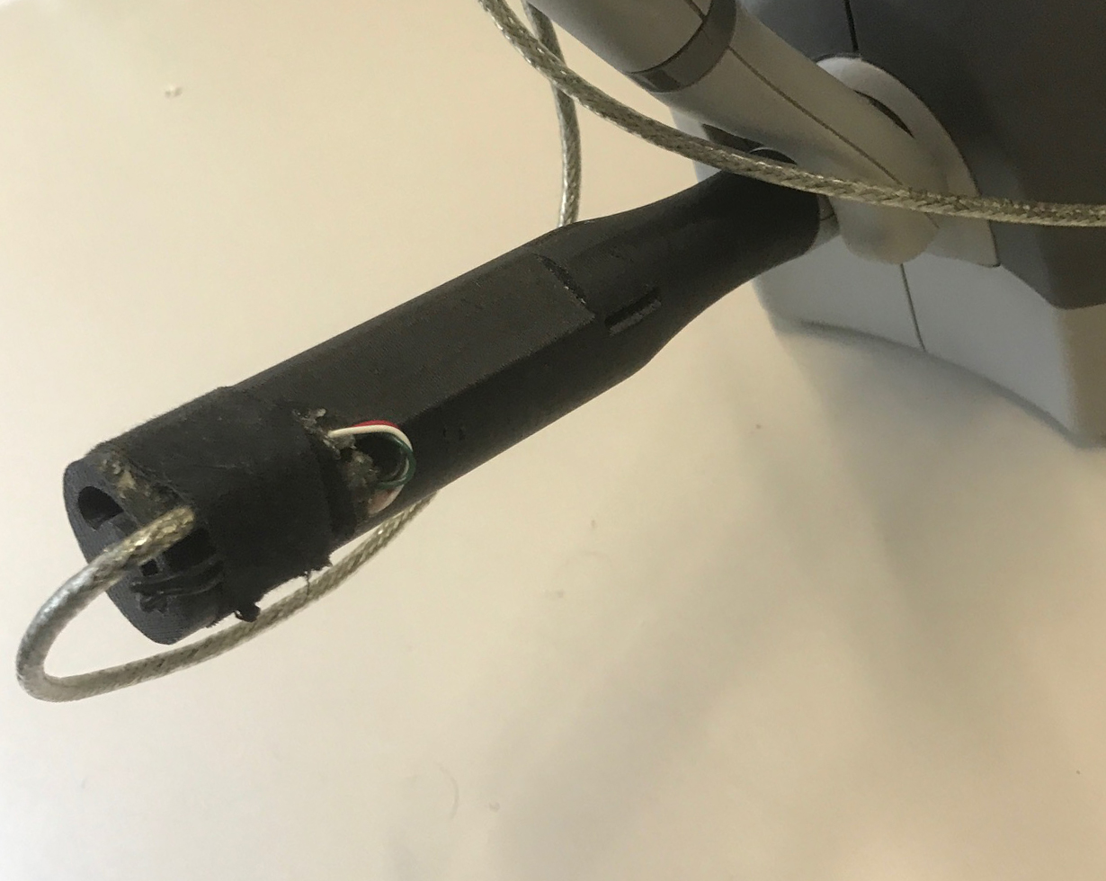
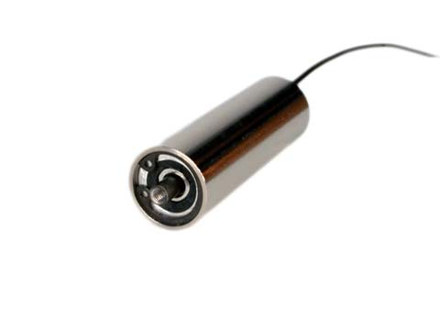
Haptic tool with advanced capabilities
Adapter for Phantom device
Voice coil
(Type: NCM02-05-005-4JB)
Peltier element
Voice coil
inside
Source: Matti Strese
Source: https://www.h2wtech.com/product/voice-coil-actuators/NCM02-05-005-4JB
Haptics Showroom

Slide 7
Task allocation
Ke
Naina
Hannes
Object(s) with texture (voice coil usage)
Sticky Object(s)
Object(s) with texture (voice coil usage)
Light switch
Object(s) with heat/cold property (Peltier element usage)
Object(s) with texture (voice coil usage)
Haptics Showroom

Slide 8
Time Plan
June
CW 25: - First tests with template (support of two devices and Oculus)
CW 26: - First tests with Arduino setup
- First test with voice coil setup
July
CW 27: - Introduce the first objects
- Start with design of room
CW 28: - Test interaction with objects
- Introduce more objects
CW 29: - Finish design of room
- Finish design of objects
CW 30: - Finalization of project
CW = Calender Week
Haptics Showroom

