Slide 1

Computational Haptics Labratory Final Project Presentation
Naina Dhingra, Ke Xu, Hannes Bohnengel
Technical University of Munich
TUM Department of Electrical and Computer Engineering
Chair of Media Technology
Munich, 08 August 2017

Slide 2
Agenda:
Motivation of the Haptics Showroom
Software Implementation
Hardware Implemetation
Task mapping
Future work
Haptics Showroom demonstration
Haptics Showroom

Slide 3
Motivation of Haptics Showroom
Great introduction to haptics in general (especially for newbies)
Enable user to walk through the room and interact with different haptic experiences within one virtual room.
Enable successors for the continued perfection of our haptics showroom effortlessly.
Haptics Showroom

Slide 4
Creating an Environment
Creating the room
Making the walls
Making the floor and the ceiling
Creating 3ds objects
Taking two dimensional objects and converting them to 3ds model.
Creating different mesh objects. Mesh objects may be translated, rotated, or resized, and have one material and texture property assigned to them
Creating different objects to experience the haptic effect of different textures and of varied temperature
3ds objects help to experience a feel of reality (compared to 2D objects)
Haptics Showroom

Slide 5
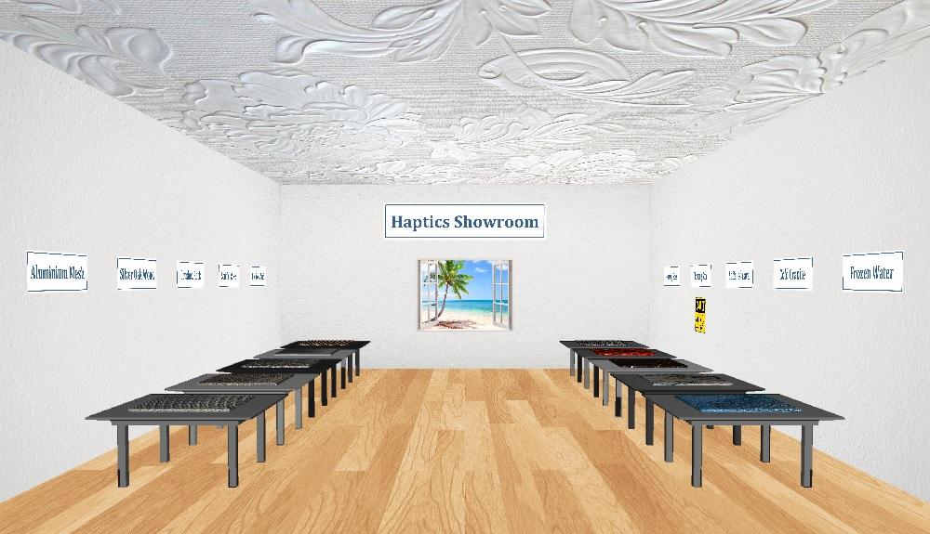
Haptics Showroom
Texture objects
Temperature objects
Haptics Showroom

Slide 6
Software Implementation
Functions
void checkBoundaries();
int checkTempRegions();
void drawCoordinates(cVector3d position, double length, double width);
int newPlane(cVector3d position, MyProperties properties);
int newObjectcMesh(cVector3d position, MyProperties properties);
int newObjectcMultiMesh( cVector3d position, MyProperties properties,
string objectFile, double scalingFactor);
Haptics Showroom
Notes:
Function to create planes with enabled force feedback (walls, floor)
Function to check if boundaries of room are violated when walking
Function which draws karteesian coordinates at some position
Function to create haptic objects at run time
Function to check the temperature region of the objects

Slide 7
Software Implementation
Global variables
vector<cMesh*> object(MAX_OBJECT_COUNT);
int objectCounter = 0;
vector<cMultiMesh*> object3ds(MAX_OBJECT_COUNT);
int object3dsCounter = 0;
vector<MyRegions*> tempRegion(MAX_REGIONS_COUNT);
int tempRegionCounter = 0;
vector<cAudioBuffer*> audioBuffer(MAX_AUDIOBUFFER_COUNT);
int audioBufferCounter = 0;
Haptics Showroom

Slide 8
Software Implementation
Classes
MyProperties
+ MyProperties(…)
+ ~MyProperties(void)
+ textureImage: string
+ normalImage: string
+ audio: string
+ size: cVector3d
+ orientation: MyOrientation
+ shape: MyShape
+ temperature: int
+ stiffness: double
+ staticFriction: double
+ dynamicFriction: double
+ textureLevel: double
+ audioGain: double
+ audioPitchGain: double
+ audioPitchOffset: double
- id: static int
MyRegions
+ MyRegions(…)
+ ~MyRegions(void)
+ position: cVector3d
+ size: cVector3d
+ temperature: int
- id: static int
Haptics Showroom

Slide 9
Hardware Implementation
Oculus Rift
Computer
(optional)
Phantom
Omni
Arduino Nano
Audio
Amplifier
Voice Coil
Power Supply
Switching Circuit
Peltier
Element
Controller Box
Tool Adapter
Haptics Showroom

Slide 10
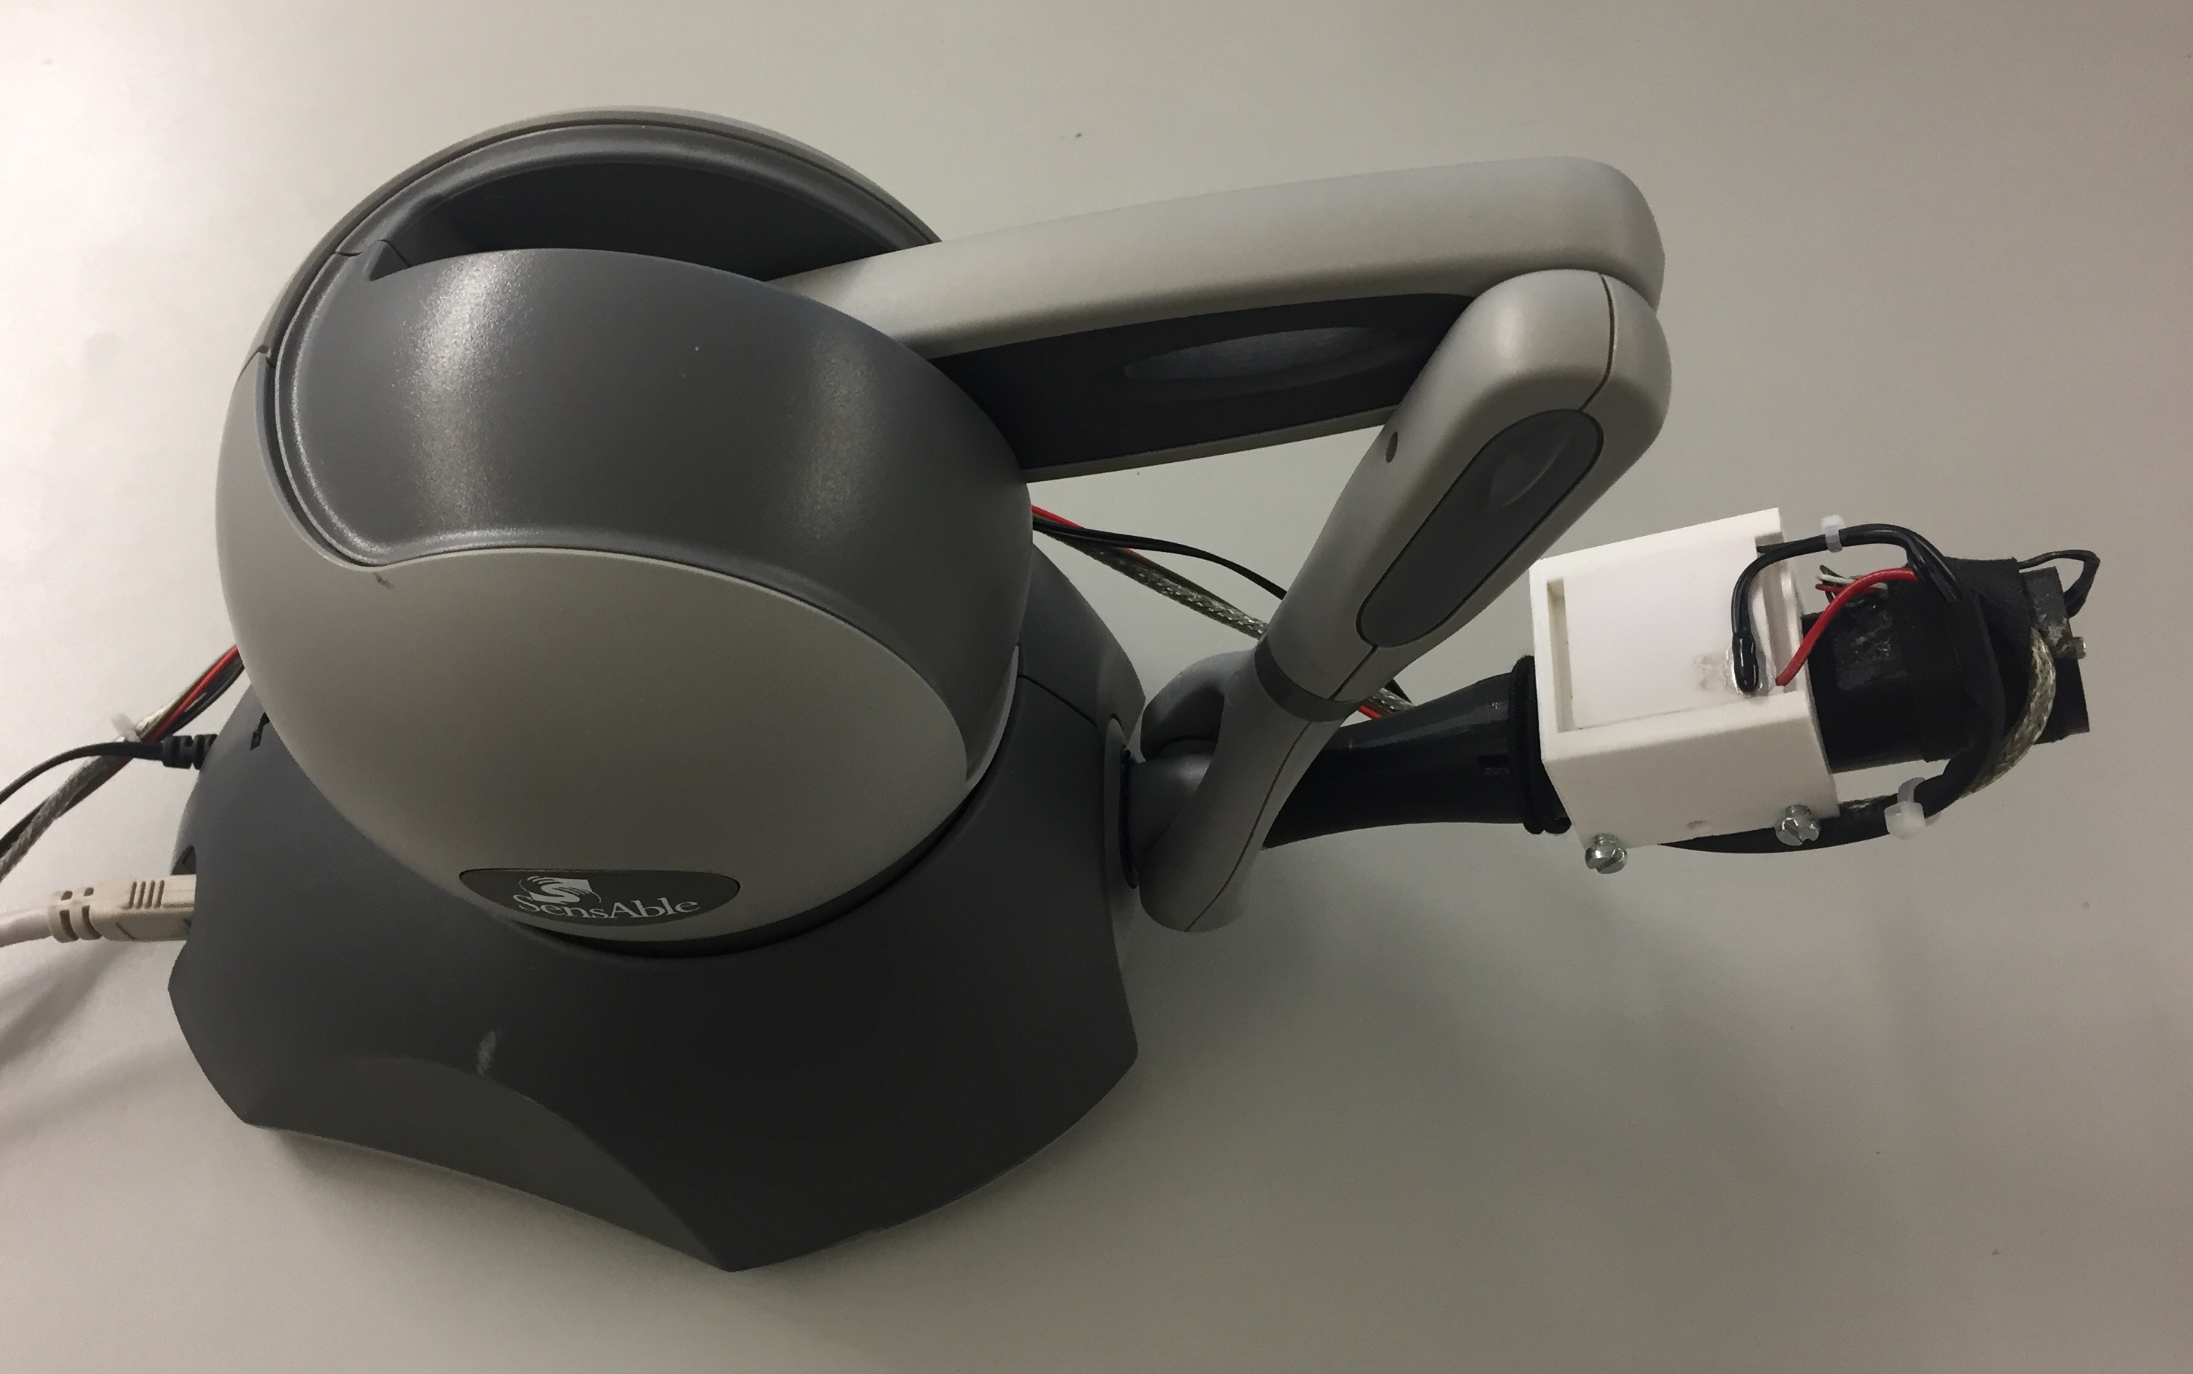
Hardware Implementation
Phantom Omni and Tool Adapter
Peltier element
Voice coil
inside
Haptics Showroom

Slide 11
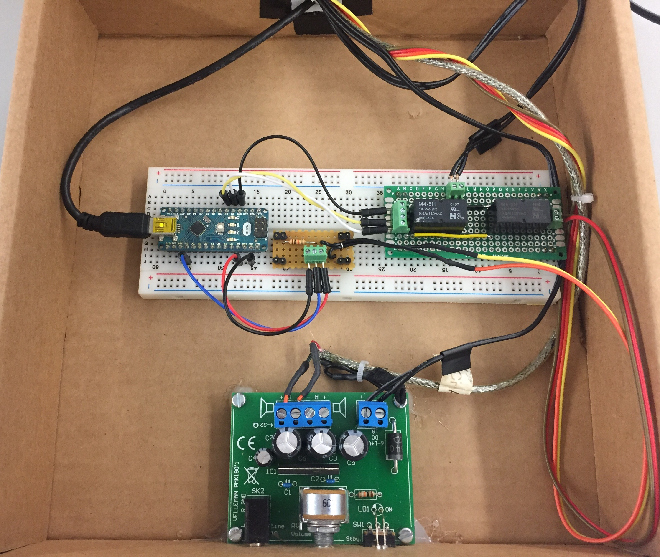
Hardware Implementation
Controller Box
Switching Circuit
Arduino Nano
Audio Amplifier
Haptics Showroom

Slide 12
Task mapping
SW:
Design of the room (floor, walls, ceiling, labels, walking functionality)
Audio stuff
Arduino control (SW + Interface in Visual Studio)
3ds objects (tables)
Classes (MyProperties, MyTempRegions)
MyObjectDatabase
Oculus support optional
HW:
Audio amplifier
Recording of sound files (for voice coil)
Peltier control (switching circuit)
Controller Box (putting it all together)
Haptic device adapter (Peltier and voice coil)
Ke, Hannes, Naina
Ke, Hannes
Hannes
Ke, Hannes, Naina
Hannes
Ke, Hannes
Ke, Hannes
Ke, Hannes
Ke
Hannes
Hannes
Ke, Hannes
Haptics Showroom

Slide 13
Task mapping
Task | Contributing Students
Designing the room (floor, walls, ceiling, labels, walking) | Naina | Hannes | Ke
Implementing Audio playback functionality |  |  | Ke
Implementing Arduino control (control SW + Interface in C++) |  | Hannes
Introducing 3ds objects | Naina | Hannes | Ke
Creating custom classes (MyProperties, MyTempRegions) |  | Hannes
Creating custum object database (MyObjectDatabase) |  | Hannes | Ke
Implementing Oculus support as optional |  | Hannes | Ke
Recording sound files (for voice coil) |  |  | Ke
Building Peltier control (switching circuit) |  | Hannes
Building controller box (cabling and assembly) |  | Hannes
Building haptic device adapter (Peltier and voice coil) |  | Hannes | Ke
SW
HW
Haptics Showroom

Slide 14
Future work
Apply texture to 3ds objects
Improve voice coil usage (not only scraping but also impact)
Support multidevice usage
Improve Peltier controller SW (exact temperature regulation)
Introduce moving objects (with ODE)
Introduce fixed objects (with 1 DoF)
Haptics Showroom

Slide 15
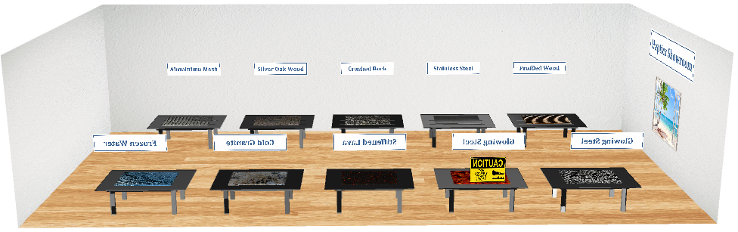
Haptics Showroom Demonstration
Insert Video
Haptics Showroom

