Slide 1
Fields of Gold
Boegershausen, Datta, Borah, and Stephen (2022)
Scraping Web Data for Marketing Insights

Slide 2




Enormous & diverse web data for marketing research
Boegershausen, Datta, Borah, and Stephen (2022)
7:11
time spent online per day by the average American consumer
~ 244m reviews
hours
> 1b reviews & opinions
85%
proportion of US consumers that use the Internet every single day
500m/day
556K projects
based on available company and market research statistics in May 2022

Slide 3

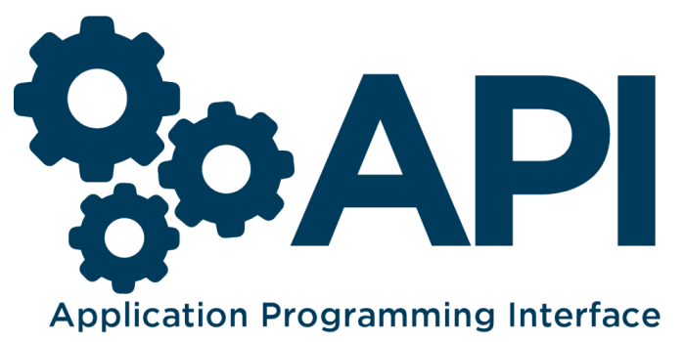



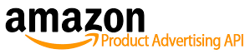

Web scraping & APIs can be used to extract web data at scale
Boegershausen, Datta, Borah, and Stephen (2022)
Web Scraping
… the process of developing software to automatically collect information displayed in a web browser
… allow programmatic access to the internal databases or algorithms of data providers
EXAMPLE SOURCES
EXAMPLE SOURCES
Example articles: Chevalier and Mayzlin (2006); Ludwig et al. (2013)
Example articles: Tellis et al. (2019); Toubia and Stephen (2013)

Slide 4
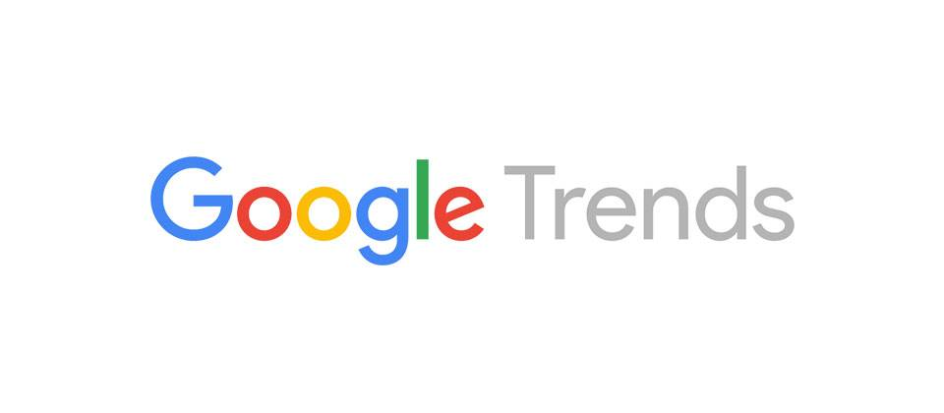
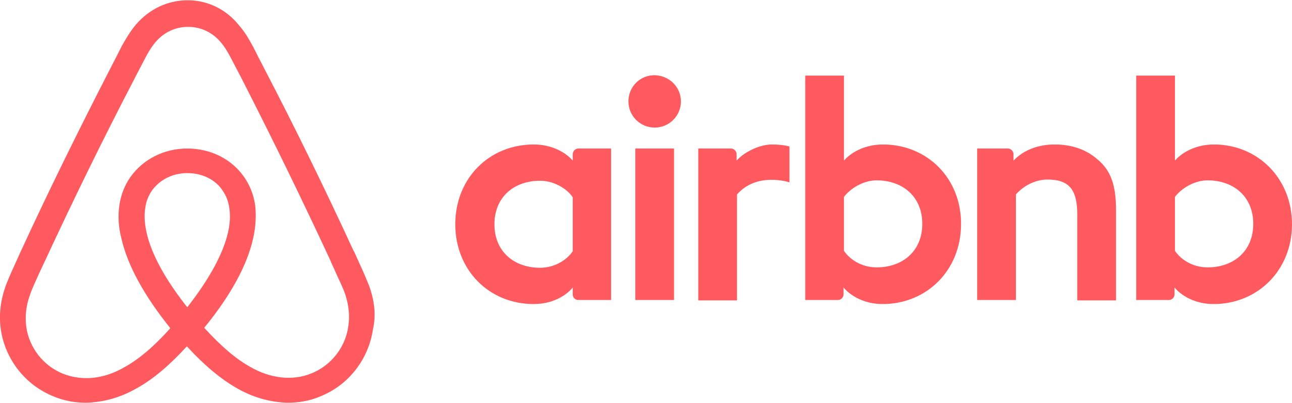




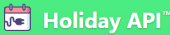
Highly versatile data collection technique
Boegershausen, Datta, Borah, and Stephen (2022)
Studying new phenomena
Boosting ecological value
Pathway ①
Pathway ②
e.g., Zervas et al. (2017); Datta et al. (2018)
e.g., Du et al. (2015); Ludwig et al. (2013)
Facilitating methodological advancement
Improving measurement
Pathway ③
Pathway ④
e.g., Netzer et al. (2012); Liu et al. (2020)
e.g., Li et al. (2017); Datta et al. (2022)

Slide 5
Collecting valid web data poses many challenges…
Boegershausen, Datta, Borah, and Stephen (2022)
Validity concerns may arise from, among others:
failing to capture contextual information in a rapidly changing environment (e.g., updates to the website’s data-generating process)
not sufficiently aligning the psychological processes of interest with the frequency of data extraction on review platforms (e.g., the collected information does not capture the time when the behavior occurred)
overlooking the influence of algorithmic interference on e-commerce websites (e.g., the effect of personalization algorithms on information display)
failing to retain raw website or API data necessary for construct validation, sampling, and analysis
…and many more.

Slide 6
How to extract valid web data?
Boegershausen, Datta, Borah, and Stephen (2022)
Jointly consider validity concerns, alongside technical and legal/ethical questions
Examples and solutions
Collecting user data from social networks may infringe upon users’ privacy rights → anonymize user IDs
Product review data may be biased by personalization algorithms → check whether own browsing behavior affects information display
Extraction of all of the information from a website may take too long → be mindful about limits to data extraction and take a sample
Technical feasibility
Legal and ethical risks
1. Source Selection
2. Collection Design
3. Data Extraction
Validity

Slide 7
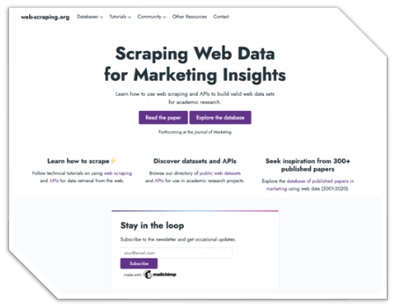
Want to get started collecting and using web data? Visit https://web-scraping.org/
Boegershausen, Datta, Borah, and Stephen (2022)
Explore a database with 300+ published marketing articles using web data & get inspired!
Discover web datasets & APIs for your research projects.
Find tutorials and example code for collecting web data using web scraping & APIs

