Slide 1

The BNL⁺⁺ Algorithm for Evaluating
Pareto Preference Queries
Timotheus Preisinger, Werner Kießling, Markus Endres
University of Augsburg
Institute for Computer Science
ECAI 2006 – Advances in Preference Handling

Slide 2
Outline
Motivation
Our Preference Model
The Better-Than-Graph
Pruning
The BNL⁺⁺ Algorithm
Summary and Outlook

Slide 3
1. Motivation
- A typical Preference SQL database query:
SELECT *
FROM cars
PREFERRING brand in (BMW) else (Mercedes) AND
price around 5000, 500
- Translation into a Pareto preference in Preference Algebra [Kie02]:
⊗( POS/POS(brand, {BMW}, {Mercedes},
AROUND(price, 5000, 500))
- Evaluation algorithms for Pareto preference queries:
  Index-based algorithms: not suitable for all cases
  Block-Nested-Loop ([BKS01]): universal, but low performance
⇒ here we come into play…

Slide 4
2. Our Preference Model
A Pareto preference P = ⊗(P₁, …, P_{m}) = ({A₁, …, A_{m}}, <_{P})
is defined as:
A tuple y is better than a tuple x iff
      y is better than or substitutable (equally good)
      than x in all P_{i}
      y is better than x in at least one P_{i}
P is a strict partial order [Kie05]
For this talk: all P_{i} are weak order preferences
      x_{i} is substitutable with y_{i} iff x_{i} and y_{i} are indifferent
      substitutable tuples form an equivalence class

Slide 5
Base preferences
Working on simple numerical or categorical attributes
Weak orders
Values with the same level value belong to one equivalence class
- Domination can be computed by numerical comparisons:
level_{P} : dom(A) → ₀
x <_{P} y ⇔ level_{P}(x[A]) > level_{P}(y[A])
- Each level value represents one equivalence classe
2 different types:
categorical: for discrete, categorical values like colors
numerical: for numerical values like prices

Slide 6
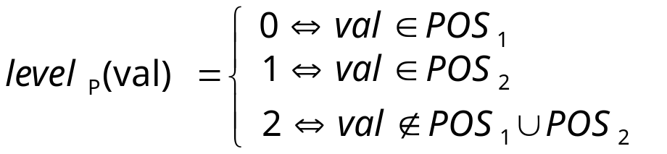
Base preference example (1)
POS/POS preference:
  User has a set POS₁ of „best“ values
  User has a set POS₂ of „second best“ values
P := POS/POS(A, POS₁, POS₂) has the level function

Slide 7
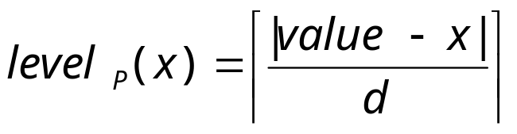
Base preference example (2)
AROUND_{d} preference:
  User has a desired numerical value
  Less numerical distance means „better“
P := AROUND_{d}(A, value) has the level function
maximum level: max(level_{P}(infimum), level_{P}(supremum))

Slide 8
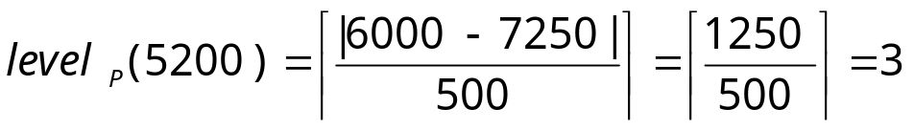
Example:
Level values of a numerical preference
„I want to buy a car with a price around 6000€.
I don‘t care about minor price differences of up to 500€.“
⇒ P₂ = AROUND₅₀₀(price, 6000)
inf=5100
…
sup=7250
dom(price)
level = 3
level = 3
5000
6000
7500
level=0

Slide 9
3. The Better-Than-Graph (BTG)
Visualization of a strict partial order (Hasse-diagram)
One node for each equivalence class
Level value of a node:
  Length of a longest path from a top element to the node
  Matches level functions for base preferences
- POS/POS(color, {blue, red}, {black}) sample BTG:
{red, blue}
(0)
level 0
{black}
(1)
level 1
{… all other colors …}
(2)
level 2

Slide 10
BTGs for Pareto preferences
P₁ = POS/POS(…)
P₂ = AROUND_{d}(…)
P = ⊗ (P₁, P₂)
(0,0)
level 0
(0,1)
(1,0)
level 1
(0,2)
(1,1)
(2,0)
level 2
(0,3)
(1,2)
(2,1)
level 3
(1,3)
(2,2)
level 4
(2,3)
level 5

Slide 11
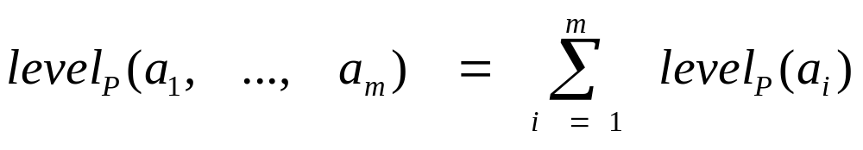
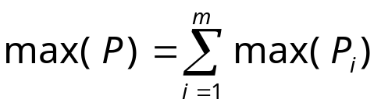
Properties of the BTG of a Pareto preference
P = ⊗ (P₁, …, P_{m})
- One node for each possible level value combination of all P_{i}
- One top node, one worst node
Theorem:
Level value of a node:
b) Maximum possible level:

Slide 12
Level values for a Pareto preference
(0,0)
level 0
Example: P = ⊗(P₁, P₂)
(0,1)
(1,0)
level 1
(0,2)
(1,1)
(2,0)
level 2
(0,3)
(1,2)
(2,1)
level 3
(1,3)
(2,2)
level 4
(2,3)
level 5

Slide 13
4. Pruning
(0,0)
level 0
Find all tuples t with
t <_{P} (1,1)
(0,1)
(1,0)
level 1
(0,2)
(1,1)
(2,0)
level 2
(0,3)
(1,2)
(2,1)
level 3
(1,3)
(2,2)
level 4
(2,3)
level 5

Slide 14
Pruning level
For each node x there is a level,
from which on all nodes are dominated by x.
Theorem:
A node x has the following pruning level pl(x):
if x is the top node:
pl(0, 0, …, 0) = 1
b) if x is the bottom node:
pl(max(P₁), max(P₂), …, max(P_{m})) = max(P) + 1
c) otherwise:
pl(x₁, …, x_{m}) = max(P) – min( { max(P_{i}) – x_{i} | x_{i} > 0 } )

Slide 15
Pruning level - example
Example:
pl(1,1) = 5 – min({2 – 1, 3 – 1})
= 5 – 1
= 4
(0,0)
level 0
(0,1)
(1,0)
level 1
(0,2)
(1,1)
(2,0)
level 2
(0,3)
(1,2)
(2,1)
level 3
(1,3)
(2,2)
level 4
(2,3)
level 5

Slide 16
5. The BNL++ Algorithm
Design principle:
Be as flexible as standard BNL, but try to omit unnecessary
comparisons by:
  Using pruning
  Working on equivalence classes rather than on tuples
  (cmp. to [CGGD03])
  Grouping equivalence classes by their levels

Slide 17
Block-Nested-Loop (BNL)
- Standard algorithm to retrieve the best matching objects
(i.e. tuples not dominated by others)
- No indexes necessary: very flexible (e.g. useable for join results)
Initialization:
Candidate list cand = ∅;
Computation:
  Read next tuple t, compare it to all c ∈ cand:
    Discard t if dominated by any c and go on with step 3
    Remove c from cand if dominated by t
  Add t to cand
  If there is another input tuple, go to step 1
  Return cand as result set

Slide 18
BNL++: The Algorithm
Initialization:
Candidate list cand = ∅;
pruning_level = max(P) + 1;
Computation:
1. Read one tuple and compute its equivalence class ec_{t} and:
  Check if level_{P}(ec_{t}) ≥ pruning_level: if true, go to step 1.
  Set pruning_level to min(pruning_level, pl(ec_{t}).
  Remove equivalence classes pruned by ec_{t}.
  For all c ∈ cand with level(ec_{t}) > level(c): if ec_{t} <_{P} c: go to 1
  Add ec_{t} to cand
  For all c ∈ cand with level(c) > level(ec_{t}): if c <_{P} ec_{t}: remove c
5. If there is another input tuple, go to step 1
6. Return cand as result set

Slide 19
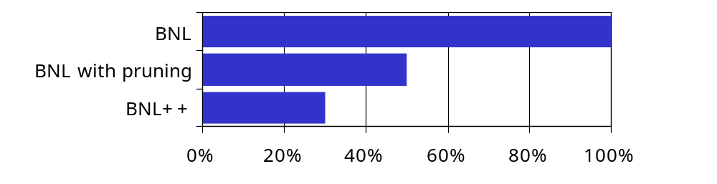
Preliminary evaluation results
- Made in cooperation with MAN Roland
Tests on a set of 4925 drills:
  256 different queries on 8 different attributes
  4 numerical attributes, 4 categorical
  Result sizes between 1 and 1250 tuples
- Results: average number of tuple comparisons
proportional to standard BNL

Slide 20
6. Summary and Outlook
Summary:
New kind of BNL optimization found by careful analysis of the BTG
Use of pruning techniques
Based on equivalence classes grouped by their levels
- Combination with other BMO algorithms possible
Outlook:
- Detailed performance tests

Slide 21
Thank you very much
for your attention.
Questions?

Slide 22
References
[BKS01] S. Börzsönyi, D. Kossmann, K. Stocker:
The Skyline Operator.
Proc. 17th Intern. Conf. on Data Engineering,
Heidelberg, Germany, 2001.
[Cho02] J. Chomicki:
Querying with Intrinsic Preferences.
Proc. of the 8th Intern. Conf. on Extending Database Technology, Prague, Czech Republic, 2002.
[CGGD03] J. Chomicki, P. Godfrey, J. Gryz, D. Liang:
Skyline with presorting.
Proc. of the IEEE Intern. Conf. On Data Engineering (ICDE),
Bangalore, India, 2003.

Slide 23
References
[Kie02] W. Kießling:
Foundations of Preferences in Database Systems.
Proc. 28th Intern. Conf. on Very Large Databases (VLDB),
Hong Kong, China, 2002.
[Kie05] W. Kießling:
Preference Queries with SV-Semantics
Proc. 11th Intern. Conf. on Management of Data (COMAD),
Goa, India, 2005.

Slide 24
Pruning level - continued
- Preference P = ⊗(P_{1,} P₂);
max(P₁) = 2; max(P₂) = 3;
- Given: a node with level values (a₁, a₂)
Wanted: maximum level of a node b with ¬(b <_{P} a)
⇒ (a₁< b₁ ∧ a₂ > b₂) ∨ (b₁< a₁ ∧ b₂ > a₂)
b₁ + b₂ should be maximal
⇒ maximize the b_{i} bigger than the corresponding a_{i}
Candidates: (a₁ – 1, max(P₂)) and (max(P₁), a₂ – 1)
Set each b_{i} to max(P_{i}), except for one:
  The one which is next to its maximum,
  for which the raise would be lowest.

Slide 25
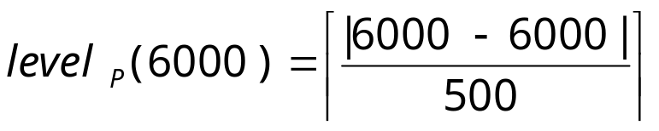
Example:
Level values of a numerical preference
„I want to buy a car with a price around 6000€.
I don‘t care about minor price differences of up to 500€.“
⇒ P₂ = AROUND₅₀₀(price, 6000)
inf=5100
…
sup=7250
dom(price)
5000
6000
7500
level=0

Slide 26
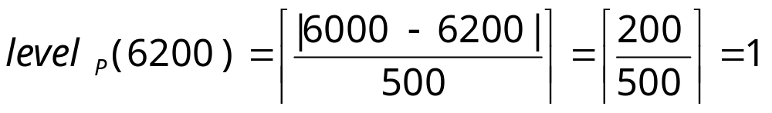
Example:
Level values of a numerical preference
„I want to buy a car with a price around 6000€.
I don‘t care about minor price differences of up to 500€.“
⇒ P₂ = AROUND₅₀₀(price, 6000)
inf=5100
…
sup=7250
dom(price)
level = 1
level = 1
5000
6000
7500

Slide 27
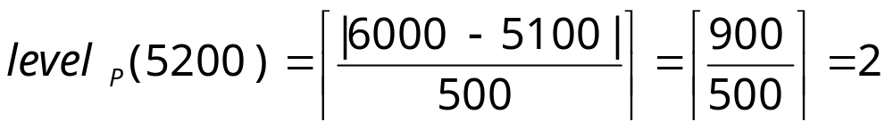
Example:
Level values of a numerical preference
„I want to buy a car with a price around 6000€.
I don‘t care about minor price differences of up to 500€.“
⇒ P₂ = AROUND₅₀₀(price, 6000)
inf=5100
…
sup=7250
dom(price)
level = 2
level = 2
5000
6000
7500

Slide 28
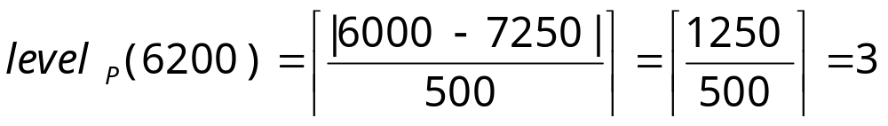
Example:
Level values of a numerical preference
„I want to buy a car with a price around 6000€.
I don‘t care about minor price differences of up to 500€.“
⇒ P₂ = AROUND₅₀₀(price, 6000)
inf=5100
…
sup=7250
dom(price)
level = 3
level = 3
5000
6000
7500

