Slide 1

The Hexagon Algorithm for
Pareto Preference Queries
Timotheus Preisinger, Werner Kießling
University of Augsburg
Institute for Computer Science
M-PREF 2007

Slide 2
Outline
Motivation
Our Preference Model
Analysis of the Better-Than-Graph
Hexagon
Complexity and Performance
Summary and Outlook

Slide 3
1. Motivation
John Doe has the following preferences for a used car:
“I want a BMW or a VW if no BMW is available.
“I want to spend around € 6000.
“I don’t care for price differences less than 10%.”
The preferences on brand and price are equally important.
In Preference SQL:
SELECT * FROM cars
PREFERRING brand in ('BMW') ELSE (‘VW') AND
price AROUND 6000, 600
Sample database:
Which car is best suited for John?
  Best Matches Only (all tuples not worse than any other tuple):
 | brand | price
t₁ | VW | 5600
t₂ | BMW | 7500
t₃ | VW | 6400
t₄ | VW | 5500
t₅ | Audi | 6000
(VW, 5600)
(BMW, 7500)
(VW, 6400)
(Audi, 6000)

Slide 4
Theoretical Background
- Multiple preferences without weighting
⇨ Pareto preference (Preference Algebra [Kie02]: ⊗)
- John’s preferences in Preference Algebra:
  ⊗ ( POS/POS(brand, {‘BMW’}, {‘VW’}),
  AROUND₆₀₀(price, 6000))
- BMO evaluation algorithms for Pareto preference queries:
  Index-based algorithms: not suitable for all cases
  Block-Nested-Loop [BKS01]: quadratic worst case
  LESS [CGGD03]: over-linear worst case
  BNL⁺⁺ [PKE06]: over-linear worst case
- Can we find an algorithm with linear worst case running time?

Slide 5
2. Our Preference Model
Base Preferences: Weak orders defined on simple attributes
Weak order preferences (WOPs):
Domination can be computed by numerical comparisons:
level_{P} : dom(A) → ₀
x <_{P} y ⇔ level_{P}(x[A]) > level_{P}(y[A])
- All values in one level are considered equally good and form an
equivalence class
2 different types:
  categorical: for discrete domains
  numerical: for numerical domains

Slide 6
Base preferences
SCORE
LAYERED
POS/POS
POS/NEG
BETWEEN
AROUND
POS
NEG
HIGHEST
LOWEST
ANTI-CHAIN

Slide 7
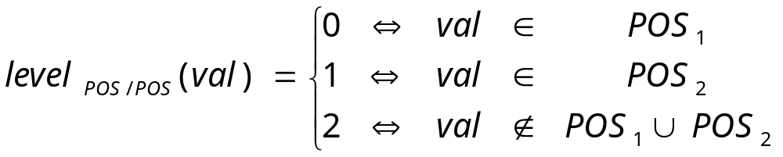
POS/POS preference
POS/POS(A, S₁, S₂) preference:
  User has a set S₁ of „best“ values
  User has a set S₂ of „second best“ values
  Level function for a POS/POS preference
  P₁ := POS_{d}(A, value):
  Example:
  P₁ := POS/POS(brand, {'BMW'}, {'VW'})
level 0:
'BMW'
level 1:
'VW'
level 2:
other values

Slide 8
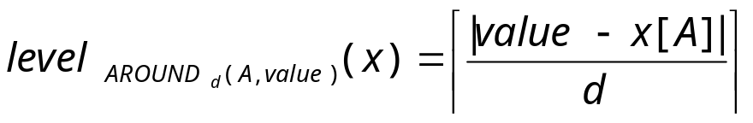
AROUND preference
AROUND_{d}(A, value) preference:
  User has a desired numerical value
  Less numerical distance means „better“
  Level function for a AROUND preference
  P := AROUND_{d}(A, value):
  Example:
  P₂ := AROUND₆₀₀(price, 6000)
dom(price)
level = 3
level = 2
level = 1
level = 1
level = 2
level = 3
5000
6000
7000
level=0

Slide 9
Pareto Preferences
- We consider the combination of multiple WOPs
A Pareto preference
P = ⊗(P₁, …, P_{m}) = ({A₁, …, A_{m}}, <_{P})
is defined as:
x <_{P} y ⇔
P is not a WOP but a strict partial order [Kie05]

Slide 10
The Better-Than-Graph (BTG)
Hasse diagram
Level value of a node:
length of a path from the top element to the node
Base Preferences:
- BTG for P₁ := POS/POS(brand, {‘BMW’}, {‘VW’}):
BTG size for a base preference P_{i}: max(P_{i}) + 1
{‘BMW’}
(0)
level 0
{‘VW’}
(1)
level 1
{… all other brands …}
(2)
level 2

Slide 11
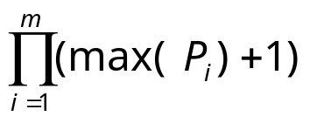
BTGs for Pareto preferences
- Sample preference:
P₁ = POS/POS(…)
P₂ = AROUND_{d}(…)
P = ⊗ (P₁, P₂)
- BTG size for a
- Pareto preference P:
- Marked in white:
nodes with tuples from
sample database
(0,0)
level 0
(0,1)
(1,0)
level 1
(0,2)
(1,1)
(2,0)
level 2
(0,3)
(1,2)
(2,1)
level 3
(1,3)
(2,2)
level 4
(2,3)
level 5

Slide 12
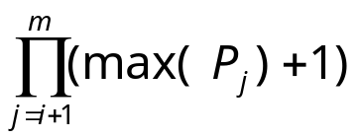
4. Analysis of the BTG
Edge weights:
An edge from one node to another stands for domination:
(0,1): dominated because of P₂
(1,0): dominated because of P₁
- Distinctive feature of edges: preferences they stand for
⇨ in P = ⊗(P₁, …, P_{m}): m different kinds of edges
Weight of an edge representing domination by a P_{i}:
(0,0)
(0,1)
(1,0)

Slide 13
BTG edges and their weights
weight(P₂) = 1
weight(P₁) = max(P₂) + 1 = 4
level 0
(0,0)
level 1
(0,1)
(1,0)
level 2
(0,2)
(1,1)
(2,0)
level 3
(0,3)
(1,2)
(2,1)
level 4
(1,3)
(2,2)
level 5
(2,3)

Slide 14
Unique node ID
Unique integer number for each node
Sum of edge weights of any path to the
node from the top node
Minimal ID: 0
Maximal ID: “number of nodes” – 1
Each integer between 0 and the
- maximum is a valid ID
Example:
weight(P₂) = 1
weight(P₁) = max(P₂) + 1 = 4
ID((1, 2)) = 1 * 4 + 2 * 1 = 6
(0,0)
(0,1)
(1,0)
(0,2)
(1,1)
(2,0)
(0,3)
(1,2)
(2,1)
(1,3)
(2,2)
(2,3)

Slide 15
Unique node IDs in a BTG
level 0
0:(0,0)
weight(P₂) = 1
weight(P₁) = 4
level 1
1:(0,1)
4:(1,0)
level 2
2:(0,2)
5:(1,1)
8:(2,0)
level 3
3:(0,3)
6:(1,2)
9:(2,1)
level 4
7:(1,3)
10:(2,2)
level 5
11:(2,3)

Slide 16
4. The algorithm Hexagon
Three parts:
- Construction of the BTG
- Adding tuples to their respective nodes
- Removal of dominated tuples

Slide 17
Construction phase and adding phase
Construction phase:
Compute BTG size using the max(P_{i})
2. Initialize arrays with BTG size:
- next for breadth-first-walk
- nodes for storing input tuples
3. Loop over all IDs (starting at 0)
- compute level for ID
- set next for all nodes
Adding phase:
for each tuple in the input relation
- compute its ID
- add tuple to the corresponding node
0:(0,0)
1:(0,1)
4:(1,0)
2:(0,2)
5:(1,1)
8:(2,0)
3:(0,3)
6:(1,2)
9:(2,1)
7:(1,3)
10:(2,2)
11:(2,3)

Slide 18
Removal phase
General workflow:
- Start at node 0 and follow next (breadth first walk)
- Remove empty nodes from next relation
- Remove nodes dominated by non-empty nodes with a
- depth first walk:
    in each non-empty node,
    walk down all edges with weights not higher
    than the edge used to reach the node

Slide 19
Hexagon: before removal phase
BTG:
0:(0,0)
next relation:
0:(0,0)
1:(0,1)
4:(1,0)
1:(0,1)
4:(1,0)
2:(0,2)
5:(1,1)
8:(2,0)
2:(0,2)
5:(1,1)
8:(2,0)
3:(0,3)
6:(1,2)
9:(2,1)
3:(0,3)
6:(1,2)
9:(2,1)
7:(1,3)
10:(2,2)
7:(1,3)
10:(2,2)
11:(2,3)
11:(2,3)
(white nodes contain tuples)

Slide 20
Hexagon: in removal phase
Current status:
- empty nodes at the beginning
of next relation removed
- non-empty node (1,1)
is reached
To do now:
- walk down edges to
dominated nodes
- note:
  start with edge with lowest weight
  never follow edges with higher weight
5:(1,1)
8:(2,0)
3:(0,3)
6:(1,2)
9:(2,1)
7:(1,3)
10:(2,2)
11:(2,3)

Slide 21
Hexagon: in removal phase (2)
Current status:
- dominated notes have been removed from next relation
To do now:
- follow edges with higher weights to dominated nodes
5:(1,1)
8:(2,0)
3:(0,3)
6:(1,2)
9:(2,1)
7:(1,3)
10:(2,2)
11:(2,3)

Slide 22
Hexagon: in removal phase (3)
Current status:
- dominated nodes have been found
To do now:
- remove dominated nodes from next
5:(1,1)
8:(2,0)
3:(0,3)
9:(2,1)
10:(2,2)
11:(2,3)

Slide 23
Hexagon: end of removal phase
Current status:
- dominated notes have been removed from next relation
5:(1,1)
8:(2,0)
3:(0,3)
To do now:
follow next and remove other dominated nodes

Slide 24
Hexagon: end of removal phase
5:(1,1)
8:(2,0)
3:(0,3)
8:(2,0): no more nodes to remove
3:(0,3): no more nodes to remove, last node in next relation reached
End of computation!

Slide 25

5. Complexity and Performance
- Construction phase: O(|BTG|)
- Adding phase: O(n)
- Removal phase: O(|BTG|)
Theorem:
Given
- a Pareto preference P := ⊗(P₁, …, P_{m}) with m WOPs
- an input relation R of size n
where the BTG size is at most linear in n,
then Hexagon evaluates P in linear time.
Small BTG sizes guaranteed for categorical base preferences
Numerical base preferences: BTG size depends on modelling
guaranteed costs

Slide 26
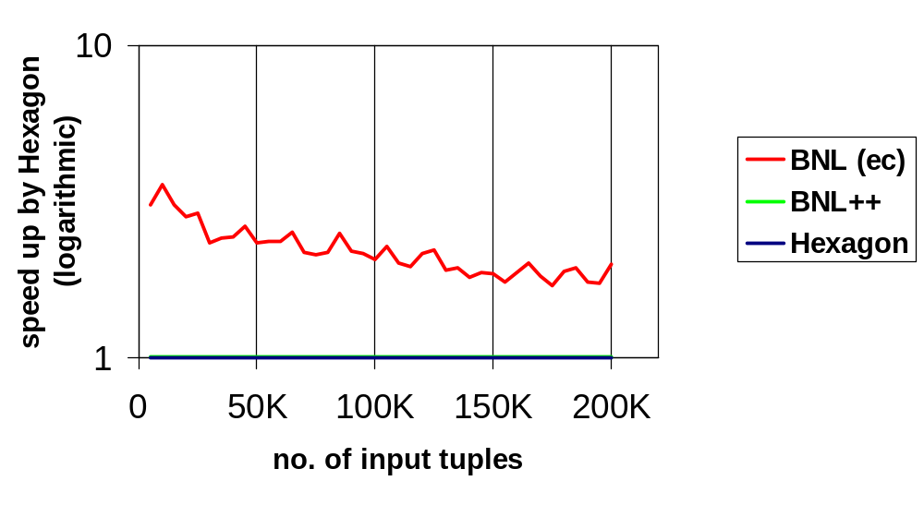
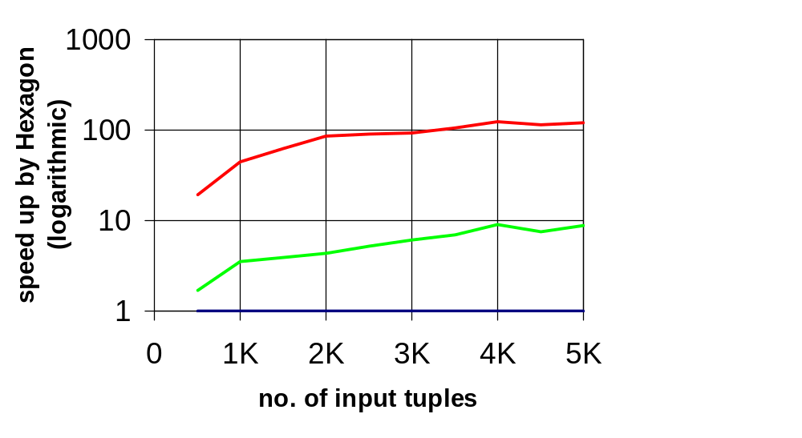
Performance evaluation results
94 Pareto preferences P = ⊗ (P₁, P₂, …, P_{m}), m ∈ {2, 3, …, 10}
BTG sizes between 10.000 and 20.000
Comparing Hexagon, BNL++ and BNL(ec)
average case (independent data)
BNL⁺⁺ and BNL(ec) worst case

Slide 27
6. Summary and Outlook
Summary:
New type of algorithm found by careful analysis of the BTG
Hexagon is linear in many practical use cases
Better performance other algorithms in these cases
- Hexagon is not useful for very large BTGs: BNL⁺⁺ seems feasible
Outlook:
Analysis of influence of BTG size on execution times of
Hexagon and BNL⁺⁺
- Integration of BNL⁺⁺ and Hexagon into a cost based
preference query optimizer

Slide 28
Thank you very much
for your attention.
Questions?

Slide 29
References
[BKS01] S. Börzsönyi, D. Kossmann, K. Stocker:
The Skyline Operator.
Proc. 17th Intern. Conf. on Data Engineering,
Heidelberg, Germany, 2001.
[CGGD03] J. Chomicki, P. Godfrey, J. Gryz, D. Liang:
Skyline with presorting.
Proc. of the IEEE Intern. Conf. On Data Engineering (ICDE),
Bangalore, India, 2003.
[Kie02] W. Kießling:
Foundations of Preferences in Database Systems.
Proc. 28th Intern. Conf. on Very Large Databases (VLDB),
Hong Kong, China, 2002.

Slide 30
References
[Kie05] W. Kießling:
Preference Queries with SV-Semantics
Proc. 11th Intern. Conf. on Management of Data (COMAD),
Goa, India, 2005.
[PKE06] T. Preisinger, W. Kießling, M. Endres:
The BNL++ Algorithm for Evaluating Pareto Preference
Proceedings of the ECAI 2006
Multidisciplinary Workshop on Advances in Preference Handling,
Riva del Garda, Italy, August 2006.

