Slide 1
P-OSRA Polymer Optical Structure Recognition Application
Bryn Reinstadler
Computational Chemistry and
Materials Science Group

Slide 2
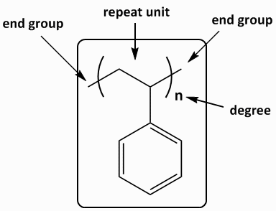
What are polymers?
Molecules composed of many repeated subunits
Ubiquitous in everyday life, from proteins to plastics.

Slide 3
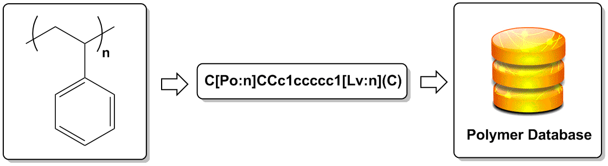
P-OSRA
Uses extended image recognition software to provide a textual representation of the polymer (SMILES format)
Stores all information in polymer database

Slide 4
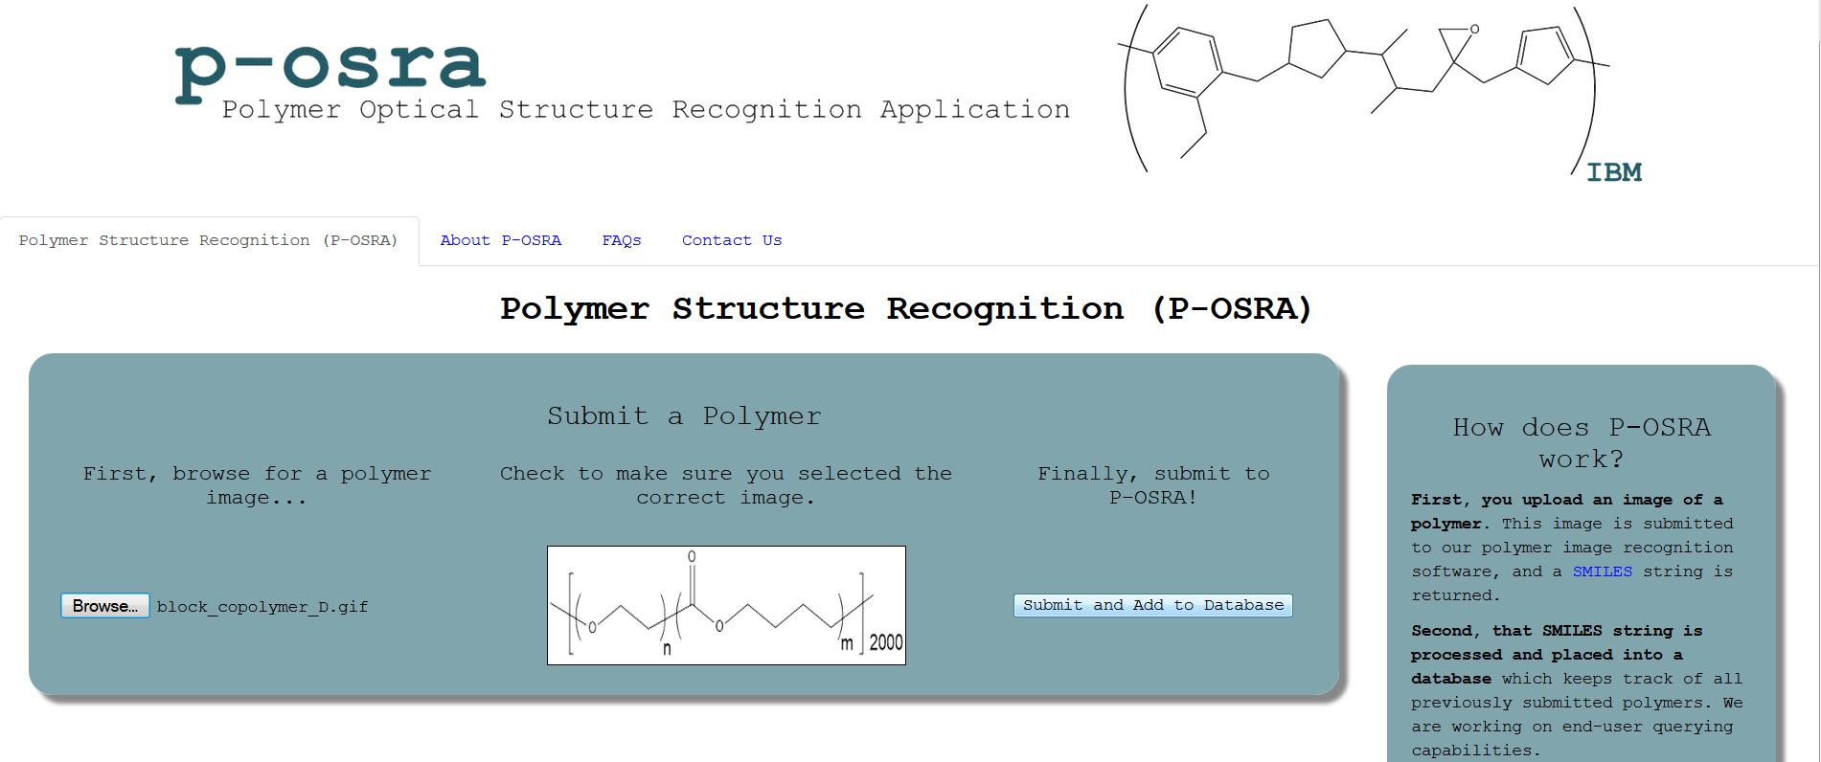
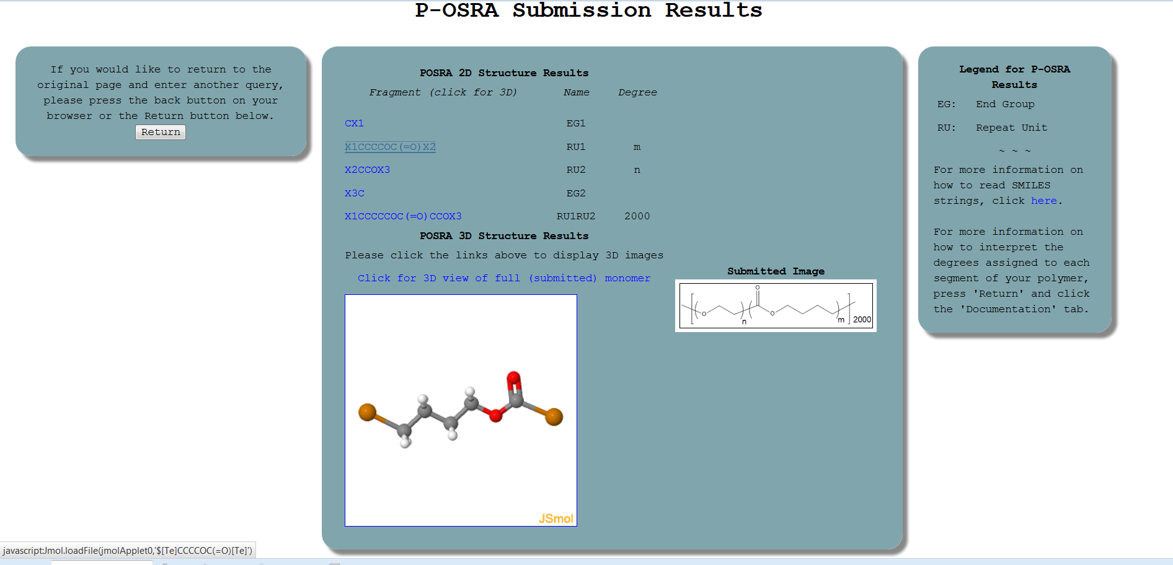

Slide 5
Looking towards expansion
Scientific Literature and Patents
Polymer Diagrams (P-OSRA)
Polymer Names
Tables and other textual info
PI2S
(“PolymerImage to Structure” effort @ UCSC)
PN2S (“PolymerName to Structure” effort @ NTU)
Text Extraction and Analytics
(SIIP @ Watson)
Polymer Database

Slide 6



Acknowledgements
Mentor: Hans Horn
Manager: Jed Pitera
Funded and co-sponsored by IBM and the American Physical Society (APS) Research Internship for Undergraduate Women

