Slide 1
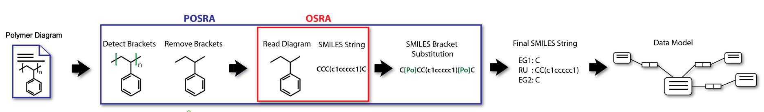
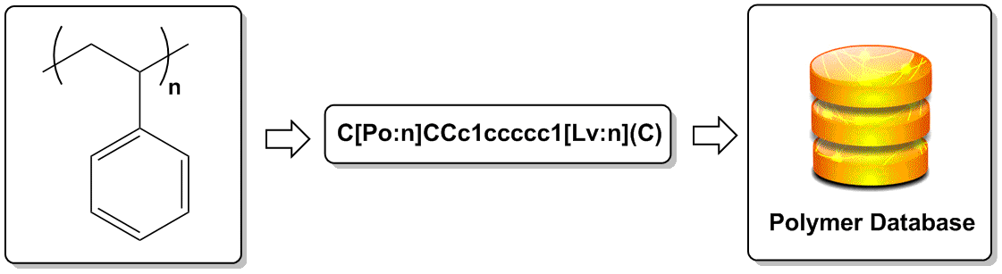
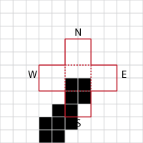
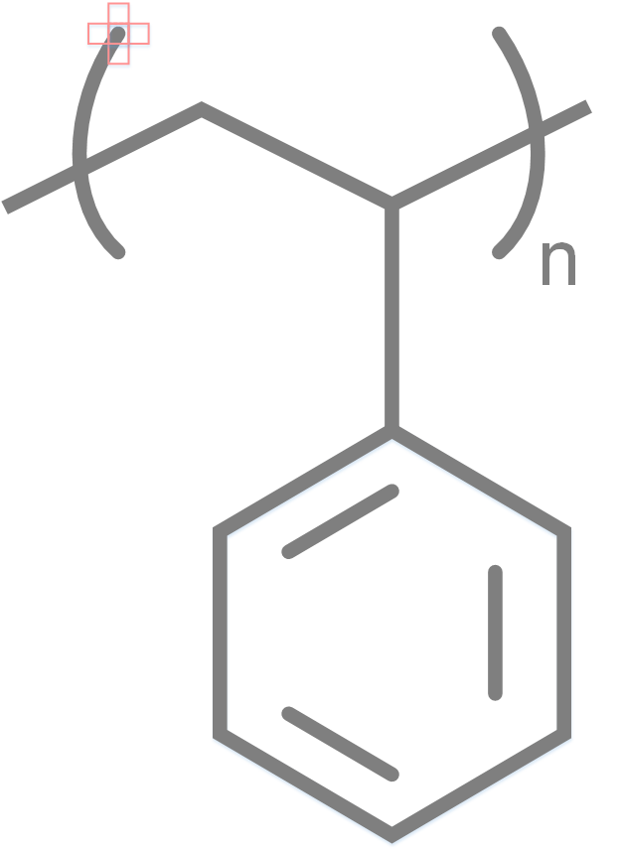
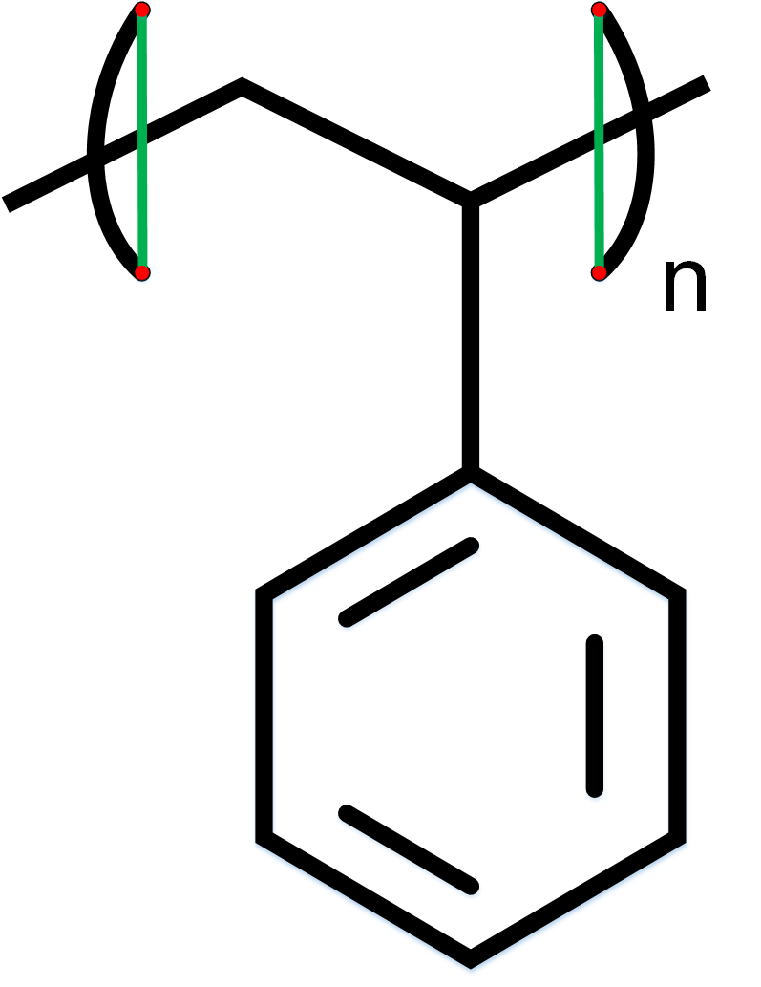
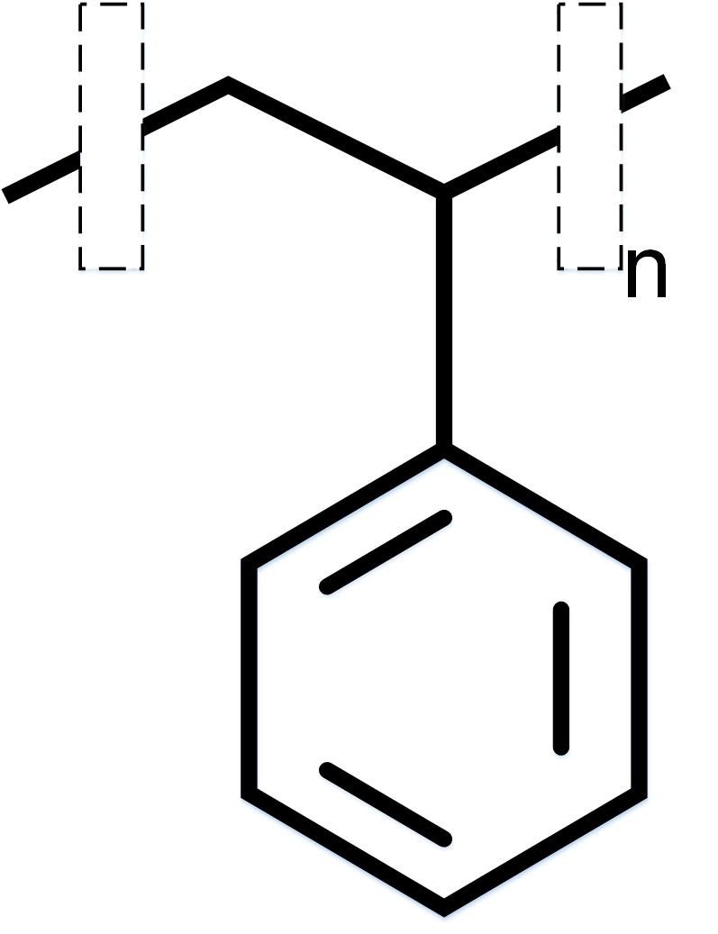
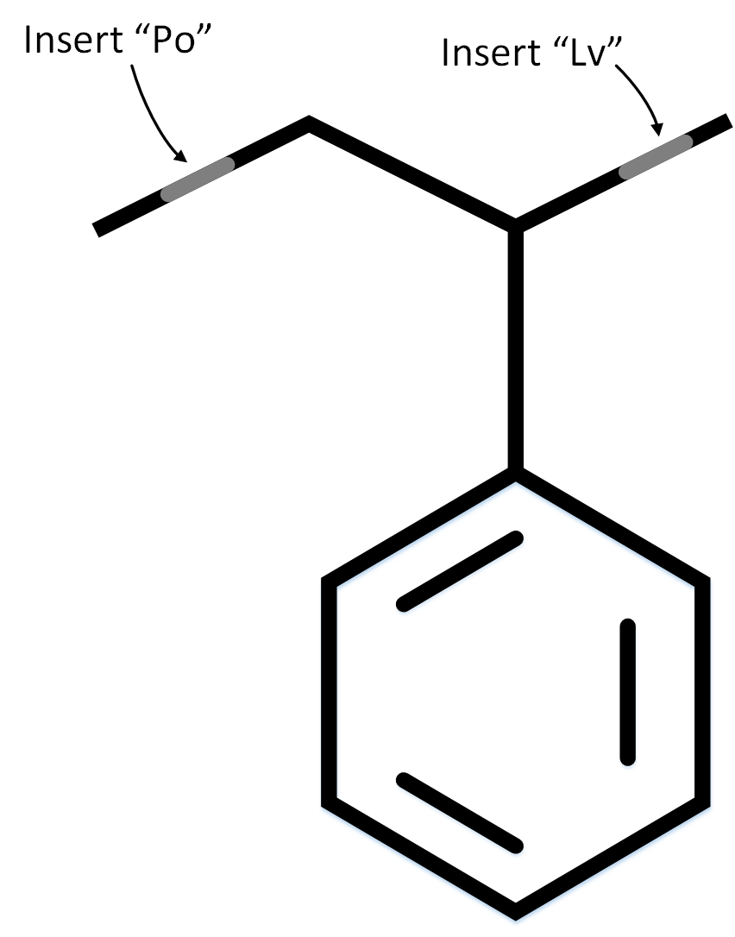
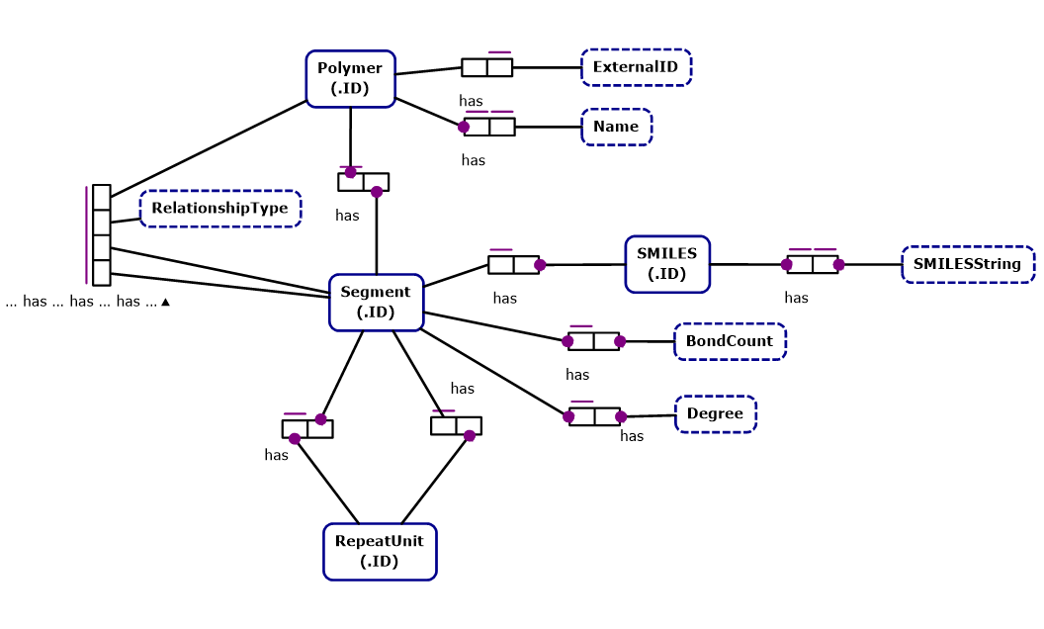


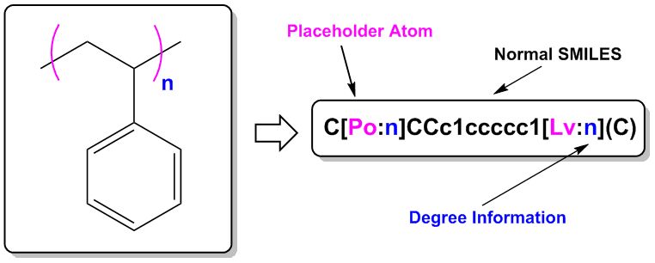
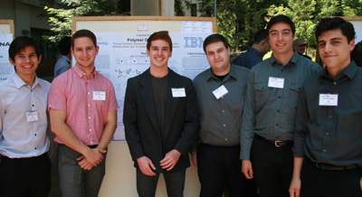







P-OSRA: polymeric image recognition and database storage
Bryn M Reinstadler¹ and Hans W Horn²
1 Williams College (br6@williams.edu) 2 IBM Almaden Research Center (hanshorn@us.ibm.com)
Introduction
What if all polymer information was easy to access? P-OSRA is application for recognizing images of polymers, converting them into the SMILES format (a line notation form to describe chemical structures), and then storing the structural information in a database.
We aim to use this free, open-source utility to make polymeric information more broadly and easily available.
Image Recognition
Our image recognition software recognizes polymeric image attributes such as degrees and brackets, stores that information textually, and then passes an image to OSRA (Optical Structure Recognition Application).
The image passed to OSRA has been denuded of all its brackets and degrees. OSRA returns a SMILES string corresponding to the OSRA image, and then our extension, P-OSRA, does SMILES bracket substitution to ‘add back in’ the polymeric information.
Database Storage
Why P-OSRA?
The idea to create a database to store polymeric information is not a novel one. However, in other polymer databases, such as the PolyInfo database, end group and degree information are lacking, as are complex structural data. Clearly, there is room to improve the functionality of already extant polymeric databases.
What’s Next?
We are working in collaboration with several groups across the world to make polymer information more readily available.
A Polymeric Extension of the SMILES String
The SMILES output format textually expresses chemical structural information. We have developed an extension of this utility that adds polymeric functionality. The ‘place-holder’ atoms Po, Te, and Lv are assigned degrees within the SMILES string so we can store degree information about the polymer within the SMILES string itself.
Scientific Literature and Patents
Polymer Diagrams (P-OSRA)
Polymer Names
Tables and other textual info
PI2S
(“PolymerImage to Structure” effort @ UCSC)
PN2S (“PolymerName to Structure” effort @ NTU)
Text Extraction and Analytics
(SIIP @ Watson)
After producing the modified (polymeric) SMILES string, the data for each polymer is stored in a database. The polymer is stored modularly to reduce risk of redundant values and increase the ease of querying from the database.
Polymer Database
UCSC Group
Prof. Jane Tseng, NTU
Watson Group
Object Role Model (ORM)
Open-Source Resources Used
OSRA: "Optical Structure Recognition Software To Recover Chemical Information: OSRA, An Open Source Solution" J. Chem. Inf. Model., 2009, 49 (3), pp 740–743
SMILES: O’Boyle, Noel M. "Towards a Universal SMILES Representation - A Standard Method to Generate Canonical SMILES Based on the InChI." Journal of Cheminformatics 4.1 (2012): 22.
JSmol: an open-source HTML5 viewer for chemical structures in 3D. http://wiki.jmol.org/index.php/JSmol#JSmol
Also the libraries:
GraphicsMagick (graphics), potrace (image vectorization), TCLAP (command parser), GOCR/OCRAD (optical character recognition), and OpenBabel (chemistry toolbox)
Acknowledgments
Funded and co-sponsored by
IBM and the American Physical
Society (APS)
Primary Mentor: Hans Horn
Manager: Jed Pitera
Further information
P-OSRA is an open-source application that will be available online in the near future. Inquiries about the forthcoming website may be directed to Ms Reinstadler.
Poster Template © Copyright Colin Purrington.
Notes:
Copyright Colin Purrington (http://colinpurrington.com/tips/academic/posterdesign).

