Slide 1


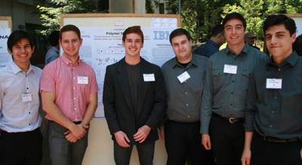




Technical Presentation: PolymerInformatics
What if all polymer information was easily accessible?
First Steps: turn non-structured data in literature and patents into queryable data
Scientific Literature and Patents
Polymer Diagrams (P-OSRA)
Polymer Names
Tables and other textual info
PI2S
(“PolymerImage to Structure” effort @ UCSC)
PN2S (“PolymerName to Structure” effort @ NTU)
Text Extraction and Analytics
(SIIP)
Ying Chen
Watson Group
Jeff Kreulen
Prof. Jane Tseng, NTU
Scott Spangler
Cartic Ramakrishnan
Polymer Database
Roxana Stanoi

Slide 2

Polymer Database
“…Information on polymers including properties, chemical structures, IUPAC names, processing methods of measured samples, measurement conditions, used monomers and polymerization methods are stored in a object database. About 100 types of properties including thermal, electrical and mechanical properties are covered. Homopolymers, copolymers, furthermore polymer blends, composites and compounds that consist of homopolymers and copolymers are open to the public. Property Prediction Subsystem, Nomenclature System and NMR Database are also available as advanced functions….”
not new; PolyInfo database
http://polymer.nims.go.jp/index_en.html
however,
end group and degree info lacking
structural info insufficient
need data model that better deals with structural info
Objectives for “PI2S” PolymerInformatics Project:
We want to
convert polymer diagrams to SMILES strings (need polymer SMILES extension)
preserve degree information and end groups (better than PN2S)
have a data model that can accommodate the above (better than PolyInfo)
have the ability to create 3D representations when needed
build upon open source software

Slide 3
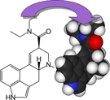
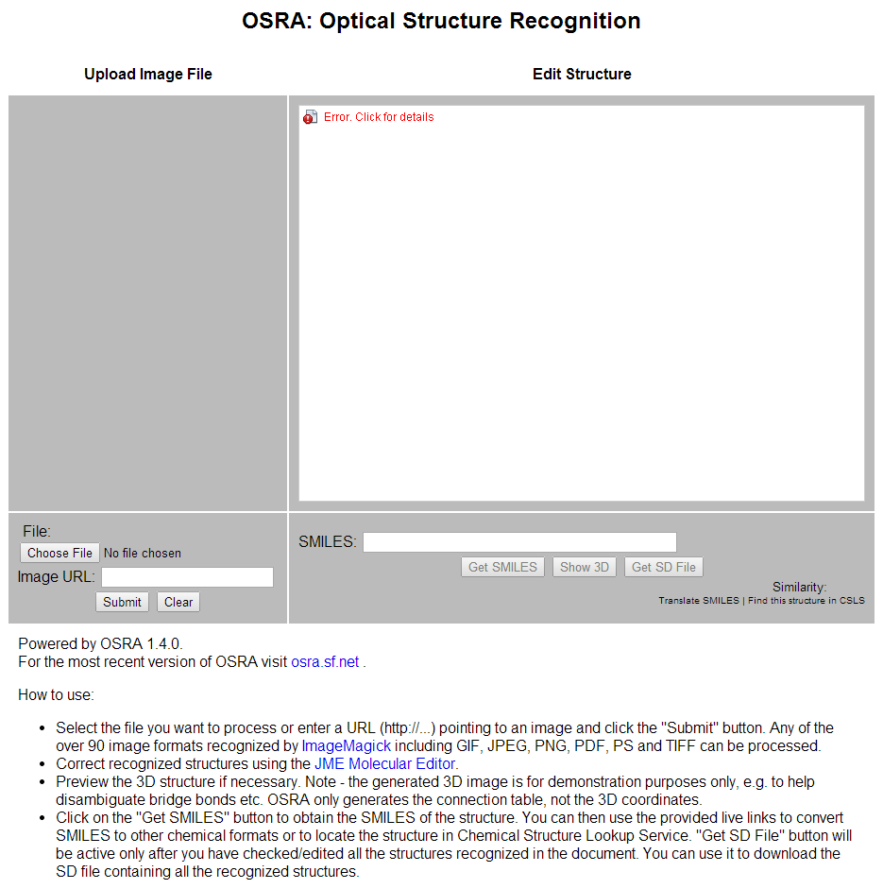
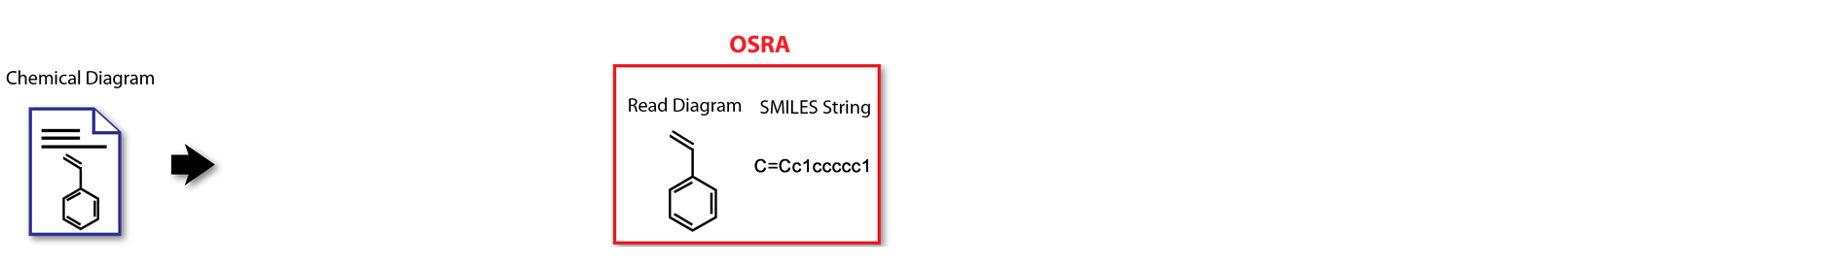
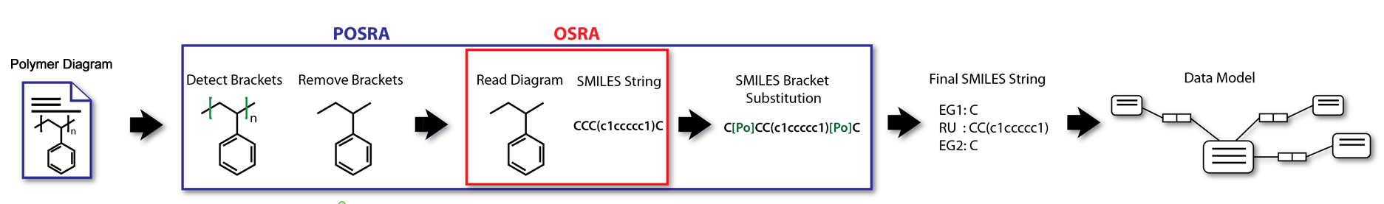
PI2S
Take open-source program “OSRA” (http://sourceforge.net/apps/mediawiki/osra; NIH, Igor Fillipov)
(POSRA: “Polymer Optical Structure Recognition Application”)
“Optical Structure Recognition Software To Recover Chemical Information: OSRA, An Open Source Solution”; I. Fillipov et al; J. Chem. Inf. Model., 2009, 49, 740
http://cactus.nci.nih.gov/cgi-bin/osra/index.cgi
Uses myriad of other open source libraries:
TCLAP command line processing
GraphicsMagic image processing
potrace image vectorization
GOCR, OCRAD OCR
OpenBabel SMILES processing
(can buy binaries for $$)
… teach it bracket notation … and store result in database

Slide 4
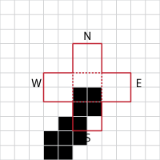
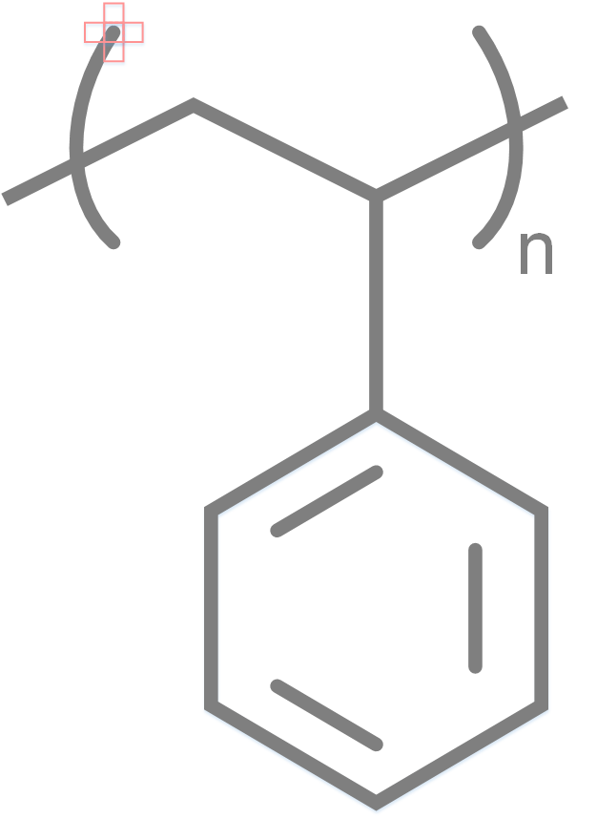
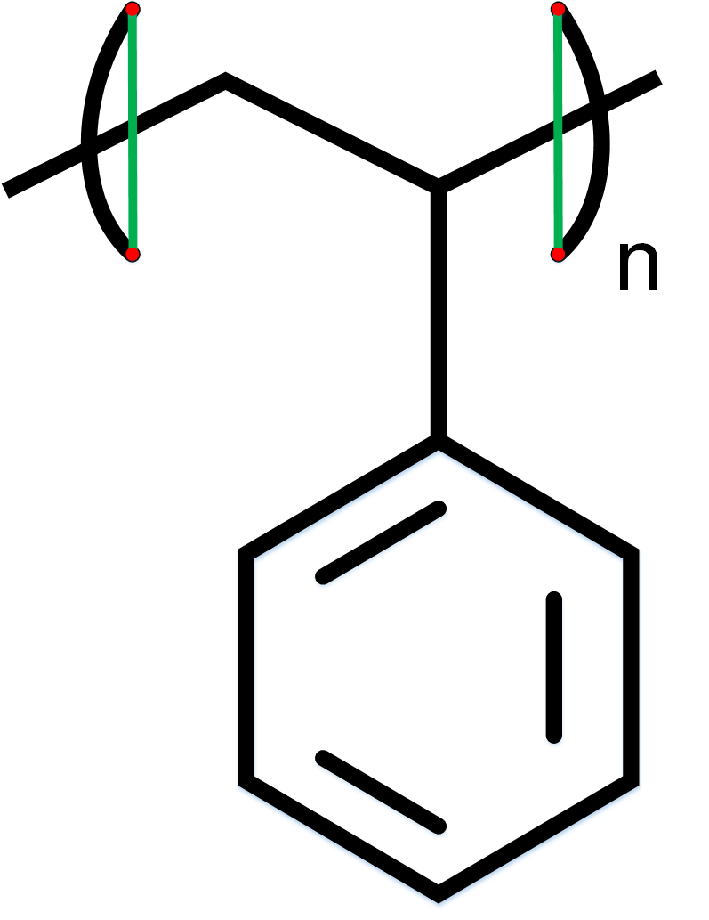
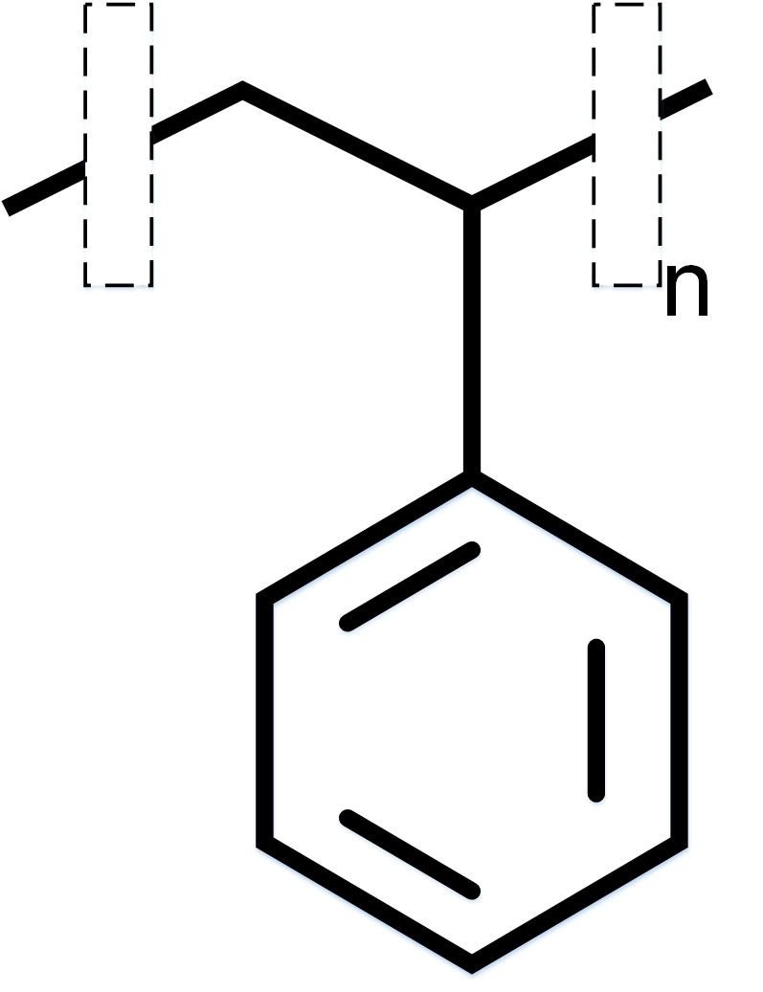
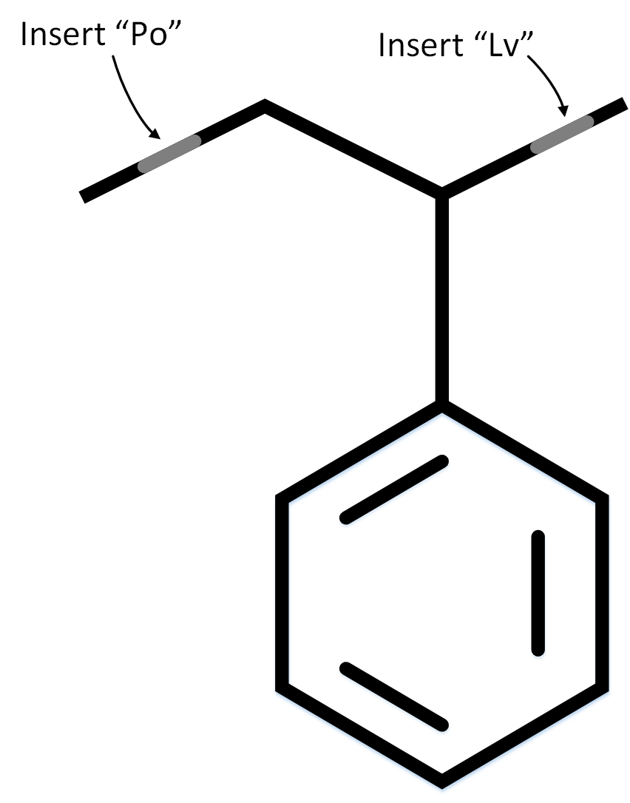
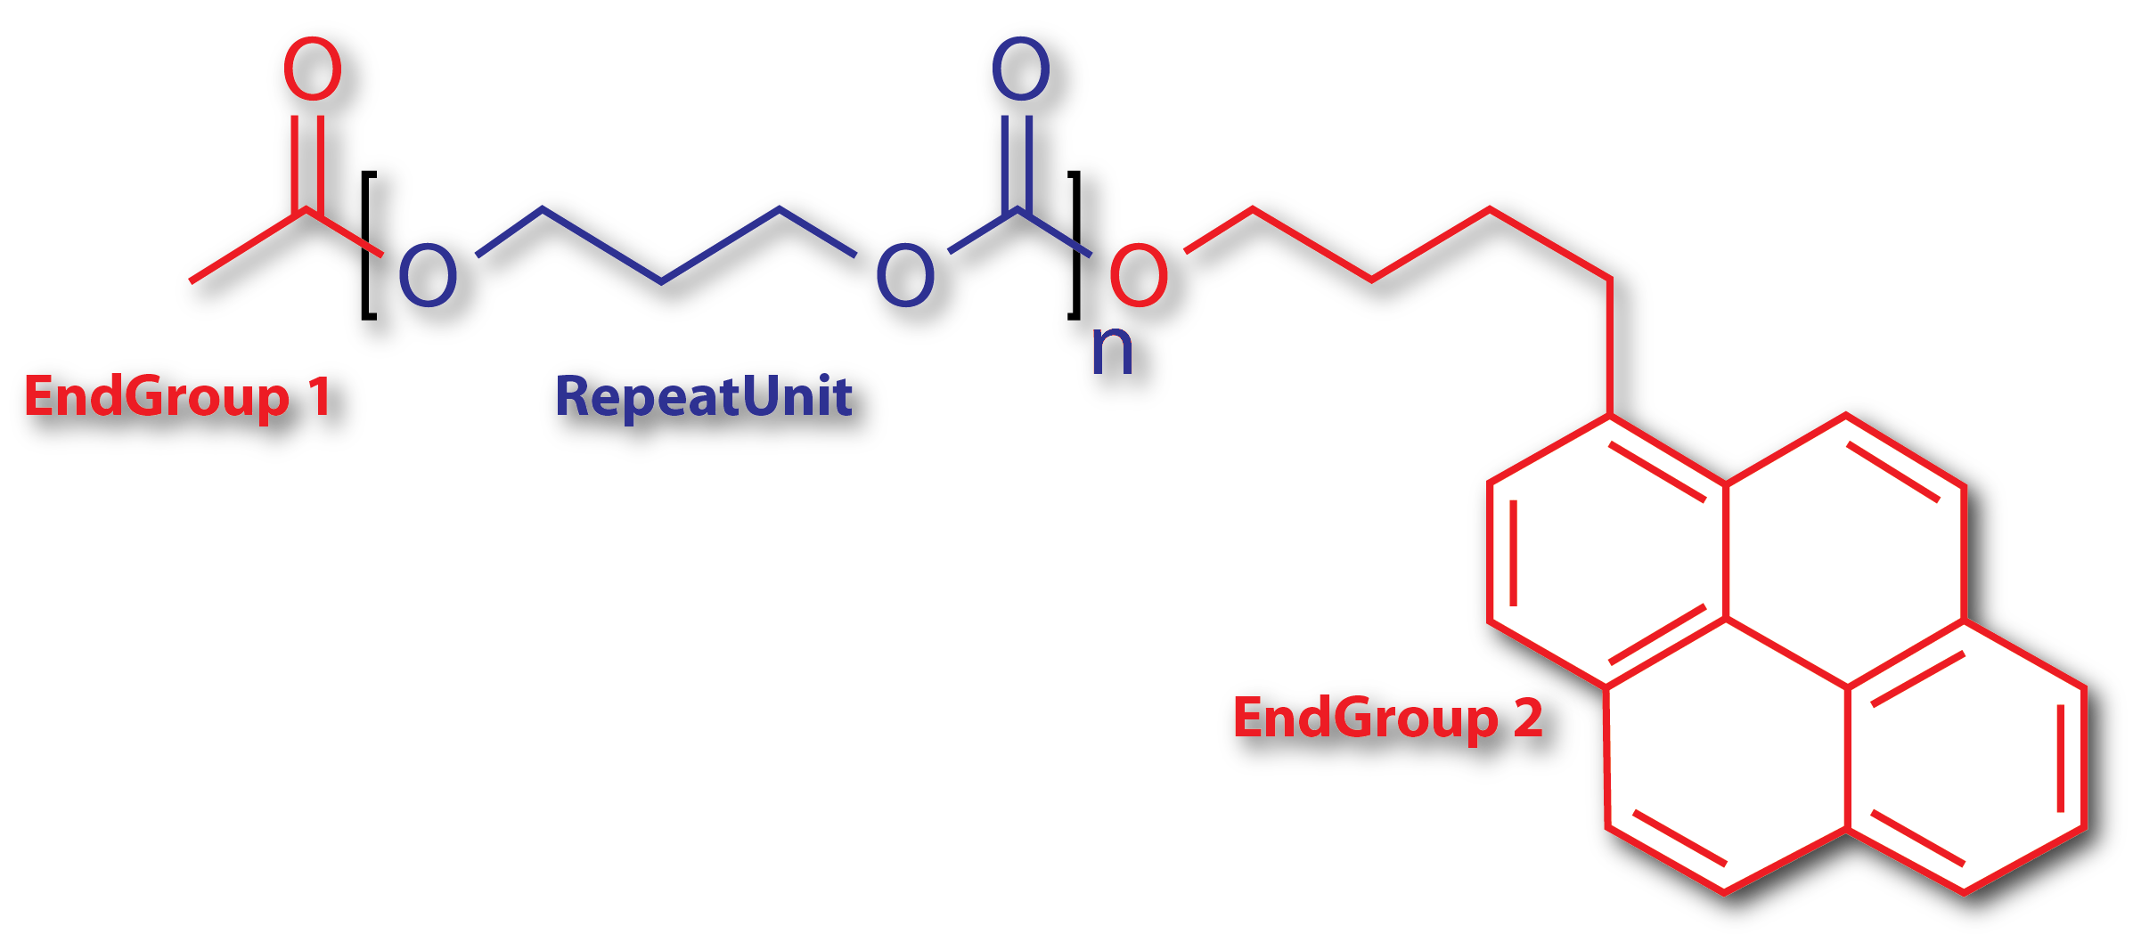
Bracket recognition
and removal
Proposed Extension to SMILES Notation (“X-notation”)
CC(=O)[Po:n]OCCCOC(=O)[Lv:n]OCCCCc1ccc2ccc3cccc4ccc1c2c34
SMILES Utils
EG1: CC(=O)X1
RU: X1OCCCOC(=O)X2, n
EG2: X2OCCCCc1ccc2ccc3cccc4ccc1c2c34
Notes:
PN2S: uses * for bracket (* is wildcard supported by standard SMILES) and forgets about anything else

Slide 5
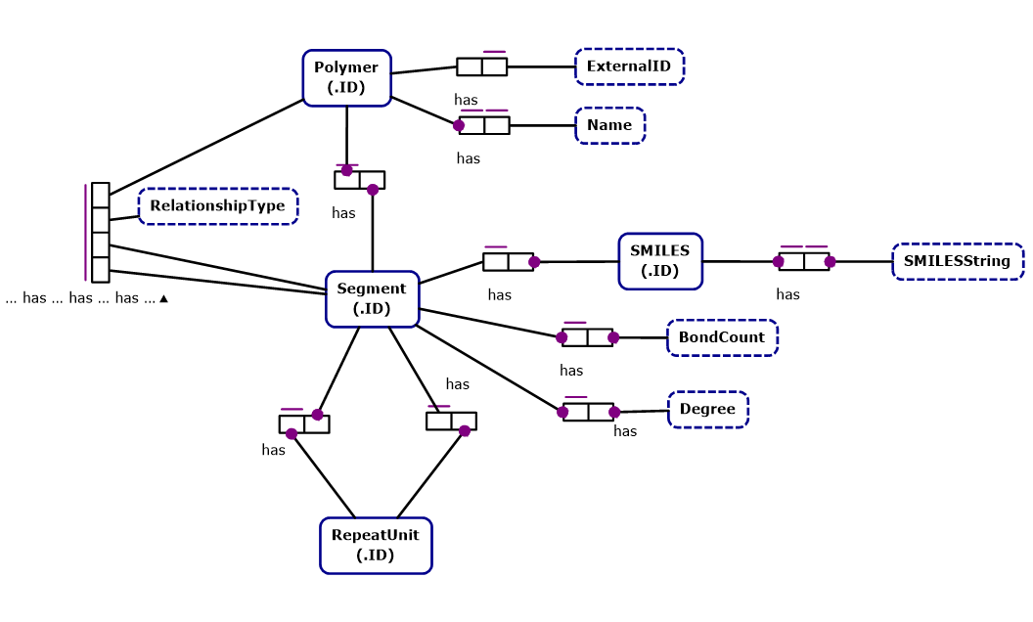
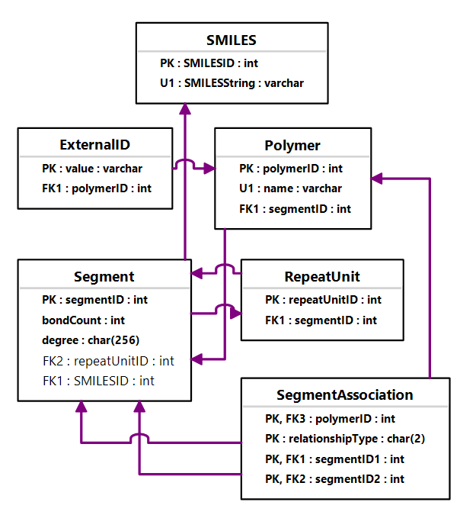
The Polymer Datamodel : Need to store polymer data
Datamodel must support complex chemical relationships and constraints while providing the ability to query the data.
object role model (ORM)
entity relationship model (ERM)
tools to create an ORM from a textual description
tools to create database tables from an ORM
tools to create database access layer (i.e. code) with constraints from an ORM
Notes:
Both data modeling existed since the 1970s
ERMs are hard to define, need to be “normalized” (error-prone, manual)

Slide 6
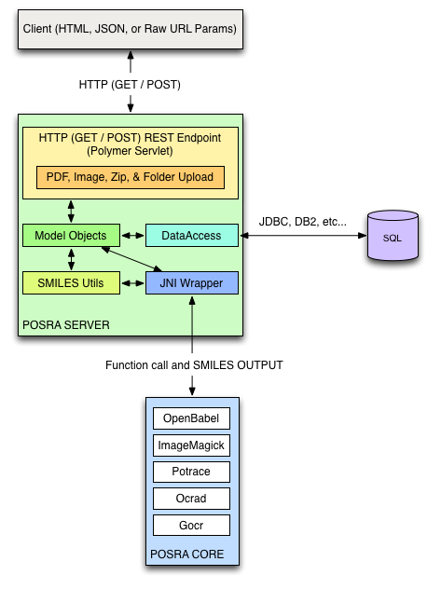
The POSRA Architecture –
how the bits will fit together
Still waiting for glue code from UCSC
UCSC: too hard
System call and SMILES OUTPUT
Notes:
Both data modeling existed since the 1970s
ERMs are hard to define, need to be “normalized” (error-prone, manual)

Slide 7

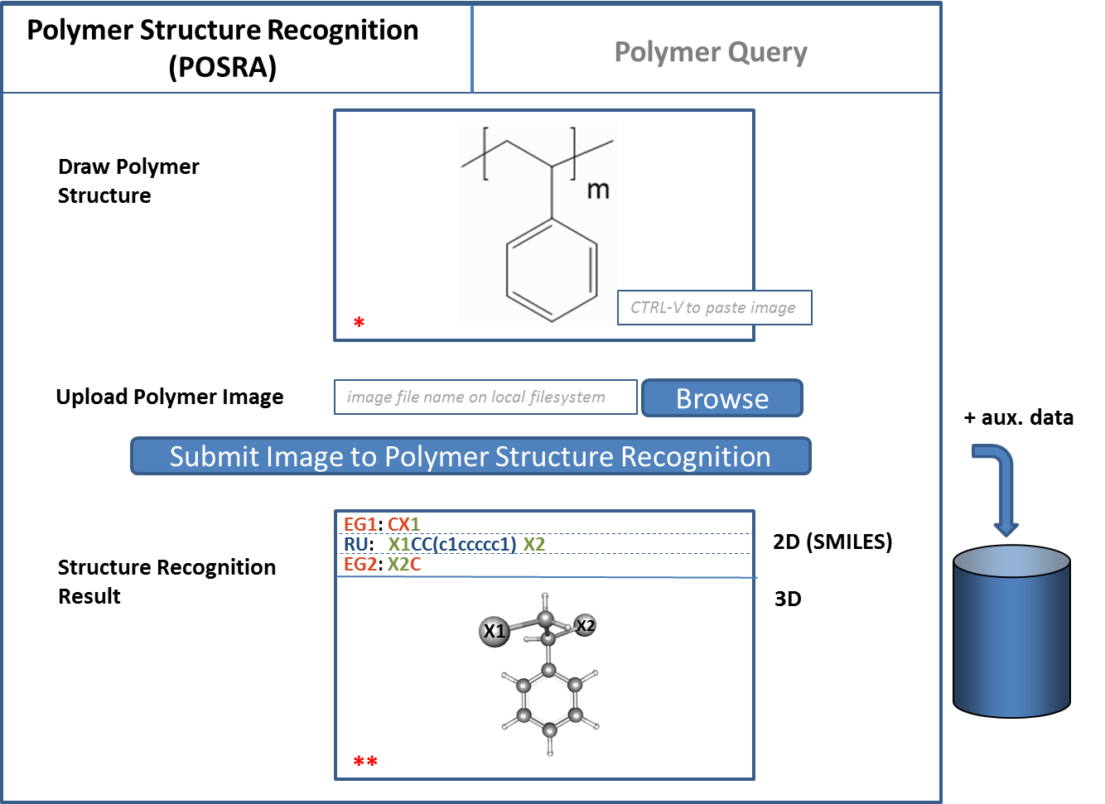
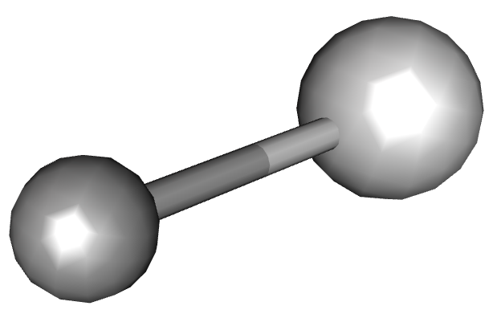
Focus during the upcoming months
Fix bugs in osra software
can’t handle “small” molecules, e.g. EG
can’t handle PDFs
can’t handle transparent images
can’t handle angled multiple bonds
“Magic Wand”
scaling / parallelize
vertically aligned brackets
improve general recognition accuracy
…
Create web client (HTML,CSS,JavaScript) using open source libs
X1
X2
e.g.
JSME
JSMol
*
**
Notes:
Both data modeling existed since the 1970s
ERMs are hard to define, need to be “normalized” (error-prone, manual)

