Slide 1



IBM Polymer Discovery
Thomas Goddard, Konstantin Litovskiy,
Nathan Nichols-roy, Matthew Reed,
Igor Shvartser, Nicholas Smith, And David Zeppa,
University Of California, Santa Cruz
Santa Cruz, CA
With Linda Werner, Ph.D.,
University Of California, Santa Cruz, Ca, 95064
Julia E. Rice, Ph.D., Hans W. Horn, Ph.D.,
and Amanda C. Engler, Ph.D.,
IBM Almaden Research Center
650 Harry Road
San Jose, CA 95210
Notes:
Thank you everyone for coming to our beautiful campus. We would also like to thank Linda for introducing our project and for mentoring us though this project.
We are presenting today in regards to the IBM Polymer Discovery project. A corporate-sponsored, undergraduate computer science project.

Slide 2
IBM Polymer Discovery
"Someone I spoke with put it this way: in the first 50 years of computer science, we did not need to talk to people in other fields. Since software was so bad and hardware was so slow, it was obvious what to work on. But now that we have made so much progress, we should reach out to other fields because we need new challenges to drive our technology."
- David Patterson, Professor of Computer Science at
UC Berkeley and a pioneer in the area of RISC computers
Notes:
We’d like to begin by reading you a quote by David Patterson, a Professor of Computer Science at UC Berkeley and a pioneer in a core technology used in ARM processors.
"Someone I spoke with put it this way: in the first 50 years of computer science, we did not need to talk to people in other fields. Since software was so bad and hardware was so slow, it was obvious what to work on. But now that we have made so much progress, we should reach out to other fields because we need new challenges to drive our technology."

Slide 3
IBM Polymer Discovery
Why Polymer Discovery
Need To Recognize Polymer Images
Current Tools Do not Support Polymers
No Method for storing digitally
Will Shorten Development Cycle
Lead to improvements and innovations
Notes:
Currently, the majority of chemical research is distributed through printed literature.
Researchers have a need to be able to process images in such literature for working with them digitally.
While there are currently tools for processing images of normal molecules, there is no support for the more complex polymers.
There is also a need for storing this information digitally in a manner that would allow for organization and categorization.
<>
Allowing researches to process polymer images, store and query them digitally, shortens the research and development cycle for polymer discovery.
Shortening this cycle will lead to improvements and innovations in countless applications including semi-conductors, nanomaterials, polymeric drug delivery vehicles, and recyclable polymers for green chemistry

Slide 4
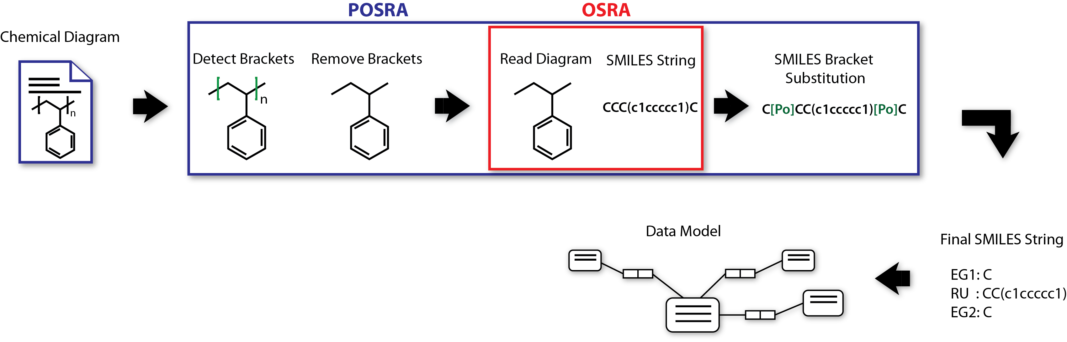
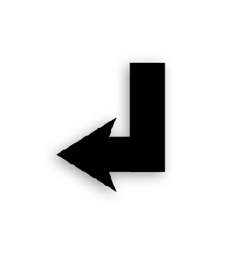
IBM Polymer Discovery
Notes:
We were asked to add functionality to the Optical Structure Recognition Application, also known as OSRA, the open-source image recognition software for processing molecular diagrams.
The project required us to add polymer detection, to allow the research team to digitize polymer diagrams.
We named this Project POSRA, or Polymer – OSRA.
The end goal of this project would involve pre-processing chemical diagrams before passing data to an existing OSRA workflow.
The application then imports the recognized data into a database, enabling researchers in the published literature to locate polymers based on certain attributes.
<>
Corporate-sponsored projects such as this one provide a unique opportunity for students to collaborate with top researchers, engineers, and scientists across a vast array of industries.

Slide 5
IBM Polymer Discovery
The Team
Computer Science and MCD-Biology Students
Research Scientists and Chemists
UCSC Faculty
Notes:
Our team consists of Students from the university of California santa cruz majoring in Computer Science, Computer Engineering, and even Molecular Cell and Developmental Biology.
We worked together with Research Scientists and Chemists from IBM’s Almaden research facility in San Jose.
Our Collaboration was facilitated by Professor Linda Werner.

Slide 6
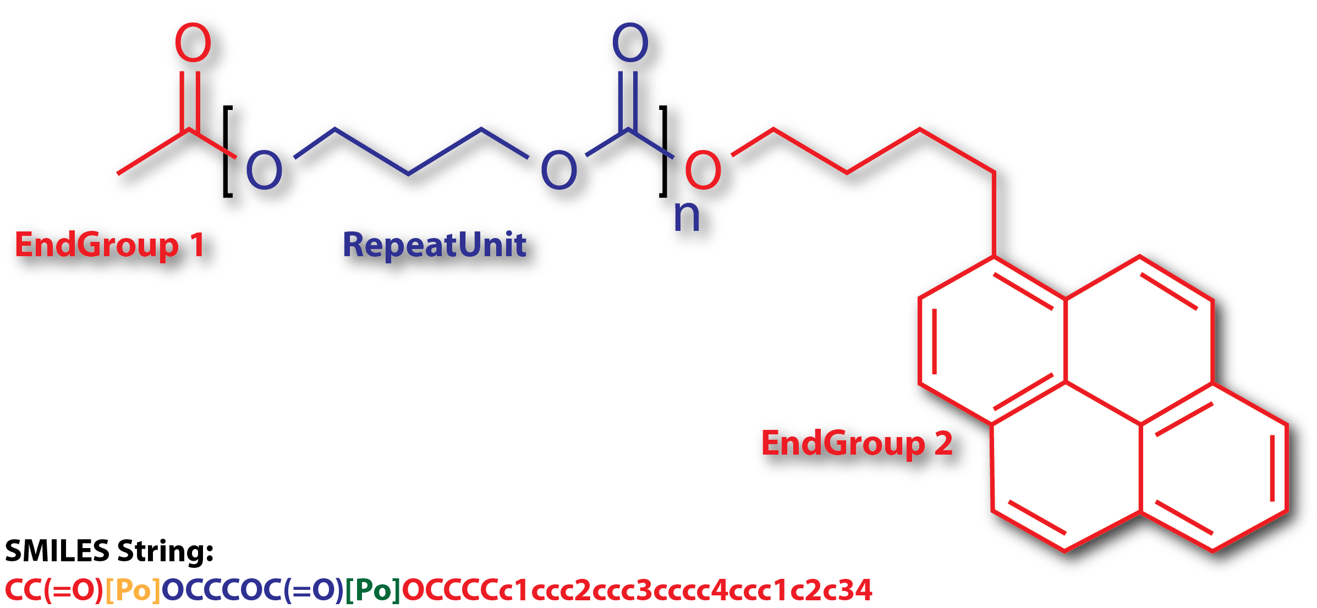
IBM Polymer Discovery
Anatomy of a Polymer
Repeat Unit
End Group
Segments
Degree (“n”)
SMILES (string)
Notes:
What is a Polymer Molecule?
Simply, a polymer molecule is a molecule containing a repeating element, which we refer to as a “repeat Unit”
Here are some other aspects of a Polymer Molecule:
An End Group,
A structural element that is connected to a Repeat Unit and has only a single connecting bond.
A Segment,
A structural element that has at least two connecting bonds, but is not repeated.
Degree
The number of repetitions of the repeat unit in a polymer
And finally, SMILES,
A method for representing a chemical structure as a string.

Slide 7
IBM Polymer Discovery
How to Store Polymer Data
Need a Data Model
Convergence of the two disciplines
Need to handle many complex chemical relationships
Need query capability
Notes:
Now that we know what a polymer is, we can delve into specific aspects of the project.
Creating the data model was a convergence of two disciplines, mixing the theories of computer science with the relationships within chemistry.
This was difficult because the project required support for many complex chemical relationships and constraints while providing the ability to query the data.

Slide 8
IBM Polymer Discovery
How to Store Polymer Data:
Need a Data Model: How does a Computer Scientist Make One
Compile list of requirements
Deconstruct data into smaller pieces
Determine relationships between pieces
Store and treat as objects
Notes:
So the question is this: how does a computer scientist approach the task of creating a data model for polymers?
We chose to apply the standard process for creating a data model to that of a polymer.
<>
The standard process involves the collection of requirements and expectations of the data model.
A computer scientist then looks at the data and deconstructs it into smaller pieces while considering the relationship between each piece, and determines how this information can be stored and accessed.

Slide 9
IBM Polymer Discovery
How to Store Polymer Data:
Need a Data Model: Applying this to Polymers
Compile list of requirements
From IBM Researchers
Deconstruct data into smaller pieces
From chemistry crash-course
Determine relationships between pieces
From the definitions of Repeat Units, End Groups, and Segments
Store and treat as objects
Store everything as a Segment, treat it based on properties
Notes:
The requirements for the data model, provided by the IBM research team, included the ability to store and query polymers, based on properties of individual end groups, repeat units, and segments.
<>
We chose to use the logical separation that already exists in polymers to deconstruct the data where repeat units, end groups, and segments would be considered individual pieces.
<>
The relationships between these were taken from the definitions of each type of piece.
<>
Finally, we decided to store everything as a segment and enforce constraints based on its specific properties.
For example, a repeat unit is a segment with a degree greater than 1 and containing 2 bonds.

Slide 10
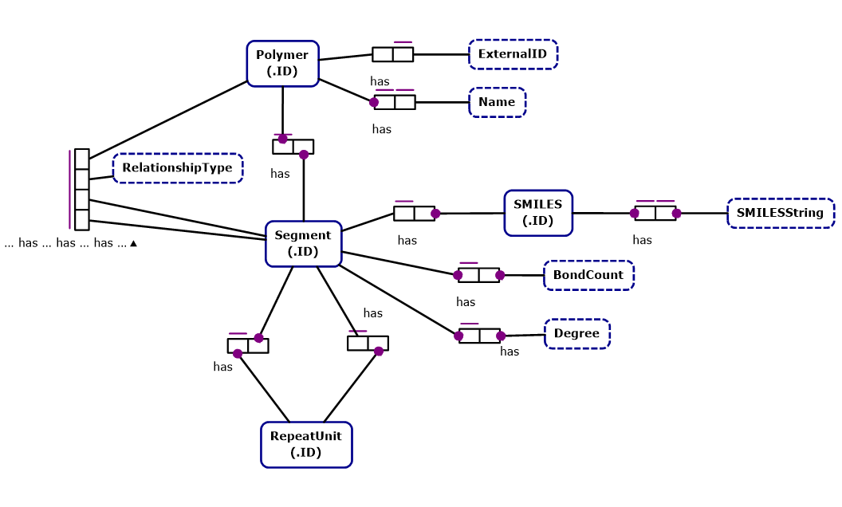
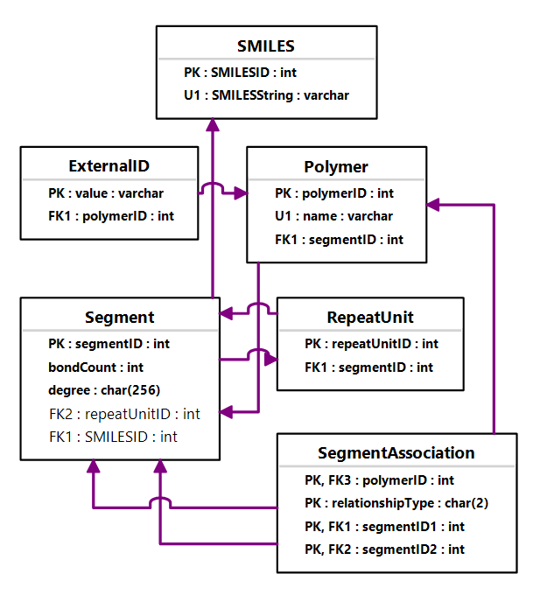
IBM Polymer Discovery
Challenges
Defining the Data Model
Notes:
As you can see, even at an early stage, this is a complex data model.
On the left we have a object role model, and on the right we have an entity relationship model.
[[[Wait 10 seconds]]]

Slide 11
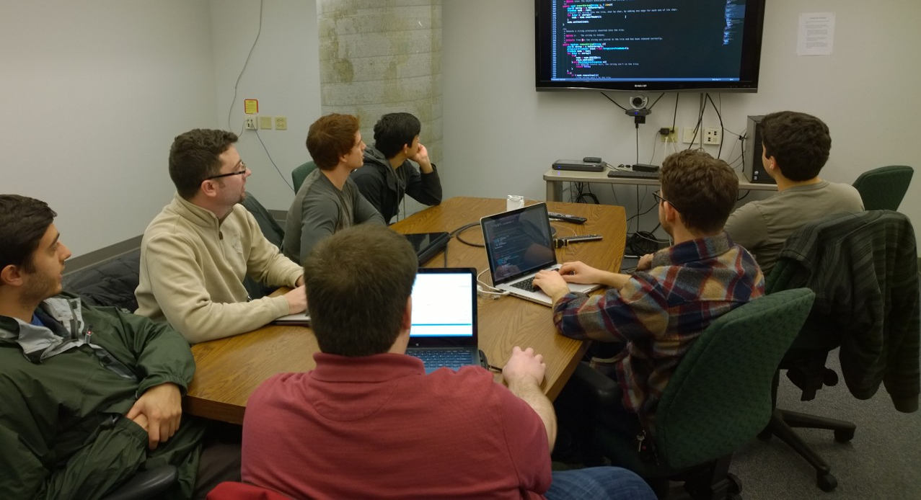
IBM Polymer Discovery
Software Development Techniques
Techniques Presented in Class
Agile Development / Scrum
Mob Programing
<Add Image of Scrum>
Notes:
Our classes at UCSC, provided us with a number of tools and techniques for developing software. One of the Techniques that we learned was agile software development, more specifically the Scrum development process. SCRUM is an agile project management framework focused around incremental releases to software with heavy pre-planning of tasks and work allocation.
A Project Management process, such as scrum, is invaluable in helping organize a team and work involved in a complex project such as POSRA.
Another technique was presented during a talk given in our class by Woody Zuill, an industry leader in collaborative software development.
He introduced the concept of mob programming to us, which consisted of an entire team working at one computer on one overhead screen, rotating about every 30 minutes.
Allowing everyone to be in the same room at once really helped with communication and brainstorming, enabling us to use our time together more efficiently.
Here is a picture of us during one of our mob-programming sessions.

Slide 12

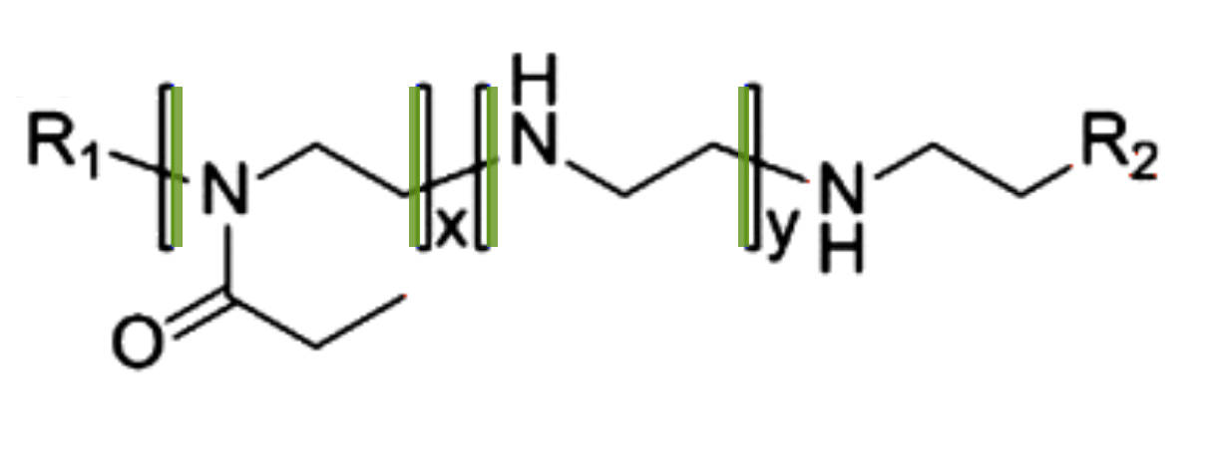
IBM Polymer Discovery
Preliminary Results
Notes:
Since January we’ve had a great experience with the process.
We’ve made progress with detecting various features in images of polymers including PNG, JPEG, and GIF, and now have the ability to detect parentheses and brackets.
The green lines represent these detected brackets.
<>
One of the main technical challenges is in detecting brackets in various chemical diagrams, which are at times coupled with complex elements like repeat units, and intersected by lines representing bonds.

Slide 13

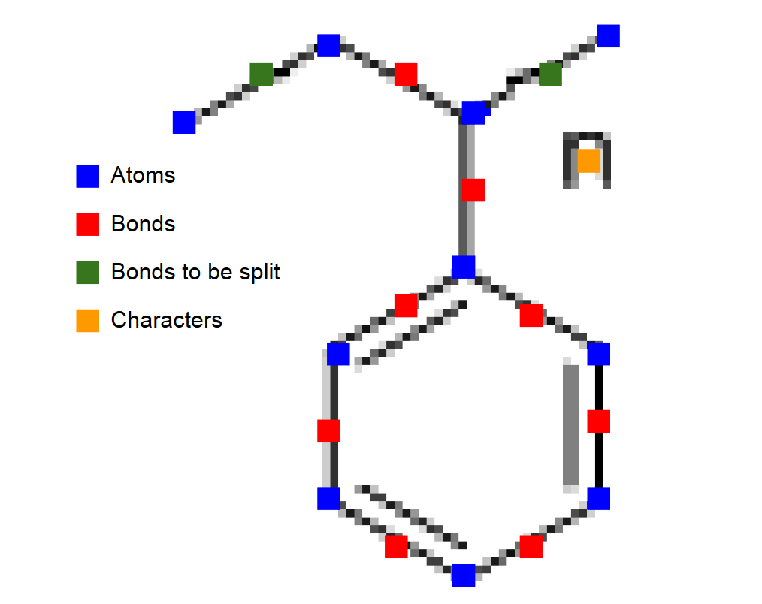
IBM Polymer Discovery
Preliminary Results
Initial Diagram
Diagram Ready for SMILES Conversion
Notes:
As of now, we’re able to process polymers, which includes detecting, removing, and marking the locations of parentheses and brackets -- resulting in an image that’s ready to be processed by OSRA.
[[ Wait 5 Seconds ]]

Slide 14
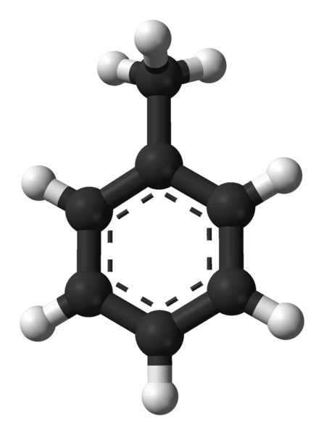
IBM Polymer Discovery
Future
Output 3D coordinates
Notes:
In our next steps, we hope to include capability to generate coordinates which then can be used to render 3D models such as the one you see here, but for polymers.
<>
We believe our work here will contribute to the scientific community, and play a very important role in making the polymer discovery process much faster and cheaper.

Slide 15
IBM Polymer Discovery
Acknowledgments
Igor Filippov, creator of OSRA
Funding Sources
IBM
Professor Pat Mantey, Ph.D, UCSC Director of Corporate Sponsored Projects
Adrienne Harrell, UCSC Director of Undergraduate Student Affairs
Notes:
We would like to thank Igor Filippov, the creator of OSRA, for taking time to speak with us and providing valuable information on OSRA and its processes.
Finally we would like to thank IBM, Professor Pat Mantey, and Adrienne (AW-DREE-EN) Harrel of UCSC, for providing us with funds to be able travel here to present to you today.
On the behalf of the University of California Santa Cruz,
Thank you!

