Slide 1


Polymer Discovery Senior Design Project May 29, 2014
Team Members:
Thomas Goddard
Konstantin Litovskiy
Nathan Nichols-Roy
Matthew Reed
Igor Shvartser
Nicholas Smith
David Zeppa
Notes:
Thank you everyone for taking the time to visit us today. We’ve been working closely with IBM to develop software to help Polymer Discovery.

Slide 2
"Someone I spoke with put it this way: in the first 50 years of computer science, we did not need to talk to people in other fields. Since software was so bad and hardware was so slow, it was obvious what to work on. But now that we have made so much progress, we should reach out to other fields because we need new challenges to drive our technology."
- David Patterson, Professor of Computer Science at
UC Berkeley and a pioneer in the area of RISC computers
Notes:
We’d like to begin by reading you a quote by David Patterson, a Professor of Computer Science at UC Berkeley and a pioneer in a core technology used in ARM processors.
"Someone I spoke with put it this way: in the first 50 years of computer science, we did not need to talk to people in other fields. Since software was so bad and hardware was so slow, it was obvious what to work on. But now that we have made so much progress, we should reach out to other fields because we need new challenges to drive our technology."

Slide 3
Why Polymer Discovery
Needs to recognize polymer images
Lacks tools that support polymers
No method for storing polymer data digitally
Shortens development cycle
Leads to improvements and innovations
Notes:
Our opportunity to reach out to other fields comes with polymer discovery.
Currently, chemical research is spread out over 130 scientific journals in multiple formats. This means the scientific community generates thousands of issues per year with numerous images of polymers that aren’t yet processed digitally.
*Pause*
Allowing researchers to digitally store and query polymeric images, shortens the research and development cycle for polymer discovery.
Shortening this cycle will lead to improvements and innovations in countless applications including semi-conductors, nanomaterials, polymeric drug delivery vehicles, and recyclable polymers for green technologies.
While there are tools for processing images of simple molecules, there is currently no support for the more complex polymers.
Furthermore there is a need for storing this information digitally in a manner that would allow for greater categorization and organization.

Slide 4
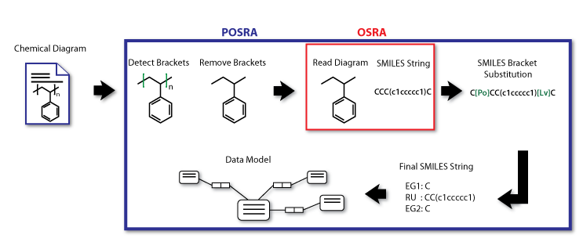
Project Goals
Notes:
We were asked to add functionality to the Optical Structure Recognition Application, also known as OSRA, as seen above outlined in Red, OSRA is an open-source image recognition software for processing molecular diagrams.
The project required us to add polymer detection, to allow the research team to digitize polymer diagrams.
You can see our portion of the project outlined in blue. We named it POSRA, or Polymer – OSRA.
The end goal of this project would involve pre-processing chemical diagrams before passing data to an existing OSRA workflow.
The application then imports the recognized data into a database, enabling researchers using the published literature to locate polymers based on certain attributes.

Slide 5
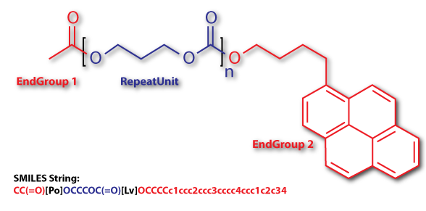
Anatomy of a Polymer
Repeat Unit
End Group
Segments
Degree (“n”)
SMILES (string)
Notes:
Before we dive too deeply into our work, we’d like to make sure we’re on the same page when we talk about a polymer molecule because we’ll be using these terms later in our description of the computer science structures we built for this project.
Simply, a polymer molecule is a molecule containing a repeating element, which we refer to as a “repeat Unit”
Here are some other aspects of a Polymer Molecule:
An End Group,
A structural element that is connected to a Repeat Unit and has only a single connecting bond.
Then a Segment,
A structural element that has at least two connecting bonds, but is not repeated.
A degree
The number of repetitions of the repeat unit in a polymer
And finally, SMILES,
A method for representing a chemical structure as a string.

Slide 6
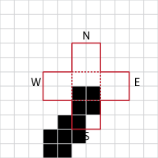
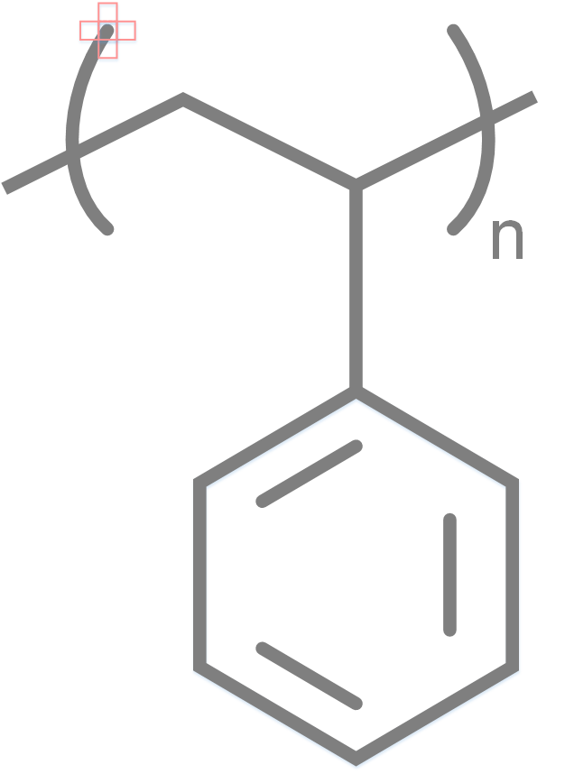
Process
Notes:
For curved and square bracket detection, we designed an algorithm that uses a crosshair to read through pixels on the diagram. Once we find a specific pattern on the crosshair, we know a bracket exists in that area.

Slide 7
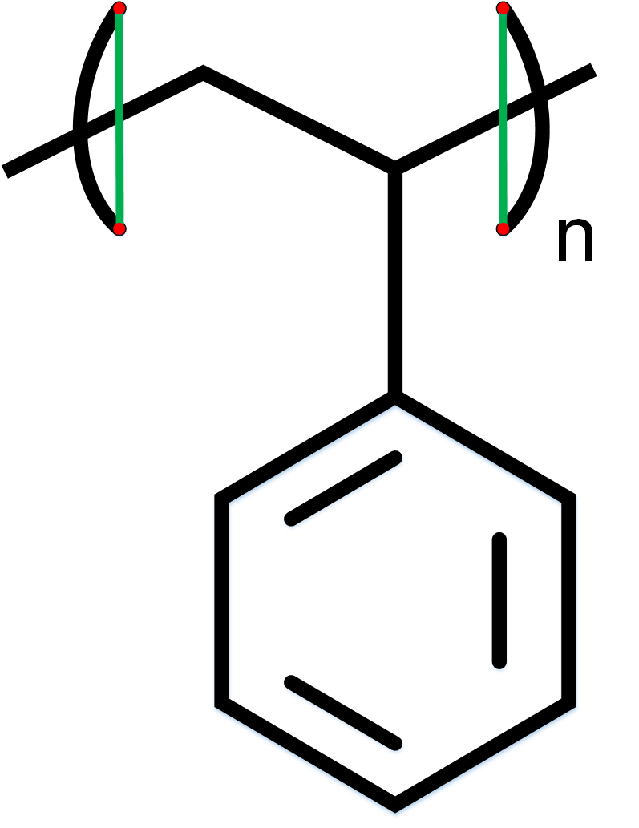
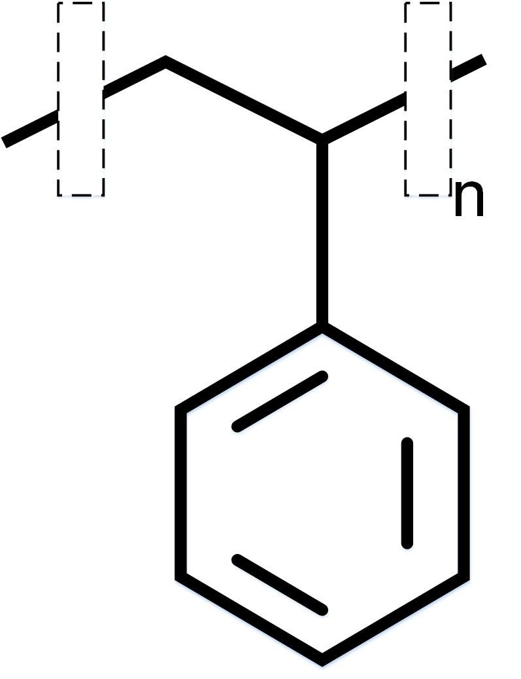
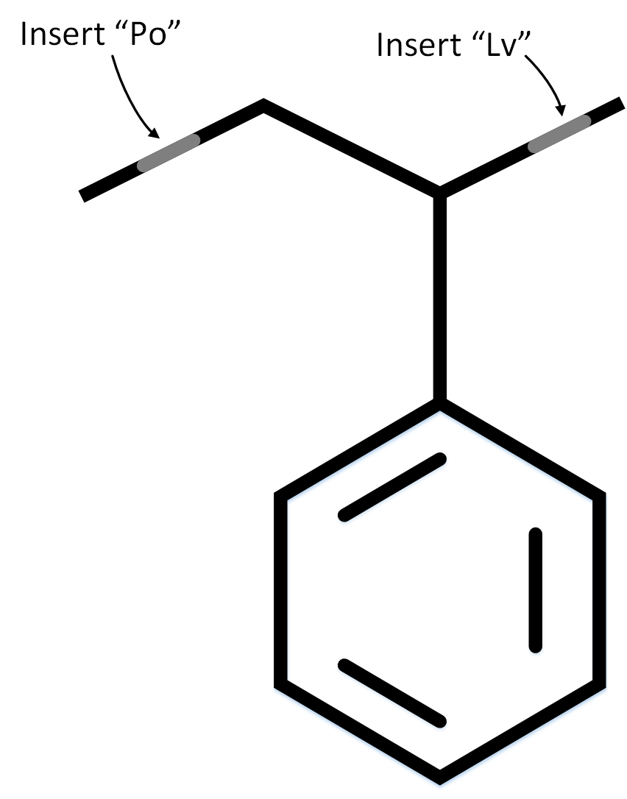
Process
Notes:
POSRA then continues by marking the areas where brackets exist. You can see these here as two green vertical lines. Next, these brackets are removed, and are replaced by element placeholders, Polonium and Livermorium, two synthetic elements that never occur in polymers. The presence of these elements alert POSRA that brackets occur in these position, and help us identify brackets in the resulting SMILES string.

Slide 8
How to Store Polymer Data
Need a Data Model
Convergence of the two disciplines
Handle complex chemical relationships
Query capability
Notes:
Creating the data model was a convergence of two disciplines, mixing theories of computer science with relationships within chemistry.
The data model required support for complex chemical relationships and constraints while providing the ability to query the data.

Slide 9
How to Store Polymer Data
Need a Data Model
Compile list of requirements
Deconstruct data into smaller pieces
Determine relationships between pieces
Store and treat as objects
From IBM Researchers
From chemistry crash-course
From the definitions of Repeat Units, End Groups, and Segments
Store everything as a Segment, treat it based on properties
Notes:
The standard process for creating a data model, involves the collection of requirements and expectations of the data model.
<Press>
These requirements were provided by the IBM research team, including the ability to store and query polymers based on properties of individual end groups, repeat units, and segments.
--
A computer scientist then looks at the data and deconstructs it into smaller pieces while considering the relationships between each piece.
<Press>
We used the logical separation that exists in polymers to deconstruct the data where repeat units, end groups, and segments would be considered individual pieces.
<Press>
The relationships between these were taken from the definitions of each type of piece.
--
Finally, a determination, on how this information can be stored and accessed, needs to be made.
<Press>
We chose to store everything as segments, and enforce constraints based on the polymer’s specific properties. For example a Repeat Unit can be stored as a segment with 2 bonds and a degree greater than one.

Slide 10
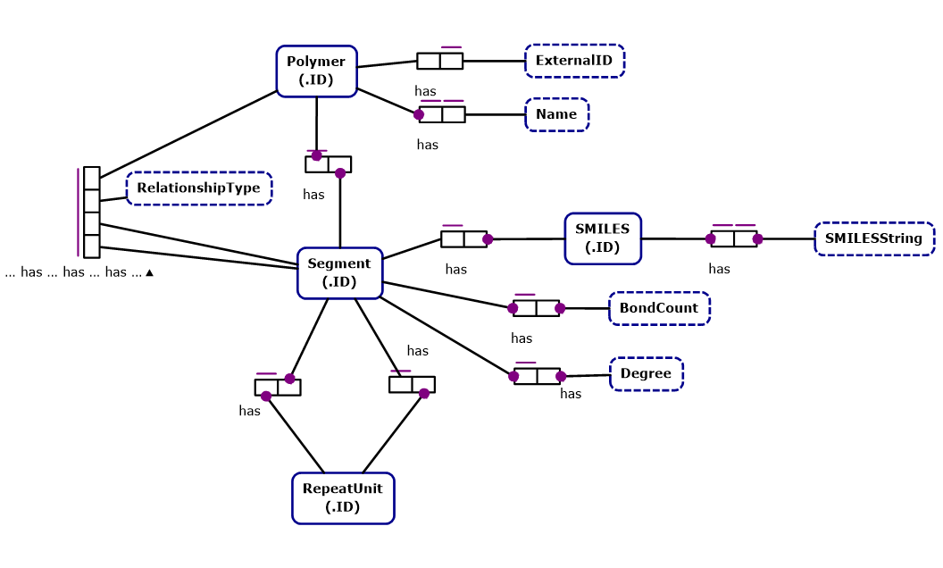
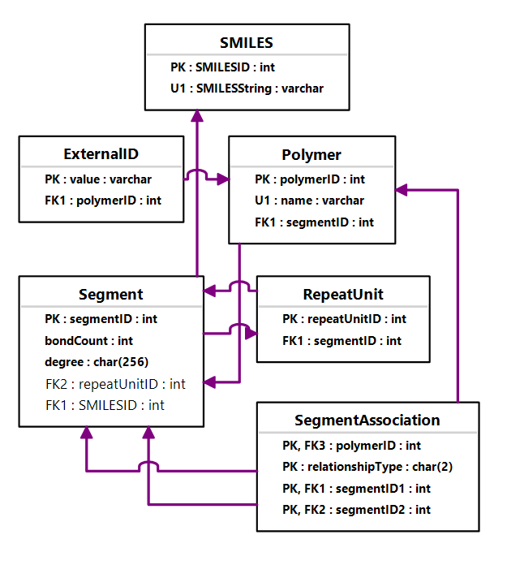
How to Store Polymer Data
Need a Data Model
Notes:
Here’s our data model, represented as an object role model as seen on the left, and as an entity relationship model as seen on the right.

Slide 11

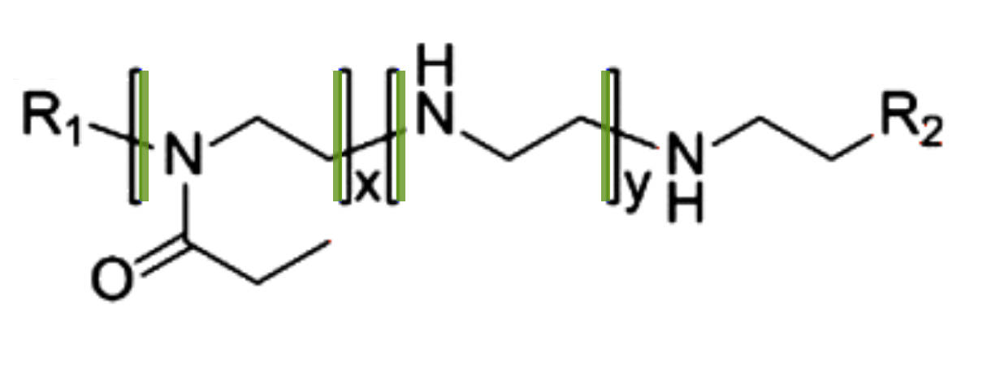
Results
Notes:
We’ve made progress with detecting various features in images of polymers in various file formats like PNG, JPEG, and GIF, and now have the ability to detect square and curved brackets.
The green lines you see here represent these detected brackets.
<>
One of the main technical challenges for our project is detecting brackets in various chemical diagrams, which are at times coupled with complex elements like repeat units, and intersected by lines representing bonds.

Slide 12

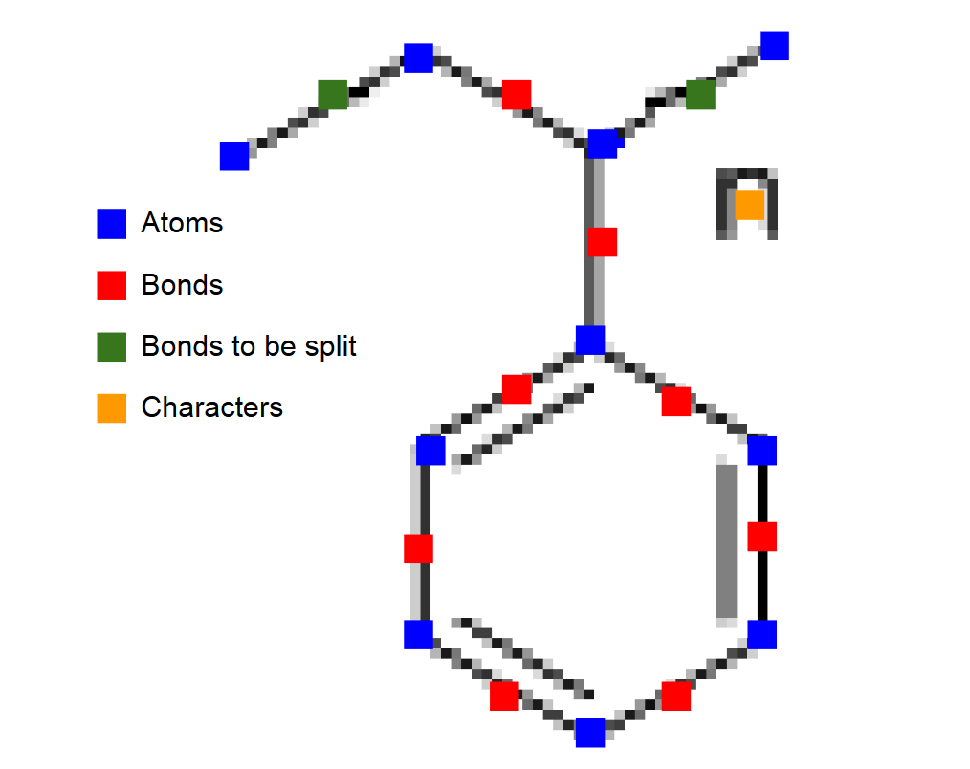
Results
Initial Diagram
Diagram Ready for SMILES Conversion
Notes:
As of now, we’re able to process polymers, which includes detecting, removing, and marking the locations of brackets -- resulting in an image that’s ready to be processed by OSRA.
We are also able to detect the orientation of brackets so that we can pair them with their repeat units. Also, we can associate repeat units to a degree, specifying the number of times that a repeat unit occurs.
[[ Wait 5 Seconds ]]

Slide 13
Thank you
Dr. Igor Filippov, creator of OSRA
Drs. Julia E. Rice, Hans W. Horn, Amanda C. Engler, Jed W. Pitera, IBM Researchers
Dr. Linda Werner, Professor of Computer Science, UC Santa Cruz
Notes:
Just to close, we’d like to thank Igor Filippov, the creator of OSRA, for taking time to help us understand OSRA, and a special thanks to Drs. Julia Rice, Hans Horn, Amanda Engler, and Jed Pitera of IBM for working closely with us throughout our project.
Finally we’d like to thank Professor Werner for all of her care and support.
Thank you!

Slide 14
Contact
Thomas Goddard - tgoddard@ucsc.edu
Konstantin Litovskiy - klitovsk@ucsc.edu
Nathan Nichols-Roy - nmnichol@ucsc.edu
Matthew Reed - mbreed@ucsc.edu
Igor Shvartser - ishvarts@ucsc.edu
Nicholas Smith - nihasmit@ucsc.edu
David Zeppa - dzeppa@ucsc.edu

