Slide 1
POSRA

Slide 2
Code Insertion
osra_process_image()
Image Processing (Cleaning, resizing, deskewing, etc.);
POTRACE Vectorization;
Atom, bond, and label detection;
Finalized structure passed off to OpenBabel;

Slide 3
Code Insertion
osra_process_image()
Image Processing (Cleaning, resizing, deskewing, etc.);
Endpoint Detection (Find bracket locations);
Image Alteration (Remove brackets from the image);
POTRACE Vectorization;
Atom, bond, and label detection;
Splice molecule (Mark bonds to be cut);
Finalized structure passed off to OpenBabel;
Substitute Atoms (Po);

Slide 4
Code Insertion
struct bond
References to the Atoms it connects;
Type (Single, Double, Triple);
Booleans (exists, hash, wedge, up, down,
Small, arom, split, conjoined);

Slide 5
Endpoint Detection

Slide 6
N
W
E
S

Slide 7


Slide 8
N
W
E
S

Slide 9

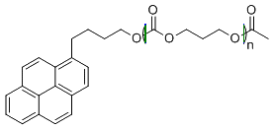

Slide 10



Slide 11

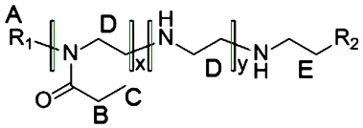

Slide 12
What Works
Round and square vertical bracket detection in simple diagrams.

Slide 13
What doesn’t work
Non-vertical bracket detection
Successful detection in complex diagrams
Endpoint detection algorithm has room for improvement.

Slide 14
Image Alteration

Slide 15
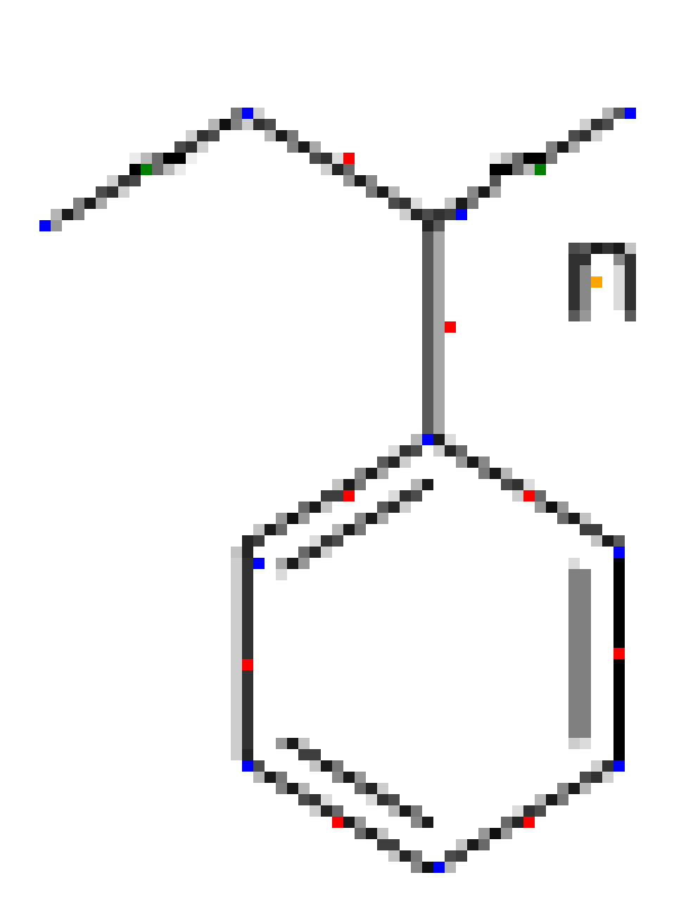
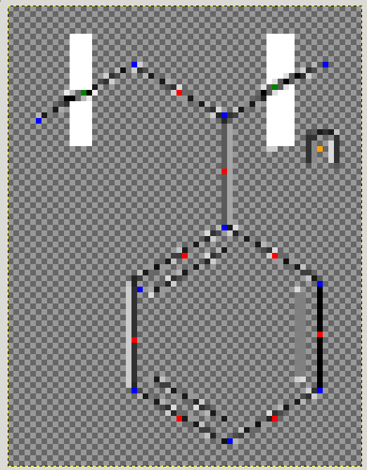

Slide 16
What Works
Draws boxes and fills in bond lines
Determines orientation of the bracket (Left facing or right facing)
Vertical, round and square, brackets

Slide 17
What didn’t work
Editing POTRACE paths (POTRACE internally relies on the fact that a path remains intact, caused segfault)
Flagging an atom as nonexistent (Though possible, there are too many places for code insertion)

Slide 18
What doesn’t work
Horizontal Brackets
Multiple / Nested Brackets

Slide 19
Splice Molecule

Slide 20
Atoms
Bonds
Bonds to be split
Characters

Slide 21
Atoms
Bonds
Bonds to be split
Characters

Slide 22
What Works
Vertical brackets
Finds the intersection between the bracket and the bond
Simple algorithm for intersection between two line segments

Slide 23
Atom Substitution

Slide 24
Before Substitution
Atoms
Bonds
Bonds to be split
Characters

Slide 25
After Substitution
Atoms
Polonium
Bonds
Bonds to be split
Characters
Substitution

Slide 26
What works
Substituting one extra atom and one extra bond (Currently only with Po)
Polystyrene, PolyMethylmethacrylate
Only one set of brackets, (EG [RU] EG)

Slide 27
What didn’t work
Substituting two Fluorines at a split proved to be more difficult than substituting a single atom, which also guarantees structure connectedness
Some SMILE strings end prematurely after substitution (PolyBLA, PolyTMC)

Slide 28
Current Sample Input / Output
$ ./src/osra test/PolyStyrene.gif EG: C RU: C(c1ccccc1)C EG: C C[Po]C(c1ccccc1)C[Po]C

Slide 29
Current Sample Input / Output
$ ./src/osra test/PolyMethylmethacrylateSQ.gif EG: C RU: CC(C(=O)OC)( EG: )C C[Po]CC(C(=O)OC)([Po])C *

Slide 30
Test Harness

Slide 31
Testing
4 sets of testing diagrams
Basic, Parenthesis, Horizontal, Nested
A single text file in each of these diagram folders lists the filename and their respective smiles string
Ability to test large batches of diagrams to ensure OSRA is working correctly

Slide 32
Problems
Correctness of Smiles strings

Slide 33
Data Model

Slide 34
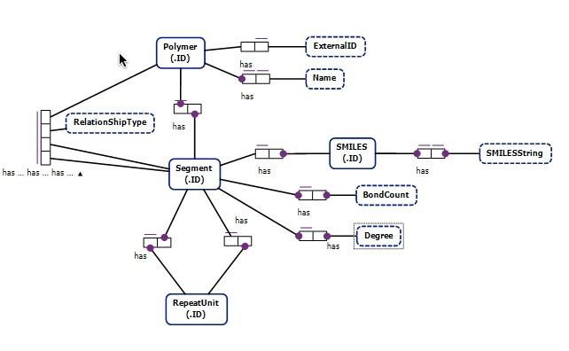
Object Relational Model

Slide 35
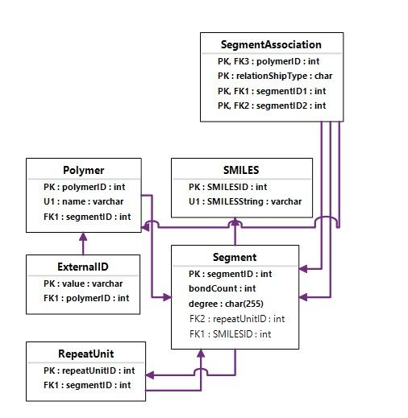
Entity Relationship Model

Slide 36
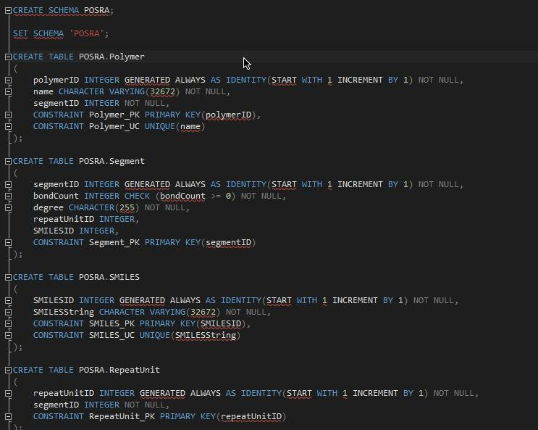
IBM DB2 SQL create statements (Also have mySQL scripts)

Slide 37
Next Steps
Repeat Identifier Association
Horizontal Brackets
Multiple / Nested Brackets (For all steps)
Data Model Implementation
Edge Cases

