Slide 1
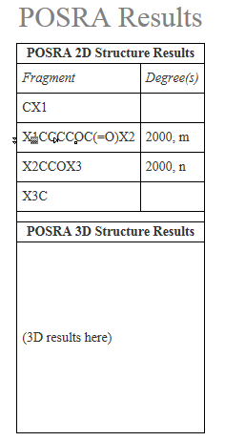

POSRA 2D Structure Results
Name Fragment Degree
CX1
RU1 X1CCCOC(=O)X2 m
RU2 X2CCOX3 n
RU3 RU1-RU2 2000
X3C

