Slide 1
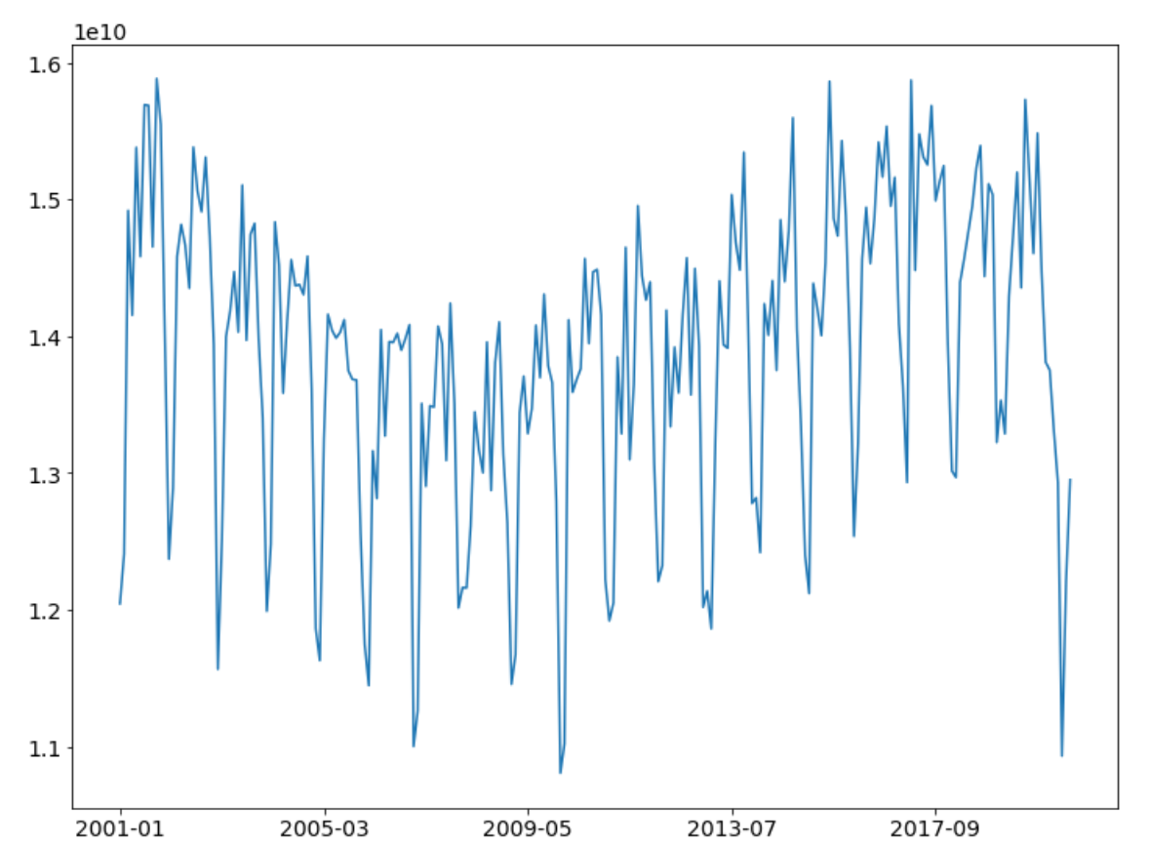
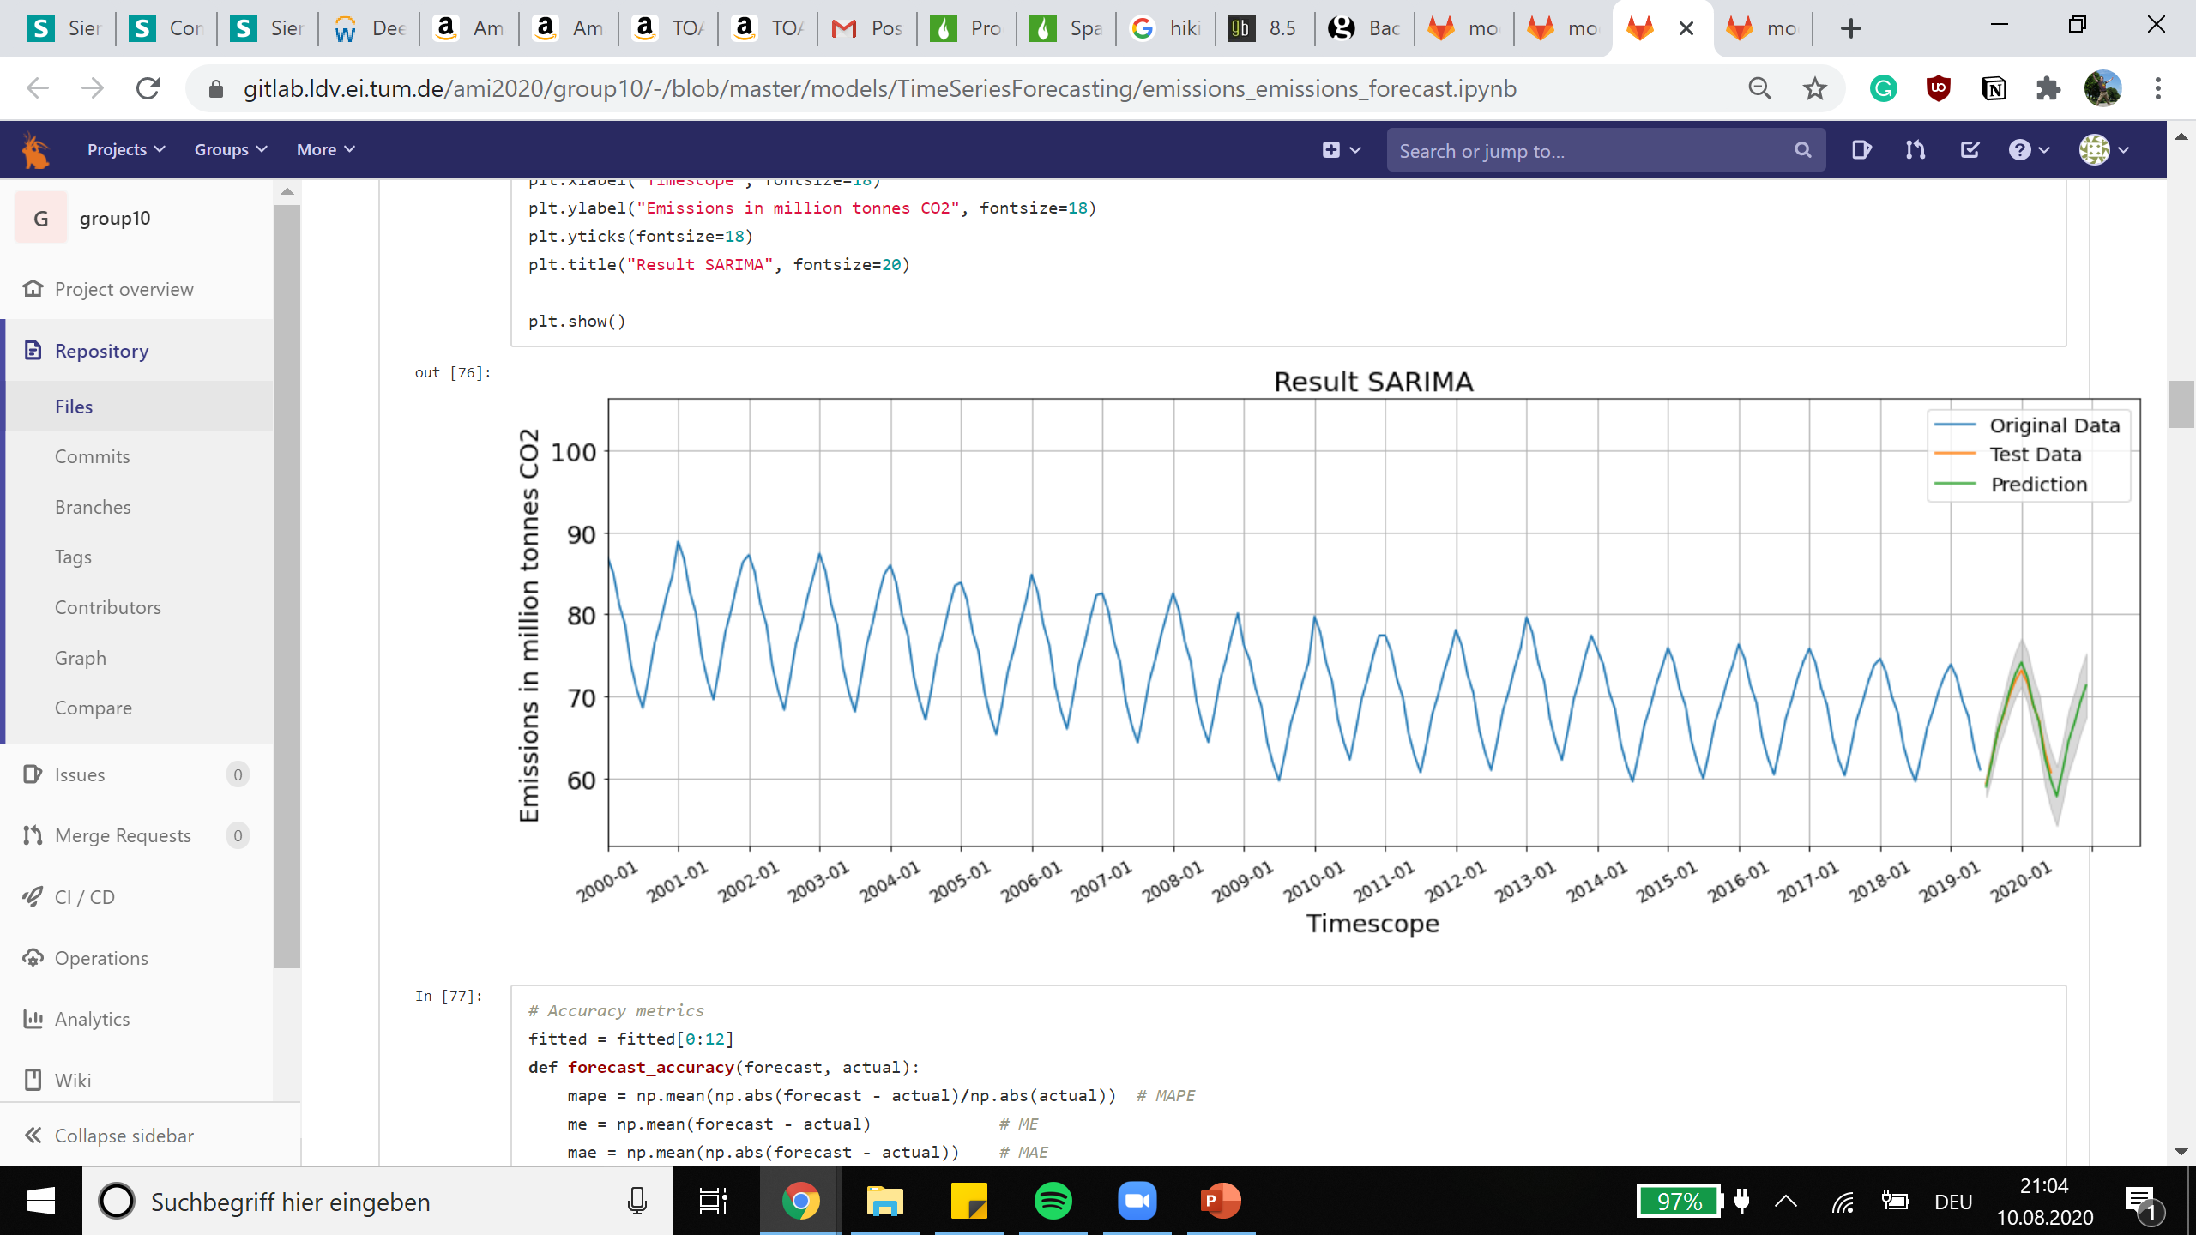




Data
Prediction
Model 1
Model 2
Boundary
06.2019 12.2019 06.2020 12.2020
Estimated amount of emission saving in Mio. Tons CO2: 13,57
Prediction for the CO Emissions until the end 2020 in Mio. tons of CO2.
Parameter settings for lower bound:
Second wave
Max number of infection
R-Value
Off On
Update

Slide 2
Data
Prediction
Model 1
Model 2
Boundary
06.2019 12.2019 06.2020 12.2020
Estimated amount of emission saving in Mio. Tons CO2: 13,57
Prediction for the CO Emissions until the end 2020 in Mio. tons of CO2.
Select Prediction Sector:
Mobility
Energy
Economy
All
Update

Slide 3
Data
Prediction
DAX Data
MAX Data
Mobility Data
Transportation cars Data
Transportation flight Data
Hours of sun light Data
CO2 Emission in million of tons. Describes the total emission of Germany measured in CO2.
http://www.mysamplesource.de/co2emissions
2011|2012|2013|2014|2015|2016|2017|2018|2019|2020
CO2
DAX
MDAX
Mobility
Flight

Slide 4
Data
Prediction
DAX Data
CO2 Emission in million of tons. Describes the total emission of Germany measured in CO2.
http://www.mysamplesource.de/co2emissions
2011|2012|2013|2014|2015|2016|2017|2018|2019|2020
CO2
DAX
MDAX
Mobility
Flight

Slide 5
Data
Prediction
Model 1
Model 2
Lower Bound
06.2019 12.2019 06.2020 12.2020
Estimated amount of emission saving in Mio. Tons CO2: 13,57
Prediction for the CO Emissions until the end 2020 in Mio. tons of CO2.
Parameter settings for lower bound:
Second wave
Max number of infection
R-Value
Off On
Update

Slide 6
Data
Prediction
CO2 Emission in million of tons. Describes the total emission of Germany measured in CO2.
http://www.mysamplesource.de/co2emissions
2011|2012|2013|2014|2015|2016|2017|2018|2019|2020
CO2
DAX
MDAX
Mobility
Flight

Slide 7
Data
Prediction
Prediction for the CO Emissions until the end 2020 in Mio. tons of CO2.
Parameter settings for lower bound:
Second wave
Max number of infection
R-Value
Off On
Update

