Slide 1

Bei 100 Mrd. Clicksteam-Events & Backend-Daten den Überblick wahren? Mit SQL geht’s - Eine Coding-Challenge
ITCS Hamburg 01. Juli 2022
Otto Group data.works
Josefine Kuka – Head of Data Engineering Hannes Ortmeier – Data Engineer
Otto Group data.works GmbH

Slide 2




Otto Group data.works GmbH at a Glance
>40
~20
>300
>25
Colleagues with different backgrounds and expertise
Group companies are our customers
Terrabytes of data stored in our datapool
Digital products and currently running apps

Slide 3
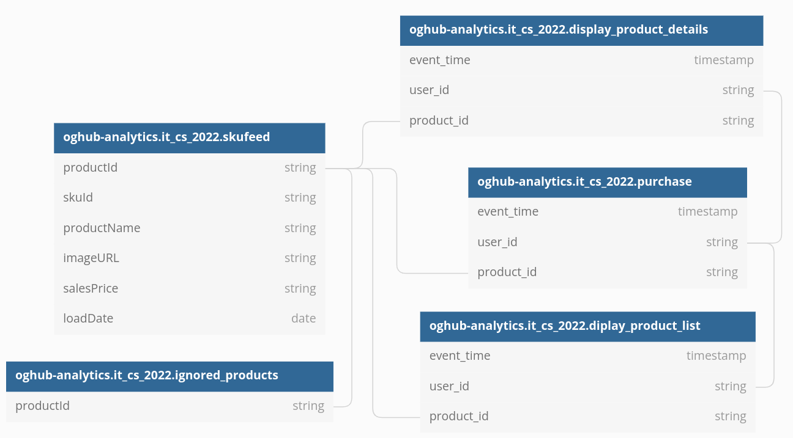
Coding-Challenge Data Tables

Slide 4
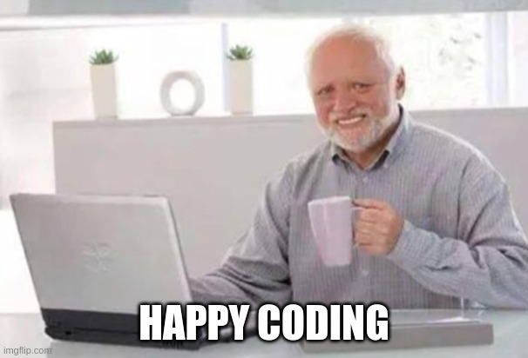
Coding-Challenge Workshop
Three challenges
Count the unique daily views of users for every product in a product listing or product details page for 1st and 2nd of Mai 2021
Calculate the most current state for every stock-keeping-unit (SKU) from the product master data but don't include ignored products for october 2021
Count the weekly purchases of every customer and the purchase count for the four previous weeks
You can find the full challenges and db diagramm under:
https://github.com/hannesortmeier/og_it_cs_2022

Slide 5
Thank you!

