Slide 1
Machine learning for economists

Slide 2
ME!
Hannes Rosenbusch
Social Psychology
PhD project on data science methods for psychology

Slide 3
Agenda
What is machine learning?
Important concepts
Classic prediction models
Coding

Slide 4
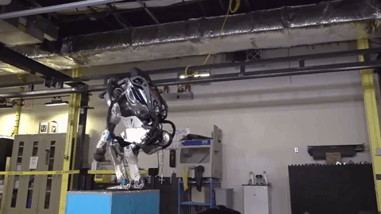
Machine learning is…

Slide 5
Actually it is this…
y = m * x + b
Prediction models (supervised machine learning)
Pattern recognition (unsupervised)

Slide 6
What is the difference to my work?
Social Scientists
y = m * x + b
p(m) < 0.05
“My theory is true!”
Notes:
Go through first time → explain difference in workflow
Second time → similarities (models) and differences (inference vs prediction accuracy)

Slide 7
What is the difference to my work?
Social Scientists | Machine learners
y = m * x + b | y = m * x + b
p(m) < 0.05 | R² = 0.9
“My theory is true!” | “This prediction model is useful!”
Slight difference in focus
Notes:
Go through first time → explain difference in workflow
Second time → similarities (models) and differences (inference vs prediction accuracy)

Slide 8
Am I already machine learning?
Machine learning = regression models + focus on prediction?
Kind of, yes.
I thought I can ask for a bigger computer?!?!

Slide 9
Benefits of ML
Remind us what is useful (prediction)
Unbiased quantifications of prediction accuracy
Better, cooler, more accurate prediction models

Slide 10
How to quantify accuracy
We need to quantify accuracy
→ many metrices available

Slide 11
Basic concepts
Accuracy Metrics
-R² -RMSE/MAE -Correlation -Percent accurate -Sensitivity/Specificity -AUC

Slide 12
How to quantify accuracy
We need to quantify accuracy
→ many metrices available
… and make predictions for “new samples”
Fit model on sample A + Evaluate model on sample A → BIAS
Evaluate model on sample B instead

Slide 13
Basic concepts
Accuracy Metrics | Out-Of-Sample Testing
-R² -RMSE/MAE -Correlation -Percent accurate -Sensitivity/Specificity -AUC | -Hold out method -K-fold cross-validation -Leave one out -Bootstrap

Slide 14
Hold out method
Training set & Test set
Build model with training set (50-80% of data)
Evaluate accuracy with rest data
How much data do I need?

Slide 15
Cross-validation
Split data into k sets
Build model with all but one set
Evaluate accuracy on left out set
Rotate left-out set

Slide 16
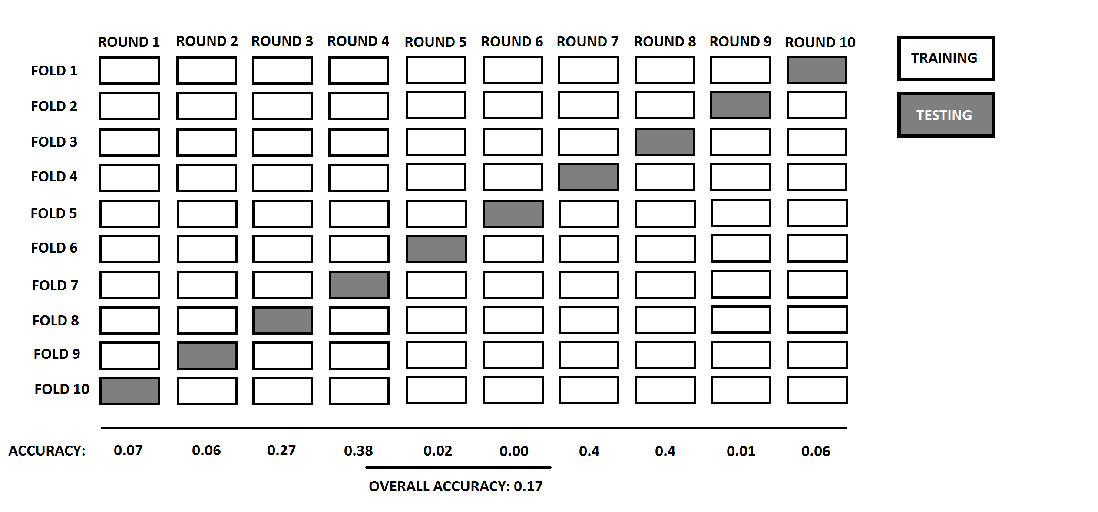
Cross-validation

Slide 17
Let’s get to the models
Linear and logistic regression are machine learning!
But there are others!
Today we look at three
regularization-focused, tree-based, similarity-based

Slide 18
Cool models 1: Penalized regression
Normal regression: shrink residuals
Resulting model potentially unstable (multicolinearity)
Better transferability to new samples
Solution: minimize residuals AND coefficients (draw)

Slide 19
Cool models 2: decision trees/forests
Yes/no rules instead of beta weights
Where do rules come from?
Optimization in training sample
Minimize hetereogeneity in leaves
Notes:
Entropy = - ppos * log(ppos) – pneg * log(pneg)

Slide 20
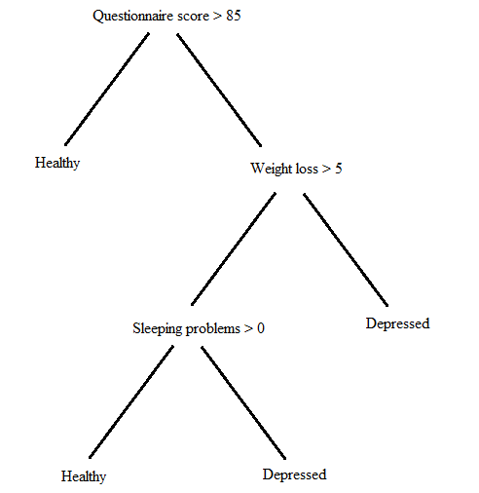
Cool models 2: decision trees/forests
Yes/no rules instead of beta weights
Where do rules come from?
Optimization in training sample
Minimize hetereogeneity in leaves
Notes:
Entropy = - ppos * log(ppos) – pneg * log(pneg)

Slide 21
Cool models 2: decision trees/forests
Random forest
Combination of different decision trees
Take a random sample of data
Take a random sample of variables at the splits
Build tree
Repeat 500 times
Notes:
Entropy = - ppos * log(ppos) – pneg * log(pneg)

Slide 22
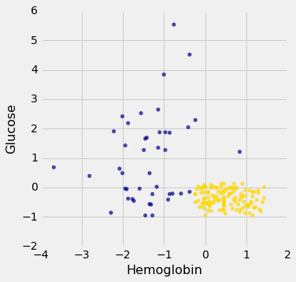
Cool models 3: nearest neighbors models
Predict case that is most similar to new observation
Notes:
Chronic kidney disease

Slide 23
Hyperparameters
You need to tell these models how to act
Ridge regression → How much penalization?
Trees → How many branches?
Nearest neighbors → How many neighbors?
Tuning means adjusting hyperparameters to make model accurate
Choose the hyperparameter that gives highest accuracy on new data

Slide 24
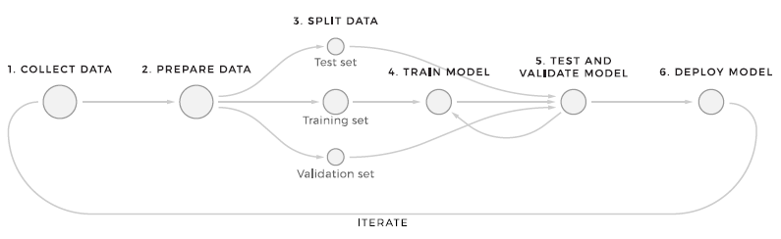
Workflow of machine learning

Slide 25
In sum
Machine learning is not magic …it is prediction
Social scientists are very well prepared to acquire ML skills
Extensions to classic methods are:
Focus on prediction
Out-of-sample evaluation
Cool new models

Slide 26
Break and then coding

Slide 27
Making it happen
Python offers simple implementations of:
many ML models
splitting into training and test set
quantifications of accuracy
#1 ML package: sklearn

Slide 28
Practice challenge
Predict the median income of US counties
You get a dataset with plenty of predictors
(census, election results, psych. Tests, Twitter)
Together we implement:
Regression model
Cross-validation
Evaluation

