Slide 1
EENA NG112 Committee
Hannes Tschofenig
Cristina Lumbreras
Wolfgang Kampichler

Slide 2
Agenda
  NG112 Technical Committee Conference Calls
  NG112 LTD v1.1 document
  Interoperability Tests
  Next Steps

Slide 3
NG112 TC
Conference Calls
  Calls are held monthly and all proposals will be considered for themes;
  We are trying to involve external speakers and cover a broad range of technical topics
    Not just standardization efforts
    Want to have a good mix in terms of technical details

Slide 4
NG112 TC
Example Topics
  Emergency Texting Applications, Open Source MSRP Java library, Smart Phone Apps – December 2012 (27 attendees)
  NENA i3 Update – January 2013 (25 attendees)
  Ongoing NG 9-1-1 Deployments in the US – February 2013 (22 attendees)
  All presentations are available here
  Suggest new topics and speakers!

Slide 5
What is the NG112 LTD Document?
Description for building the technical emergency services infrastructure
  Uses the Internet Protocol (IP) and
  the Session Initiation Protocol (SIP)
Re-uses existing standards developed outside EENA
  Particularly those standards developed and used in large Internet and telecommunication standards organizations (such as IETF, 3GPP, OMA).
  NENA also uses the same standards.

Slide 6
What is the NG112 LTD Document?
Describes envisioned end state
  But: Parts of it is already deployed today!
  With much more available in commercial products and even as open source software.
Document is intentionally verbose:
  Not only references specifications but also explains how they are used.
  Original standards are written for implementers.
  Still, it is written for a technically minded audience.

Slide 7
Changes with Version 1.1
New chapter about organizations
New chapter about the integration with non-SIP-based systems
Updated references: For example, various specifications for sending location information around have been finalized.
Deleted references to unused specifications from W3C, NIST, NENA, OASIS, COMCARE, ISO, and IETF.

Slide 8
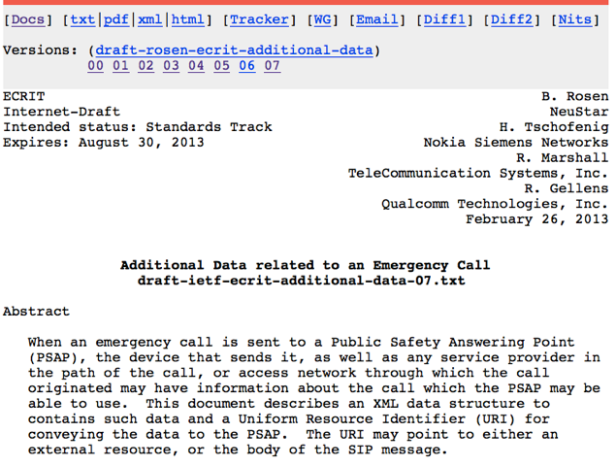

Slide 9
Additional Data
The IETF specification for “Additional Data related to an Emergency Call” made a lot of progress during the last year.
Three types of data:
  Data Associated with a Call
  Data Associated with a Location
  Data Associated with a Caller
Specification defines data structures in XML format.

Slide 10
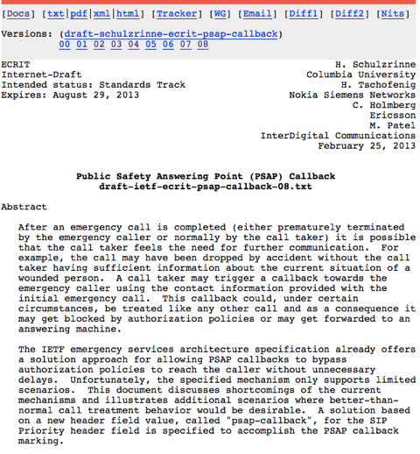

Slide 11
PSAP Callback
The story:
  After an emergency call is completed it is possible that the call taker feels the need for further communication.
  How does he call back to the caller?
The standardization work is now finalized - after years of discussion!
The solution is based on a new header field value, called "psap-callback", for the SIP Priority header field is specified to accomplish the PSAP callback marking.
Technical details can be found here.

Slide 12
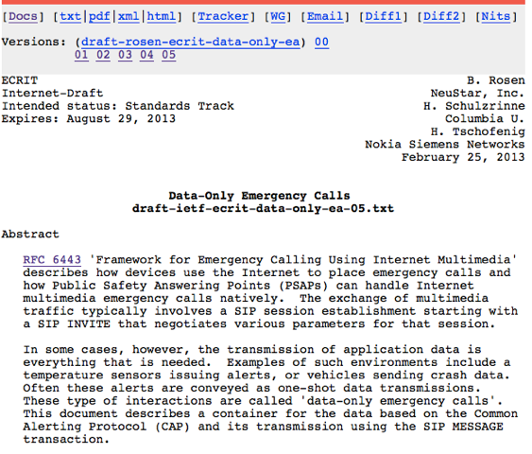

Slide 13
Data-Only Emergency Calls
The specification on data-only emergency calls is also getting completed.
  Also known as “non-human initiated calls”.
  Usable for sensors and alarms.
The story:
  The exchange of multimedia traffic typically involves a SIP session establishment starting with a SIP INVITE.
  In some cases the transmission of data is everything that is needed. No voice / video / real-time text.
  This document explains how the OASIS Common Alerting Protocol (CAP) and the additional data specification is used in that situation.

Slide 14
Interoperability Tests
EENA has been strategising about commencing Interop Tests for some time and we have started the “planning phase”
The tests will be executed in 2014 (precise dates tbc) and are open to all EENA members.
We are investigating possible funding opportunities.
The event is a validation-driven opportunity; not a certification-driven one.

Slide 15
Interoperability Tests
(cont.)
In advance, we established a Planning Committee to, well, plan the event to
  look at themes,
  scope out test cases/scenarios,
  assess industry requirements,
  look at logistics,
  develop the marketing strategy, etc.
The Planning Committee will be
  led by Wolfgang Kampichler and Hannes Tschofenig, and
  supported by EENA.

Slide 16
Interoperability Tests
Scope
You may want to
  Be involved in the planning committee,
  Work with us on defining the scope of the tests,
  Work on the test case description,
  Host or sponsor the event.
Talk to us at this workshop.
  Your feedback is valuable to us.

Slide 17
Next Steps
As planned we want to develop our transition documents.
  Content: Description of how to get from current deployment to NG112.
  Caveat: EC member states are at a different level of deployment → Different stories for how to get to NG112.
  Note: Organizational structure does not need to be replicated to technical structure.
  Milestones: First deployment models by end of 2013; all deployment models by 2014.

Slide 18
Thank you!!
Hannes Tschofenig: ht@eena.org
Cristina Lumbreras: cl@eena.org
Wolfgang Kampichler: wolfgang.kampichler@frequentis.com

