Slide 1




Dominik Trixl – Dominic Köstenbaumer – Hannes Zelger

Slide 2
Content
General
Special Features
Difficulties
Solutions
Future
Program Presentation
Graphic Showcase

Slide 3


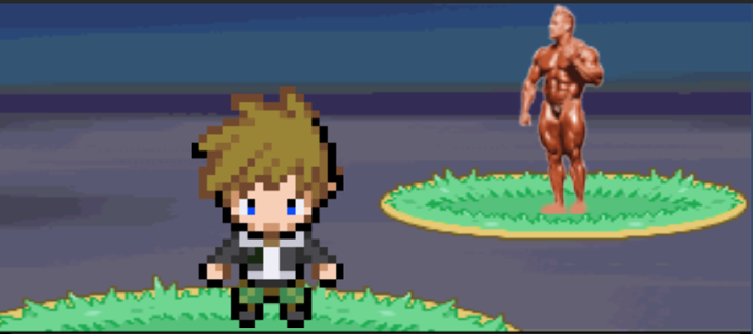
General
Pokemon like game with bodybuilders
Pokemon Map
Attacks -> Poses
Egodamage
Arena with Bodybuilding Legends
Map, Gym, Shop, Doc, Dealer

Slide 4
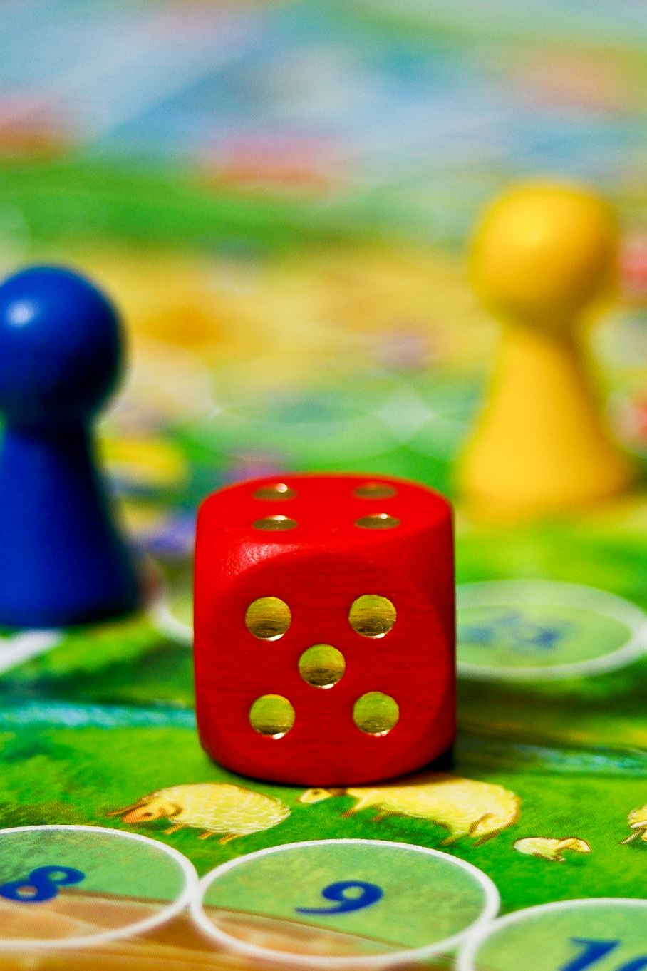
Special Features
Special Idea; no other similar game
Huge Map
Mini-Games to level Muscles

Slide 5
Difficulties
Graphic Design
Creating Enemies and Items
Saving and Loading Objects

Slide 6
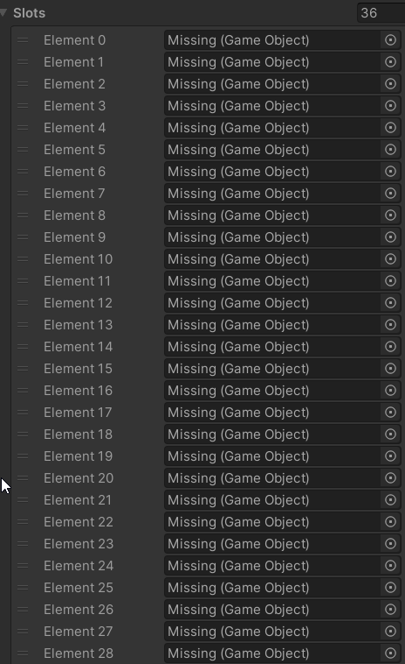
Loading Bug
Saving GameObject InstanceID
Different Scene -> Different ID
= GameObject missing

Slide 7
Solutions
Inspired by different
Games
ScriptableObjects
JSON in Playerprefs

Slide 8

Future
Menu
Animations
Pre-Arena
Loading Screen
Eventually other items

Slide 9

Program Presentation

Slide 10
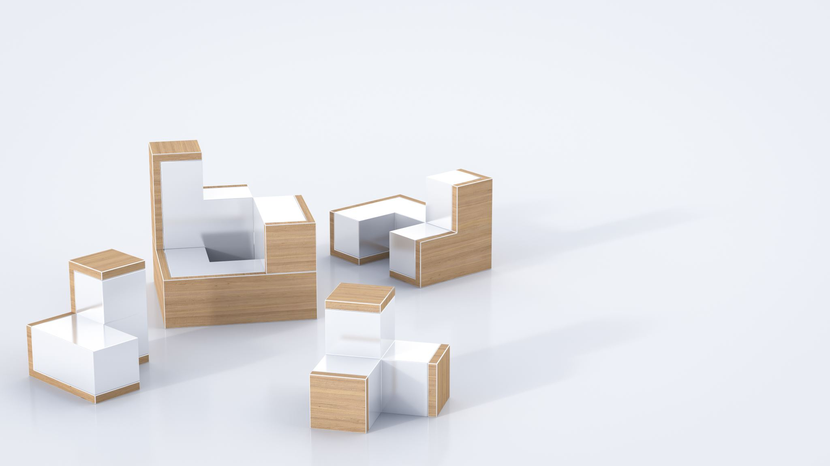
Graphics Showcase

Slide 11
