Slide 1

ZENDESK
Zendesk is a tool we use to manage client incidents.(service desk)

Slide 2
What is a Zendesk ticket?
The user who is asking for support through a ticket is the requester. For most businesses that use Zendesk Support, the requester is a customer(E.g Heritage), but requesters can also be agents in your Zendesk Support instance. The submitter is the user who created a ticket. By default, the requester of a ticket is the submitter.

Slide 3
Importance of Zendesk
Track all client incidents
Ensure there is transparent on the work we have(backlog)

Slide 4
What do you need to do when a client transitions to support?
Ensure the organization has been added to zendesk and relevant support users have credentials to access.

Slide 5
Ways of registering request to ZENDESK
Send a mail to support@turnkeyafrica.com
Client to log in to zendesk and register the request

Slide 6
Status in zendesk
New
Open
Pending
Closed

Slide 7
Critical things to make sure are observed in zendesk
SLA-Ensure issues are tagged to the right SLA
Urgent
High
Normal
Low
Response time
This is the time it takes to respond to request based on the urgency and SLA shared to the client

Slide 8
Ensure all issues are tagged to a jira ticket and updated with right status
Ensure all issues which belongs to your site your are assigned
Ensure all issues are tagged to a system

Slide 9
Introduction to the Support agent interface
Agent Dashboard overview-When you open Zendesk Support as an agent the agent Dashboard appears
The sidebar-These sidebar icons navigate you to major feature areas. Your sidebar may include additional icons for apps installed by your admin.
Home: Displays the agent dashboard, where you can access your recently updated tickets and tickets that require your attention. You can also view your customer satisfaction statistics.
Views: Displays your shared views and any personal views you've created, and enables you to access and worth through tickets in each space. You create views in Admin settings.
Reporting: Displays the Reporting Overview, where you can view data about your ticket volume and management, updated on an hourly basis. It also enables you to compare your own ticket metrics, and against those of your fellow agents. It may include other tabs, such as Insights and Satisfaction, if these options are enabled.

Slide 10
Introduction to the Support agent interface
Side Bar
Admin: Displays the Admin home page, where you can find the tools you need to configure Zendesk Support and view your current setup. Agents can view a version of the Admin page tailored to their permissions.
The top toolbar-area at the top of the interface, with tabs to open and move between tickets, as well as quick links to search and other apps.
The main window-where most of your content is displayed
The apps panel

Slide 11
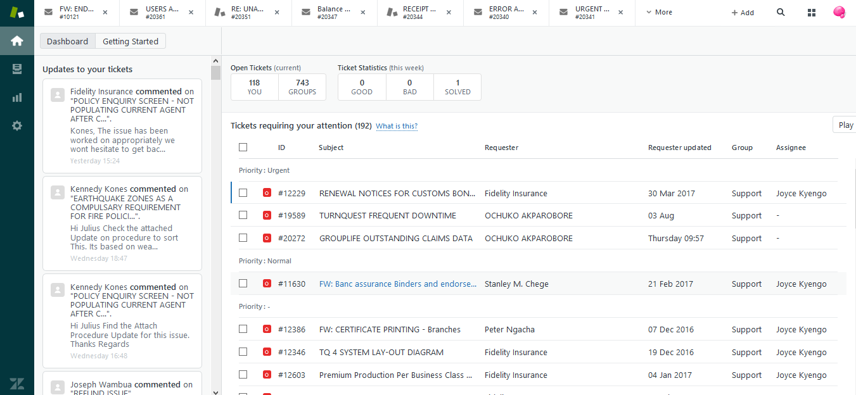
See below
Tool bar
Side bar
Main window

Slide 12
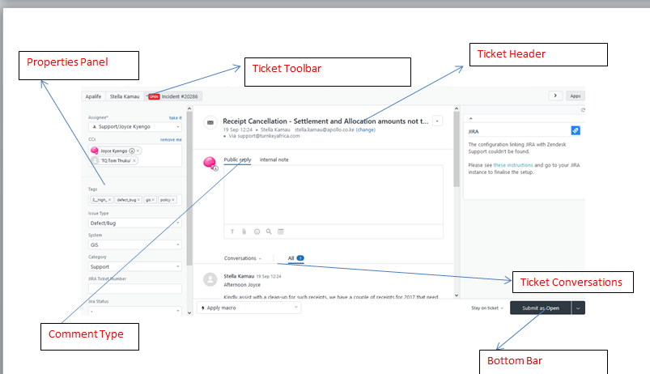
Main Window

Slide 13
Main Window
The information displayed on your ticket can vary, again, depending on your setup. The sections below describe some of the more common elements you may run into.
Properties panel
Down the left side of the window, you'll see the Properties panel. The fields displayed here contain metadata about the ticket. These fields, including their field type (drop-down, text entry, and the like) are defined on the Admin Home page.
Ticket toolbar
Along the top of the ticket is the Ticket toolbar, displaying a series of labels containing information about the ticket and who submitted it:

Slide 14
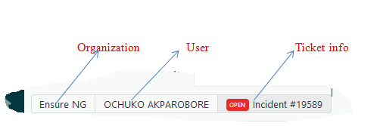
Ticket toolbar Along the top of the ticket is the Ticket toolbar, displaying a series of labels containing information about the ticket and who submitted it:

Slide 15
Ticket toolbar
Organization is the name of the organization the ticket submitter belongs to. Clicking this label takes you to a list of all tickets submitted from this organization.
User is the name of the person who submitted the ticket. Clicking this label takes you to a list of all the tickets submitted by this person.
Ticket info displays the ticket status, type, and number.
Next ticket scrolls you to the next ticket in your selected view.
The Apps button opens a panel listing all of your available apps.

Slide 16
Ticket header
Below the Ticket toolbar is the Ticket header. Here, you'll see a number of items conveying additional information about the ticket:
Subject is the title given to the ticket. You can edit this by clicking on the subject and entering a new one.
Requester is the name of the user who submitted the ticket. You can change this by clicking the change link.
SLA displays any user-specific rules applied to the ticket. In the example above, tickets from this company must be solved within seven days, per the Service Level Agreement. Hovering your mouse over the rule displays the date by which the ticket must be solved.
Ticket options is a drop-down menu displaying actions you can take on the ticket.

Slide 17
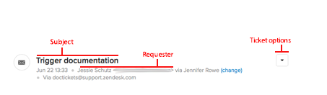
Ticket header

Slide 18
Ticket header
Below the Ticket toolbar is the Ticket header. Here, you'll see a number of items conveying additional information about the ticket:

Slide 19
Ticket header
Subject is the title given to the ticket. You can edit this by clicking on the subject and entering a new one.
Requester is the name of the user who submitted the ticket. You can change this by clicking the change link.
SLA displays any user-specific rules applied to the ticket. In the example above, tickets from this company must be solved within seven days, per the Service Level Agreement. Hovering your mouse over the rule displays the date by which the ticket must be solved.
Ticket options is a drop-down menu displaying actions you can take on the ticket.

Slide 20
Comment type
Comment type
The Comment type allows you to select what kind of comment you want to leave on the ticket:
Click Public reply (the default selection) so your reply is visible to anyone viewing the ticket.
Click Internal note so your reply is visible only to other agents with permissions to view the ticket.
In line with the comment types, you may see one or both of the following optional buttons:

Slide 21

Ticket conversation
The Ticket conversation allows you to choose what information you want to view in the comment stream:

Slide 22
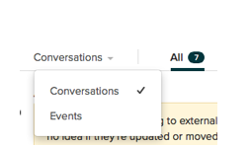
Ticket conversation
Click the Conversation drop-down to choose what to display in the body of the ticket:

Slide 23
Ticket conversation
Conversation displays only the communication between the agent and the customer, or the agent and other agents.
Events displays all replies, status changes, and the like, applied to the ticket by an agent or a business rule.
Use the Comment filters to choose what type of comments to display in the comment stream:
All (the default selection) displays all of the activity happening to a ticket, including (but not limited to):
Internal notes (highlighted in yellow in the comment stream)
Public comments

Slide 24
END OF PRESENTATION

