Slide 1
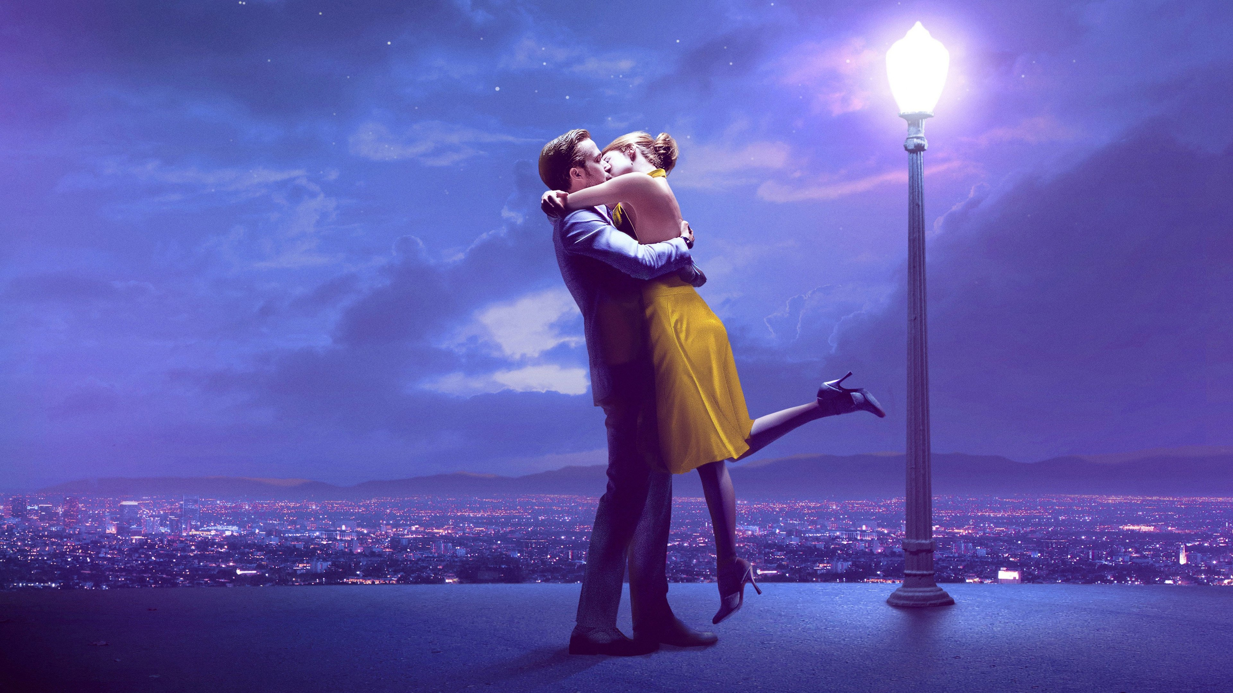
La La Land 2016
directed by Damien Chazelle
starring Emma Stone, Ryan Gosling, J.K. Simmons
DVD

Slide 2
La La Land
2016
Notes:
outline could be median color of poster

