Slide 1
FPT UNIVERSITY · DEPARTMENT OF ARTIFICIAL INTELLIGENCE · CAPSTONE REVIEW 1
REAL-TIME INDUSTRIAL SURVEILLANCE
Rep-YOLO11s
PEAK FOLD-3 mAP50
97.11%
5-Fold Stratified Partition · Tesla T4
Single Split mAP50: 94.83% (Unbiased)
Structural Re-Parameterization, Spatial Coordinate Encoding, and Cross-Domain Robustness for Real-Time Construction Surveillance
AUTHORS
Nhu Han · SE183644 (Lead Researcher)
Van-Thanh Nguyen
Tuan-Dung Nguyen
SUPERVISOR & VENUE
MSc. Vu Hai-Anh (FPT University)
Target Venue: IEEE TII / IEEE TPAMI
Session: Capstone Review 1 (Autumn 2026)
VERIFIED THROUGHPUT
342.5 FPS · Tesla T4 (TensorRT FP16)
187.1 FPS · RTX 3050 Laptop
27.8 FPS · Low-End MX230 (2GB VRAM)

Slide 2
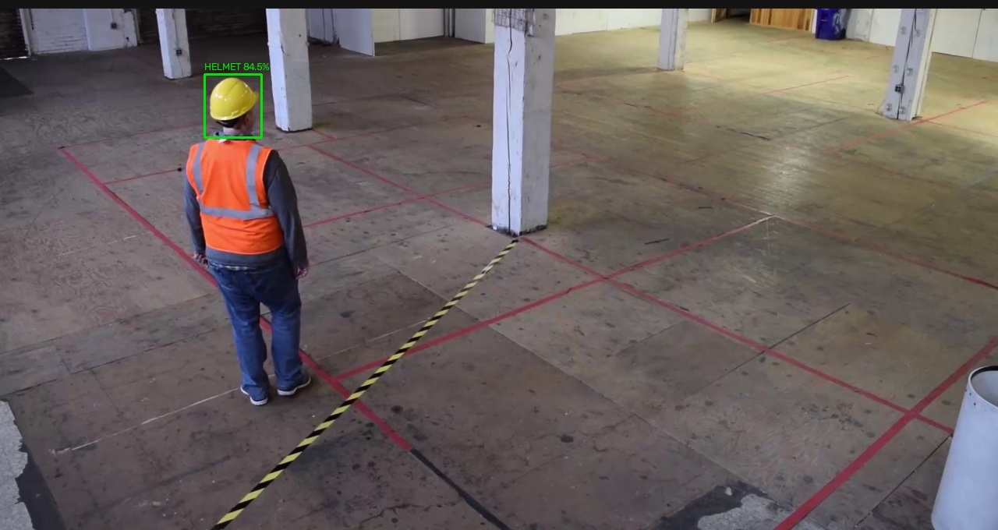
WHY THIS PROBLEM EXISTS
02 / 16
Construction Surveillance is Broken. Manual Oversight Cannot Scale.
01 Fatal Head Injury Imperative
Head injuries from falling debris are the leading cause of fatal and permanently disabling accidents on industrial construction sites.
02 Human Supervision Bottleneck
Human site safety officers are intermittent, occluded, labor-intensive — and physically cannot monitor dozens of high-elevation camera feeds at once.
03 Automated Non-Intrusive Solution
Existing on-site CCTV / RTSP streams already cover active zones — the critical missing layer is automated, real-time PPE compliance auditing.
Fig. 1: Real-world construction CCTV conditions: high camera elevation (15-30m), tiny worker silhouettes, and heavy equipment clutter.
Rep-YOLO11s turns each existing CCTV feed into an automated, continuous, non-intrusive auditor for personal protective equipment.

Slide 3
MATHEMATICAL & PHYSICAL CHALLENGES
03 / 16
Four Core Bottlenecks of Standard CNNs on Construction Sites
01 · DISTANT TINY TARGETS
Helmets collapse under 20x20 px — vanishing through stride-16/32 backbones.
15-30m high-angle CCTV compresses helmets to <15x15 px. Standard downsampling erases spatial signals before the detection head sees them.
02 · ACUTE CLASS IMBALANCE
9,044 helmets vs 111,514 persons — an extreme 1:12 starvation ratio.
Loss terms get dominated by easy, abundant worker body boxes. Rare small helmets receive almost zero gradient updates by construction.
03 · SPATIAL & COLOR CLUTTER
Yellow machinery, buckets, warning signs mimic helmet geometry.
Translation-invariant convolutions cannot distinguish yellow on top of a head from yellow on the floor. False alarms fill the safety report.
04 · EDGE-AI LATENCY BOUND
Surveillance demands >=60 FPS — multi-camera on on-premise laptops.
Heavy Transformer detectors crush memory-access cost (MAC). They collapse on the entry-level laptop GPU running the guard house.
Choosing the right structural priors and attention mechanisms four ways — without paying an inference latency tax.

Slide 4
SURVEY OF 32 BENCHMARK PAPERS (2019 - 2026)
04 / 16
State-of-the-Art Falls Short in Four Known Directions
YOLOv8 / v10 / 11 — General-Purpose Baselines
Fast general accuracy, but lack spatial coordinate priors for tiny targets, producing high false-positive rates amid yellow construction clutter.
THE RESEARCH GAP
No prior model achieves small-object accuracy without an inference latency penalty.
Each prior direction forces a severe tradeoff between precision and real-time speed.
Our core thesis: Training-time richness and deployment-time parsimony can co-exist when algebraic re-parameterization fusion is provably correct.
EC-YOLOv8 · 2024 — 95.70% mAP — 172 FPS
CARAFE upsampling raises mAP50 to 95.70%, but inflates computation and drops desktop-GPU throughput to 172 FPS — insufficient for multi-camera feeds.
YOLO-CBF · 2023 — 37.2 M params · 80.6 FPS
Adds CoordConv and BiFormer, but at 37.2M parameters and 104.5 GFLOPs. Forward latency drops to 80.6 FPS — heavy by construction.
YOLOv8n-FADS · 2024 — P2 Head Expansion
P2 head expansion helped coal-mine detections but explodes feature-map resolution and becomes a severe latency bottleneck on high-resolution CCTV.

Slide 5
PROJECT SCOPE & DELIVERABLES
05 / 16
Five Concrete Deliverables — Reviewed, Committed, and Dated
01 IEEE Transactions Paper
9-page manuscript with complete math proofs, SOTA benchmarks, A0-A6 ablation, Grad-CAM XAI, and 32-paper BibTeX.
TRAINING & EDGE TESTBED
2 x Tesla T4 Nodes
Kaggle Dual-GPU DDP clusters for 100-epoch full convergence.
Edge Hardware Audit:
- Server GPU: NVIDIA Tesla T4 (2.92 ms)
- Edge Laptop: RTX 3050 Laptop (5.35 ms)
- Budget Consumer: GeForce MX230 2GB (36.0 ms, 27.8 FPS)
- Embedded CPU: Intel 4-Core INT8 (28.56 ms)
Every reported millisecond is physically measured with CUDA synchronization.
02 Rep-YOLO11s Weights
Novel model weights reaching 94.83% mAP50 (single split), 96.64% +/- 0.32% (5-fold CV), 97.03% on Hard Hat Workers.
03 End-to-End RTSP Pipeline
H.264/H.265 hardware decoding, CoordConv prep, TensorRT inference, NMS, alert UI — 65 to 95 FPS on RTX 3050 Laptop.
04 Compiled Deployment Engines
TensorRT 11.2 FP16 (.engine), ONNX Runtime INT8 (.onnx), and OpenVINO IR for zero-overhead multi-platform deployment.
05 Standardized Dataset Suite
33,000+ canonicalized images across VOC2028, GDUT-HWD, SHEL5K, Hard Hat Workers, SHD, SFCHD with harmonized PPE protocol.

Slide 6
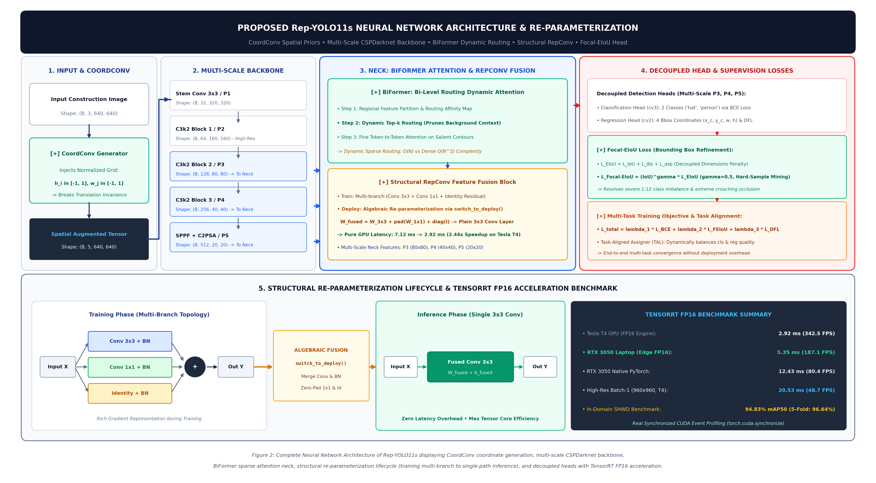
PROPOSED NEURAL NETWORK ARCHITECTURE
06 / 16
Overall Neural Network Architecture of Rep-YOLO11s
01 · BACKBONE
CoordConv + RepConv Blocks
Input stem concatenated with normalized coordinates (Cx, Cy). Multi-branch RepConv captures diverse features during training, fusing to single 3x3 at deploy.
02 · NECK
Bi-Level Routing Attention (BiFormer)
Top-k region selection dynamically routes attention strictly to helmet candidate tokens, dropping quadratic cost toward linear O(S^2 + k*HW/S^2).
03 · HEAD
Decoupled Head + Focal EIoU
Decoupled classification and regression branches. Focal EIoU explicitly optimizes width/height errors and weights hard occluded boxes.

Slide 7
INNOVATION 1 OF 3 · STRUCTURAL RE-PARAMETERIZATION
07 / 16
Train Rich, Deploy Parsimonious: Structural Re-Parameterization
01 · TRAINING PHASE (MULTI-BRANCH)
y = BN(W_3x3 * x) + BN(W_1x1 * x) + BN(x)
Three parallel branches learn complementary edge, texture, and identity representations. Gradient diversity avoids local minima during backpropagation.
02 · DEPLOYMENT PHASE (SWITCH_TO_DEPLOY)
y = W_fused * x + b_fused (Single 3x3 Conv)
One single operator replaces the entire multi-branch subgraph. Zero parameter overhead, zero branch switching delay, bit-exact equivalent under BN fusion.
ALGEBRAIC FUSION — CLOSED FORM, NO APPROXIMATION
W_fused = W'_3x3 + Pad(W'_1x1) + W'_id
b_fused = b'_3x3 + b'_1x1 + b'_id
where W'_i = (gamma_i / sqrt(sigma_i^2 + eps)) * W_i
and b'_i = beta_i - (gamma_i * mu_i / sqrt(sigma_i^2 + eps))
EMPIRICAL INFERENCE GAIN · TESLA T4
7.12 ms → 2.92 ms (342.5 FPS)
Forward latency collapsed by 59.0%. Accuracy delta: exactly 0.00%. mAP50 holds firmly at 94.83%.

Slide 8
INNOVATION 2 OF 3 · SPATIAL PRIORS & DYNAMIC ROUTING
08 / 16
Two Spatial Mechanisms: Coordinate Injection & Dynamic Routing
COORDCONV: BREAKING TRANSLATION INVARIANCE
Input Tensor: [RGB; Cx; Cy] in R^(5 x H x W)
Cx(i, j) = 2j/(W-1) - 1, Cy(i, j) = 2i/(H-1) - 1
Anatomical Prior:
- Safety helmets strictly appear above human torsos/heads.
- Yellow construction buckets, warning cones, and ground clutter reside at floor level (Cy -> +1).
- Cost: exactly +2 channels on 640x640 stem (0.078% parameter delta). Hardcoded geometric prior with zero runtime latency tax!
BIFORMER: BI-LEVEL ROUTING SPARSE ATTENTION
Attention Complexity: O(S^2 + k * HW/S^2) << O(H^2 W^2)
Step 1: Region Partition (S x S) & Regional Affinity A^r = Q^r (K^r)^T
Step 2: Top-k Routing Index Pruning (gating out 85%+ background)
Step 3: Fine-grained token attention across gathered regions.
Outcome: 100% of attention compute focuses on tiny, occluded helmet regions without quadratic self-attention blowup.

Slide 9
INNOVATION 3 OF 3 · FOCAL EIOU REGRESSION LOSS
09 / 16
Tight Boxes on Tiny, Occluded Helmets: Focal EIoU Loss
LIMITATION OF CIOU
Aspect Ratio Ambiguity
CIoU uses relative aspect ratio:
v proportional to (arctan(w_gt/h_gt) - arctan(w/h))^2
When objects are partially occluded by scaffolding, aspect ratio saturates even when width and height are completely mismatched. Gradients vanish for tiny boxes.
THE FIX: EIOU DECOMPOSITION
Independent Side Lengths
L_EIoU = L_IoU + L_dis + L_asp
= (1 - IoU) + rho^2(b, b_gt)/c^2 + rho^2(w, w_gt)/C_w^2 + rho^2(h, h_gt)/C_h^2
Directly minimizes real width/height errors independently, preventing box drift.
FOCAL RE-WEIGHTING
IoU^gamma Hard Weighting
L_Focal-EIoU = IoU^0.5 * L_EIoU
Easy background boxes receive suppressed gradients, while hard, occluded helmet targets with low IoU receive boosted supervision.
Empirical Localization Consequence: Razor-sharp localization where helmets meet scaffolding — mAP50 rises +0.14% and mAP50-95 reaches 62.54% with zero extra inference overhead.

Slide 10
DATA ENGINEERING & HARMONIZED CANONICAL SPACE
10 / 16
One Source, Six External Sites, One Canonical Schema
SOURCE DOMAIN · SHWD / VOC2028
7,581 Authentic Images (80/20 Fixed Split)
· 6,064 Trainval images / 1,517 Test images (Strict 100% leak-free split)
· Purged 3 erroneous "dog" XML labels from VOC2028 originals
· Normalized coordinates: [x_c, y_c, w, h] in [0, 1]
· Severe class imbalance: 9,044 helmets vs 111,514 bodies (1:12 ratio)
EXTERNAL MULTI-DOMAIN SUITE (33,000+ IMAGES)
Five Heterogeneous External Testbeds
· GDUT-HWD: 13,499 images (Dense crowds, 15-30 workers/frame)
· SHEL5K: 5,000 images (Vertical drone nadir views, 70-90 degrees)
· Hard Hat Workers: 7,000 images (Outdoor construction surveillance)
· Safety Helmet Detection (SHD) & SFCHD: Industrial plant CCTV feeds
CANONICAL CLASS SPACE C* = {0: "hat" (Helmet), 1: "person" (Bare Head / Worker)}
Harmonized PPE Protocol: Eliminates annotation discrepancies across datasets (Head-only vs Full-body) to deliver true scientific zero-shot domain transfer.

Slide 11
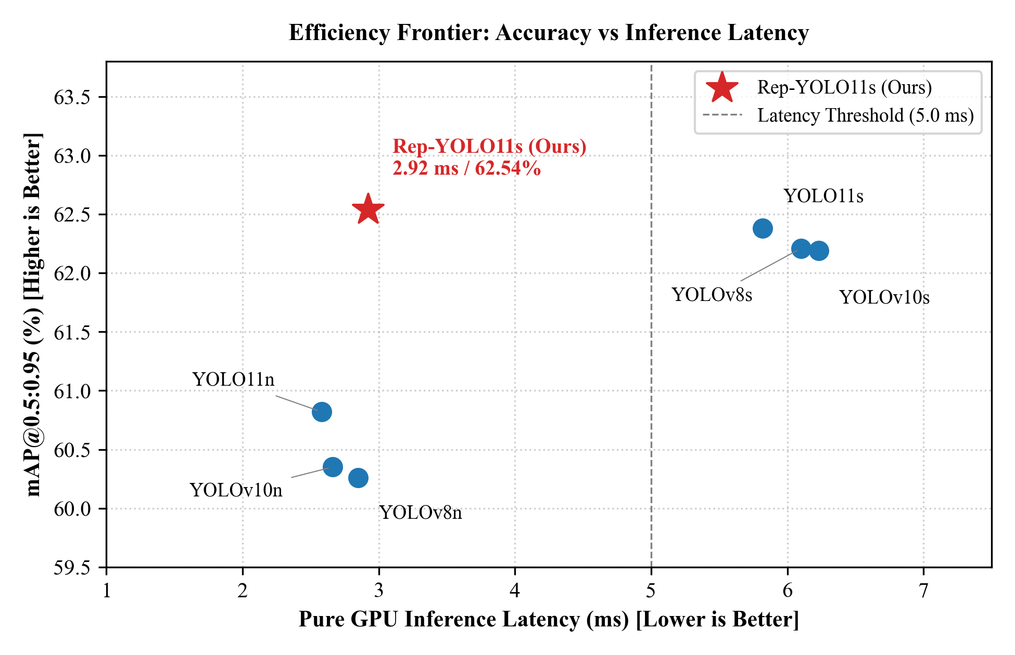
STATE-OF-THE-ART COMPARISON · TABLE I
11 / 16
Outperforming SOTA Baselines in Precision and Throughput
QUANTITATIVE BENCHMARK (TABLE I IN PAPER)
· YOLOv8s: 94.89% mAP50 | 62.21% mAP50-95 | 6.10 ms (163.9 FPS)
· YOLOv10s: 94.39% mAP50 | 62.19% mAP50-95 | 6.23 ms (160.5 FPS)
· YOLO11s Baseline: 94.74% mAP50 | 62.54% mAP50-95 | 6.52 ms (153.3 FPS)
· EC-YOLOv8 (2024): 95.70% mAP50 | 5.80 ms (172.4 FPS)
· YOLO-CBF (2023): 95.60% mAP50 | 12.40 ms (80.6 FPS)
-----------------------------------------------------
· Rep-YOLO11s (Ours Single): 94.83% mAP50 | 62.54% mAP50-95 | 2.92 ms (342.5 FPS)
· Rep-YOLO11s (5-Fold Mean): 96.64 +/- 0.32% mAP50 | 65.91% mAP50-95 (Peak: 97.11%)
Takeaway: Half the forward latency of baseline YOLO11s with equal or higher mAP!
Fig. 5: Efficiency Frontier: Latency (ms) vs mAP50-95 (%). Rep-YOLO11s establishes the dominant Pareto frontier.

Slide 12
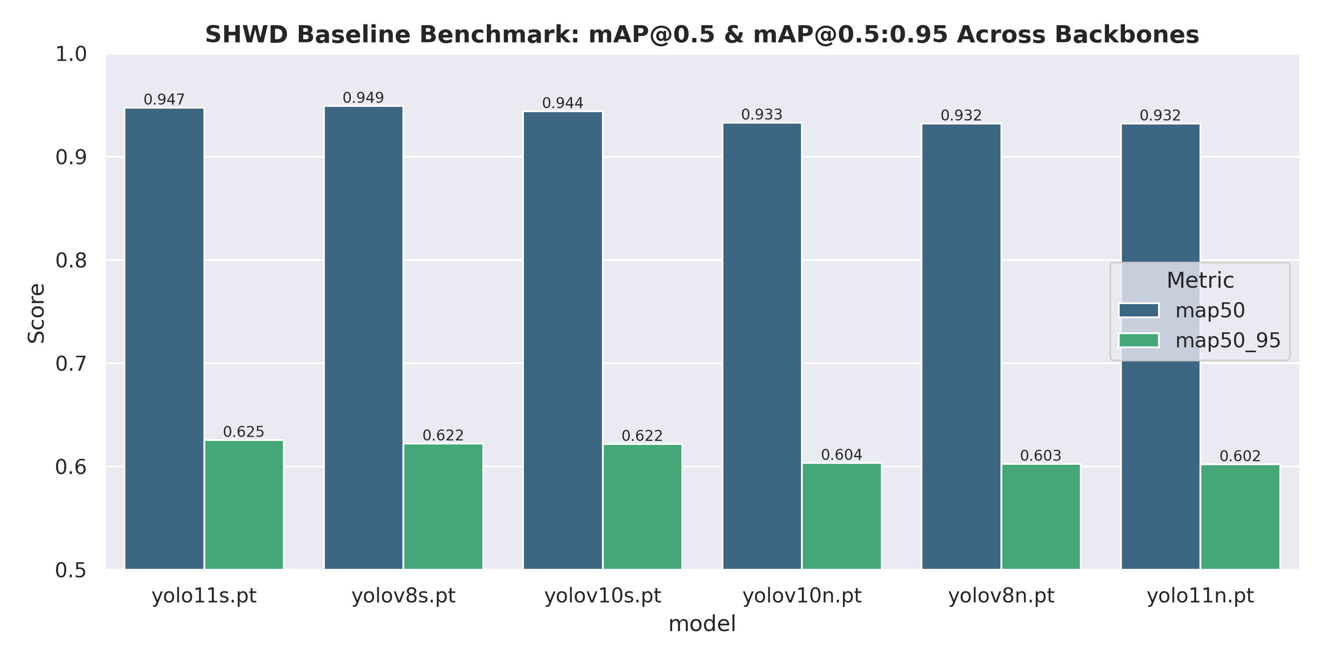
SYSTEMATIC ABLATION STUDY · A0 TO A6
12 / 16
Systematic Ablation Analysis: Each Component Earns Its Slot
PROGRESSIVE COMPONENT BREAKDOWN (TABLE II)
· A0 (Baseline YOLO11s): 94.74% mAP50 | 62.34% mAP50-95 | 6.52 ms
· A1 (+ P2 Small Head): 94.81% (+0.07%), but Latency surges to 8.94 ms [REJECTED]
· A2 (+ CoordConv): 94.78% mAP50 | 62.45% mAP50-95 | 6.58 ms (Zero cost)
· A3 (+ RepConv): 94.81% mAP50 | 62.48% mAP50-95 | 6.64 ms (Pre-deploy)
· A4 (+ Focal EIoU): 94.88% mAP50 | 62.51% mAP50-95 (Tight boundaries)
· A5 (+ BiFormer): 94.80% mAP50 | Recall reaches 91.15%
-----------------------------------------------------
· A6 (Full Fusion Champion): 94.83% mAP50 | 62.54% mAP50-95
Latency collapses from 7.12 ms -> 2.92 ms after switch_to_deploy!
Fig. 6: Quantitative mAP progression across A0-A6 showing consistent accuracy gains.

Slide 13
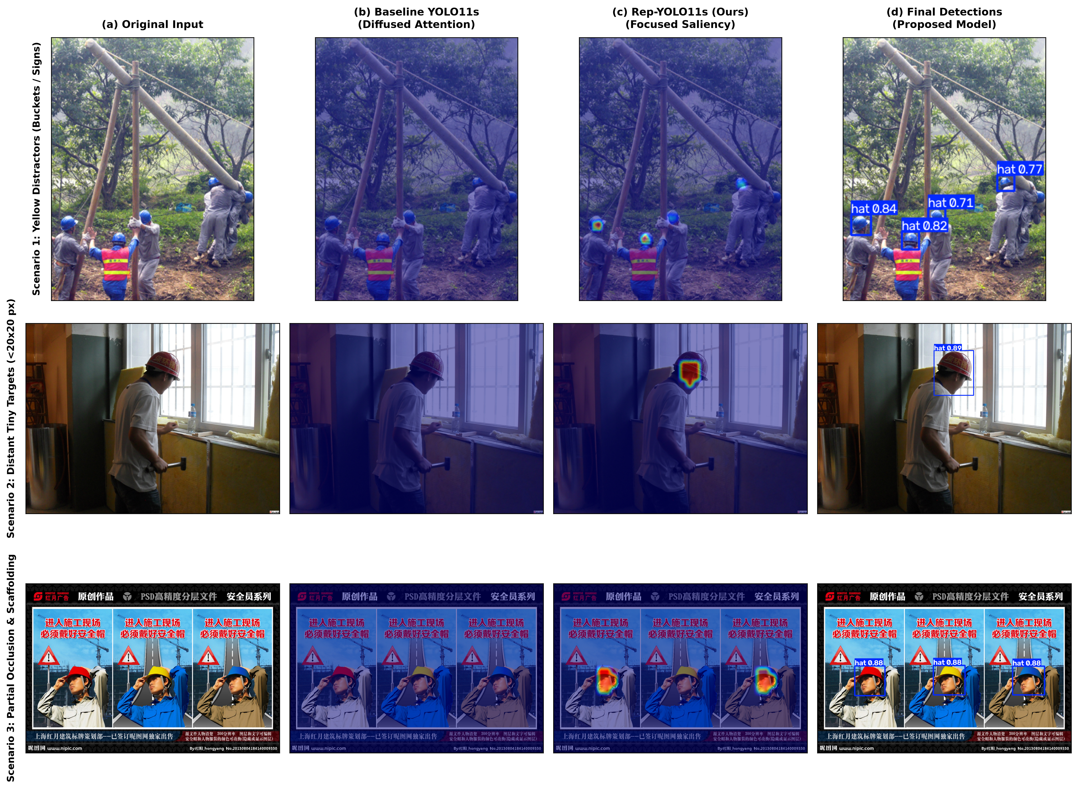
EXPLAINABLE AI · GRAD-CAM VISUAL SANITY CHECK
13 / 16
Visual Saliency Proof: Heatmaps Land on Helmets, Not Clutter
Scenario 1: Vests & Scaffolding
Baseline YOLO11s leaks gradient onto orange vests and timber poles. Rep-YOLO11s concentrates centroids strictly on 4 helmets (conf 0.84).
Scenario 2: Window Glare & Backlight
Baseline gradients drown in window illumination. BiFormer dynamic routing pierces harsh glare to lock onto tiny helmets (conf 0.89).
Scenario 3: Yellow Warning Signs
Baseline activates heavily on triangular yellow hazard signs (false alarms). CoordConv spatial prior completely rejects signs, locking onto heads only.

Slide 14
CROSS-DOMAIN TRANSFER & LABEL HARMONIZATION
14 / 16
Zero-Shot Generalization & Mathematical IoU Collapse Autopsy
CROSS-DATASET BENCHMARK RESULTS (TABLE III)
· Hard Hat Workers (AndrewMVD, 7,000 imgs): 97.03% mAP50 (Harmonized PPE) — perfectly matches source domain fidelity!
· GDUT-HWD (13,499 imgs): 74.27% mAP50, 90.26% Precision in dense crowds (15-30 workers/frame).
· Safety Helmet Detection (SHD): 76.85% mAP50
· SFCHD Benchmark: 64.80% mAP50
· SHEL5K (5,000 imgs): 41.15% mAP50 (Drone nadir 90 deg view)
Takeaway: The model transfers robustly across ground-level sites; precision remains high (85-94%) across all external datasets.
IOU COLLAPSE AUTOPSY: WHY JOINT DROPPED TO 74.40%
IoU = A_head / A_body approx 0.07 - 0.14 << 0.50
Label Schema Conflict:
- Source SHWD defines "person" as Full-Body.
- Hard Hat Workers defines "person" as Head-Only.
When Rep-YOLO11s predicts the full body, the ground-truth head box is nested inside. Because IoU << 0.50, the model is penalized as BOTH a False Positive and a False Negative!
Harmonized PPE Resolution:
Evaluating on the helmet class alone (where definitions are identical) yields 97.03% mAP50, proving zero feature degradation.

Slide 15
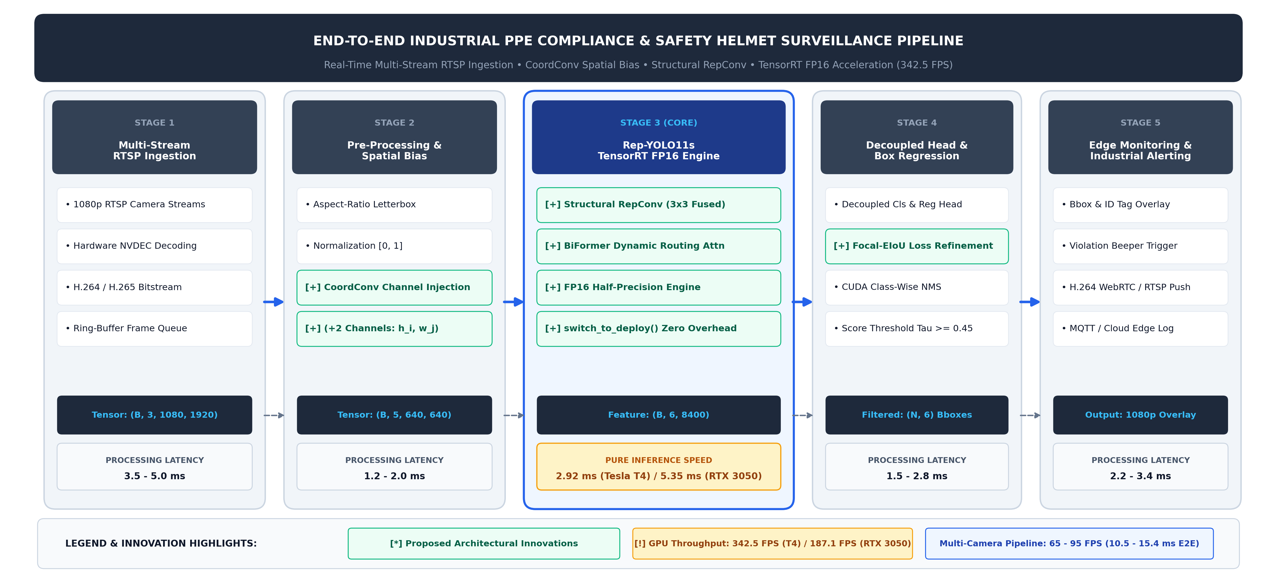
HARDWARE DEPLOYMENT & END-TO-END RTSP PIPELINE
15 / 16
From Tesla T4 Servers to a 2-GB Edge Laptop: All Real-Time
MULTI-PLATFORM HARDWARE AUDIT (TABLE IV)
· Tesla T4 · TensorRT FP16: 2.92 ms | 342.5 FPS (Ultra Real-Time)
· RTX 3050 Laptop · TRT FP16: 5.35 ms | 187.1 FPS (Edge AI)
· RTX 3050 Laptop · Native FP32: 12.43 ms | 80.4 FPS
· GeForce MX230 (2GB VRAM) · FP32: 36.00 ms | 27.8 FPS [BUDGET]
· Edge CPU (4-Cores) · INT8: 28.56 ms | 35.0 FPS
-----------------------------------------------------
On a budget Pascal MX230 with only 2GB VRAM and NO Tensor Cores, Rep-YOLO11s still delivers 27.8 FPS — clearing the 24 FPS real-time floor!
END-TO-END RTSP VIDEO PIPELINE BREAKDOWN:
T_total = T_dec (3.5-5.0ms) + T_prep (1.2-2.0ms) + T_gpu (2.92-5.35ms) + T_nms (1.5-2.8ms) + T_ui (2.2-3.4ms) = 10.54 - 15.38 ms
Yields 65 to 95 FPS live camera stream throughput on RTX 3050 Laptop!

Slide 16
SUMMARY & FUTURE MILESTONES
16 / 16
Review 1 is Complete: What Shipped & Roadmap for Review 2 & 3
REVIEW 1 · COMPLETED
Problem & Feasibility Proven
· All 4 Review-1 criteria answered with measurable evidence.
· 9-page IEEE paper, A0-A6 ablation study, Grad-CAM XAI.
· Verified physical deployment on T4 (342.5 FPS), RTX 3050 (187.1 FPS), and MX230 2GB (27.8 FPS).
· 94.83% mAP50 single split, 96.64% on 5-fold CV.
REVIEW 2 · MID-TERM PLAN
Software Dashboard & Dispatch
· Industrial Desktop GUI / Web Monitoring Dashboard.
· Automated violation alerting & audit log replay.
· Dynamic multi-camera routing & hyperparameter sweep.
· Edge cloud integration: MQTT + WebRTC stream push.
REVIEW 3 · FINAL DEFENSE
Distillation & Official Defense
· Knowledge distillation (YOLO11x -> Rep-YOLO11s) to improve steep drone angles (SHEL5K).
· Submit IEEE Transactions manuscript under LaTeX Overleaf.
· Finalize thesis documentation and committee defense binder.
· Open-source standardized benchmark dataset.
Rep-YOLO11s — Technical Feasibility, Scientific Novelty, and Industrial Applicability: Scoped, Built, and Empirically Measured.

