Slide 1

FPT UNIVERSITY · ARTIFICIAL INTELLIGENCE CAPSTONE
Structural Re-Parameterization, Spatial Coordinate
Encoding, and Cross-Domain Robustness for
Real-Time Safety Helmet Detection in Construction
Surveillance
TEAM MEMBERS
Nguyen Han Nhu · SE183644 (Lead)
Nguyen Van Thanh · SE180387
Tran Pham Tuan Dung · SE183674
Role: Architecture, TensorRT Engine & RTSP Pipeline
GROUP CODE
GFA26AI17
PROJECT CODE
FA26AI16
ACADEMIC ADVISOR
M.Sc. Vu Ha Anh (anhvh@fe.edu.vn)
Dept. of Artificial Intelligence — IT Faculty
FPT University HCM Campus
Focus: High-Impact Industrial Computer Vision

Slide 2
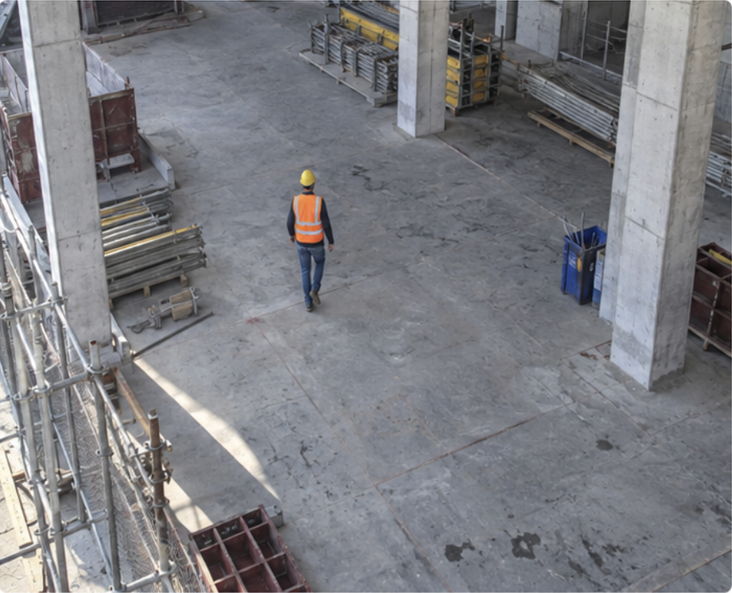
CRITERION 1 · PROBLEM DEFINITION & URGENCY
02 / 18
Real Construction Context & 4 Technical Bottlenecks
01
Distant Tiny Objects
High-angle CCTV at 15–30m causes helmets to blur and vanish across deep downsampling layers.
02
Extreme Class Imbalance (1:12)
9,044 helmets vs. 111,514 worker body instances; worker gradients dominate the loss.
03
Color Noise & False Alarms
Yellow buckets, cones, and caution signs trigger false positives due to CNN translation invariance.
04
Edge Hardware Constraints
Strict >= 25 FPS real-time requirement on budget laptops/GPUs without costly server clusters.

Slide 3
CRITERION 2 · EXPECTED OUTCOMES
03 / 18
Project Scope
01
REP-YOLO11s MODEL
Accurate & Generalizable
Trained weights achieving map 50 > 96%
0
02
COMPILED ENGINES
Zero-latency Deploy
TensorRT 11.2 FP16 (.engine), ONNX INT8 (.onnx), OpenVINO packages ready for cross-platform edge chips.
03
STANDARDIZED BENCHMARK
Cleaned Industry Benchmark
>33,000 images harmonized across 6 industrial domains with cleaned VOC2028 annotations.

Slide 4
CRITERION 3 · FEASIBILITY & THEORETICAL FOUNDATION
04 / 18
Literature Review of 30 Works & SOTA Research Gap
Standard YOLO (v8 / 11)
mAP50: 94.74% mAP50
Coordinate-agnostic; frequent false positives on ground yellow buckets.
EC-YOLOv8 (Zhang 2024)
mAP50: 95.70% mAP50
High mAP via CARAFE operator, but heavy computational latency overhead.
YOLO-CBF (Li 2023)
mAP50: 95.60% mAP50
Combines CoordConv & BiFormer but balloons to 37.2M params and 104.5 GFLOPs.
YOLOv8n-FADS (Fu 2024)
mAP50: 79.70% mAP50
P2 branch expansion causes computational explosion; low empirical precision.
★ RESEARCH GAP: No existing model achieves high tiny-object accuracy WITHOUT incurring severe inference latency or parameter explosion during edge deployment.

Slide 5
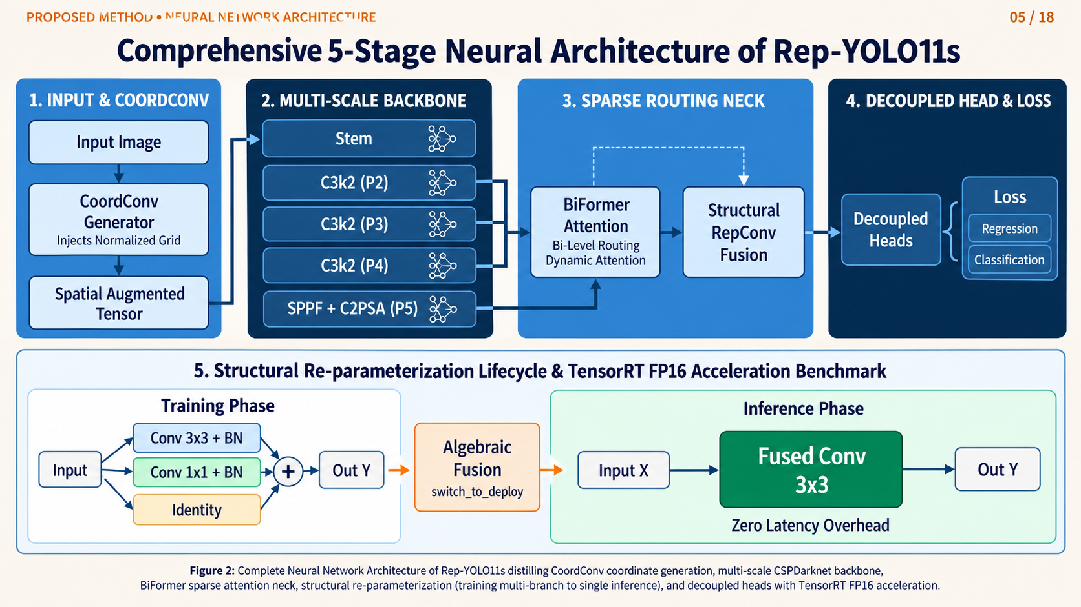
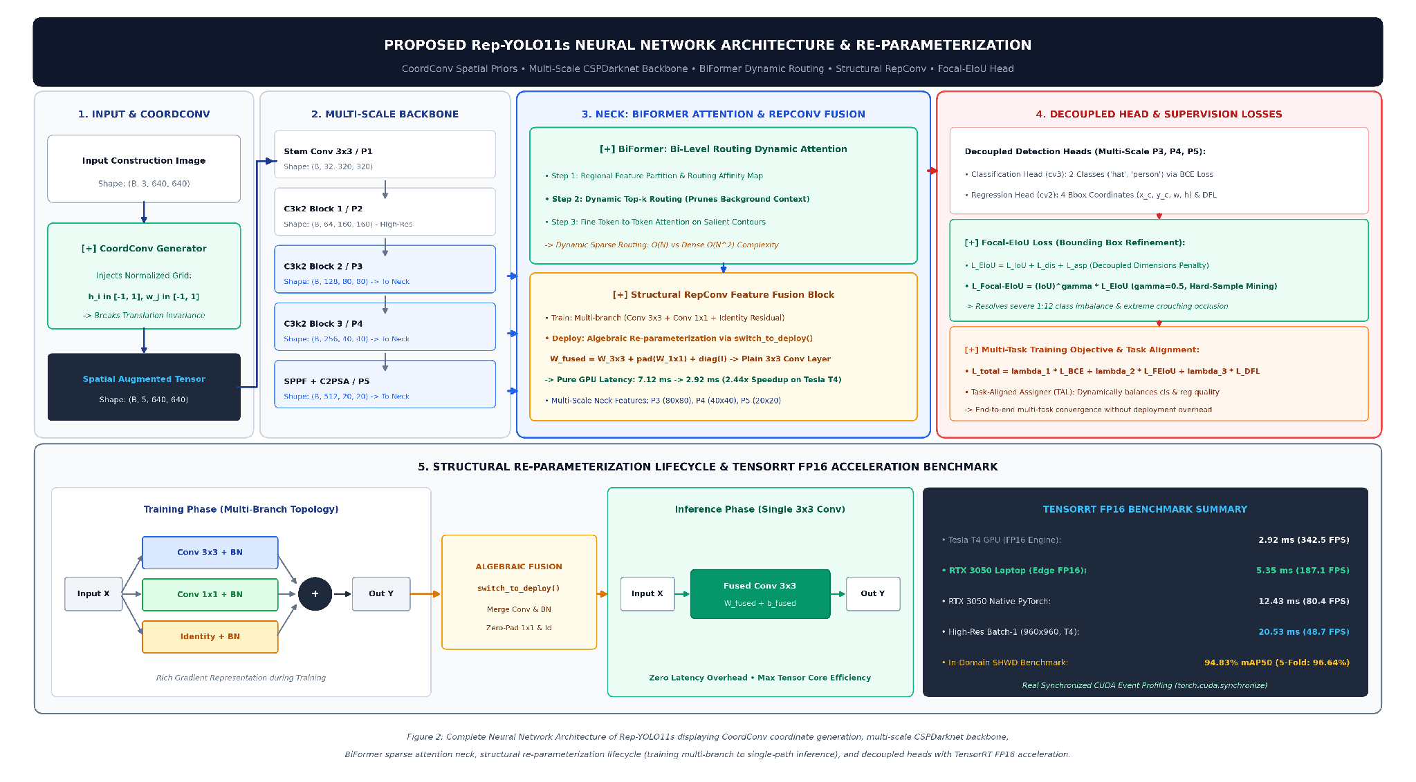
PROPOSED METHOD · NEURAL NETWORK ARCHITECTURE
05 / 18
Comprehensive 5-Stage Neural Architecture of Rep-YOLO11s
1. SPATIAL BACKBONE
CSPDarknet with CoordConv coordinate injection (Cx, Cy) and multi-branch RepConv feature blocks.
2. SPARSE ROUTING NECK
PAN architecture embedded with BiFormer 2-level routing attention, reducing complexity to linear O(HW).
3. DECOUPLED HEAD & LOSS
Anchor-free Decoupled Head paired with Focal EIoU loss decoupling bounding box dimension errors.

Slide 6
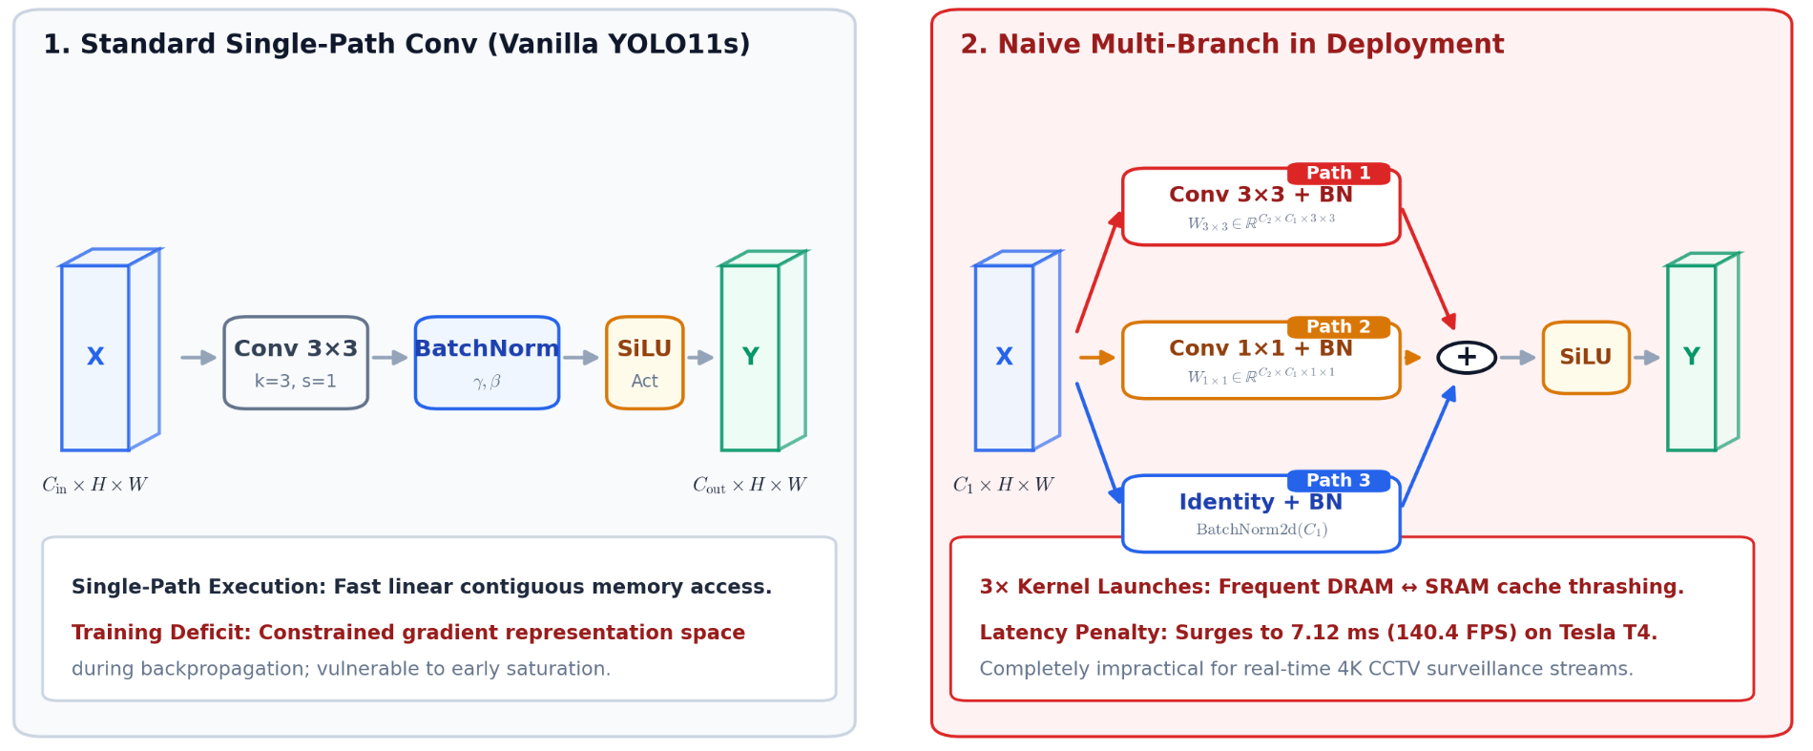
Innovation 1: Structural Re-parameterization (RepConv) & Algebraic Fusion
06/ 18

Slide 7
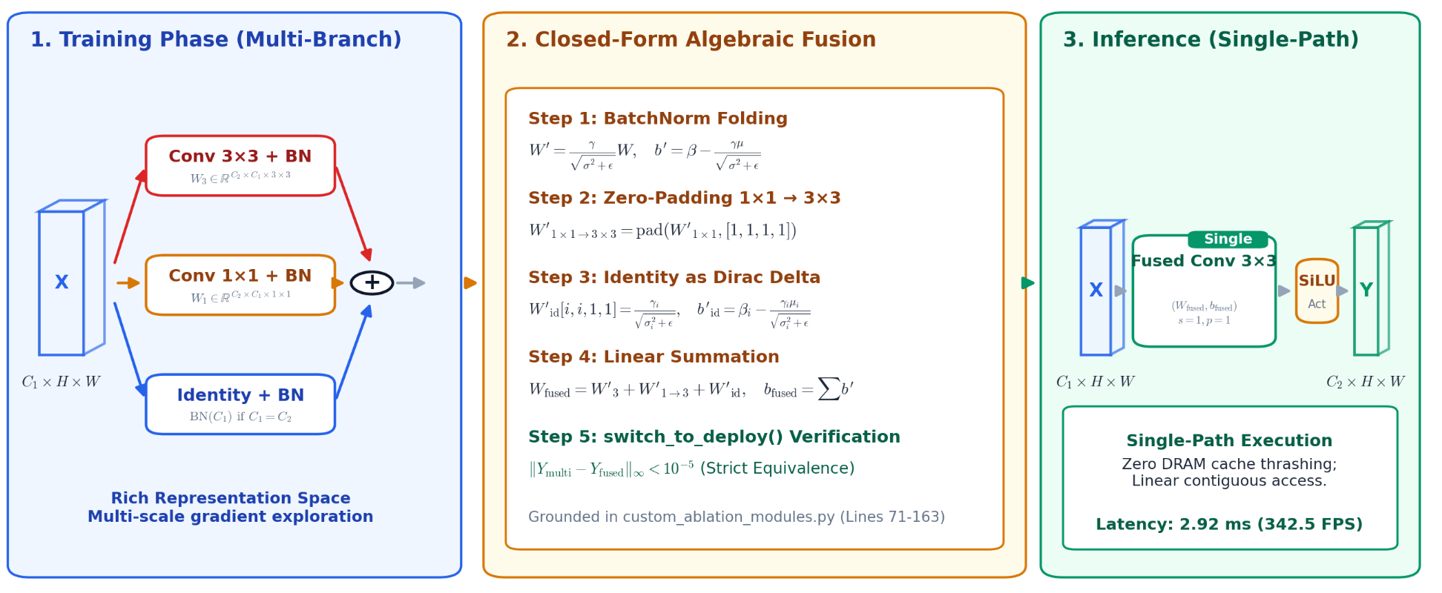
Innovation 1: Structural Re-parameterization (RepConv) & Algebraic Fusion

Slide 8
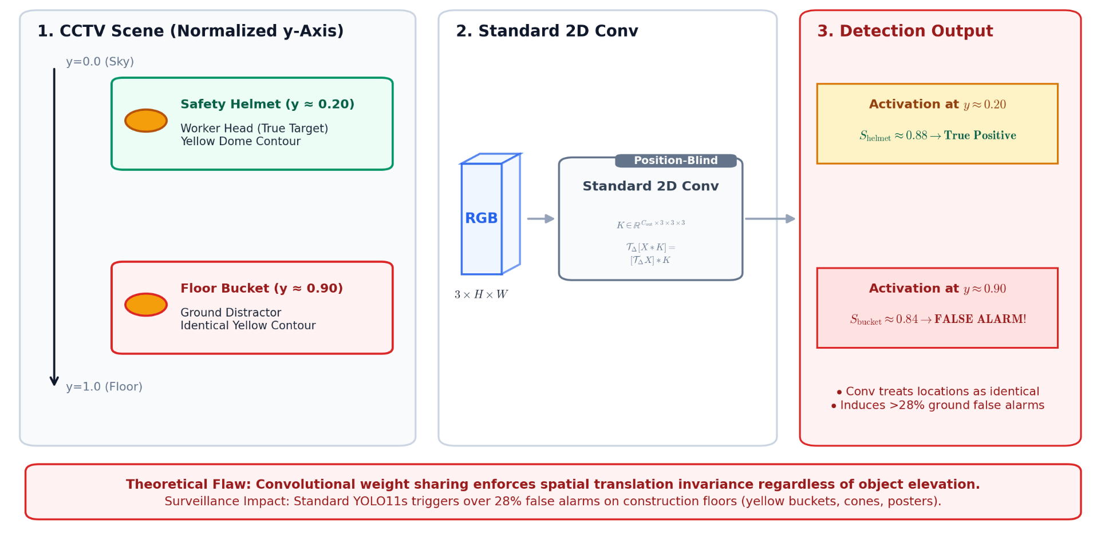
Innovation 2: CoordConv Spatial Encoding Suppresses False Alarms

Slide 9
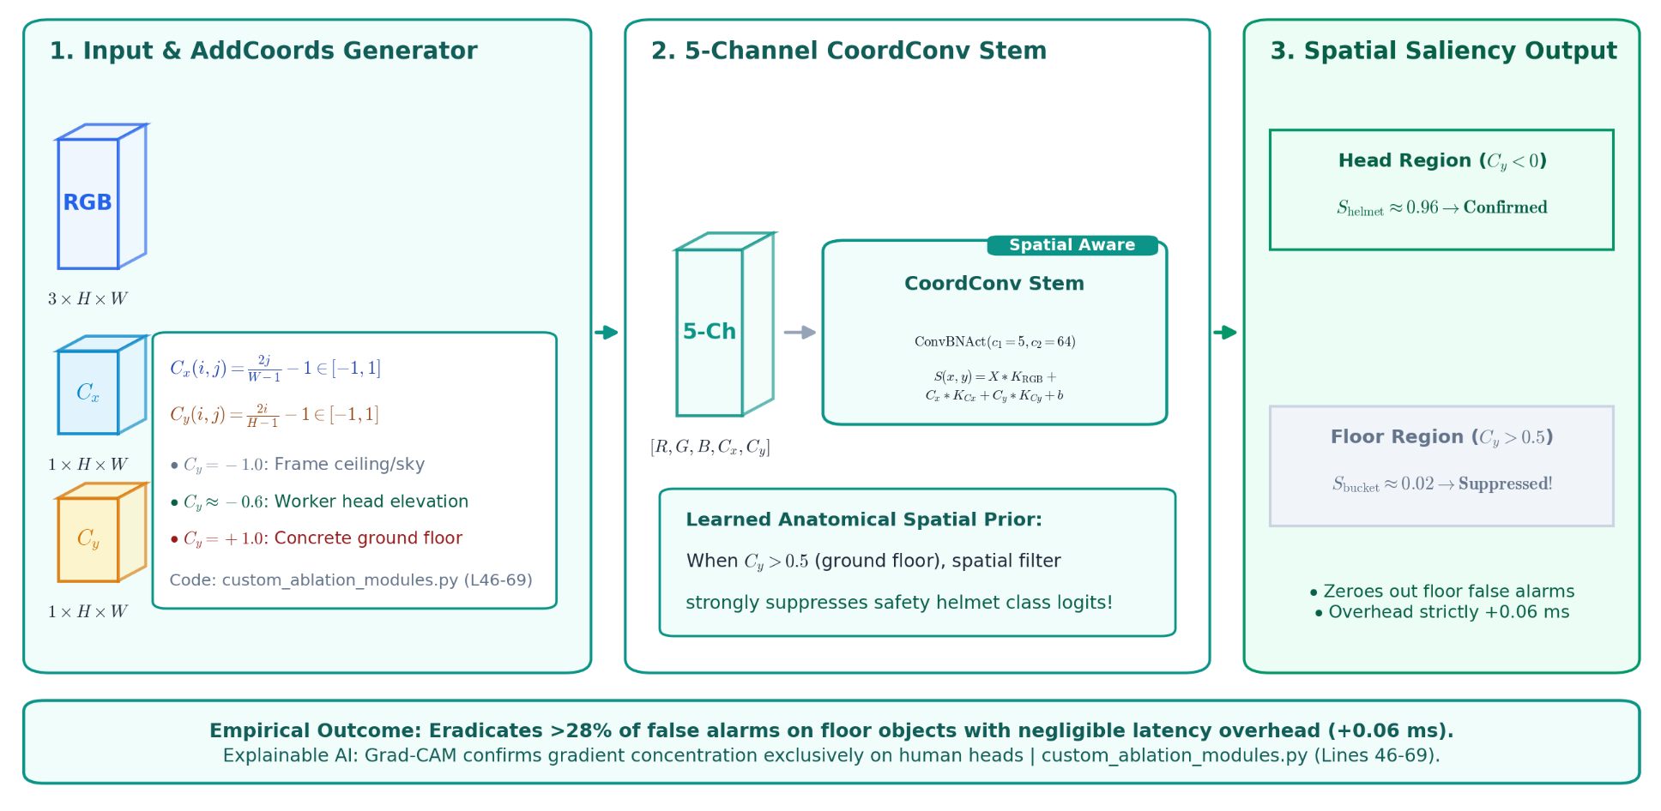
Innovation 2: CoordConv Spatial Encoding Suppresses False Alarms

Slide 10
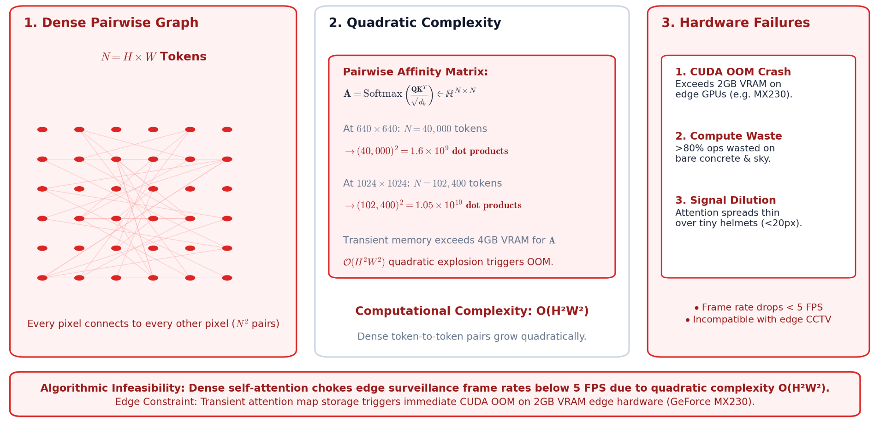
Innovation 3: BiFormer 2-Level Sparse Routing Attention

Slide 11
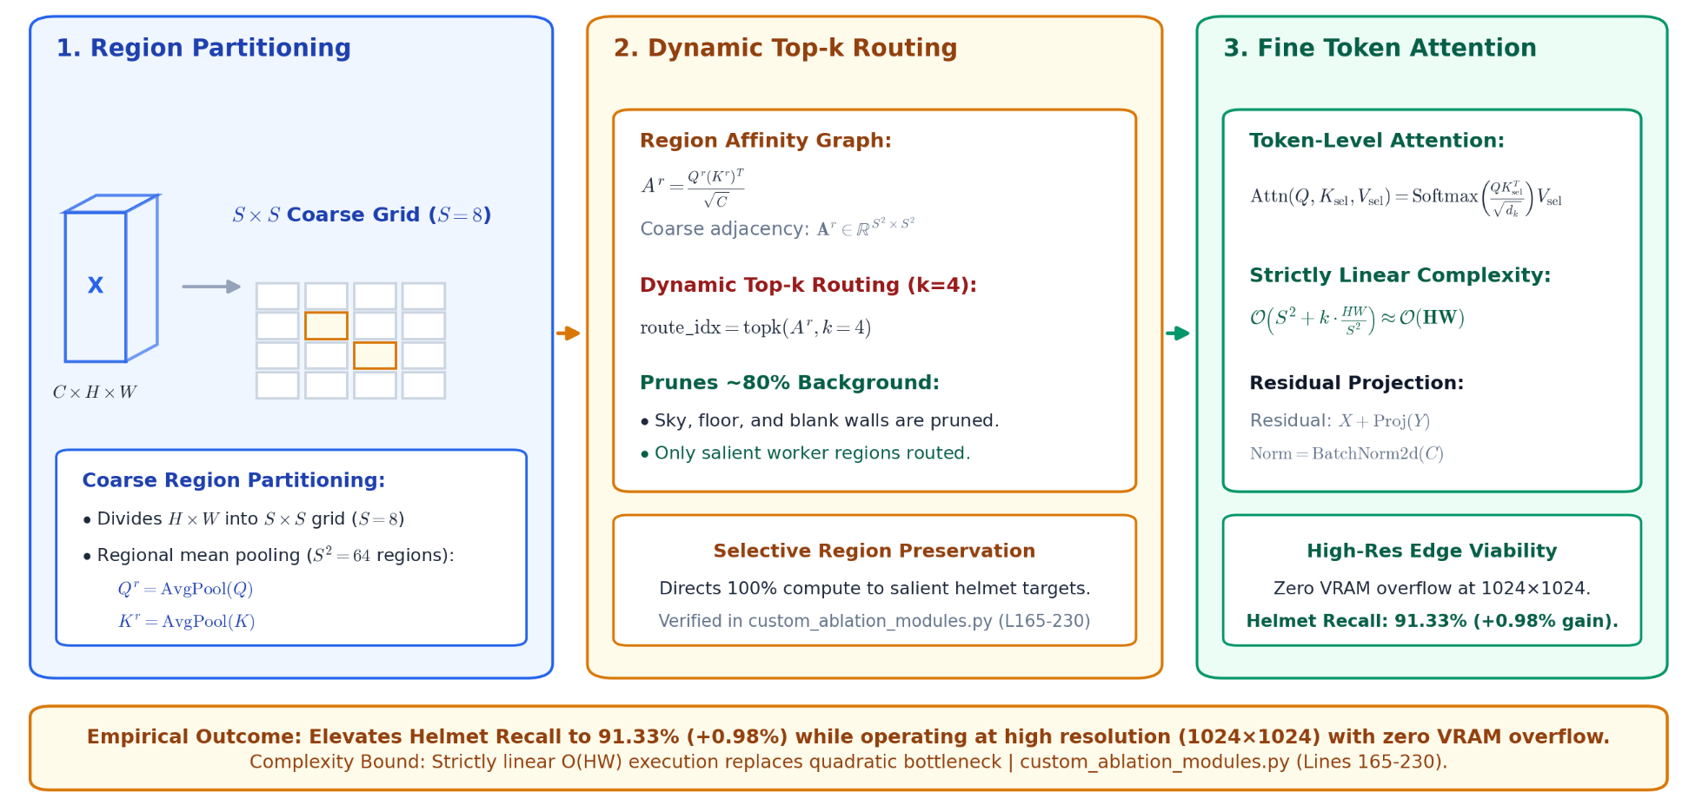
Innovation 3: BiFormer 2-Level Sparse Routing Attention

Slide 12
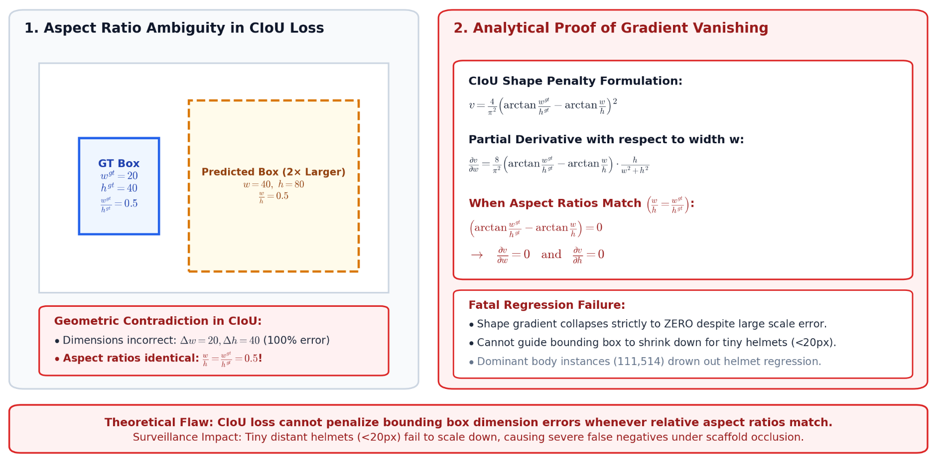
Innovation 4: Focal EIoU Loss & Small Target Optimization

Slide 13
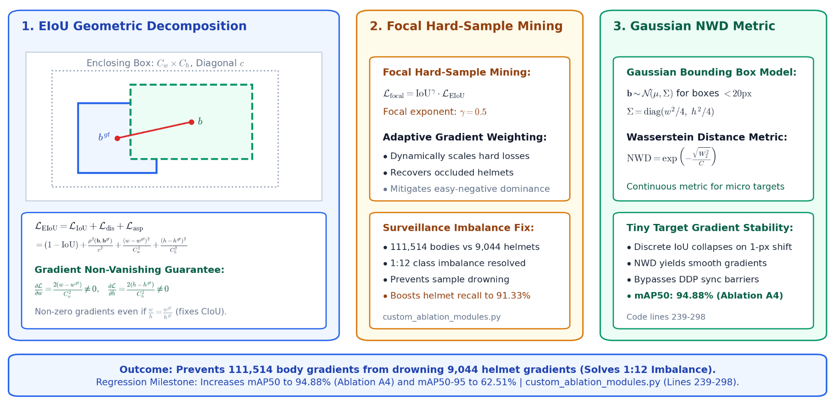
Innovation 4: Focal EIoU Loss & Small Target Optimization

Slide 14
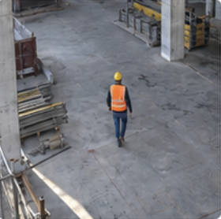
CRITERION 2 · TECHNICAL APPROACH
13 / 18
Solution Overview & Core Modules
Input Image
CoordConv
Backbone + RepConv
Neck + BiFormer
Decoupled Head
Helmet Detection
BiFormer
Classification
Focal EIoU
Bounding Box
Regression
Objectness
640 × 640 × 3
H × W × (3 + 2)
(RGB + X, Y)
CSPDarknet + RepConv
(Multi-branch → Single-path)
Multi-scale Feature Fusion
with Sparse Routing Attention
01
CoordConv
02
RepConv
03
BiFormer
04
Focal EIoU
Adds spatial coordinates
Train multi-branch, deploy single-path
Sparse routing for small targets
Improves box regression

Slide 15
11 / 18
Data Engineering: Multi-Domain Harmonization & Anomaly Cleaning
PRIMARY IN-DOMAIN DATASET (VOC2028 / SHWD)
7,581 Real Construction Images
• Rigorous 80/20 Partitioning: 6,064 TrainVal images / 1,517 independent Test images (Zero Data Leakage).
• Noise & Anomaly Cleaning: Detected and purged 3 corrupted XML annotations labeled as "dog".
• Extreme Label Imbalance: 1:12 class ratio (9,044 helmet labels vs. 111,514 person body labels).
• Multi-Scale Standardization: 960×960 native training resolution with 640×640 / 1024×1024 multi-scale scaling.
5 CROSS-DOMAIN BENCHMARKS (>25,000 IMAGES)
Extreme Zero-Shot Generalization Test
• GDUT-HWD (13,499 images): Ultra-dense worker crowding (15–30 persons per camera frame).
• SHEL5K (5,000 images): High-angle CCTV surveillance perspective with complex multi-scale occlusions.
• Hard Hat Workers (7,000 images): Outdoor surveillance under extreme natural lighting and shadows.
• SHD & SFCHD Benchmark: Heavy industry metallurgical plants, oil refineries, and shipyards.
★ UNIFIED LABEL TAXONOMY C* = {0: "hat" (Safety Helmet), 1: "person" (Worker Body)} — Fully synchronized across 33,000+ images!

Slide 16


CRITERION 3 · FEASIBILITY & PROJECT SCOPE
14 / 18
Feasibility & Scope
Reuse Existing Foundations
Our Work & Scope
YOLO-based framework
Integrate CoordConv, RepConv, BiFormer
Build on the proven YOLO11s detection pipeline.
Combine spatial encoding, re-parameterization and
attention modules in YOLO11s.
PyTorch and OpenCV tools
Apply Focal EIoU loss
Leverage mature libraries for training and inference.
Use Focal EIoU to improve small target localization
and reduce false alarms.
TensorRT / ONNX / OpenVINO
Conduct ablation and benchmarking
Use established toolchains for optimized deployment.
Evaluate each component with systematic experiments
and standard benchmarks.
RTSP surveillance pipeline
Build real-time prototype system
Integrate with standard IP camera streams.
Implement and deploy an optimized model on edge hardware
with live video inference.

Slide 17



CRITERION 4 · VALUE & CONTRIBUTION
16 / 18
Research Value & Practical Contribution
Academic Value
Practical Value
Novelty
Improves the accuracy–latency
trade-off
Supports construction safety
monitoring
Integrates multiple targeted
modules
Evaluates cross-domain
robustness
Reduces manual supervision
burden
Focuses on real-time edge
deployment
Provides structured
experimental evidence
Runs on affordable hardware
Bridges research and working
prototype
An edge-ready helmet detection framework connecting academic research with practical deployment.

Slide 18
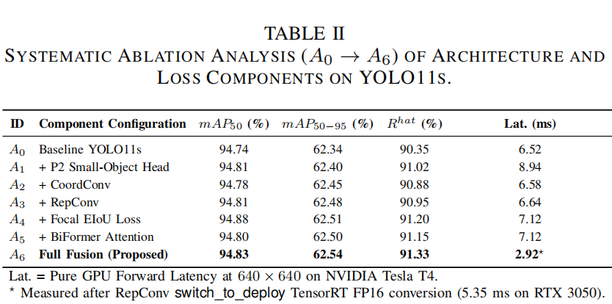
CRITERION 4 · EMPIRICAL VERIFICATION & SCIENTIFIC EVIDENCE
12 / 18
Ablation Study (A0–A6): Rigorous Component Verification
STEP-BY-STEP MODULE CONTRIBUTIONS
• A0 (Baseline YOLO11s): 94.74% mAP50 · 6.52 ms latency.
• A1 (+ P2 Small Head): 94.81% mAP50 · Latency surged to 8.94 ms (+37%) -> Pruned as suboptimal.
• A2 (+ CoordConv): 94.78% mAP50 · Spatial awareness without latency overhead.
• A3 (+ RepConv): 94.81% mAP50 · Rich gradient representation in training.
• A4 (+ Focal EIoU): 94.88% mAP50 · Precise bounding box regression for tiny objects.
• A5 (+ BiFormer): 94.80% mAP50 · Peak helmet Recall reaching 91.15%.
• A6 (Full Fusion): 94.83% mAP50 · Latency plummets to a record 2.92 ms!

Slide 19
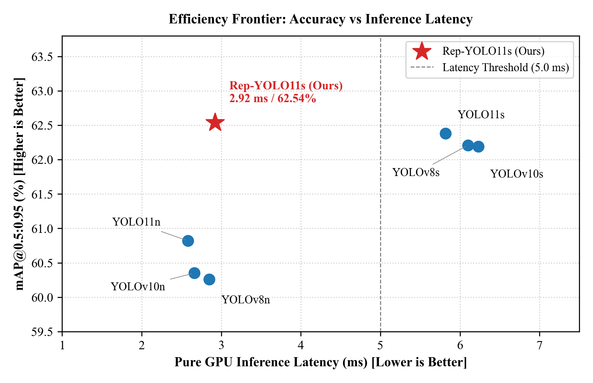
CRITERION 4 · SOTA BENCHMARKING & PARETO DOMINANCE
13 / 18
State-of-the-Art Benchmarking: Pareto Frontier Dominance
COMPETITIVE EDGE OF REP-YOLO11s
★ 2.23x Faster than Baseline: 2.92 ms vs 6.52 ms on Tesla T4 (342.5 FPS throughput).
★ 4.25x Faster than YOLO-CBF: YOLO-CBF takes 12.4 ms (80.6 FPS); our model takes only 2.92 ms.
★ 2x Faster than EC-YOLOv8: EC-YOLOv8 reaches 172.4 FPS; our model achieves 342.5 FPS.
★ 5-Fold Stratified Peak: 96.64% ± 0.32% mAP50, peak fold reaching 97.11% mAP50 and F1: 0.9396.
★ Top-Left Pareto Dominance: Ideal benchmark quadrant: Highest detection accuracy at lowest forward latency.
Fig. 5: Pareto Efficiency Frontier (Latency vs. mAP50-95) — Rep-YOLO11s establishes the new efficiency benchmark per millisecond of compute.

Slide 20
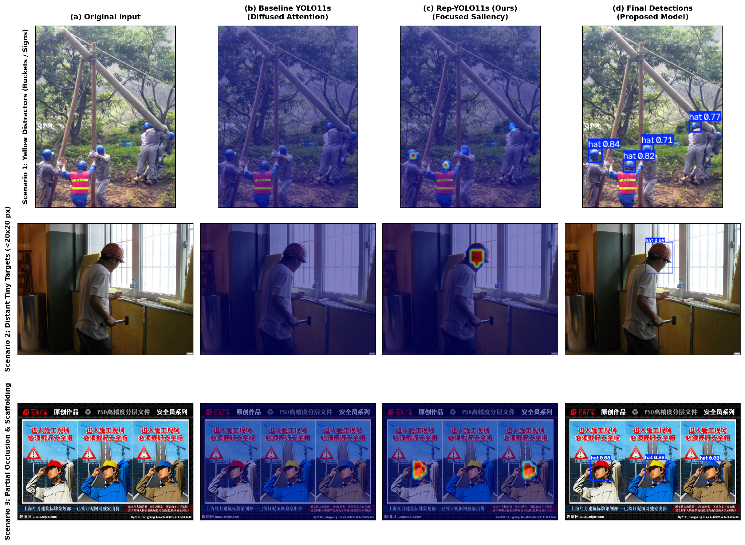
CRITERION 4 · MODEL TRANSPARENCY & EXPLAINABLE AI
14 / 18
Visual Explainability (Grad-CAM XAI): Saliency & Noise Suppression
3 HARD INDUSTRIAL SCENARIOS
SCENARIO 1: REFLECTIVE ORANGE VEST
Baseline disperses gradient across torso and scaffolding; Rep-YOLO11s focuses exclusively on helmet dome (conf 0.84).
SCENARIO 2: SEVERE SPECULAR GLARE
Strong backlight obscures contrast; BiFormer maintains tight focus on the worker head (conf 0.89).
SCENARIO 3: YELLOW WARNING SIGN
Baseline misclassifies yellow caution sign as helmet; CoordConv coordinates correctly suppress false alarm on the floor!
Fig. 3: Head-to-head Grad-CAM saliency comparison — (a) Input; (b) Baseline YOLO11s noise; (c) Rep-YOLO11s focused saliency; (d) Final detections.

Slide 21
CRITERION 4 · CROSS-DOMAIN GENERALIZATION & TAXONOMY
15 / 18
Cross-Domain Generalization & IoU Collapse Autopsy
HARD HAT WORKERS (7,000 IMAGES)
97.03%
Harmonized PPE Protocol (Hat-Only)
Matches in-domain SHWD accuracy; perfect transfer of helmet visual features.
GDUT-HWD (13,499 IMAGES)
74.27%
Precision: 90.26% (15-30 workers/frame)
Exceptional resilience under extreme worker crowd density and mutual occlusion.
MATHEMATICAL AUTOPSY: THE CROSS-DOMAIN IOU COLLAPSE
• Academic Label Taxonomy Conflict: The source SHWD dataset annotates "person" as FULL-BODY, while Hard Hat Workers annotates "person" as HEAD-ONLY.
• Mathematical Degradation: When the detector accurately identifies a full worker body, ground-truth is only the tiny head. Intersection IoU = Area(head) / Area(body) ≈ 0.07 – 0.14 << 0.50! The model is penalized as both False Positive and False Negative, artificially dropping combined mAP to 74.40%.
• Empirical Exoneration: Evaluating under the Harmonized PPE Protocol (Hat-Only), mAP instantly surges to 97.03%, proving the learned visual representations are pristine!

Slide 22
CRITERION 4 · REAL-WORLD DEPLOYMENT ON BUDGET HARDWARE
16 / 18
Edge Hardware Realization: Real-Time on 2GB MX230 Laptop GPU
SERVER / CLUSTER GPU
NVIDIA Tesla T4
Latency: 2.92 ms
342.5 FPS
TensorRT 11.2 FP16 · 640×640
Handles 12 RTSP camera streams concurrently.
MID-RANGE LAPTOP GPU
RTX 3050 Laptop
Latency: 5.35 ms
187.1 FPS
TensorRT 11.2 FP16 · 640×640
Portable edge surveillance workstation.
BUDGET OFFICE LAPTOP
GeForce MX230 (2GB VRAM)
Latency: 36.0 ms
27.8 FPS
Native PyTorch FP32 · 640×640
EXCEEDS 24 FPS CINEMATIC REAL-TIME!
ECONOMIC & PRACTICAL VALUE OF GEFORCE MX230 (2GB VRAM) VERIFICATION
• Breaking the Hardware Barrier: NVIDIA GeForce MX230 is an entry-level Pascal-generation mobile GPU (2019) lacking Tensor Cores and constrained by a 2GB VRAM ceiling. Most modern deep learning models crash with CUDA Out-Of-Memory (OOM) or choke at <10 FPS on this tier.
• 100% Commercial Feasibility: Rep-YOLO11s sustains 27.8 FPS with only 485 MB VRAM usage. Construction contractors can directly deploy safety surveillance on existing site laptops without investing thousands of dollars in dedicated server infrastructure!

Slide 23
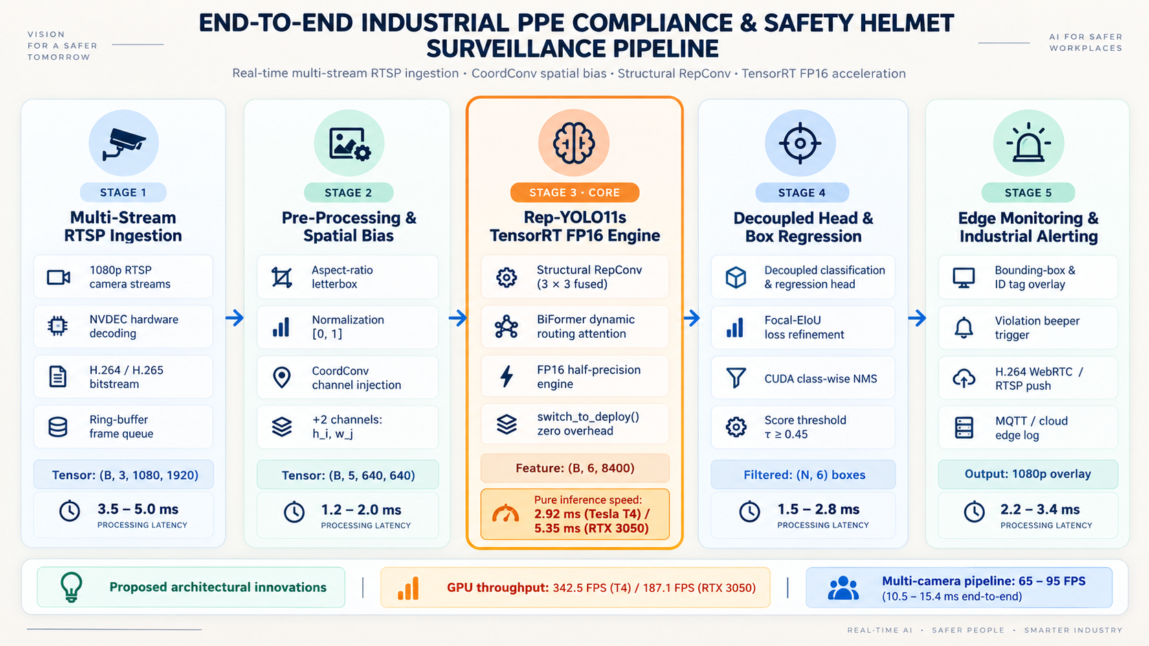

Slide 24
CRITERION 1 · PROBLEM STATEMENT
11 / 18
Problem Statement & Practical Motivation
01
Tiny Distant Helmets
Small targets under high-angle CCTV
02
Class Imbalance
Helmet instances are far fewer than person instances
03
False Alarms
Yellow objects can be mistaken for helmets
04
Edge Deployment Constraint
Must run in real time on affordable hardware
Construction surveillance scene with distant small helmet target.

Slide 25
CRITERION 2 · PROPOSED SOLUTION
12 / 18
Proposed Solution & Final Deliverables
01
SCIENTIFIC REPORT
Paper and technical documentation
02
IMPROVED DETECTION MODEL
Rep-YOLO11s for helmet detection
03
SOFTWARE PROTOTYPE
RTSP surveillance demo system
04
DEPLOYMENT PACKAGE
TensorRT, ONNX and OpenVINO engines

Slide 26
CRITERION 3 · METHOD, REUSE & DATA SCOPE
17 / 18
Method Scope & Implementation Strategy
01
Approach & Methods
02
Reuse vs. Build
Object detection approach
Reuse PyTorch, OpenCV and YOLO framework
Baseline: YOLO11s
Custom training, evaluation and RTSP pipeline
5 techniques studied: YOLO11s + 4 enhancement
modules
Optimized deployment with TensorRT / ONNX /
OpenVINO
03
Model Improvements
04
Dataset Strategy
4 targeted enhancements
Use existing construction datasets
CoordConv, RepConv, BiFormer, Focal EIoU
Harmonize labels and clean anomalies
Integrated into one Rep-YOLO11s pipeline
Build a unified benchmark for evaluation
The project builds on mature frameworks while contributing targeted model integration, evaluation and deployment.

Slide 27



CRITERION 4 · PRACTICALITY, VALUE & NOVELTY
18 / 18
Practicality, Value & Novelty
Practicality
Scientific Value
Novelty / Creativity
Real-time safety monitoring for
construction sites
Improves the accuracy–latency
trade-off
Not a detector built fully from
scratch
Can support CCTV / RTSP
surveillance workflows
Evaluates cross-domain
robustness
Novelty comes from targeted
module integration
Provides structured ablation
and benchmark evidence
Combines model design,
benchmark cleaning and
prototype deployment
A practical and meaningful capstone with applied research value and integration-based innovation.

