Slide 1
北京十號線SNMP加速
Yutzu

Slide 2
Target
Model: MDS-G4000-4XGS-L3
Base branch: NOS v5.x
Jira issue: https://jira-dc.moxa.com/browse/RDMDS42-32
Gitlab issue: https://gitlab.com/moxa/sw/switch/general/buildsystem/moxa/-/issues/3892
Aim: reduce one SNMP GET access time for target OIDs under 50ms
目前解法因有限制，無法直接導回NOS 7.0
Notes:
為什麼從100ms 改成 50ms 原因是過去交控使用我們的交換機 都是以這個數據當作告警要求
所以 換成 nos 後 也堅持 要維持
如果偶爾出現超過50ms 是可以接受

Slide 3
CV Schedules
10/17交付FWR給手測，使用交控testbed，確認行為符合交控期望
11/21交付FWR給自測，使用三天測項，確保一般行為正常；同時交付給MCN小臣進行測試
11/28交付FWR給MCN

Slide 4
Target OID
IF-MIB
ifTable
1.3.6.1.2.1.2.2.1.8 //交换机端口UP/DOWN状态 (ifOperStatus)
1.3.6.1.2.1.2.2.1.10 //交换机端口流量统计值 (ifInOctets)
1.3.6.1.2.1.2.2.1.14 // 交换机端口错误包数 (ifInErrors)
ifXTable
1.3.6.1.2.1.31.1.1.1.15 // 交换机端口带宽 (ifHighSpeed)
mxFiberCheck.mib
1.3.6.1.4.1.8691.603.5.3.2.1.1.1.8 // fiberCheckStatTxPower
1.3.6.1.4.1.8691.603.5.3.2.1.1.1.9 // fiberCheckStatRxPower
MOXA-CVCOMMON.mib
1.3.6.1.4.1.8691.7.999.1.1.2.0 //交换机CPU使用率
1.3.6.1.4.1.8691.7.999.1.1.1.0 //交换机系统时间
其他資訊
GET OID最後面帶有port index。例如”GET .1.3.6.1.2.1.2.2.1.10”最後並沒有帶有port index，而”GET .1.3.6.1.2.1.2.2.1.10.1”最後帶有port index 1
不會使用SNMP v3，僅使用GET method v1
不會使用SNMP SET，皆為read-only OID

Slide 5
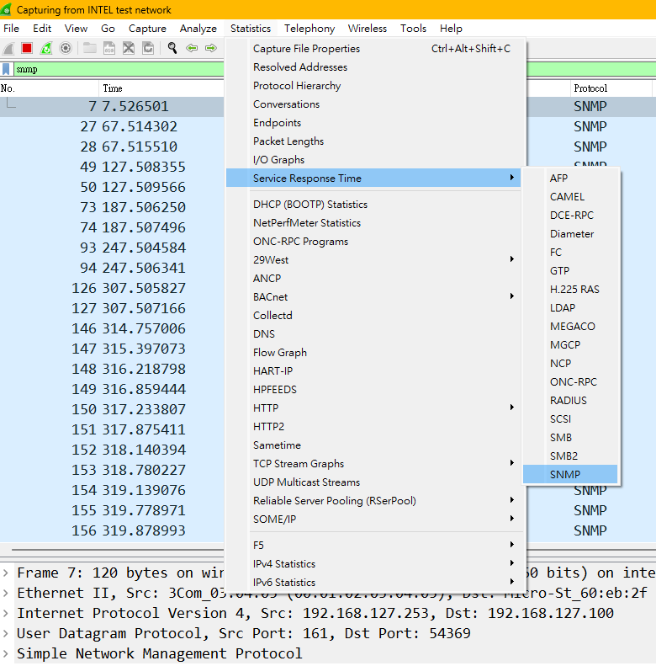
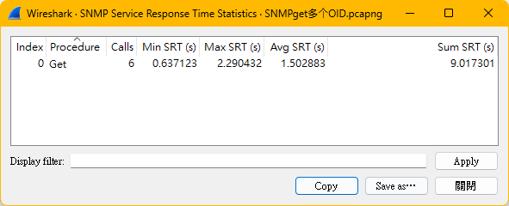

Slide 6
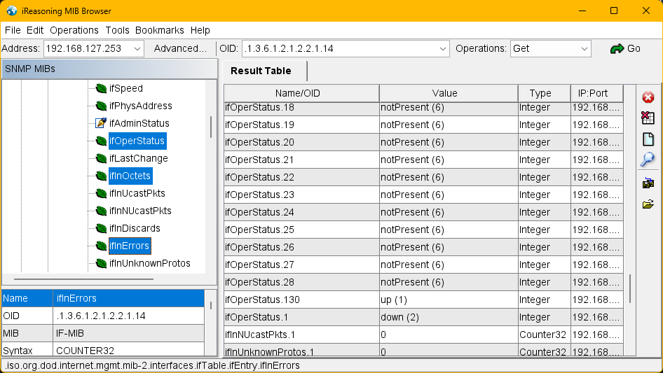
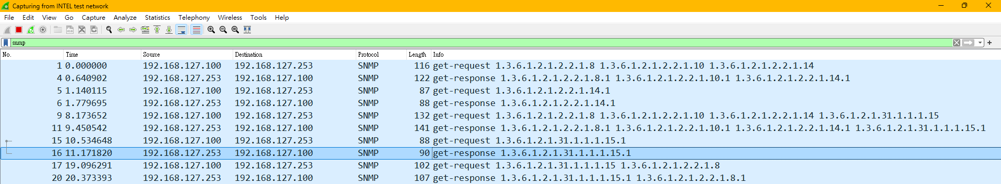
Current status
MDS-G4028-L3-4XGS v5.0 2025_0623_1125
Case 1
Version: v1
Method: GET同一個ifTable底下1-3個OID
Result: 約600ms

Slide 7
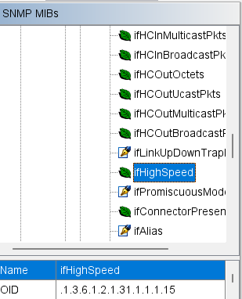
Current status
MDS-G4028-L3-4XGS v5.0 2025_0623_1125
Case 2
Version: v1
Method: GET跨ifTable, ifXTable底下2個以上OID
Result: 約1200ms

Slide 8
Current status
MDS-G4028-L3-4XGS v5.0 2025_0623_1125
Case 3
Version: v3
Method: GET同一個ifTable底下1-3個OID
Result:

Slide 9
Current status
MDS-G4028-L3-4XGS v5.0 2025_0623_1125
Case 4
Version: v3
Method: GET跨ifTable, ifXTable底下2個以上OID
Result:

Slide 10
How does SNMP get DATA from ISS
Net-SNMP
ies_auto_mibs
dlmod
Before | After Proxy
Execute Program Connect (With socket) Call function (Translate OID to URI) Send Data Write File (Remap Port/ Port Channel) Read Data | Proxy GET req to port 6161 ISS response
1
1
6
Proxy
ies_uri_handle_client
5
Output File
2
4
2
SNMP
URI ctrl hook
3
snmpdb
Config
Status
ISS

Slide 11
Known reasons for long access time
ISS URI Ctrl Hook
ISS URI hook
SNMP
GET req
ies_uri_handle_connect
accept
connected
write(magic, uri, fname)
ies_uri_handle_srv_handle_func
select(start)
with 100ms timeout & 500ms delay
For tabular get all table
write(magic, uri, fname)
select(fd ready)
util_read_until_full

Slide 12
Limitation for proxy by snmpd.conf
snmpd需要事先設定特定要進行proxy的OID和SNMP version
可以帶入framework的設定給snmpd
client不能直接用column OID進行GET (若修改ISS可能可達成)
Cannot access framework for read/write config

Slide 13
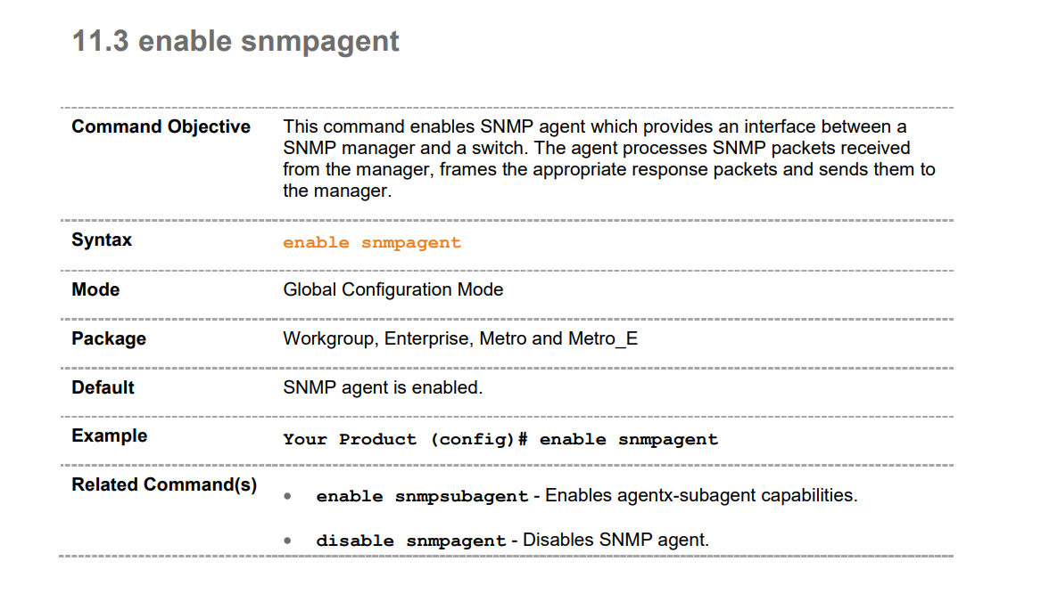
ISS as SNMP agent
Notes:
以NOS 5.0 code base，default狀態snmpagent是enable的。但仍無法在shell中，以snmpd的command直接向ISS存取snmp。
可先參考https://jira-dc.moxa.com/browse/RDNOS-3253的修改，使ISS在啟動時就可以直接init snmpagent在port 6161上。

Slide 14
Add Proxy OID in SNMPd by snmpd.conf
systemctl status config_moxa_snmp
systemctl status app_moxa_snmp_server
vi /moxa/run/snmp/snmpd.conf
proxy -v 1 -c public 127.0.0.1:6161 .1.3.6.1.2.1.2.2
proxy -v 1 -c public 127.0.0.1:6161 .1.3.6.1.2.1.31.1.1
systemctl restart app_moxa_snmp_server

Slide 15
Execution chain
plugin_moxa_snmp/app/config_moxa_snmp_control.c/setup_snmpd_config, setup_snmpd_plugin_conf -> /moxa/run/snmp/snmpd.conf
plugin_moxa_snmp/app/config_moxa_snmp_control.c/_ControlIsSnmpd -> /etc/moxa/config-moxa-snmp/init_snmpd.sh
init_snmpd.sh -> snmpd -f -C -c snmpd.conf … other configs

Slide 16
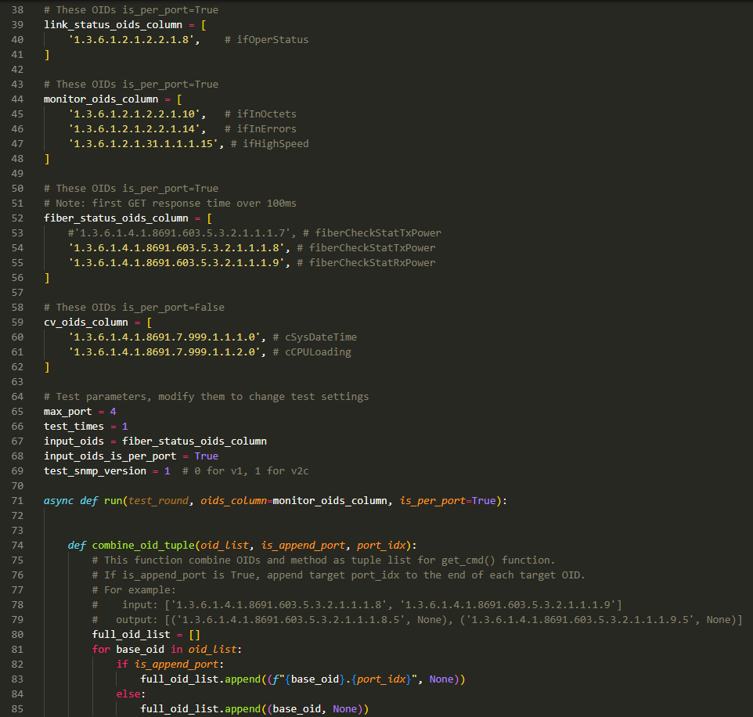
Test with pysnmp script
Modify here to change test parameters
Notes:
https://docs.lextudio.com/pysnmp/v7.1/docs/hlapi/v1arch/asyncio/manager/cmdgen/getcmd

Slide 17
Target OID combination
Test topology
MDSL3
NOS v5.0
1/4 F
2/4 B
1/4 F
1/3 F
MDSL2
NOS v5.0
TR2
fast VRRP*16
1/3 F
2/3 F
MDSXGL3(DUT)
NOS v5.0
OID获取逻辑
一包会获取28个端口的link on/off状态
1.3.6.1.2.1.2.2.1.8 //交换机端口UP/DOWN状态 (ifOperStatus)
一包获取所有“正在使用”的端口的流量、带宽、错误包，也就是在用端口数量*3
1.3.6.1.2.1.2.2.1.10 //交换机端口流量统计值 (ifInOctets)
1.3.6.1.2.1.2.2.1.14 // 交换机端口错误包数 (ifInErrors)
1.3.6.1.2.1.31.1.1.1.15 // 交换机端口带宽 (ifHighSpeed)
一包获取交换机CPU使用率
1.3.6.1.4.1.8691.7.999.1.1.2.0 //交换机CPU使用率

Slide 18
After proxy performance
获取28个端口的link on/off状态
對28個port的ifOperStatus分別做100次的GET
平均為3ms，最大為59ms
获取所有“正在使用”的端口的流量、带宽、错误包
對28個port的ifInOctets, ifInErrors, ifHighSpeed分別做100次的GET
平均為4ms，最大為52ms
获取fiberCheckStat
對28個port的fiberCheckStatTxPower, fiberCheckStatRxPower分別做100次的GET
平均為15ms，最大為122ms
获取交换机CPU使用率
對cCPULoading, cSysDateTime做100次的GET
平均為17ms，最大為32ms
Notes:
ifOperStatus Syntax INTEGER {up(1), down(2), testing(3), unknown(4), dormant(5), notPresent(6), lowerLayerDown(7) }

Slide 19
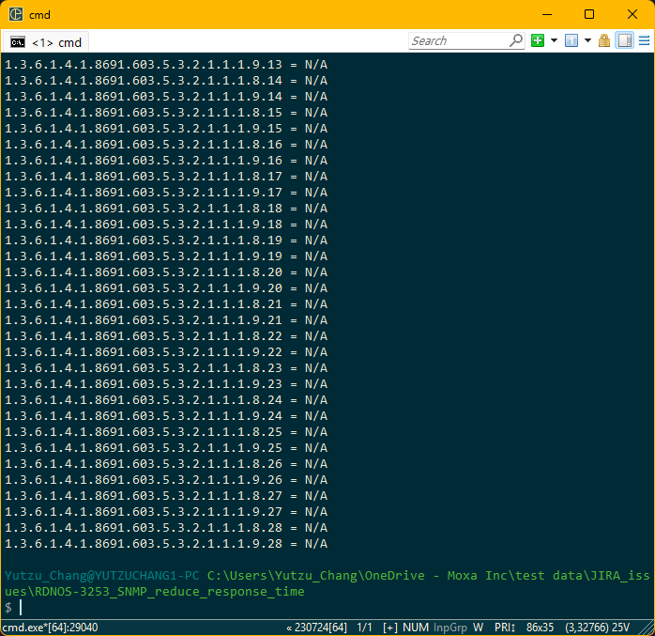
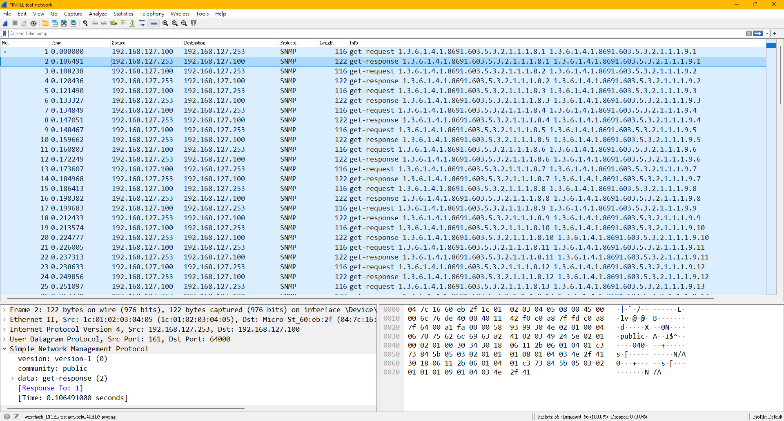
After proxy performance
获取fiberCheckStat (此OID與proxy無關, 為dlmod)
同一port GET 100次，只有第一次較慢
不同port各GET一次，一樣只有第一個port較慢

Slide 20
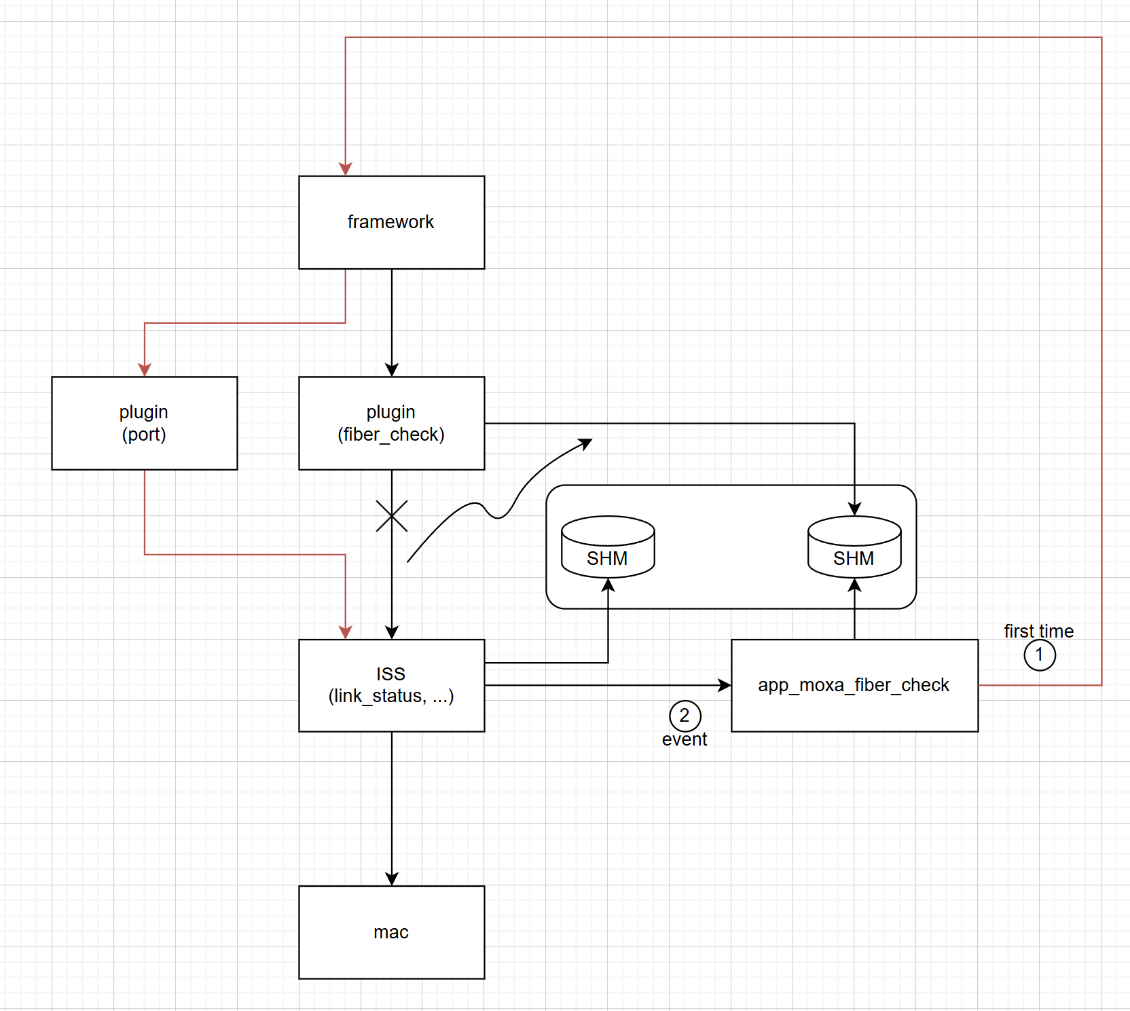
Get URI
/api/v1/status/portStatus/portTable/%d/linkStatus
If == FAKE_RX_POWER_WHEN_LINK_DOWN
rxPower = N/A
Data buffer
linkStatus
get_snmp_data_by_cli ifOperStatus
_FiberEventHandler
If == kFiberLinkUp

Slide 21
PreTest FWR 5.0.3
1MDSXGL3, default config with SNMP enabled
获取交换机CPU使用率
對cCPULoading做10000次的GET
平均為 8ms，最大為 81ms，最小為 7ms，超出50ms的比例為 5/10000
获取28个端口的link on/off状态
對28個port的ifOperStatus分別做400次的GET
平均為 2ms，最大為 19ms，最小為 2ms，超出50ms的比例為 0/11200
获取所有“正在使用”的端口的流量、带宽、错误包
對28個port的ifInOctets, ifInErrors, ifHighSpeed分別做400次的GET
平均為 3ms，最大為 66ms，最小為 3ms，超出50ms的比例為 2/11200
获取fiberCheckStat
對28個port的fiberCheckStatTxPower, fiberCheckStatRxPower分別做400次的GET
平均為 12ms，最大為 81ms，最小為 10ms ，超出50ms的比例為 6/11200
Notes:
ifOperStatus Syntax INTEGER {up(1), down(2), testing(3), unknown(4), dormant(5), notPresent(6), lowerLayerDown(7) }

Slide 22
OID types
OID | cCPULoading | fiberCheckStatTxPower, fiberCheckStatRxPower | (ifOperStatus), (ifInOctets, ifInErrors, ifHighSpeed)
OID type | Scalar | tabular | tabular
SNMP path type | dlmod | dlmod | Proxy SNMP agent
Init start | Started Moxa SNMP Server Service.
Init keyword | dlmod: dlmod_load_module systemUtilization: /etc/moxa/netsnmp/plugin/plugin_snmp_system_utilization.so | dlmod: dlmod_load_module fiber_check: /etc/moxa/netsnmp/plugin/plugin_snmp_fiber_check.so | read_config:opt: Reading optional config file: "/moxa/run/snmp/snmpd_proxy.conf" read_config:parser: Found a parser. Calling it: proxy / -v 1 -c public 127.0.0.1:6161 .1.3.6.1.2.1.2.2 read_config:parser: Found a parser. Calling it: proxy / -v 1 -c public 127.0.0.1:6161 .1.3.6.1.2.1.31.1.1
Init finish | NET-SNMP version 5.8

Slide 23
Log info
Config step
vi /etc/moxa/config-moxa-snmp/init_snmpd.sh
add “-Lo -Dproxy,snmp,transport,transports,snmp_api”
systemctl restart app_moxa_snmp_server
journalctl -u app_moxa_snmp_server -u app_moxa_framework -o short-precise -f
Test step
cCPULoading
fiberCheckStatTxPower, fiberCheckStatRxPower : port 1, port 1-4, port 1-28
ifOperStatus : port 1, port 1-4, port 1-28
ifInOctets, ifInErrors, ifHighSpeed : port 1, port 1-4, port 1-28
Notes:
Debug flag清單可參考 https://net-snmp.sourceforge.io/wiki/index.php/Debug_tokens_5.7.2

Slide 24
Access time log analyze
*1: Wireshark看到的SNMP response time會比total access time略大1ms
*2: 由於開啟許多debug print，此分析僅作為趨勢參考，實際運行時間參考附檔pcap
Unit: ms, 3DUT topology
Measurement item | ifOperStatus |  |  | ifInOctets, ifInErrors, ifHighSpeed |  |  | Note
Test port num | 1 | 4 | 28 | 1 | 4 | 28
1/Snmp recv time | 12 | Per port | Per port | 25 | Per port | Per port | per port GET，每次時間都不一樣，有可能接近0，原因未知
1/Porxy handle time | 4 | Per port | Per port | 8 | Per port | Per port | 每個GET夾帶的OID越多，需時越長
1/Snmp send time | 0 | Per port | Per port | 0 | Per port | Per port | per port GET，每次時間大致相同，有可能接近0，原因未知
0/Total access time | 16 | 6 | 8 | 33 | 51 | 48 | 僅計算第一個port
Notes:
Measurement item Definition:
Snmp recv time: “transport:recv” to “snmp_agent: tp->start”
Porxy handle time: the first “proxy: proxy handler starting” to the last “proxy: got response...”
Snmp send time: “snmp_send: Building SNMPv2 message” to “transport:send”
Total access time: “transport:recv” of the first port to “transport:send” of the first port
Measurement item Relationship:
Measurement item開頭數字為加總階層，如階層0為階層1的加總，階層1為階層2的加總，以此類推，以下示例。另外因為量測點安排因素，有可能出現加總值不等於上一階數值，以others表示。
0/Total access time = 1/Snmp recv time + 1/Proxy handle time + 1/Snmp send time + others
Data source: basic_test_journal_2.log

Slide 25
Access time log analyze
*1: Wireshark看到的SNMP response time會比total access time略大1ms
*2: 由於開啟許多debug print，此分析僅作為趨勢參考，實際總存取時間參考附檔pcap
Unit: ms, 3DUT topology
Measurement item | cCPULoading | fiberCheckStatTxPower, fiberCheckStatRxPower |  |  | Note
Test port num | - | 1 | 4 | 28
1/Snmp recv time | 40 | 53 | Per port | Per port | per port GET，每次時間都不一樣，有可能接近0，原因未知
1/RUST status/ Data prepare time | 13 | 32 | 47 | 24 | 因為有cache，因此連續多個port GET只會執行一次
2/RUST plugin/ Calculate cpu time | 0.9 | - | - | -
2/RUST plugin/ Output shm time | - | 6 | 8 | 4
2/RUST plugin/ Construct port table time | - | 21 | 38 | 18 | 2/RUST plugin/ Construct port table time
3/RUST plugin/ Load config time | - | 8 | 10 | 6
3/RUST plugin/ Check is phr time | - | 3 | 4 | 3 | MDSXG v5.0 不支援PHR，可直接移除
1/RUST status/ Response time | 2 | 26 | second port about 10 | Per port | 一次SNMP GET的Table node越多，需時越長。 建構table包含在GET table中第一個port中，因此第一個port需時較長
1/Snmp send time | 0.8 | 1 | Per port | Per port | per port GET，每次時間大致相同，有可能接近0，原因未知
0/Total access time | 61 | 117 | 86 | 52 | 僅計算第一個port
Notes:
Measurement item Definition:
Snmp recv time: “transport:recv” to “snmp_agent: tp->start”
Data prepare time: “status: path: {path:?}” to the first “status: path: {path:?} value prepare done“
Response time: the first “status: path: {path:?} value prepare done“ to the last “status: path: {path:?} value response done”
Snmp send time: “snmp_send: Building SNMPv2 message” to “transport:send”
Total access time: “transport:recv” of the first port to “transport:send” of the first port
Measurement item Relationship:
Measurement item開頭數字為加總階層，如階層0為階層1的加總，階層1為階層2的加總，以此類推，以下示例。另外因為量測點安排因素，有可能出現加總值不等於上一階數值，以others表示。
0/Total access time = 1/Snmp recv time + 1/Data prepare time + 1/response time + 1/Snmp send time + others
1/Data prepare time = sum of 2/RUST plugin + others
2/Construct port table time = 3/Load config time + 3/check is phr time + others
Data source: basic_test_journal_2.log

Slide 26
Index | OID (.8.x / .9.x) | Start time | End time | Total access time (ms)
1 | .8.1 / .9.1 | 2018-12-21 19:04:19.693432 | 2018-12-21 19:04:19.809947 | 116.52
2 | .8.1 / .9.1 | 2018-12-21 19:04:30.877365 | 2018-12-21 19:04:30.963321 | 85.96
3 | .8.2 / .9.2 | 2018-12-21 19:04:30.967270 | 2018-12-21 19:04:30.983926 | 16.66
4 | .8.3 / .9.3 | 2018-12-21 19:04:30.987176 | 2018-12-21 19:04:31.007507 | 20.33
5 | .8.4 / .9.4 | 2018-12-21 19:04:31.012295 | 2018-12-21 19:04:31.029532 | 17.24
6 | .8.1 / .9.1 | 2018-12-21 19:04:38.475311 | 2018-12-21 19:04:38.527261 | 51.95
7 | .8.2 / .9.2 | 2018-12-21 19:04:38.530854 | 2018-12-21 19:04:38.548668 | 17.81
8 | .8.3 / .9.3 | 2018-12-21 19:04:38.551863 | 2018-12-21 19:04:38.571129 | 19.27
9 | .8.4 / .9.4 | 2018-12-21 19:04:38.573680 | 2018-12-21 19:04:38.590684 | 17.00
10 | .8.5 / .9.5 | 2018-12-21 19:04:38.593620 | 2018-12-21 19:04:38.610330 | 16.71
11 | .8.6 / .9.6 | 2018-12-21 19:04:38.613189 | 2018-12-21 19:04:38.632054 | 18.86
12 | .8.7 / .9.7 | 2018-12-21 19:04:38.635105 | 2018-12-21 19:04:38.651870 | 16.76
13 | .8.8 / .9.8 | 2018-12-21 19:04:38.654712 | 2018-12-21 19:04:38.672559 | 17.85
14 | .8.9 / .9.9 | 2018-12-21 19:04:38.679743 | 2018-12-21 19:04:38.697120 | 17.38
15 | .8.10 / .9.10 | 2018-12-21 19:04:38.699555 | 2018-12-21 19:04:38.716744 | 17.19
16 | .8.11 / .9.11 | 2018-12-21 19:04:38.720469 | 2018-12-21 19:04:38.756721 | 36.25
17 | .8.12 / .9.12 | 2018-12-21 19:04:38.765753 | 2018-12-21 19:04:38.794231 | 28.48
18 | .8.13 / .9.13 | 2018-12-21 19:04:38.794231 | 2018-12-21 19:04:38.817624 | 23.39
19 | .8.14 / .9.14 | 2018-12-21 19:04:38.822318 | 2018-12-21 19:04:38.840782 | 18.46
20 | .8.15 / .9.15 | 2018-12-21 19:04:38.843728 | 2018-12-21 19:04:38.866195 | 22.47
21 | .8.16 / .9.16 | 2018-12-21 19:04:38.869251 | 2018-12-21 19:04:38.887976 | 18.72
22 | .8.17 / .9.17 | 2018-12-21 19:04:38.893426 | 2018-12-21 19:04:38.913433 | 20.01
23 | .8.18 / .9.18 | 2018-12-21 19:04:38.913433 | 2018-12-21 19:04:38.932153 | 18.72
24 | .8.19 / .9.19 | 2018-12-21 19:04:38.935366 | 2018-12-21 19:04:38.957665 | 22.30
25 | .8.20 / .9.20 | 2018-12-21 19:04:38.964679 | 2018-12-21 19:04:38.986256 | 21.58
26 | .8.21 / .9.21 | 2018-12-21 19:04:39.003540 | 2018-12-21 19:04:39.024554 | 21.01
27 | .8.22 / .9.22 | 2018-12-21 19:04:39.024554 | 2018-12-21 19:04:39.063073 | 38.52
28 | .8.23 / .9.23 | 2018-12-21 19:04:39.063073 | 2018-12-21 19:04:39.095689 | 32.62
29 | .8.24 / .9.24 | 2018-12-21 19:04:39.095689 | 2018-12-21 19:04:39.095689 | 0.00
30 | .8.25 / .9.25 | 2018-12-21 19:04:39.151685 | 2018-12-21 19:04:39.151685 | 0.00
31 | .8.26 / .9.26 | 2018-12-21 19:04:39.151685 | 2018-12-21 19:04:39.151685 | 0.00
32 | .8.27 / .9.27 | 2018-12-21 19:04:39.151685 | 2018-12-21 19:04:39.206617 | 54.93
33 | .8.28 / .9.28 | 2018-12-21 19:04:39.206617 | 2018-12-21 19:04:39.206617 | 0.00
Notes:
fiberCheckStatTxPower, fiberCheckStatRxPower
Data source: basic_test_journal_2.log

Slide 27
Read from SHM directly
app_moxa_fiber_check
lib_moxa_rust_fiber_check
plugin_moxa_fiber_check
monitor
write
SHM
Read
&
write
fiberCheck.stat
Construct
port table
read
mxfiberCheck.json
Before
After
18-38ms
8ms
monitor
write
SHM
read
Construct
port table
mxfiberCheck.json
Not support now
Notes:
此處after是已經移除PHR check和改為直接從SHM讀取

Slide 28
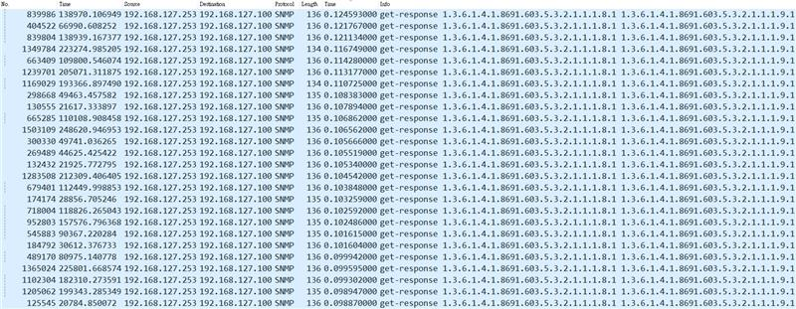

PreTest FWR v5.0.4_2025_1121_1104
1MDSXGL3, 3DUT TR2+16 fast VRRP
連續測試3天(72hr) 获取交换机CPU使用率 -> 获取28个端口的link on/off状态 -> 获取28个端口的流量、带宽、错误包 -> 获取fiberCheckStat -> delay 30s -> loop
平均為 7ms，最大為 125ms，最小為 2ms，72hr中，超出100ms的比例為21/715445 ~= 0.003%，超出50ms的比例為691/715445 ~= 0.1%
從截圖可以看出，雖然整體時間又往下降，但fiber check status依然是需時較長的OID
Notes:
Wireshark filter: snmp && snmp.version==1

