Slide 1
DATAOPS INNOVATION HACKATHON 2026 / HACK THE CORE
Palimpsest
FIELD NOTE
Case
evidence
Every document has a second layer.
A palimpsest is a manuscript scraped clean and rewritten. Traces of the earlier writing remain.
BUILT BY HANNIELVINU
PROBLEM STATEMENT 1 · AI-POWERED DOCUMENT FORENSICS AND CONTEXTUAL INTELLIGENCE
01 / 08
Notes:
0:00–0:18. Introduce Palimpsest and the manuscript metaphor. Explain that traces in documents can lead to verification questions a reviewer can act on.

Slide 2
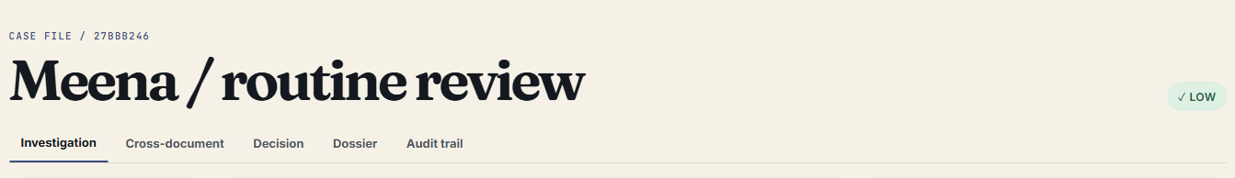
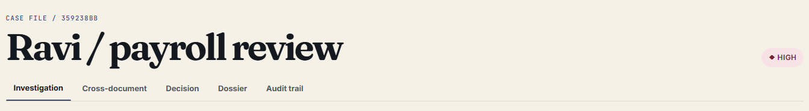
THE TWO APPLICANTS
Meena and Ravi
LOW CONCERN
HIGH CONCERN
Meena
Ravi
A blurry scan, an initial and a normal payroll delay.
A payslip amount that conflicts with the credit and an earlier PDF revision.
All sample data is synthetic. No real personal data.
SOURCE · MEENA AND RAVI SAMPLE CASES, CAPTURED FROM THE RUNNING LOCAL APP
02 / 08
Notes:
0:18–0:42. Meena's scan is blurry and her bank uses an initial. The credit fits the pay cycle. Ravi's payslip contains a changed value and invites independent checks. Both applicants are fictional.

Slide 3
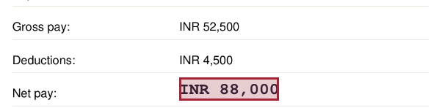
THE GAP
Reading and verifying a payslip
OCR reads a value.
OBSERVED ON THE PAYSLIP
A reviewer needs to know what corroborates it.
Compare the payroll arithmetic, the bank credit and the document’s own history.
Which source supports this amount?
SOURCE · RAVI SAMPLE CASE AND CAPTURED PAYROLL REGIONS
03 / 08
Notes:
0:42–0:59. OCR can read a number. Verification asks how the number relates to neighboring fields, the bank record and earlier PDF revisions. Those checks generate questions and preserve the source.

Slide 4
SYSTEM DESIGN
From originals to evidence
01
02
03
04
Ingest
→
Classify
→
Extract
→
Visual forensics
SHA-256 and file limits
Keywords and layout rows
PDF text or Tesseract
Typography, signatures, history
05
06
07
08
Context
→
Cross-document
→
Evidence
→
Dossier
Arithmetic and field rules
Identity and payroll window
Source boxes and alternatives
Case file and audit head
HUMAN REVIEW
Clear, request more documents, or escalate with a reason.
SOURCE · BACKEND PIPELINE AND API STATUS STEPS
04 / 08
Notes:
0:59–1:21. Follow the top row through document ingestion, extraction and visual inspection. The bottom row checks relationships, matches documents, and links evidence and explanations to a dossier. Human review follows the pipeline.

Slide 5
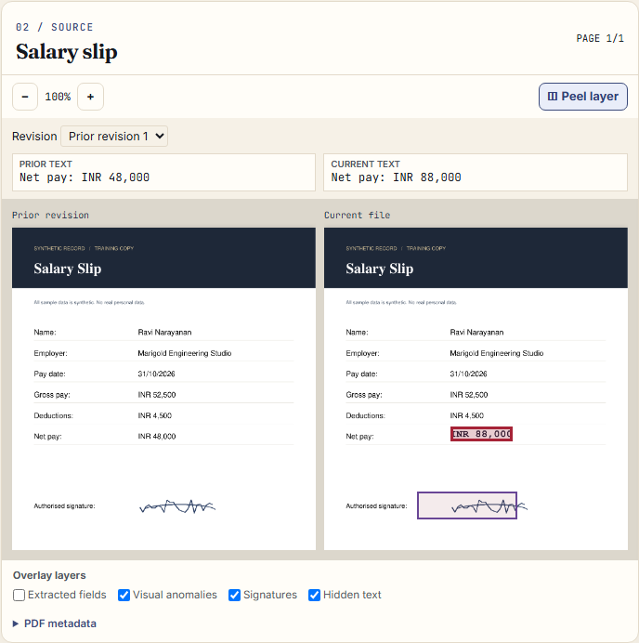
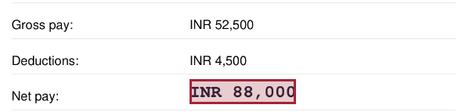
VISUAL EVIDENCE
Peel the Layer
CURRENT AMOUNT
INR 88,000
Prior net pay recovered
INR 48,000 · The earlier bytes survived an incremental save.
SOURCE · RAVI’S SYNTHETIC PAYSLIP AND RETAINED PDF REVISION, LOCAL CAPTURE
05 / 08
Notes:
1:21–1:51. Click the typography finding to see the red box on current net pay. Show the earlier INR 48,000 and current INR 88,000 side by side. This works because the PDF retained its earlier bytes. A legitimate correction can also leave incremental history.

Slide 6
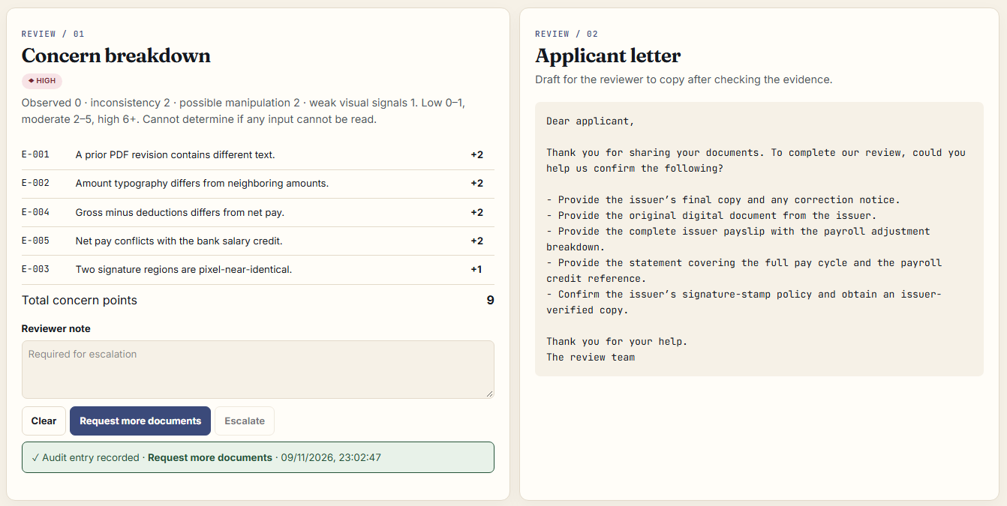
CONTEXT AND HUMAN REVIEW
The bank credit and the next step
PAY-CYCLE CONFLICT
The bank credit matches the prior amount.
Payslip INR 88,000 · Bank INR 48,000
A bonus, split credit or correction could explain the difference.
Request more documents
SOURCE · RAVI CASE MATRIX, REVIEWER DECISION AND APPLICANT LETTER, LOCAL CAPTURES
06 / 08
Notes:
1:51–2:18. The bank credit is INR 48,000, matching gross minus deductions. A bonus, arrears, split credit or payroll correction might explain the difference. Ask for the final issuer record and matching credit reference. Show the recorded reviewer action.

Slide 7
SYNTHETIC EVALUATION
Measured results and limits
9 / 10
0 / 10
1 / 5
Changed cases flagged
Genuine cases flagged
Rotated scans flagged
The hidden instruction surfaced as evidence. The review stayed pending.
Implemented
Revision recovery and audit
Partial
Visual and text heuristics
Planned
Blind evaluation
Unsupported
Flattened history recovery
RUBRIC COVERAGE
OCR & Information Extraction · Document Understanding · Visual Forensic Analysis · Contextual Intelligence
Evidence & Traceability · AI Reasoning & Explainability · Technical Implementation · Innovation
Synthetic, self-generated; a blind human-tampered set is planned.
SOURCE · DATA/BENCHMARK/RESULTS/BENCHMARK.JSON AND ROBUSTNESS.JSON
07 / 08
Notes:
2:18–2:43. The synthetic benchmark is self-generated. Nine of ten changed cases were flagged, with one miss, and no genuine flags among ten benchmark controls. Rotation caused one false alarm in five. The hidden instruction was flagged and had no decision authority. Briefly point to the rubric map.

Slide 8
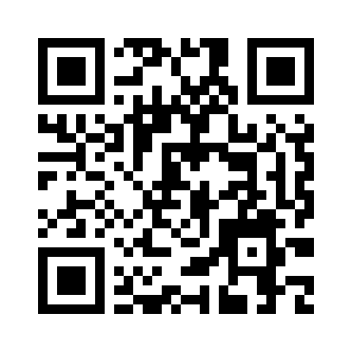
NEXT 30 DAYS
What we’ll verify next
Blind evaluation
Add independent documents and measure by detector.
Scan and layout coverage
Improve rotation handling and broaden labeled templates.
Stronger custody
Isolate native parsers and checkpoint the audit chain.
PUBLIC REPOSITORY
Source repository
github.com/hannielvinu/Palimpsest
Flattened PDFs lose recoverable history.
Public demo deployment pending
PALIMPSEST / BUILT BY HANNIELVINU
08 / 08
Notes:
2:43–3:00. Close on the limits. Flattened history cannot be recovered and concern weights are heuristic. The next steps are a blind set, better layout support, and stronger custody. Point to the link and thank the audience.

