Slide 1
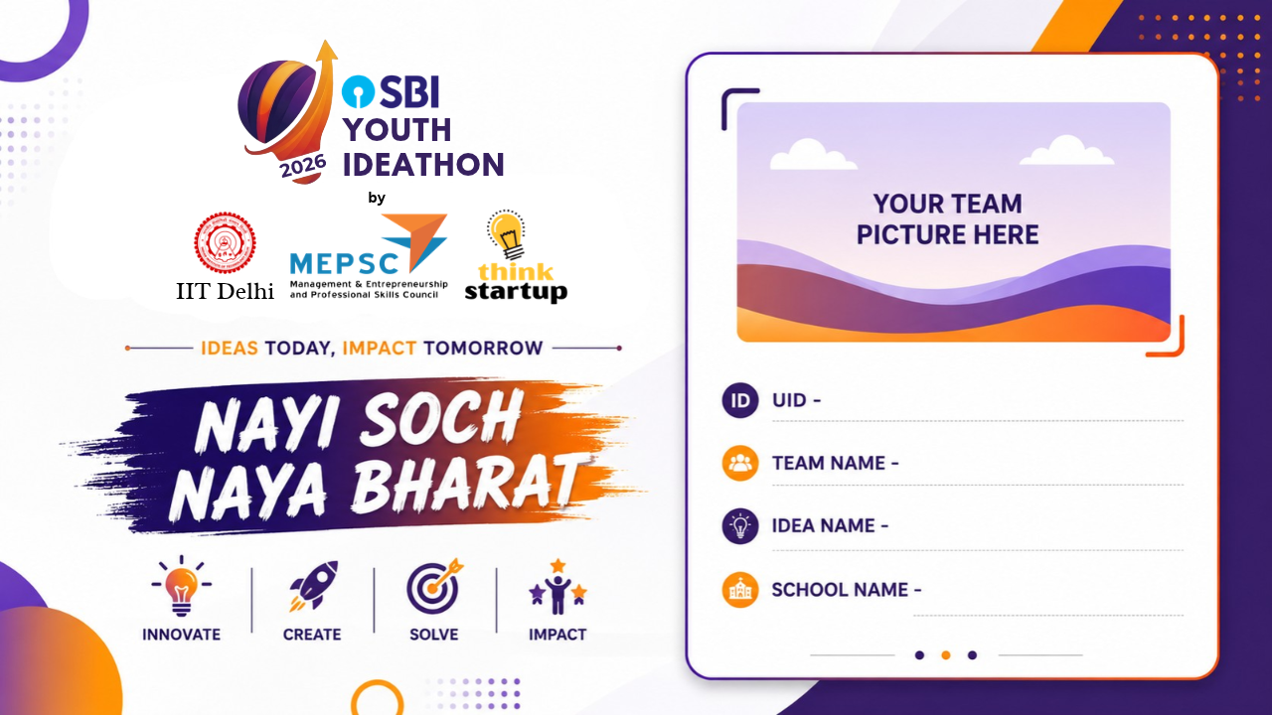
UID 127373
127373
Crack The Puzzle
RailVerify
Vellore Institute of Technology, Vellore
Notes:
5 seconds. Original organizer artwork. Add the presenter’s own photograph inside the designated region.

Slide 2
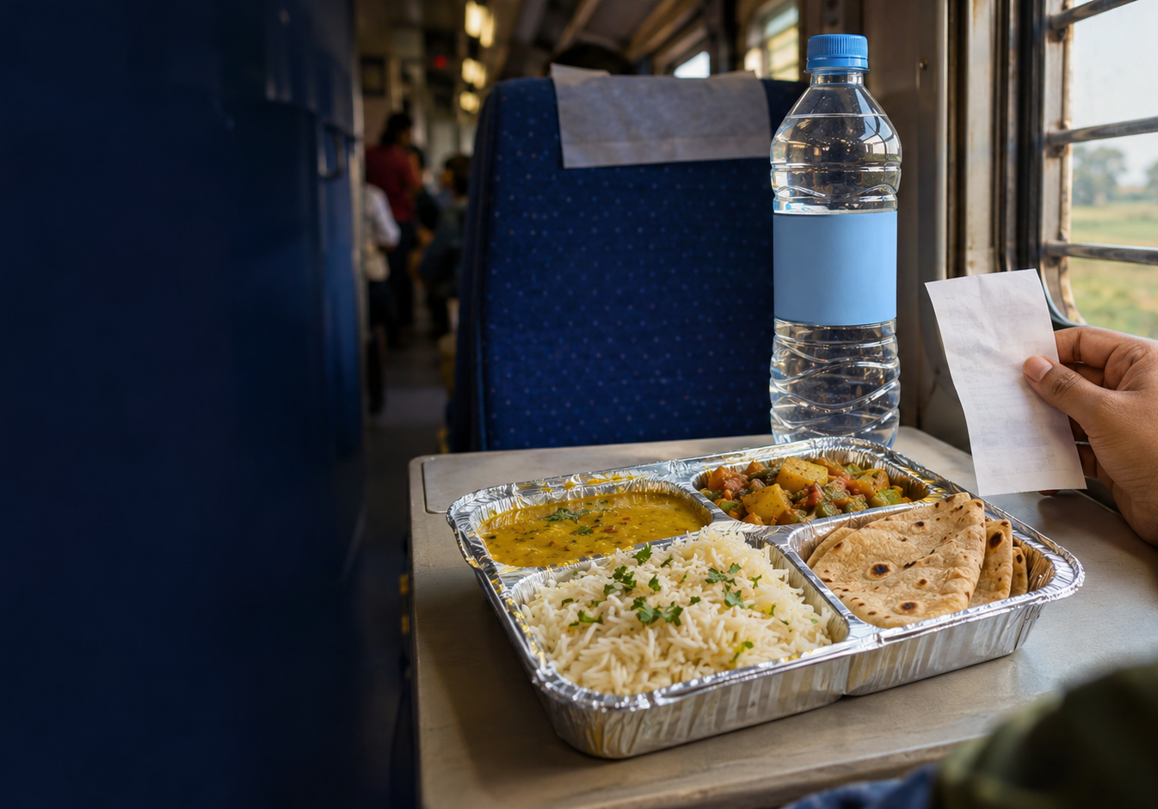
RailVerify
UID 127373
Would you challenge
the vendor?
SAMPLE BILL
LISTED TARIFF
₹150
₹80
₹70
ABOVE THE LISTED TARIFF
A sample purchase. A reason to check before reacting.
Hypothetical ₹150 payment. ₹80 reference for a covered standard Mail/Express vegetarian meal.
Notes:
16 seconds
One hundred and fifty rupees for an eighty-rupee meal. The extra seventy is only part of the problem. Would you challenge the vendor? I am Hanniel Vinu A, from VIT Vellore. This is RailVerify.
Hold a sample bill. Pause after the question, then make eye contact for your introduction.
Source https://indianrailways.gov.in/railwayboard/uploads/directorate/coaching/TAG_2023-24/Menu_Meals.pdf
The bill amount is hypothetical. The image is an original generated conceptual illustration.

Slide 3
RailVerify
UID 127373
The passenger’s next decision
For someone buying a standard meal or a bottle of water on a train.
PURCHASE
UNCERTAINTY
RAILVERIFY
Buy a meal
Question the price
Check privately
Or a bottle of water.
Check a menu. Consider reporting.
See the tariff and its source.
Clarity before a complaint
The passenger decides what happens next. No PNR is needed for a price check.
Illustrative passenger journey. Passenger research is the next validation step.
Notes:
14 seconds
For someone travelling alone, a small overcharge can become an uncomfortable decision. RailVerify gives passengers a private price check, in a familiar conversation, before they decide whether to report.
Keep the example human and conversational. This is an illustrative situation.

Slide 4
RailVerify
UID 127373
A real problem, at railway scale
ANNUAL MEALS
FINES AFTER CATERING INQUIRIES
58 crore
₹2.6 crore
served each year across
Indian Railways
over three years following
inquiries into catering complaints
A price check can sit between a purchase and a complaint.
Ministry of Railways · Lok Sabha reply · 25 March 2026. Figures do not measure under-reporting.
Notes:
13 seconds
Railways serves about fifty-eight crore meals each year. Following catering complaint inquiries, fines reached two-point-six crore rupees over three years. Fair pricing matters at this scale.
State the scale clearly. Do not call these numbers proof of under-reporting.
Source https://sansad.in/getFile/loksabhaquestions/annex/187/AU5506_SeGOEw.pdf?source=pqals
Annual meal volume and fines over three years have different time bases. These figures do not establish prevalence or under-reporting.

Slide 5
RailVerify
UID 127373
Four steps. One informed choice.
Working web prototype. WhatsApp is the planned passenger channel.
01 / SEND
02 / CONFIRM
03 / COMPARE
04 / REVIEW
Bill or text
Purchase details
Official tariff
Report draft
Upload a receipt
or enter details.
Item, quantity
and service.
Match the
applicable rate.
Approve the details
before proceeding.
SAMPLE PRICE CHECK
Official filing continues
through RailMadad.
₹150 − ₹80 = ₹70
Its identity checks still apply.
Water reference · Rail Neer 1L ₹14, 500mL ₹9. Bottle authenticity requires manual verification.
Notes:
37 seconds
Here is our working web prototype. Upload a bill, and OCR reads the text. Confirm the meal, service and amount. In this sample, one-fifty paid, eighty listed. Seventy rupees difference, with the official source beside it. Water checks use the current bottle size and price. Review the details, approve a local report, and download the evidence. Then continue through official RailMadad. WhatsApp is our planned passenger channel, using this same checking logic.
Let the recorded prototype do the visual work. Emphasize the three numbers. The bill is a clearly labeled fictional sample.
Actual local prototype covers bill OCR, confirmed purchase comparisons, consented reports and evidence downloads. RailMadad is a separate official handoff. Sources https://indianrailways.gov.in/railwayboard/uploads/directorate/coaching/TAG_2023-24/Menu_Meals.pdf and Railway Board CC18/2025.

Slide 6
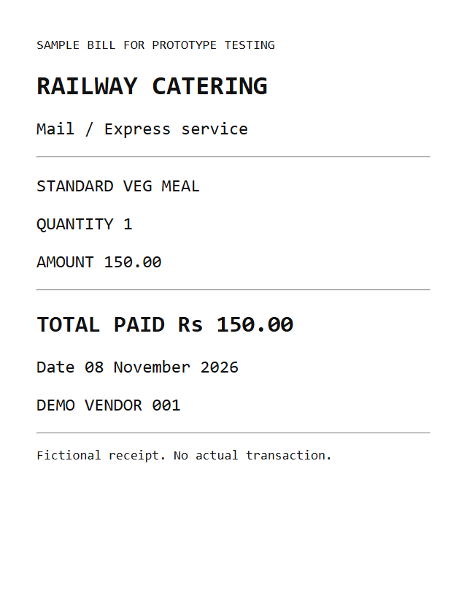
RailVerify
UID 127373
A working prototype, with evidence
ACTUAL OCR TEST
5 automated tests passed
Additional browser checks covered the complete passenger flow.
OCR + price check
Report + download
Sample bill read and confirmed.
Offline draft synchronization tested.
WHAT REVIEW CHANGED
Passengers confirm the evidence.
Fictional sample bill. Software checks passed. Passenger feedback and the railway pilot are pending.
Notes:
14 seconds
Our end-to-end test read a sample bill, checked its price and downloaded the report. Offline drafts synchronized when the connection returned. Testing also reinforced a rule. Passengers must confirm the evidence.
These are software checks, not passenger validation. Briefly pause before the last sentence.
Five automated regression tests and actual browser flow checks passed. Browser checks used real Tesseract OCR, price comparisons, geolocation, report download, dashboard access, mobile layouts and offline synchronization. No passenger interviews or actual railway pilot are claimed.

Slide 7
RailVerify
UID 127373
Passenger checks. Inspection leads.
The proposed railway workflow
Approved reports
Checked patterns
Compliance desk
Human review
Consented local records
Tariff checks and grouping
Train and vendor references
Railway pilot target
3 WEEKS
3 MONTHS
12 MONTHS
30 passengers
Seek a railway pilot
Validate a paid service
Test clarity and completion
Measure accuracy and reporting time
Catering teams as proposed buyers
Passengers use it free. Dashboard demo records are illustrative.
Proposed milestones. Railway access, passenger outcomes and buyer demand still need validation.
Notes:
26 seconds
Next, we will test with thirty passengers. In three months, we aim for a railway-approved pilot, measuring accuracy and reporting time. In twelve months, we want to turn verified reports into useful train-and-vendor patterns for catering teams, through a paid service. Passengers stay free. The dashboard here uses illustrative data. RailVerify helps every passenger make an informed choice, without starting an argument.
These are proposed targets and a proposed business model. End on camera with confidence.

Slide 8
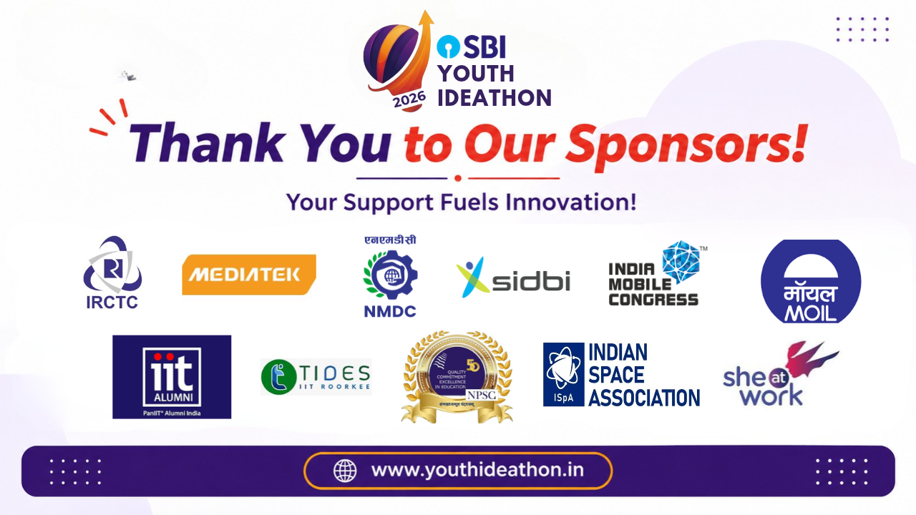
UID 127373
Notes:
5 seconds. Original official closing artwork, with UID overlay.

