Slide 1
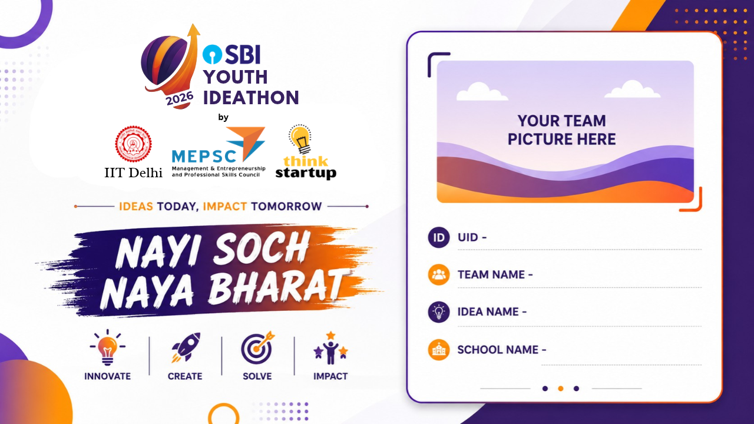
UID 127373
127373
Crack The Puzzle
RailVerify
Vellore Institute of Technology, Vellore
Notes:
5 seconds. Preserve official artwork. Add the presenter’s own photo in the designated image area.

Slide 2
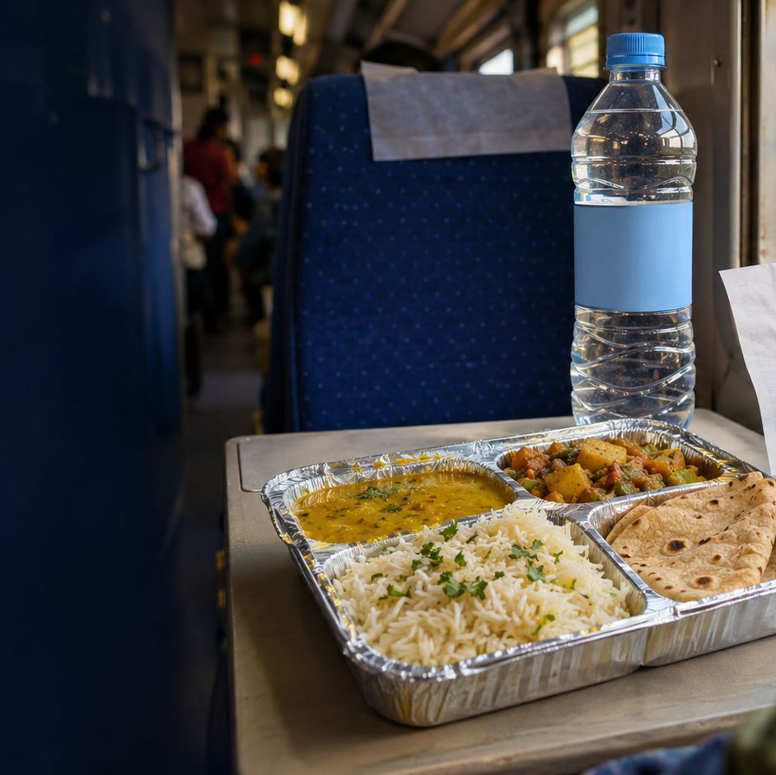
RailVerify
UID 127373
₹150.
for an ₹80 meal.
Would you challenge
the vendor?
Hypothetical ₹150 bill. Published ₹80 tariff for a covered standard veg meal.
Notes:
16 seconds
One hundred and fifty rupees for an eighty-rupee meal. The extra seventy is only part of the problem. Would you challenge the vendor? I am Hanniel Vinu A, from VIT Vellore. This is RailVerify.
Hold a sample bill. Pause after the question, then make eye contact for your introduction.
Source https://indianrailways.gov.in/railwayboard/uploads/directorate/coaching/TAG_2023-24/Menu_Meals.pdf
Hero is an original generated conceptual illustration, not a reported event.

Slide 3
RailVerify
UID 127373
A small overcharge.
An uncomfortable decision.
Let it go.
Argue.
Report.
A private price check helps the passenger
decide what to do next.
No PNR needed for a price check. Illustrative passenger situation.
Notes:
14 seconds
For someone travelling alone, a small overcharge can become an uncomfortable decision. RailVerify gives passengers a private price check, in a familiar conversation, before they decide whether to report.
Keep the example human and conversational. This is an illustrative situation.

Slide 4
RailVerify
UID 127373
Fair pricing matters
at railway scale
58 crore
₹2.6 crore
meals served each year
in fines over three years
following catering inquiries
Ministry of Railways · Lok Sabha reply · 25 March 2026
Notes:
13 seconds
Railways serves about fifty-eight crore meals each year. Following catering complaint inquiries, fines reached two-point-six crore rupees over three years. Fair pricing matters at this scale.
State the scale clearly. Do not call these numbers proof of under-reporting.
Source https://sansad.in/getFile/loksabhaquestions/annex/187/AU5506_SeGOEw.pdf?source=pqals
These figures are not a measure of overcharging prevalence or under-reporting.

Slide 5
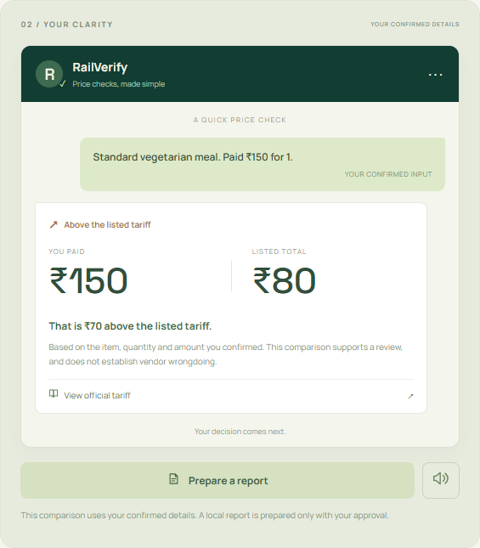
RailVerify
UID 127373
A bill. A listed price.
A clearer next step.
01
Upload a bill
OCR suggests. You confirm.
02
Check the applicable tariff
The source stays beside the answer.
Working web prototype · WhatsApp is the planned passenger channel
Notes:
37 seconds
Here is our working web prototype. Upload a bill, and OCR reads the text. Confirm the meal, service and amount. In this sample, one-fifty paid, eighty listed. Seventy rupees difference, with the official source beside it. Water checks use the current bottle size and price. Review the details, approve a local report, and download the evidence. Then continue through official RailMadad. WhatsApp is our planned passenger channel, using this same checking logic.
Let the recorded prototype do the visual work. Emphasize the three numbers. The bill is a clearly labeled fictional sample.
Actual screenshot from functioning web app. The sample purchase is hypothetical. The UI calculates ₹150 - ₹80 = ₹70 from confirmed input. Water checks use Railway Board CC18/2025. Report creation is local, followed by a separate official RailMadad handoff.

Slide 6
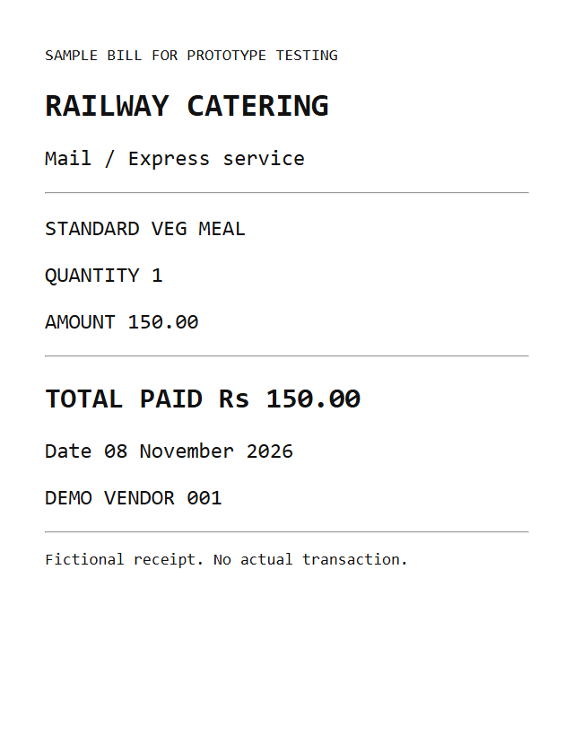
RailVerify
UID 127373
Built. Tested.
Ready for passenger feedback.
Bill OCR + tariff comparison
Consented report + download
Offline save + synchronization
Fictional sample bill
Testing reinforced passenger confirmation. Passenger feedback is still pending.
Notes:
14 seconds
Our end-to-end test read a sample bill, checked its price and downloaded the report. Offline drafts synchronized when the connection returned. Testing also reinforced a rule. Passengers must confirm the evidence.
These are software checks, not passenger validation. Briefly pause before the last sentence.
Software verification completed with actual Tesseract OCR, browser price checks, geolocation, report downloads, dashboard access and offline synchronization. These are functional tests. No passenger interviews, pilots or payment validation are claimed.

Slide 7
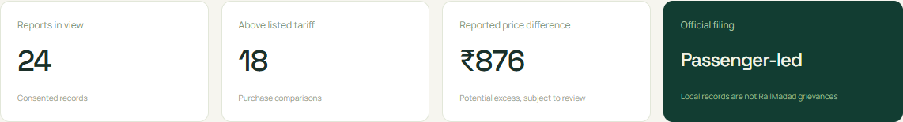
RailVerify
UID 127373
The next proof
3 weeks
3 months
12 months
Test with 30 passengers
Seek a railway pilot
Measure accuracy and time
Validate a paid service
for catering teams
Passengers stay free. Dashboard records shown are illustrative.
Proposed milestones. Railway access and buyer demand remain to be validated.
Notes:
26 seconds
Next, we will test with thirty passengers. In three months, we aim for a railway-approved pilot, measuring accuracy and reporting time. In twelve months, we want to turn verified reports into useful train-and-vendor patterns for catering teams, through a paid service. Passengers stay free. The dashboard here uses illustrative data. RailVerify helps every passenger make an informed choice, without starting an argument.
These are proposed targets and a proposed business model. End on camera with confidence.

Slide 8

UID 127373
Notes:
5 seconds. Official closing artwork unchanged, with UID overlay for continuous display.

