Slide 1
STILLTRUE / BEFORE YOU ACT
AI ANSWERS HAVE A SHELF LIFE.
STILL TRUE
StillTrue.
Answers age.
Evidence should travel
with them.
? UNCONFIRMED
! CHANGED
Claim-level freshness checks.
Official sources. Visible uncertainty.
BIFROST × TAVILY
HANNIEL VINU · GLOBAL AI HACKATHON 2026
01 / 08
Notes:
0:00–0:20. Introduce Hanniel Vinu and StillTrue: before acting on an AI answer, check whether its actionable claims remain current. This is one combined project. No guarantee of accuracy or awards is implied.

Slide 2
STILLTRUE / THE PROBLEM
A confident answer can
outlive the rule.
The person reading it is about to make a decision.
01
Money
THE QUESTION BEHIND THE QUESTION
Thresholds, rates, allowances
“Can I still
act on this?”
Paperwork
02
Eligibility, fees, deadlines
03
Software
Versions and deprecations
HANNIEL VINU · GLOBAL AI HACKATHON 2026
02 / 08
Notes:
0:20–0:40. Our core persona is an ordinary person about to act on an AI answer. These are motivating scenarios, not measured user research. Generic links may leave them to determine which rule and year applies.

Slide 3
STILLTRUE / THE PRODUCT PROMISE
One answer in.
A clear report out.
01
02
03
Paste
Check
Decide
Bring the answer. Choose a
topic. Mask common personal
details.
Extract actionable claims.
Retrieve and read official
evidence.
Inspect the verdict, copied
quote, source and retrieval
time.
STILL TRUE
! CHANGED
? UNCONFIRMED
HANNIEL VINU · GLOBAL AI HACKATHON 2026
03 / 08
Notes:
0:40–1:00. Three outcomes are intentional. Unconfirmed means the evidence or agreement is insufficient; it is not a failure hidden from the user. Personal-data masking is best-effort. Scores are heuristics, not calibrated probabilities.

Slide 4
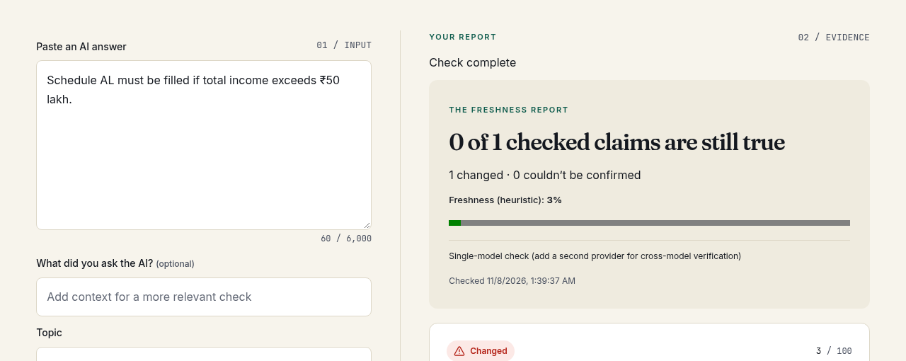
STILLTRUE / PROTOTYPE / REAL BROWSER CAPTURE
Evidence you can actually inspect.
A working interface. A visible boundary between demo and live evidence.
StillTrue / freshness report
REAL SCREENSHOT · MOCK DATA
01 / STREAM
Claim results as checks finish
02 / INSPECT
Source, quote and uncertainty
03 / REVIEW
Original answer stays visible
HANNIEL VINU · GLOBAL AI HACKATHON 2026
04 / 08
Notes:
1:00–1:25. This is a real screenshot of the actual prototype with synthetic fixtures. It is not proof of a tax rule, nor a real captured model error. The slide explicitly labels mock data. Source activation and credentialed API checks remain pending. Walk through the input and result structure.

Slide 5
STILLTRUE / ARCHITECTURE
Two technologies. Distinct jobs.
Bifrost handles models. Tavily finds evidence. Code enforces the verdict rules.
01
INPUT
02
BIFROST
03
TAVILY
React + FastAPI
PII masking
Extract actionable
claims
Search official sources
Extract page evidence
06
REPORT
05
TRUST GATES
04
BIFROST
Stream claim results
Cache evidence in SQLite
Official source + quote
Model agreement
Independent model
verification
HANNIEL VINU · GLOBAL AI HACKATHON 2026
05 / 08
Notes:
1:25–1:50. All LLM calls go through Bifrost. Tavily supplies evidence, not the final verdict. Verification uses two different providers when configured; single-model mode is honest and explicit. The app cache stores evidence and judging still runs on cache hits. Semantic caching is disabled.

Slide 6
STILLTRUE / THE DIFFERENTIATOR
Uncertainty is
a product feature.
A false “Current”
is worse than
“Couldn’t confirm.”
01
02
03
Authority first.
Show the quote.
Disagreement.
No approved official source?
No definitive verdict.
A copied quote must exist in
the cited official evidence.
If independent checks
disagree, the claim stays
Unconfirmed.
HANNIEL VINU · GLOBAL AI HACKATHON 2026
06 / 08
Notes:
1:50–2:10. The differentiator is a transparent policy, not a claim to eliminate hallucinations. Exact quotation proves provenance, not semantic correctness. Official sources can lag policy; models can agree on errors. Prefer uncertainty rather than unsupported confidence.

Slide 7
STILLTRUE / ENGINEERING EVIDENCE
Built. Tested.
Clearly bounded.
17
7
12
BACKEND TESTS PASSED
FRONTEND TESTS PASSED
LAYOUT / THEME RUNS PASSED
Lint / TypeScript / Production build / Docker startup / Dependency audits
Local engineering checks. Live verification accuracy and benchmark results: not yet measured.
HANNIEL VINU · GLOBAL AI HACKATHON 2026
07 / 08
Notes:
2:10–2:30. These results were actually observed in the build session: seventeen backend tests, seven frontend tests and twelve responsive/theme mock runs. Docker app health reached Bifrost. Dependency audits reported no known vulnerabilities for the installed packages. These are not live accuracy results or a claim that remote CI passed.

Slide 8
STILLTRUE / WHAT COMES NEXT
Before you act,
check the answer.
For people making decisions.
For developers shipping AI answers.
THE NEXT LIVE MILESTONE
01
Configure Tavily + model credentials
02
Activate and review official sources
ONE ENGINE. WEB + DEVELOPER API.
03
Capture a real demo; label
benchmarks
Start with actionable claims.
Expand source coverage with evidence.
github.com/hannielvinu/StillTrue
HANNIEL VINU · GLOBAL AI HACKATHON 2026
08 / 08
Notes:
2:30–3:00. Close on the value: a freshness layer for people and developers. The API exists; usage-based commercialization is a future hypothesis, not traction. Be explicit that real credentials, source activation, captured evidence and human-labelled benchmarks are prerequisites for a live submission. Invite judges to inspect the repository.

