Slide 1
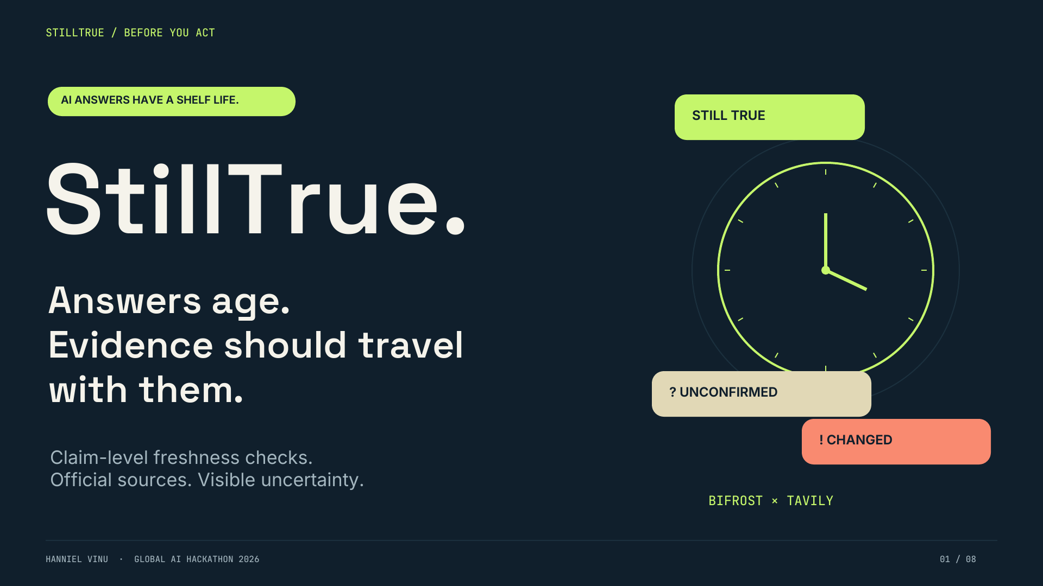
Notes:
0:00–0:20. Introduce Hanniel Vinu and StillTrue: before acting on an AI answer, check whether its actionable claims remain current. This is one combined project. No guarantee of accuracy or awards is implied.

Slide 2
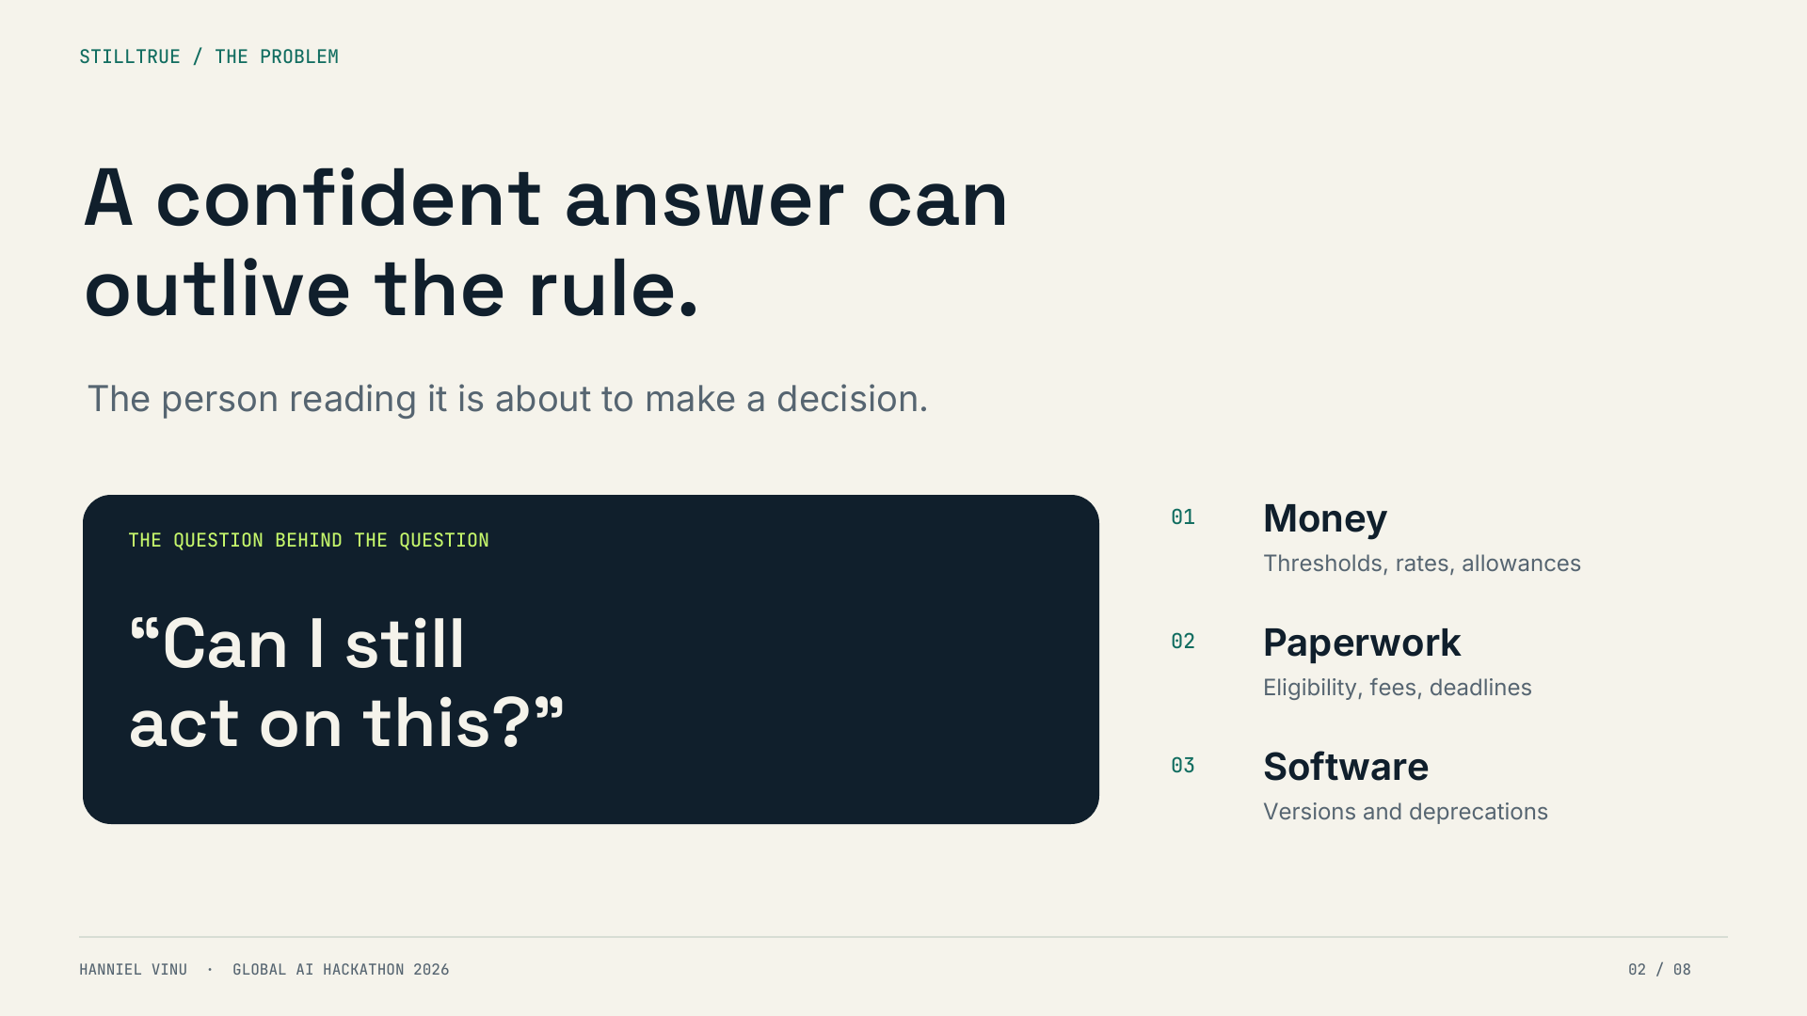
Notes:
0:20–0:40. Our core persona is an ordinary person about to act on an AI answer. These are motivating scenarios, not measured user research. Generic links may leave them to determine which rule and year applies.

Slide 3
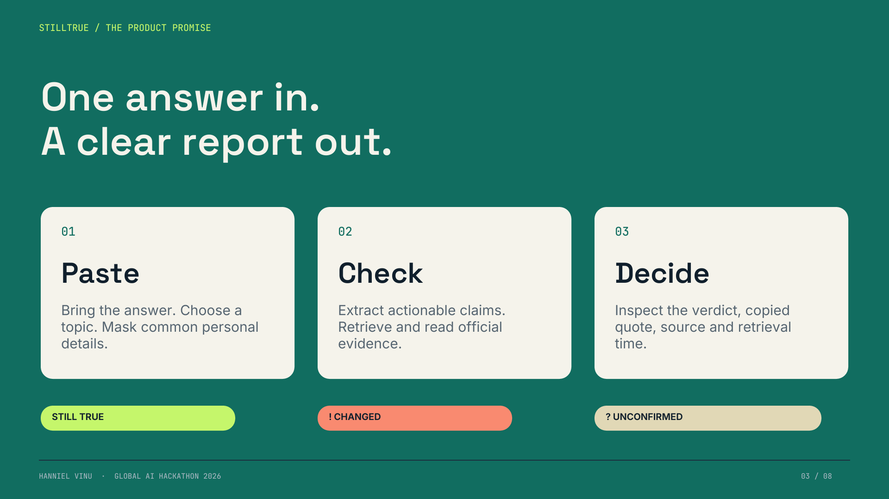
Notes:
0:40–1:00. Three outcomes are intentional. Unconfirmed means the evidence or agreement is insufficient; it is not a failure hidden from the user. Personal-data masking is best-effort. Scores are heuristics, not calibrated probabilities.

Slide 4
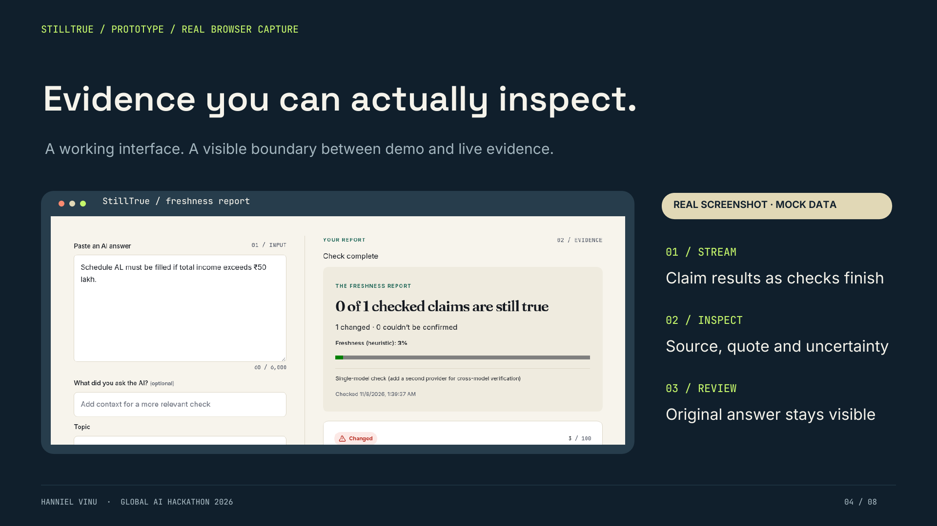
Notes:
1:00–1:25. This is a real screenshot of the actual prototype with synthetic fixtures. It is not proof of a tax rule, nor a real captured model error. The slide explicitly labels mock data. Source activation and credentialed API checks remain pending. Walk through the input and result structure.

Slide 5
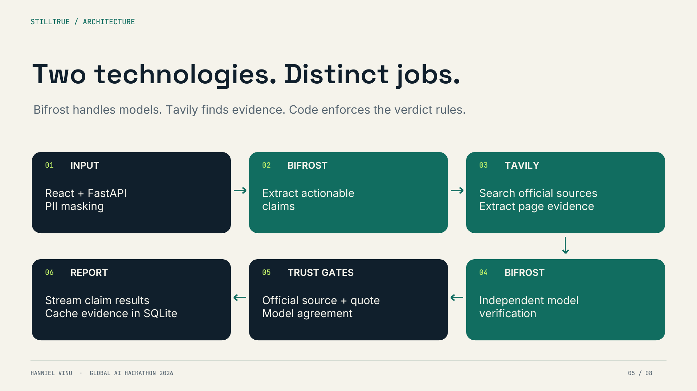
Notes:
1:25–1:50. All LLM calls go through Bifrost. Tavily supplies evidence, not the final verdict. Verification uses two different providers when configured; single-model mode is honest and explicit. The app cache stores evidence and judging still runs on cache hits. Semantic caching is disabled.

Slide 6
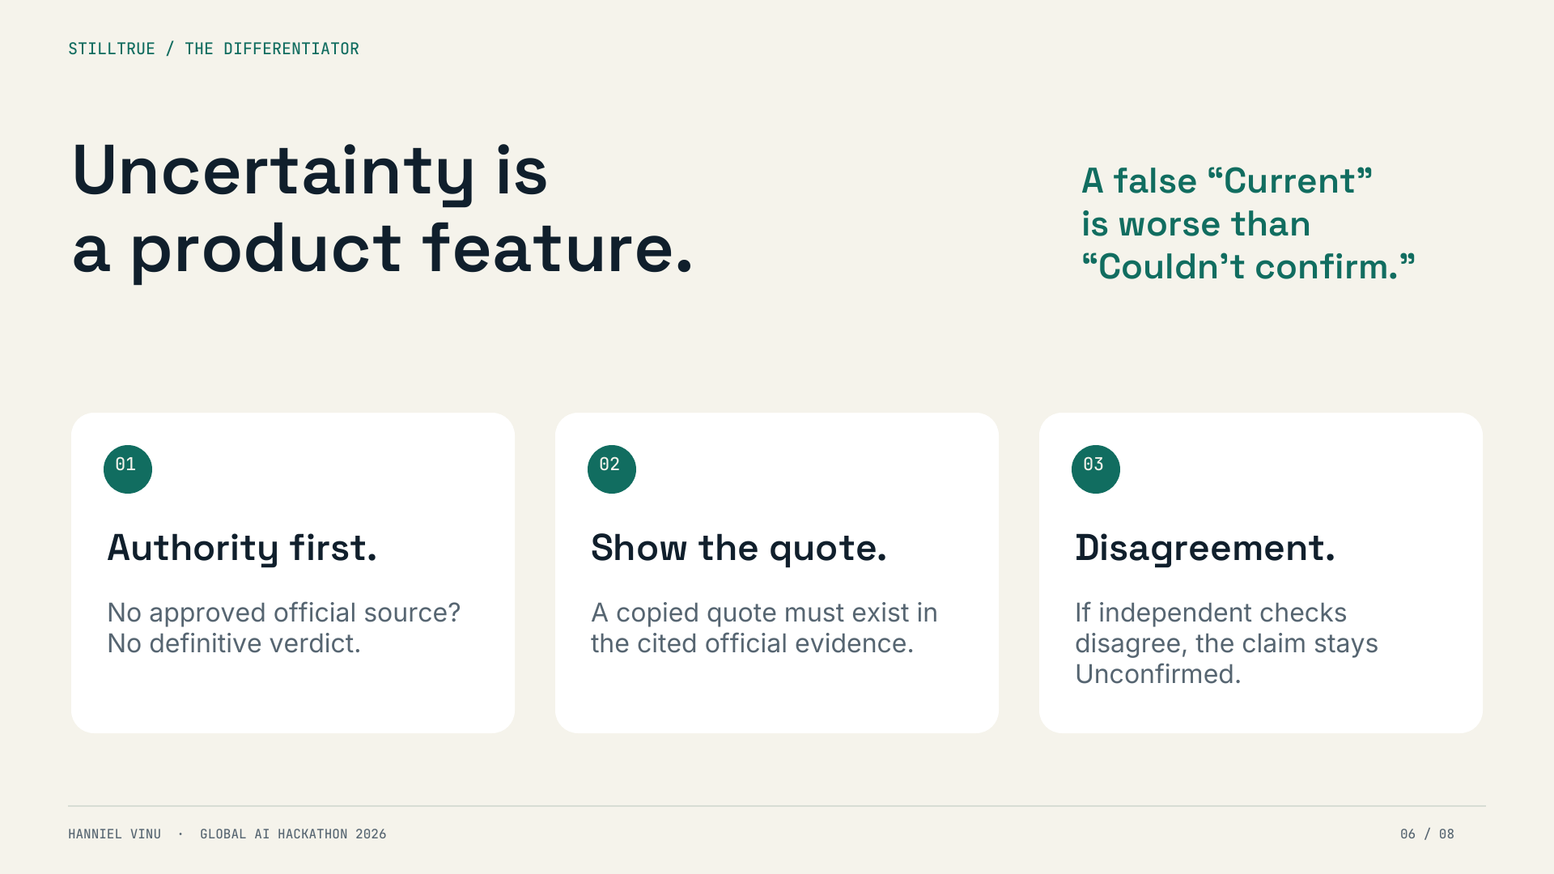
Notes:
1:50–2:10. The differentiator is a transparent policy, not a claim to eliminate hallucinations. Exact quotation proves provenance, not semantic correctness. Official sources can lag policy; models can agree on errors. Prefer uncertainty rather than unsupported confidence.

Slide 7
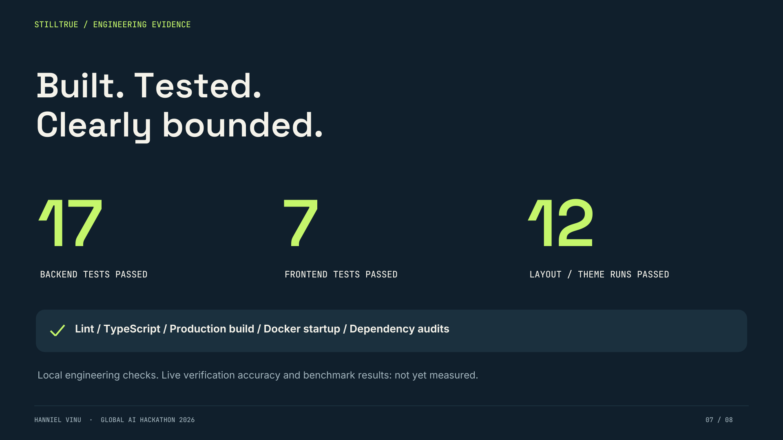
Notes:
2:10–2:30. These results were actually observed in the build session: seventeen backend tests, seven frontend tests and twelve responsive/theme mock runs. Docker app health reached Bifrost. Dependency audits reported no known vulnerabilities for the installed packages. These are not live accuracy results or a claim that remote CI passed.

Slide 8
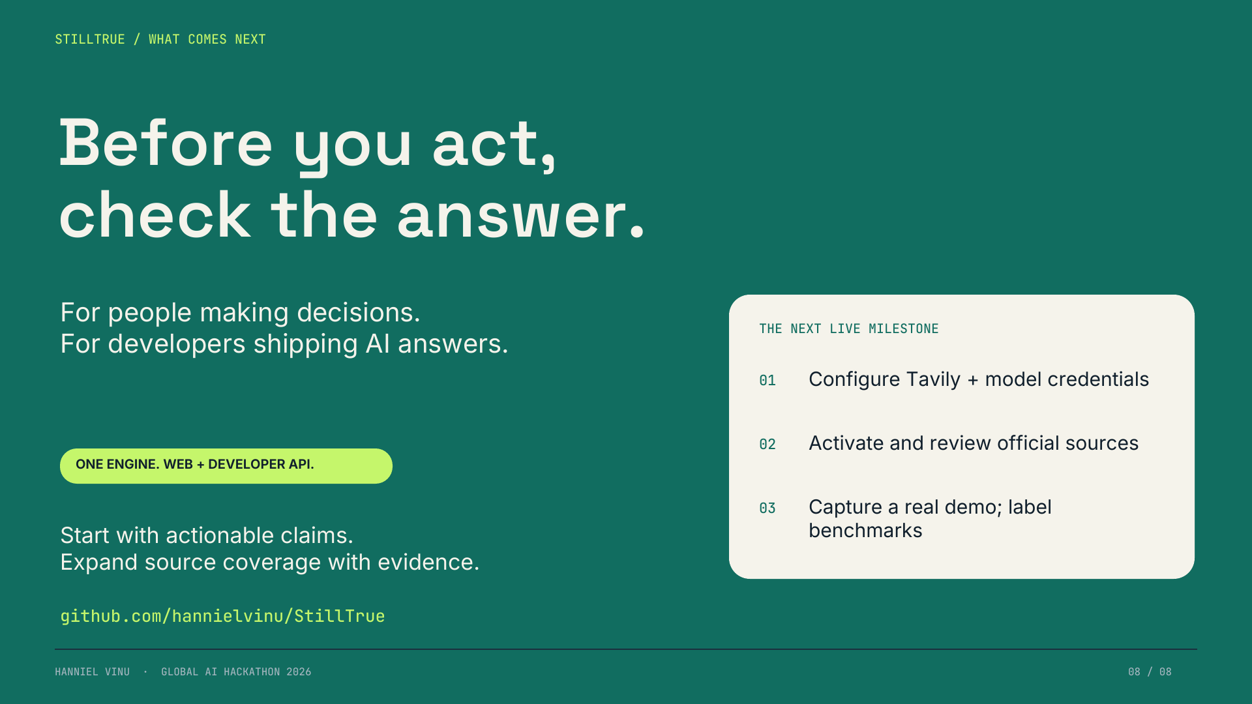
Notes:
2:30–3:00. Close on the value: a freshness layer for people and developers. The API exists; usage-based commercialization is a future hypothesis, not traction. Be explicit that real credentials, source activation, captured evidence and human-labelled benchmarks are prerequisites for a live submission. Invite judges to inspect the repository.

