Slide 1
Mysql Joins

Slide 2
What are Joins
joins are used to combine data from two or more tables based on a related column. Joins allow you to retrieve data that is distributed across multiple tables in a relational database.

Slide 3
Types of SQL Joins
INNER JOIN
LEFT JOIN
RIGHT JOIN
CROSS JOIN

Slide 4
Significance of Joins:
Combining Data: Helps fetch related data stored in different tables.
Simplifying Queries: Eliminates the need to write multiple queries for retrieving related data.
Enhancing Data Relationships: Facilitates working with normalized databases where data is divided into related tables to avoid redundancy.
Flexible Data Analysis: Allows filtering, grouping, and aggregating across joined tables for powerful analysis.

Slide 5
DEMONTRATIONS

Slide 6
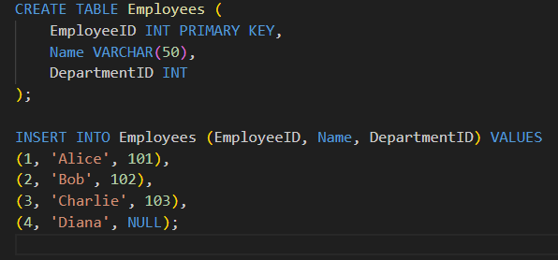
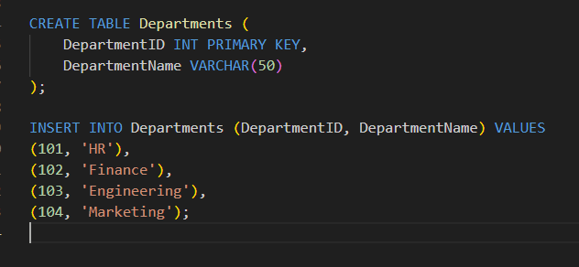
TABLES CREATION

Slide 7
INNER JOIN
Retrieves rows that have matching values in both tables.

Slide 8
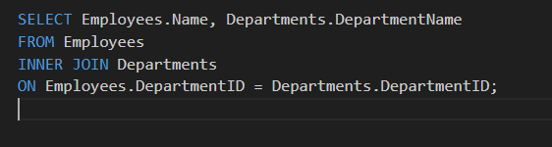
QUERY

Slide 9
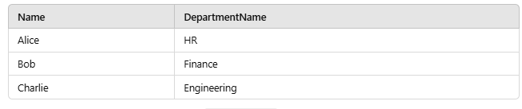
RESULT

Slide 10
LEFT JOIN
Retrieves all rows from the left table and the matching rows from the right table. Non-matching rows from the right table will show NULL.

Slide 11
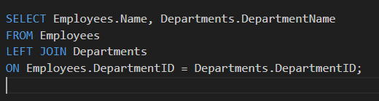
QUERY

Slide 12
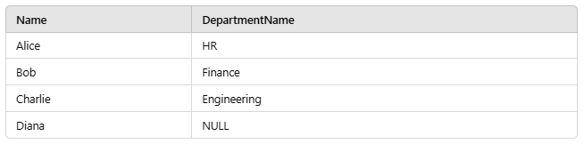
RESULT

Slide 13
RIGHT JOIN
Retrieves all rows from the right table and the matching rows from the left table. Non-matching rows from the left table will show NULL.

Slide 14
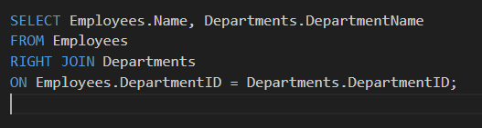
QUERY

Slide 15
RESULT

Slide 16
CROSS JOIN
Produces a Cartesian product, pairing every row of the first table with every row of the second table.

Slide 17
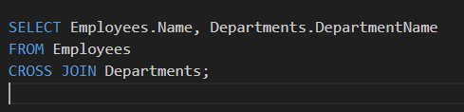
QUERY

Slide 18
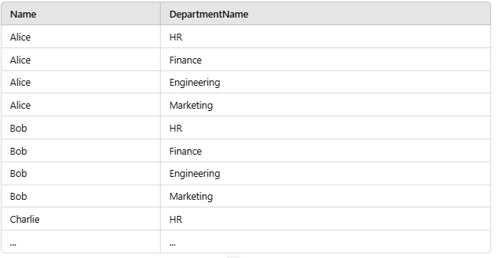
RESULT

Slide 19
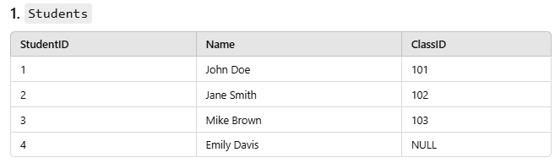
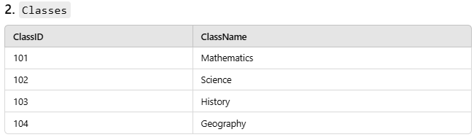
ASSIGNMENT
Create the tables and populate them with data as specified in the assignment

Slide 20
TASKS
Tasks
Task 1: Inner Join
Write a query to list all students and their corresponding class names. Only include students who are assigned to a class.
Task 2: Left Join
Write a query to list all students, including those who are not assigned to any class. Display their names and the class names.
Task 3: Right Join
Write a query to list all classes, including those without any students. Display the class name and student names.

