Slide 1
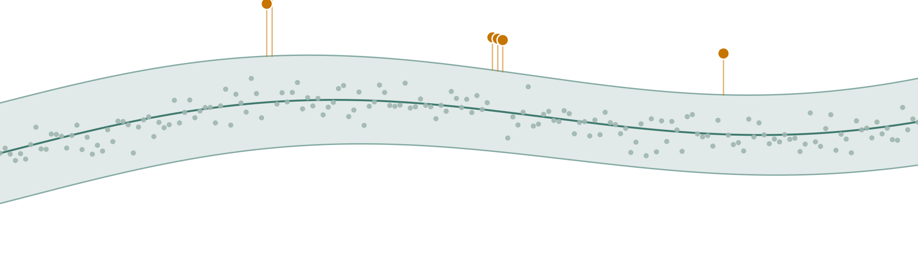
Adaptive Network Traffic
Anomaly Detection
Catching the anomalies that volume monitors miss — with lightweight online statistics.
A. Hannish Reddi, B. Keshav, E. Sai Mohan
Dept. of AI & Data Science, CBIT Hyderabad Computer Networks (22ITC10N)
Notes:
Our question: can a cheap, training-free statistical detector catch the network anomalies that simple volume monitors miss? The graphic shows the idea — a band of normal traffic that drifts over time, with a few anomalies breaching it.

Slide 2
The quiet anomalies are the hard ones
A fixed threshold catches a tenfold spike easily. It cannot see a port scan that moves almost no traffic, or a shift in the protocol mix that moves none at all. And on a busy but harmless flash crowd, a naive monitor cries wolf.
Flood / DDoS
Volume spikes — easy to see
Port scan
Many destination ports, little volume
The gap. Cheap monitors are blind to the last two kinds. Accurate ML detectors see them, but need training, memory, and retraining.
Protocol shift
The traffic mix changes, volume doesn't
Notes:
The hard part is not the dramatic spike — it is the stealthy scan and the protocol shift, which move little or no volume, while not firing on normal busy periods.

Slide 3
The question
Can a training-free statistical detector catch what volume monitors miss, keep false alarms low, and stay accurate when normal traffic drifts?
What's missing in practice: a detector that is at once lightweight, multi-feature, and robust to non-stationary traffic — and a clear account of which of those properties actually earns the detection.
Notes:
This is the honest framing of the whole project: we separate what each property contributes rather than claiming one method wins everything.

Slide 4
Five anomaly families we detect
Burst
Volumetric surge from a few sources
SYN flood
Many small packets; the SYN ratio climbs
Port scan
Many destination ports; little volume
Protocol shift
UDP share jumps; total volume stays normal
Slow ramp
Gradual growth over a long period
Volumetric and easy
Non-volumetric — the real test
Notes:
These five are injected into the simulator with ground-truth labels. The amber families — scan, protocol shift — are what separate multivariate detectors from volume monitors.

Slide 5
One pipeline, simulated and real
→
→
→
→
Traffic
Window
Eight features
Detector
Alarm
flows / packets
1-sec or 1-min bins
logs + ratios
causal score
threshold + events
The same causal pipeline runs on simulated and on real CIC-IDS2017 traffic. Two ratio features — packets-per-source and bytes-per-packet — are what expose the non-volumetric attacks.
Notes:
Using one pipeline for both data sources makes simulated and real results directly comparable. The detector step is highlighted because that is where our contribution sits.

Slide 6
Six detectors, one honest comparison
Detector
Features
Role
Fixed threshold
1 feature (volume)
baseline
Why two extra detectors?
Static Mahalanobis and the Isolation Forest are controls. They let us attribute every gain — to multi-feature scoring, to online adaptation, or to both — instead of simply declaring a winner.
Moving average
1 feature (volume)
baseline
Z-score (static)
1 feature (volume)
baseline
Mahalanobis (static)
8 features
strong baseline
Isolation Forest
8 features
heavy-ML reference
Adaptive (proposed)
8 features, online
proposed
Notes:
The honesty controls matter for the viva: the big win turns out to be multi-feature scoring, shared by two detectors — not something unique to ours.

Slide 7
The proposed detector
An online estimate of the mean m and covariance S of the eight features. The score is how far a window sits from normal:
72
numbers of state — no stored history
s = √ (xₜ − m)ᵀ S⁻¹ (xₜ − m) / p
0
training passes required
The gated update — the idea that makes it work
1
Normal window
m and S update as usual — the baseline tracks slow, honest change.
2
Suspicious window
the mean barely creeps and the covariance freezes — an attack cannot become the new normal.
Notes:
The gating is the contribution. Without it an earlier version let attacks inflate the baseline and went blind — the ablation shows exactly that.

Slide 8
How we tested it
Simulated — for ground truth
Real — CIC-IDS2017
6000 one-second windows: a benign daily cycle, noise, and realistic flash crowds. Fourteen labelled anomaly events per trace across the five families, with an optional drift control. Tuned on development seeds; reported on 30 untouched held-out seeds.
The official labelled flow captures (checksum-verified): the Friday port-scan and DDoS traffic, aggregated to one-minute windows. The method is frozen — only the alarm threshold is calibrated on a benign period, as a deployed monitor would be.
Measured by window and event metrics, 95% confidence intervals, paired Wilcoxon tests with Holm correction, and threshold-free ROC and PR on the real data.
Notes:
Strict seed hygiene: debug seeds were discarded; the final numbers come from seeds the method never saw.

Slide 9
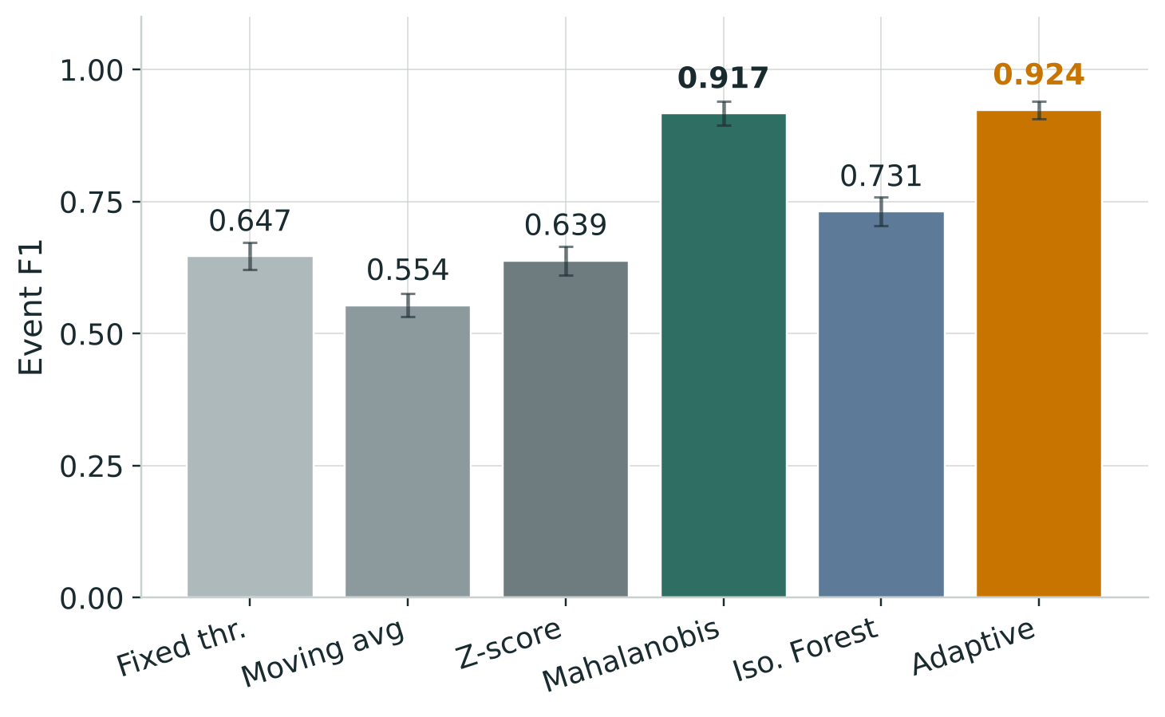
Multivariate scoring wins across the board
0.924
Event F1 — the best of six detectors
+0.19–0.37
F1 over every volume-only baseline (p < 0.0001)
0.11
false alarms per 1,000 windows — the lowest
Notes:
Headline: the two multivariate detectors clear every single-feature baseline by a wide, significant margin, and the proposed detector raises the fewest false alarms.

Slide 10
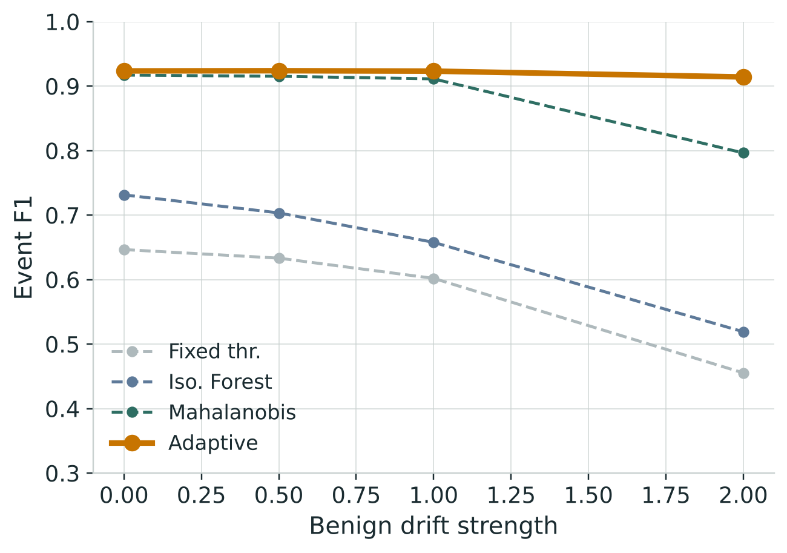
The finding that matters
When normal traffic drifts, the static model mis-calibrates.
The online detector tracks the change.
+0.118
Event F1 over the best static baseline at the strongest drift (Wilcoxon p = 0.002)
In stationary traffic the two tie (p = 0.90). Online adaptation earns its keep only when traffic is non-stationary — the realistic case for a monitor left running for days.
Notes:
This is the central, defensible claim. We do not overclaim a blanket win — adaptation wins specifically under drift, and we show exactly that.

Slide 11
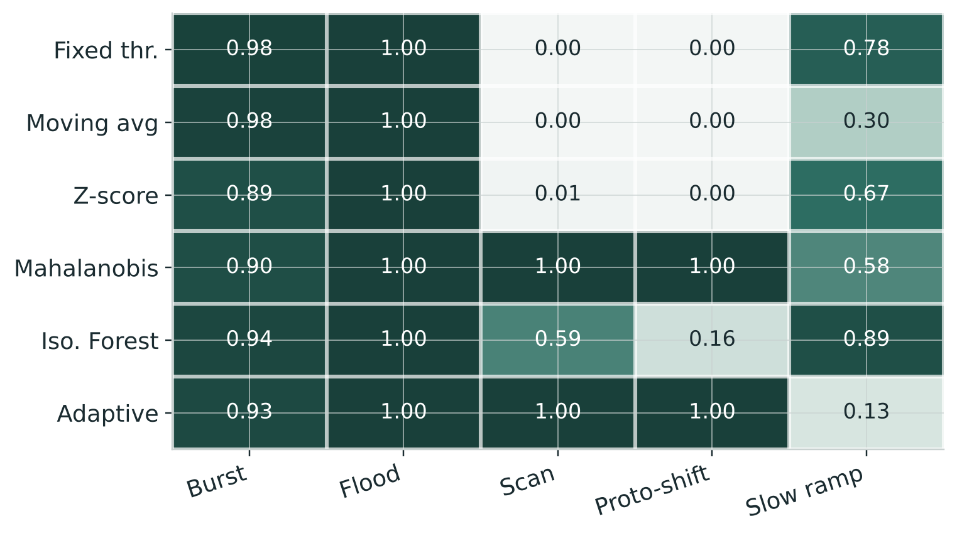
Where the advantage comes from
Scans and protocol shifts
are caught only by the multivariate detectors — the volume monitors score zero.
Slow ramps
are the proposed detector's weak point: its own adaptation absorbs a gradual attack.
Notes:
The heatmap makes the mechanism visible — the win is on the two non-volumetric columns. We show the slow-ramp weakness openly rather than hiding it.

Slide 12
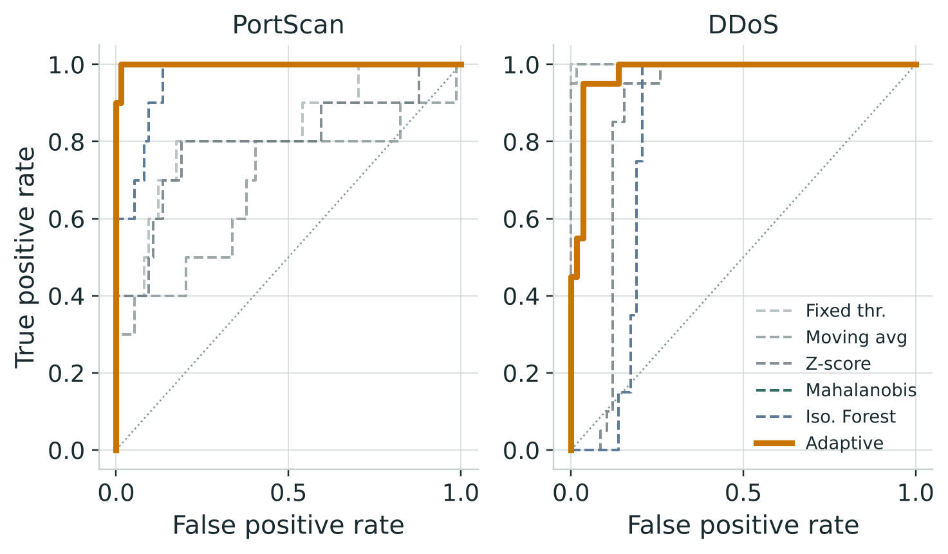
It holds on real traffic
Port scan
Multivariate: ROC-AUC 0.999, recall 1.0. Volume monitors miss most of it (recall 0.4).
DDoS
An easy volumetric case — even a fixed threshold is perfect; the multivariate detectors are close behind.
Each capture is ~1 hour and stationary, so adaptive ties static here — as the simulation predicts.
Notes:
The simulated finding reappears on real traffic: multivariate scoring catches the stealthy port scan.

Slide 13
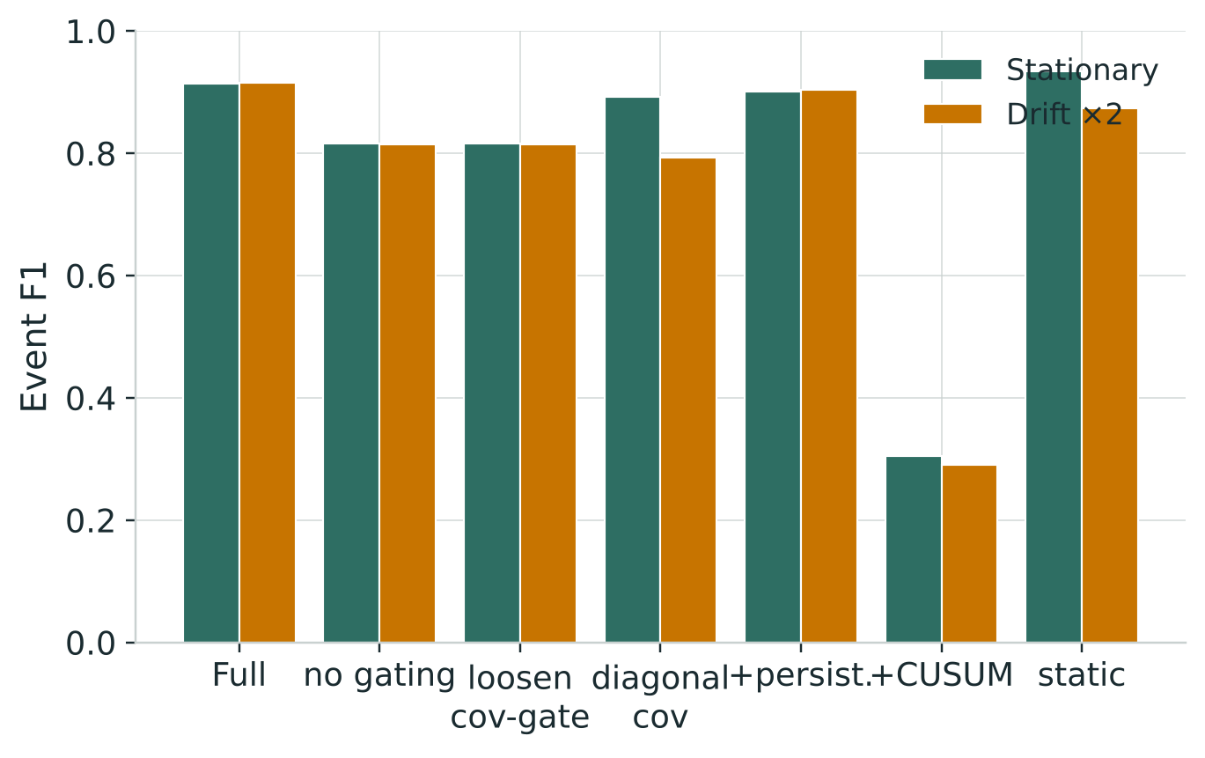
What earns its place — and what we cut
Gated update — essential. 0.91 → 0.82 without it.
Full covariance — matters under drift.
Persistence & CUSUM — tested, discarded.
~33 µs
per window — about 30,000 windows per second
Notes:
The ablation justifies every design choice with data, including three features we removed. Lightweight holds on memory and the absence of retraining — the constraints that matter for a long-running monitor.

Slide 14
What we showed
Multi-feature statistical scoring defeats non-volumetric attacks — in simulation and on real traffic. Online adaptation ties the static baseline when traffic is steady and wins when it drifts. No training; 72 numbers of state.
Where it goes next
A real-data drift study on multi-day captures
A two-timescale variant to fix the slow-ramp weakness
An incremental covariance inverse to scale to larger feature sets
Thank you
A. Hannish Reddi B. Keshav E. Sai Mohan
Notes:
Summary for the panel: cheap and multivariate beats cheap and single-feature everywhere; adaptation is the piece that keeps a long-running monitor honest under drift.

