Slide 1
INBIZ
BC Deployment
Analyzer
Living Business Central documentation, powered by Microsoft Foundry
From source code and deployed versions to trusted, searchable consultant knowledge.
CODE → KNOWLEDGE → ANSWERS
Hackathon submission | Hannes Kalisky
Notes:
[Sources]
- Solution context: attached README.md and BC_Deployment_Analyzer_Solution_Design.docx.
[/Sources]

Slide 2
THE OPPORTUNITY
Consultants should not have to read code to understand a customer solution
Today, critical knowledge is fragmented across source code, environments and individual experience.
Knowledge is hard to access
Documentation goes stale
Deployment status is unclear
Business logic lives in AL code and in developers’ heads.
Manual implementation documents quickly fall behind the actual solution.
Teams lack a fast view of which version is in Git and which version is live.
Result: consultants spend time searching, asking developers and validating facts manually.
Notes:
[Sources]
- Attached BC_Deployment_Analyzer_Solution_Design.docx, lines 37-42.
[/Sources]

Slide 3
THE USE CASE
A living knowledge layer for InBiz consultants
BC Deployment Analyzer creates and maintains customer-specific implementation documentation automatically.
Consultant question
Current documentation
“What customizations does this customer have, how do they work and when did they last change?”
Generated from the latest source code.
Deployment confidence
Versions compared across Git and Business Central.
Asked in Microsoft 365 Copilot, without opening the AL repository.
Visible change history
Merged pull requests become readable release notes.
Notes:
[Sources]
- Attached BC_Deployment_Analyzer_Solution_Design.docx, lines 42-43 and 122-125.
[/Sources]

Slide 4
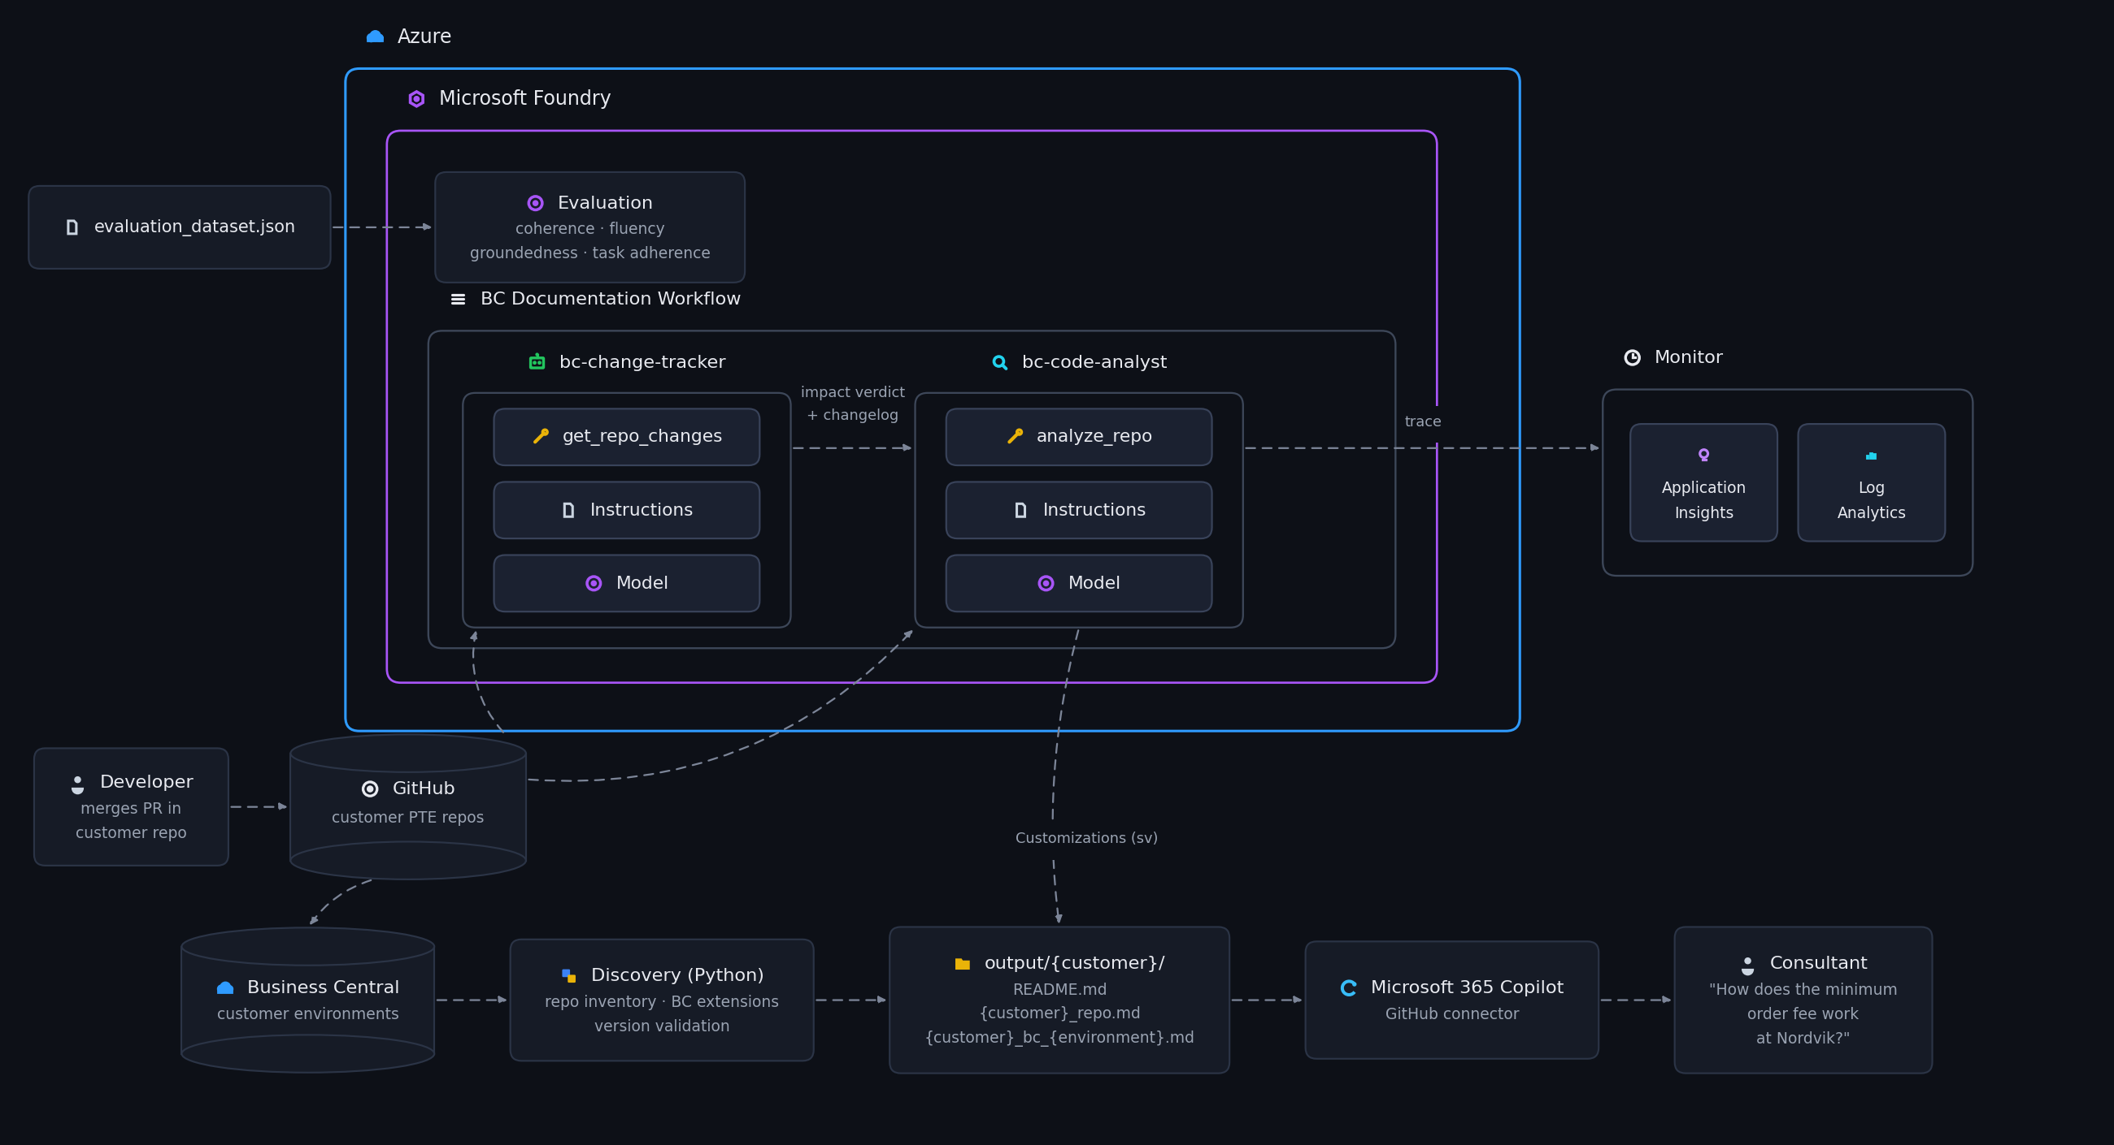
Notes:
[Sources]
- Attached BC_Deployment_Analyzer_Solution_Design.docx, lines 42-43 and 122-125.
[/Sources]

Slide 5
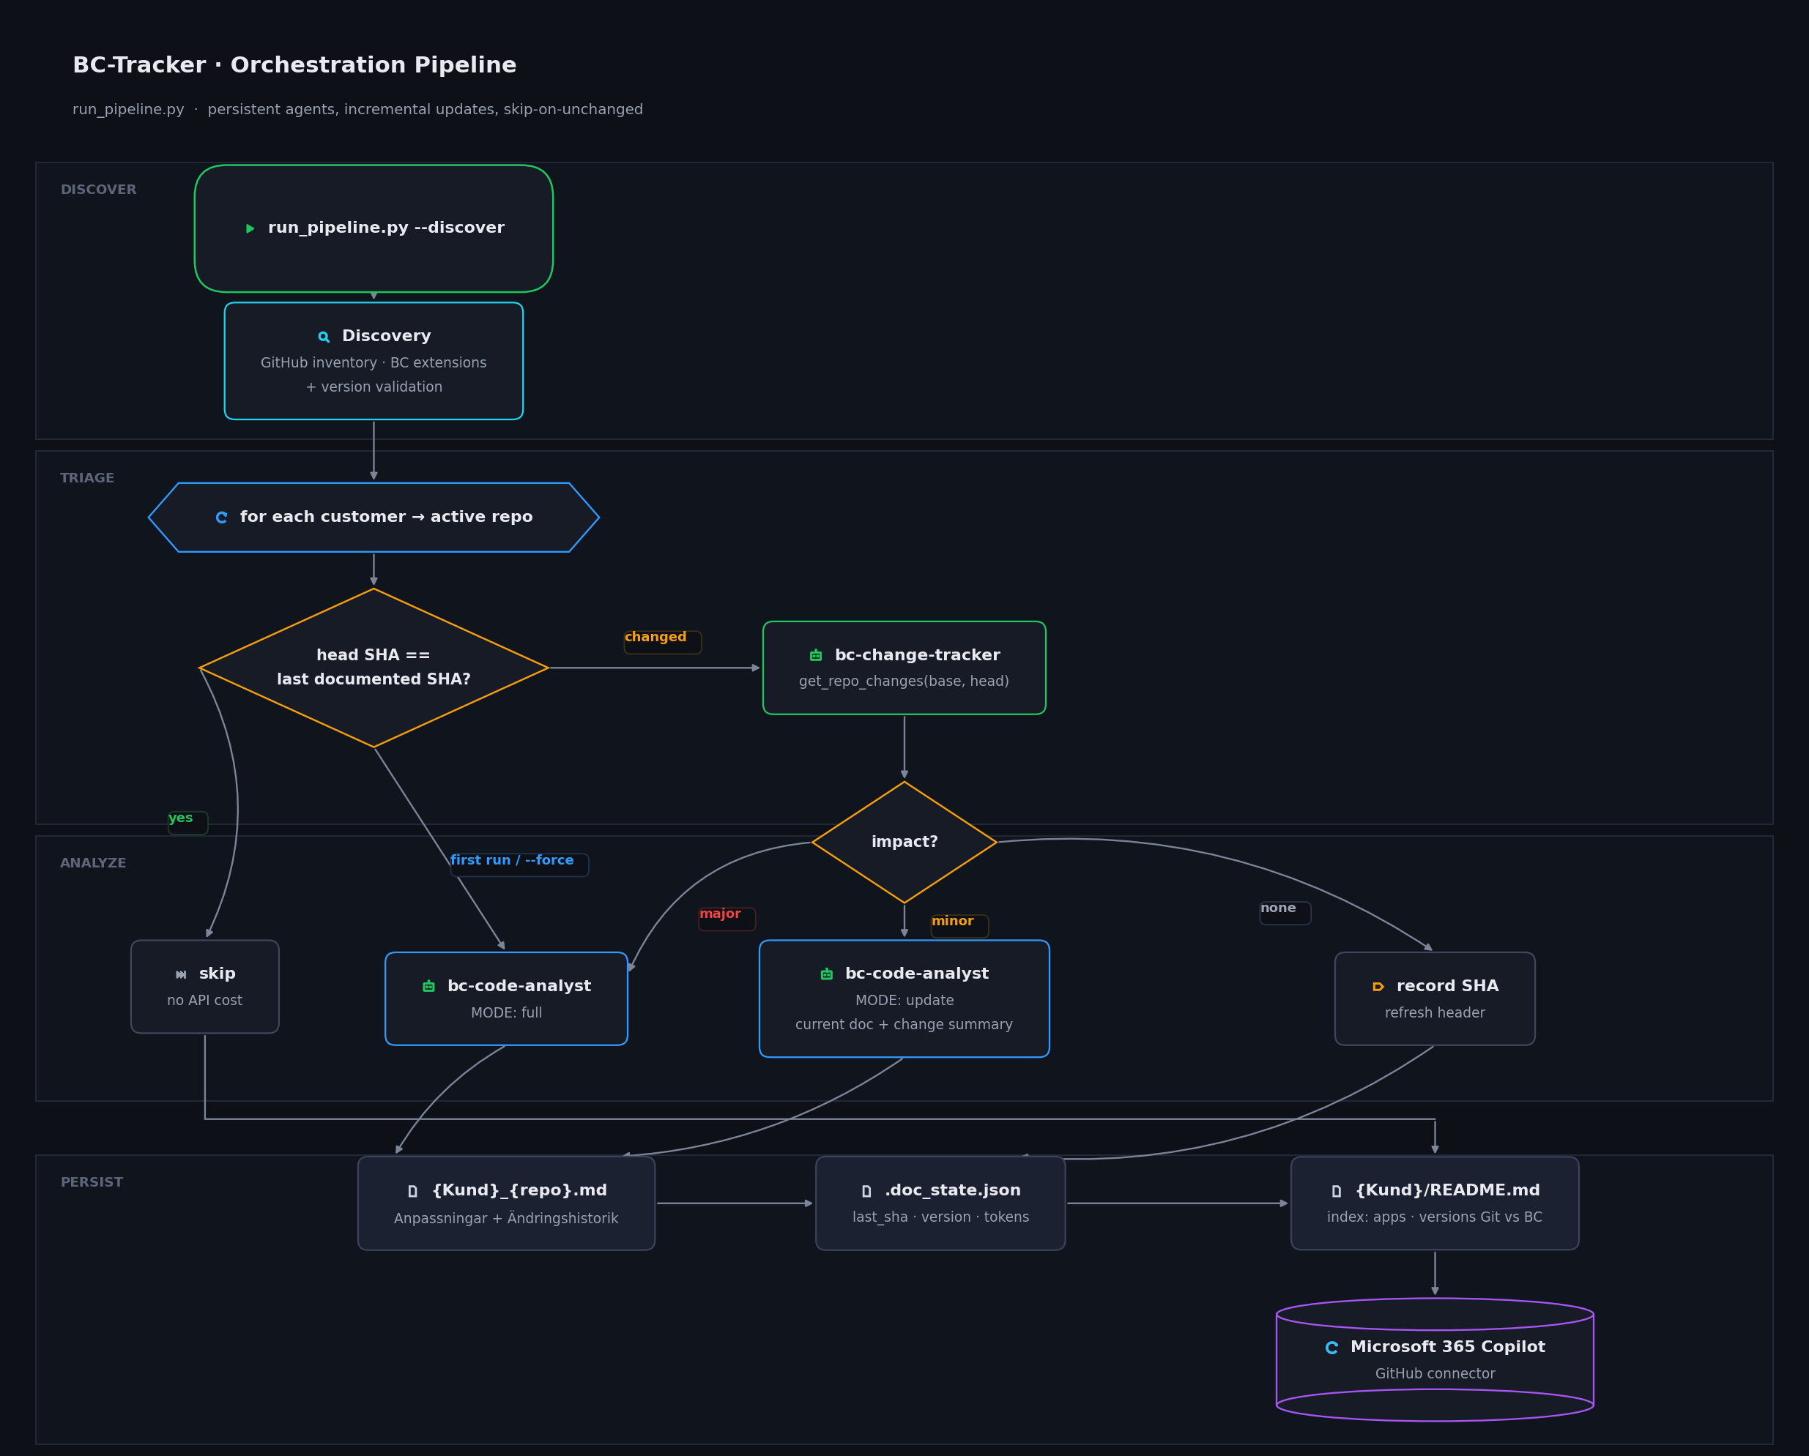
Notes:
[Sources]
- Attached BC_Deployment_Analyzer_Solution_Design.docx, lines 42-43 and 122-125.
[/Sources]

Slide 6
HOW IT WORKS
From merged code to consultant-ready knowledge
A governed flow combines deterministic analysis with specialized Foundry agents.
1
2
3
4
5
6
Discover
Detect
Track
Analyze
Publish
Use
GitHub + BC
What changed?
Impact + changelog
Explain current code
Living Markdown
Ask Copilot
Microsoft Foundry: agents • tracing • evaluation • versioning
Notes:
[Sources]
- Attached BC_Deployment_Analyzer_Solution_Design.docx, lines 108-117.
[/Sources]

Slide 7
THE AGENT COLLABORATION
Two focused agents, one controlled documentation workflow
The agents answer different questions so change detection remains precise and documentation remains complete.
Change Analyzer
Documentation Agent
Reads merged pull requests and code differences since the previous run.
Assesses whether the change has no, minor or major documentation impact.
Creates a consultant-readable change summary and routes the next step.
Uses structured analysis of the current AL source.
Explains the app and its business features in the InBiz documentation format.
Updates only affected content or regenerates the full section when required.
Unchanged repositories are skipped. Changed repositories are updated proportionally to their impact.
Notes:
[Sources]
- Attached BC_Deployment_Analyzer_Solution_Design.docx, lines 44-62.
[/Sources]

Slide 8
WHY MICROSOFT FOUNDRY
From a useful prototype to a governed enterprise solution
Foundry provides the control layer around the intelligence.
Managed agents
Traceability
Quality evaluation
Two specialized, versioned agents with clear responsibilities.
Model and tool calls are observable through Application Insights.
Groundedness, adherence, coherence and fluency can be measured.
Controlled orchestration
Enterprise governance
Changes route the pipeline to skip, update or regenerate.
Separate resources, Entra ID, least privilege and reviewable instructions.
Notes:
[Sources]
- Attached BC_Deployment_Analyzer_Solution_Design.docx, lines 64-105 and 128-130.
[/Sources]

Slide 9
FROM DOCUMENTATION TO DAILY USE
The GitHub connector brings current solution knowledge into Copilot
The generated Markdown becomes accessible where InBiz consultants already search and ask questions.
1
2
3
4
Publish
Index
Ask
Answer
Customer documentation and change history are committed to GitHub.
The built-in Microsoft 365 Copilot GitHub connector indexes the Markdown.
Consultants ask customer-specific questions in Microsoft 365 Copilot.
Copilot responds from the maintained documentation and cites the source.
The connector is the final adoption layer: it turns generated technical documentation into searchable, conversational knowledge.
Notes:
[Sources]
- Attached README.md and BC_Deployment_Analyzer_Solution_Design.docx, lines 29-34 and 110-125.
[/Sources]

Slide 10
AUTOMATED, REPEATABLE DEPLOYMENT
The pipeline deploys and runs itself — no manual babysitting
Infrastructure and documentation generation are both automated, idempotent and safe to re-run.
1
2
3
4
Provision
Trigger
Authenticate
Verify
deploy.sh provisions Foundry resources, safely reusing what already exists.
GitHub Actions runs the pipeline on a schedule or on demand.
OIDC federated identity signs in — no stored secrets or keys.
Every response is scored against a test set before it is published.
Re-running deployment or the pipeline is always safe: existing resources are reused and unchanged repositories are skipped.

Slide 11
VALUE FOR INBIZ
More consultant time spent helping customers
The solution makes technical knowledge reusable, searchable and current.
Faster answers
Less dependency
Consultants can ask Copilot instead of locating repositories or reading AL.
Knowledge is available beyond the developer who created the customization.
Lower maintenance
Safer delivery
Documentation updates incrementally when code changes.
Version mismatches and unpublished changes become visible.
Reusable release notes
Scalable governance
Change tracking produces a customer-readable history.
Monitoring and evaluation support controlled expansion across customers.
Notes:
[Sources]
- Attached README.md and BC_Deployment_Analyzer_Solution_Design.docx, lines 37-55, 121-125.
[/Sources]

Slide 12
THE OUTCOME
Trusted customer knowledge, kept alive by the delivery process
BC Deployment Analyzer connects development, operations and consulting in one continuous knowledge flow.
Code changes become current documentation.
Current documentation becomes grounded Copilot answers.
CURRENT
GROUNDED
SEARCHABLE
GOVERNED
A practical foundation for saving consultant time across InBiz.
github.com/hannisky/BC-Deployment-Analyser
Notes:
[Sources]
- Attached README.md and BC_Deployment_Analyzer_Solution_Design.docx, lines 29-34 and 122-130.
[/Sources]

