Slide 1
Workflow management with Snakemake
S. Rao
https://tinyurl.com/3b3ewyjz

Slide 2
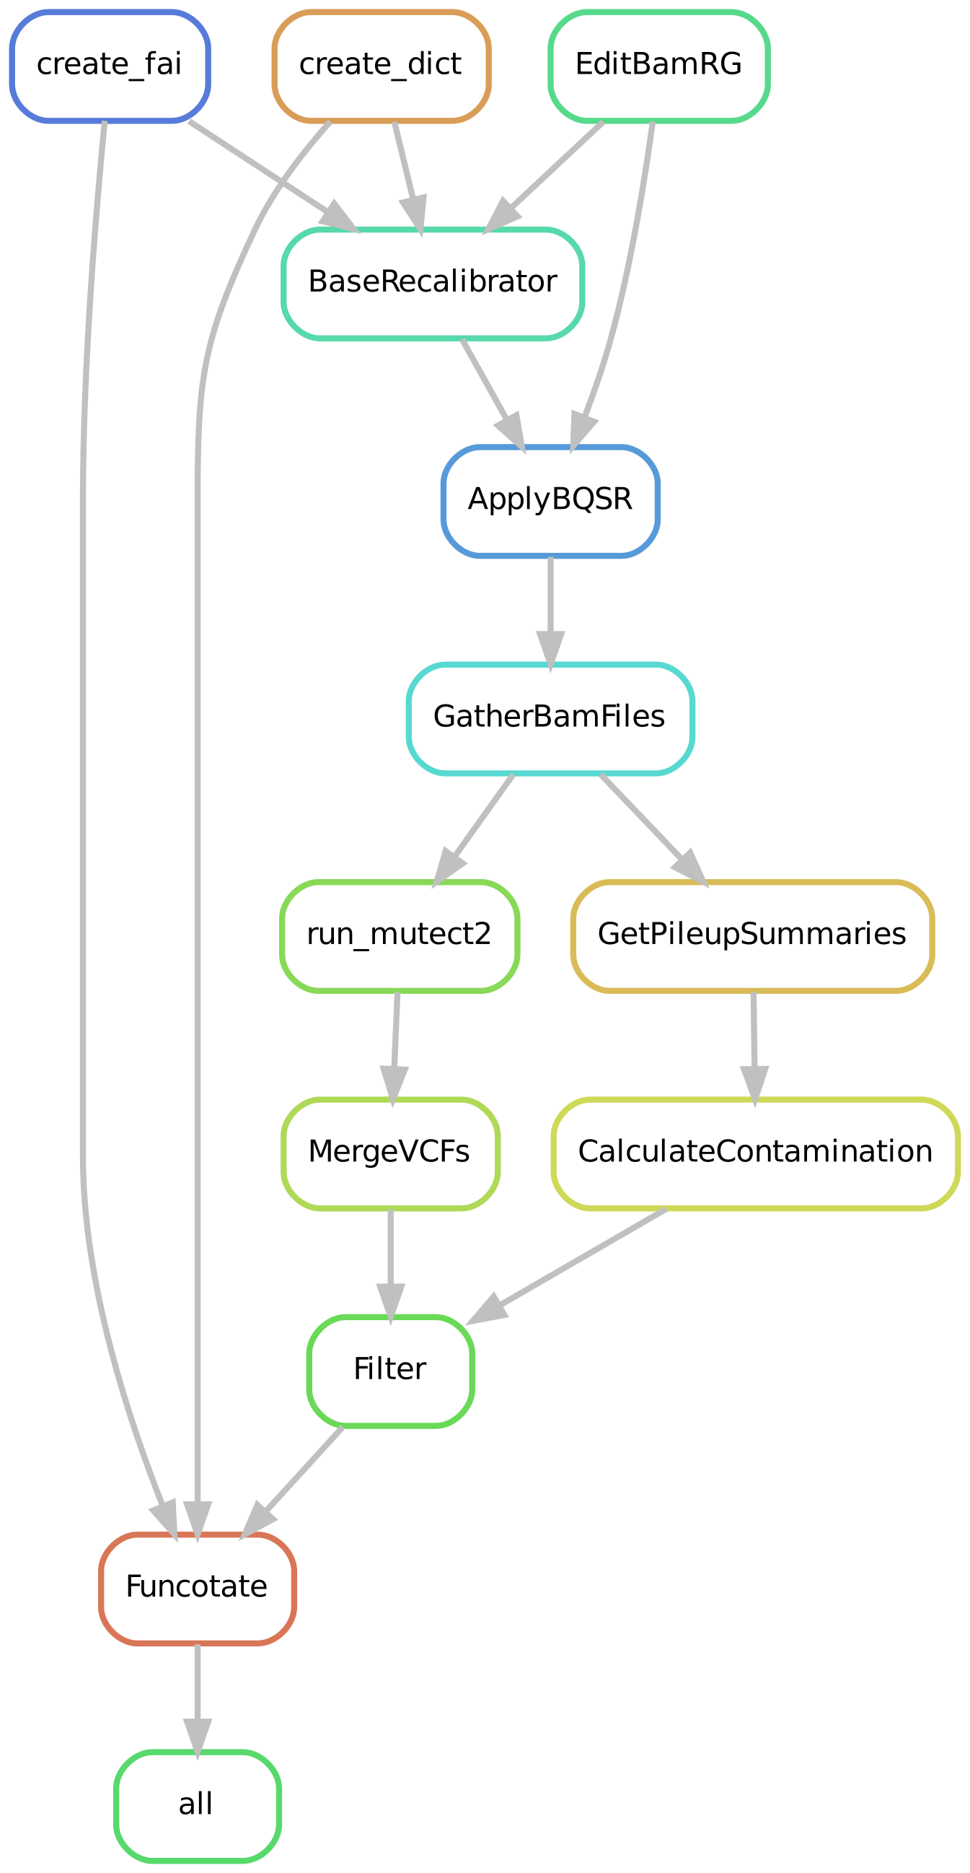
Workflow management
Reproducibility
Efficient use of resources (parallelisation)
Readability
Speed
Ease of execution (automation)
Minimising errors
https://tinyurl.com/3b3ewyjz

Slide 3
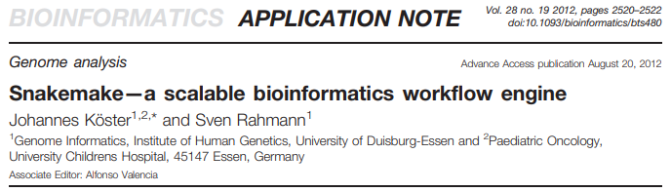
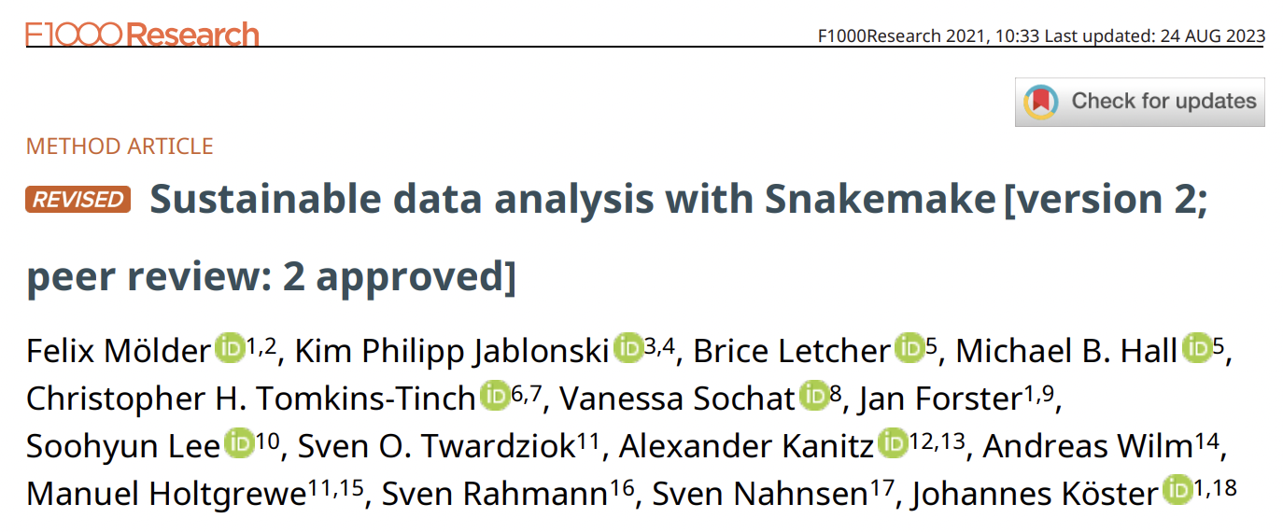
Bioinformatics workflow software
Snakemake
Nextflow
Cromwell
Toil
Bpipe
Ruffus
https://tinyurl.com/3b3ewyjz

Slide 4
Outline
Writing and running a basic rule
demo
Constructing a workflow with many rules
Wildcards
demo + try-it-yourself
Threads and resources
Configuration file
Running on a cluster
Python/snakemake code
Terminal commands/arguments
https://tinyurl.com/3b3ewyjz

Slide 5
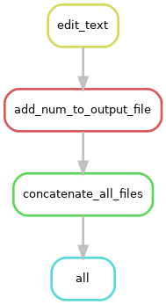
A simple snakemake rule
rule rule_name:
input: “data.txt”
output: “results.txt”
shell: “cat {input} > {output}”

Slide 6
4 ways to run a command within a rule
shell # any shell command
run # python code, can include shell()
script # Python, R, Julia
notebook # Jupyter notebooks

Slide 7
Run a workflow in your terminal
$ snakemake --dry-run
$ snakemake --cores 1
$ snakemake --cores 1 --snakefile Snakefile
$ snakemake --cores 1 target_rule

Slide 8
Multiple rules
By default, snakemake runs the first rule in a Snakefile, if a target rule is not specified at the command-line
By default, snakemake does not re-run rules whose output already exists. To re-run:
Update input files, e.g. $ touch input_files/*.*
Use --force argument (See below)
Use --delete-all-output argument (beware!)
A specific rule can be specified at the command-line
$ snakemake -j 1 --snakefile Snakefile third_rule

Slide 9
How to build a multi-step workflow
When constructing a workflow, it may help to think ‘backwards’
The input of the first rule (= target rule) is the final results you desire; target rule does not need output
Which rule’s output creates the input for the target rule? (let’s call this rule penultimate_rule)
Which rule creates the input for penultimate_rule?
and so on… until you write the rule that takes your existing input files (e.g. your raw fastq files) as input
rule all:
input:
r1 = “final_result1.txt”,
r2 = “final_result2.txt”

Slide 10
expand()
Say you have files
sample_A.fastq.gz
sample_B.fastq.gz
sample_C.fastq.gz
Try the following in a python console or a Jupyter notebook
>>> import snakemake.io as sio
>>> filenames = [‘A’, ‘B’, ‘C’]
>>> fastq_files = sio.expand(“somefile_{name}.txt”, name = filenames)
>>> fastq_files
[‘somefile_A.txt’, ‘somefile_B.txt’, ‘somefile_C.txt’]

Slide 11
Wildcards – snakemake uses regex
sample_{name}.fastq.gz
sample_{name}.trimmed.fastq.gz
sample_{name}.bam
sample_A.fastq.gz
sample_B.fastq.gz
sample_C.fastq.gz
Sample_A.trimmed.fastq.gz
sample_B.trimmed.fastq.gz
sample_C.trimmed.fastq.gz
sample_A.bam
sample_B.bam
sample_C.bam
Can be accessed in input, output, params using the {wildcard_name} notation
Can be accessed in run or shell directives using the wildcards.wildcard_name notation
Notation looks similar in expand(), but that is not wildcards
Different notation to refer to wildcards within expand() – {{wildcard_name}}

Slide 12
Threads and resources
Local execution
Total cores available for snakemake will not exceed --cores / -j
Threads for each rule allocated using threads keyword
If total threads == 10, and
A rule’s threads keyword value is set to 5, 2 jobs based on that rule can run parellelly
A rule’s threads keyword value is set to 6, 1 job based on that rule can run at a time using 6 threads
A rule’s threads keyword value is set to 15, 1 job based on that rule can run at a time using 10 threads
Cluster execution
Total jobs submitted to the cluster at a time will not exceed --cores / -j
slots for each rule allocated using the cluster json configuration file, with optional rule-specific parameters
Arbitrary resources can be allocated at workflow level using --resources
At the rule level, this is set using the resources keyword
$ snakemake --resources mem=100
resources:
mem = 50

