Slide 1







FUSIONPAY
Finance
Management System
A modular finance platform for product purchases, EMI management,
user accounts and administration — built with Spring Boot microservices and Angular.
SPRING BOOT
MICROSERVICES
ANGULAR
MYSQL
Team
Dongeshwar Sudhiksha - (85010913)
Pallikonda Hannsika - (85010971)
Sai Kirthana Konduru - (85010992)
FusionPay • Finance Management System
Spring Boot • Microservices • Angular • MySQL

Slide 2








01 • OVERVIEW
FusionPay at a glance
What the system actually delivers, based on the project implementation.
1
User accounts
2
Product commerce
3
Finance
4
Administration
Registration, login, profile, bank account and card details.
Catalog, search, category filtering, CRUD and purchase.
Purchase creation, EMI calculation, history and status tracking.
Admin management plus user and product visibility.
One application • six backend components
ANGULAR
API GATEWAY
USER
PRODUCT
FINANCE
ADMIN
EUREKA
Ports: Gateway 8080 • User 8081 • Product 8082 • Finance 8083 • Admin 8084 • Eureka 8761
FusionPay • Finance Management System
Spring Boot • Microservices • Angular • MySQL

Slide 3



02 • MOTIVATION
The problem FusionPay addresses
The project focuses on bringing product purchase and EMI-related finance operations into one system.
Fragmented finance operations
From separate concerns → one workflow
User details, product information and purchase records need coordinated handling.
USER
FusionPay coordinates these responsibilities through
independent Spring Boot services behind an API Gateway.
Manual administration
PRODUCT
Admins need dedicated capabilities to view users, products and purchase information.
FINANCE
ADMIN
MICROSERVICE BOUNDARIES
Purchase + EMI complexity
A purchase needs product information, user information and finance persistence to work together.
FusionPay • Finance Management System
Spring Boot • Microservices • Angular • MySQL

Slide 4

03 • SOLUTION
What FusionPay implements
A complete flow from Angular UI to service-level persistence.
1
2
3
4
5
Register / Login
Browse Products
Select EMI
Create Purchase
Track Purchase
Frontend
Backend
Persistence
• Angular + Router + Forms
• HttpClient for REST calls
• Responsive UI and auth guards
• Spring Boot 3 REST APIs
• Spring Data JPA + Validation
• OpenFeign for service calls
• MySQL database per service
• Repository layer
• HeidiSQL for database work
The implemented flow connects user identity, product selection, purchase creation and finance tracking.
FusionPay • Finance Management System
Spring Boot • Microservices • Angular • MySQL

Slide 5



04 • ARCHITECTURE CHOICE
Monolith vs. FusionPay's service boundaries
Why the project uses independent services for core responsibilities.
TRADITIONAL MONOLITH
FUSIONPAY MICROSERVICES
Modules tightly coupled
Independent services
Changes can span the same deployment unit
User, Product, Finance and Admin have clear responsibilities
Shared application boundary
Independent scaling
Scaling is not isolated by business function
Each service is a separate runtime component
Larger failure surface
Service discovery
A failure can affect more of the application
Eureka registers and discovers services
Single deployment
API-based communication
Services cannot be deployed independently
Gateway routes requests; OpenFeign connects services
FusionPay • Finance Management System
Spring Boot • Microservices • Angular • MySQL

Slide 6


05 • USER FLOW
A purchase journey through the system
The implemented Angular routes and backend services support this end-to-end path.
01
02
03
04
05
06
Register / Login
Dashboard
Products
Product Details
Purchase / Payment
Transactions
Account & recovery
Shopping
Finance view
Registration • login • forgot password
OTP send / verify • change password
Search • category filter • product details
purchase • automatic stock update
EMI calculation • purchase history
purchase status • tracking
FusionPay • Finance Management System
Spring Boot • Microservices • Angular • MySQL

Slide 7




06 • SYSTEM ARCHITECTURE
The runtime topology
CLIENT LAYER
Angular Frontend • localhost:4200
API GATEWAY
8080 • single entry point • request routing
USER SERVICE
PRODUCT SERVICE
FINANCE SERVICE
ADMIN SERVICE
8081
8082
8083
8084
EUREKA SERVER • 8761
Service registration + discovery
FusionPay • Finance Management System
Spring Boot • Microservices • Angular • MySQL

Slide 8

07 • SERVICE MAP
Six components, six responsibilities
Clear ownership keeps each business capability focused.
8761
8080
8081
Eureka Server
API Gateway
User Service
Service registration and discovery.
Single entry point and request routing.
Registration, login, profile, bank and card details.
8082
8083
8084
Product Service
Finance Service
Admin Service
CRUD, search, category filtering and purchase.
Purchase persistence, EMI calculation and tracking.
Admin management plus user/product/purchase views.
FusionPay • Finance Management System
Spring Boot • Microservices • Angular • MySQL

Slide 9

08 • TECHNOLOGY
Technology stack
Backend
Frontend
Java 17
Spring Boot 3
Spring Data JPA
Spring Validation
Spring Cloud Eureka
Spring Cloud Gateway
OpenFeign
Lombok
Maven
Angular
TypeScript
HTML5
CSS3
Bootstrap
Angular Router
Angular Forms
HttpClient
Data
Development Tools
MySQL
HeidiSQL
Repository layer
Four service databases
Eclipse IDE
VS Code
Git / GitHub
Postman
FusionPay • Finance Management System
Spring Boot • Microservices • Angular • MySQL

Slide 10






09 • BACKEND DEEP DIVE
Finance Service • EMI & purchase records
Port 8083 • database: finance_finance_db • table: purchase
Purchase lifecycle
What the finance layer stores
CREATE
POST /api/purchases
• Purchase records
• Purchase status
• User-specific purchase history
• Purchase retrieval by ID
• Update and delete operations
READ
GET /api/purchases
UPDATE
PUT /api/purchases/{id}
DELETE
DELETE /api/purchases/{id}
EMI CALCULATION
EMI duration and monthly EMI are shown during purchase.
FusionPay • Finance Management System
Spring Boot • Microservices • Angular • MySQL

Slide 11


10 • BACKEND DEEP DIVE
Product Service • catalog & purchase entry
Port 8082 • database: finance_product_db • table: products
Catalog
User & account management
Get all products, get by ID,
search by name and category.
Core responsibilities
• User registration and login
• Profile, bank and card details
• Account recovery with OTP flow
• User activation
• Protected frontend routes using Angular auth guard and interceptor
Product management
Add, update and delete products
through REST endpoints.
SERVICE ROLE
Purchase initiation
Owns user identity and account data for the finance application and works as an independent Spring Boot microservice.
POST /api/products/purchase
and automatic stock update.
FusionPay • Finance Management System
Spring Boot • Microservices • Angular • MySQL

Slide 12
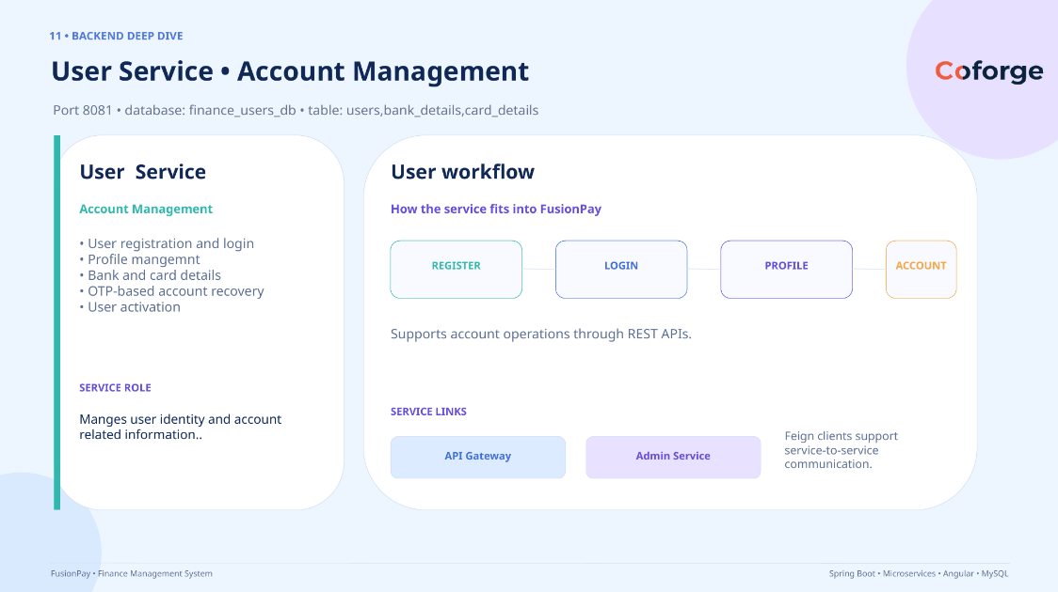

Slide 13







12 • BACKEND DEEP DIVE
Admin Service • centralized management
Port 8084 • database: finance_admin_db • table: admins
Admin operations
User visibility
Product & purchase visibility
• Add admin
• Admin login
• View all admins
• Get admin by ID
• Delete admin
• View all users
• View user by ID
• Activate user
• View all products
• View product by ID
• View all purchases
• View purchase by ID
/admin/save
/admin/login
USER-SERVICE
PRODUCT-SERVICE
FINANCE-SERVICE
Uses UserServiceClient via OpenFeign.
Admin Service • centralized administration • user visibility • product visibility • purchase visibility
Admin Service • centralized administration • user visibility • product visibility • purchase visibility
FusionPay • Finance Management System
Spring Boot • Microservices • Angular • MySQL

Slide 14


13 • INTEGRATION & INFRASTRUCTURE
How the services communicate
API Gateway handles entry and routing; Eureka supports discovery; OpenFeign defines service calls.
API Gateway • 8080
Eureka • 8761
OpenFeign
Single entry point for the Angular client.
Routes requests to the appropriate backend service.
Service registration and discovery.
Backend services register so callers can resolve service instances.
Typed client-based calls between services.
Keeps cross-service integration explicit.
REQUEST FLOW
ANGULAR CLIENT
API GATEWAY
BACKEND SERVICE
MYSQL DATABASE
4200
8080
8081–8084
PER SERVICE
Cross-service communication: SERVICE A → OpenFeign Client → SERVICE B
FusionPay • Finance Management System
Spring Boot • Microservices • Angular • MySQL

Slide 15

14 • DATA
Database-per-service design
The project defines four MySQL databases with ownership aligned to the microservices.
finance_users_db
finance_product_db
User Service
• users
• bank_details
• card_details
Product Service
• products
finance_finance_db
finance_admin_db
Finance Service
• purchase
Admin Service
• admins
FusionPay • Finance Management System
Spring Boot • Microservices • Angular • MySQL

Slide 16
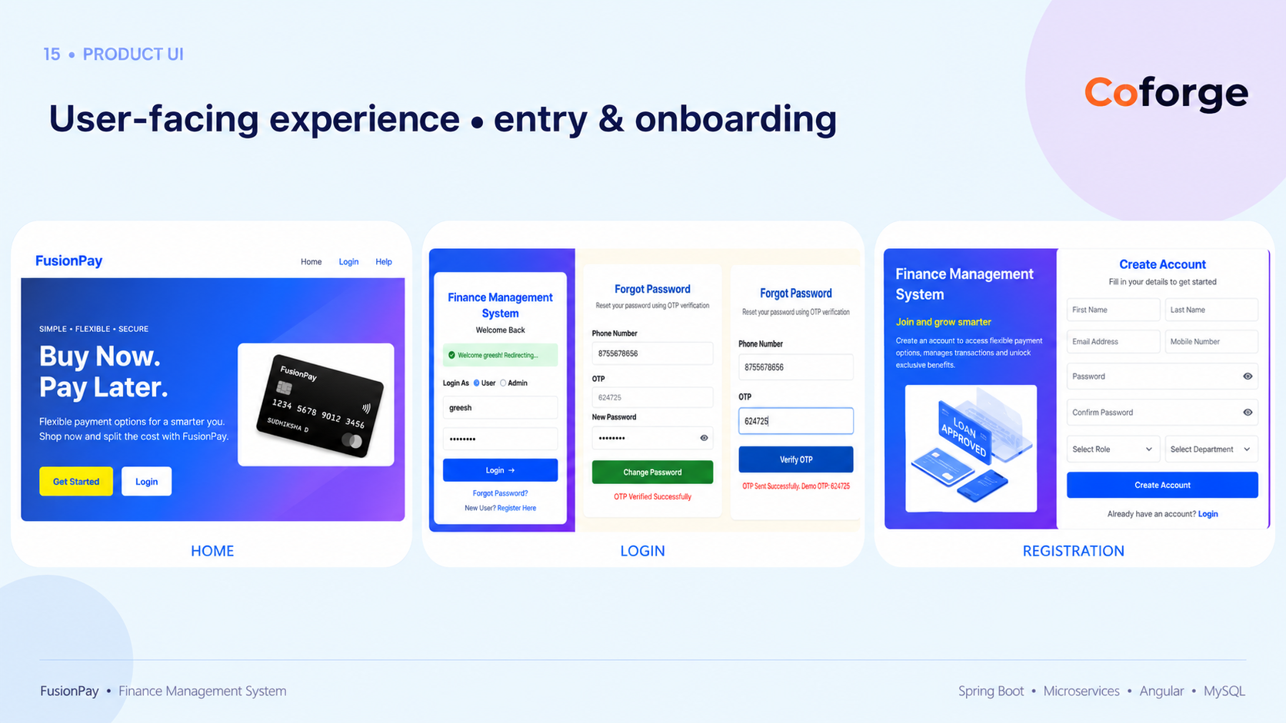

Slide 17


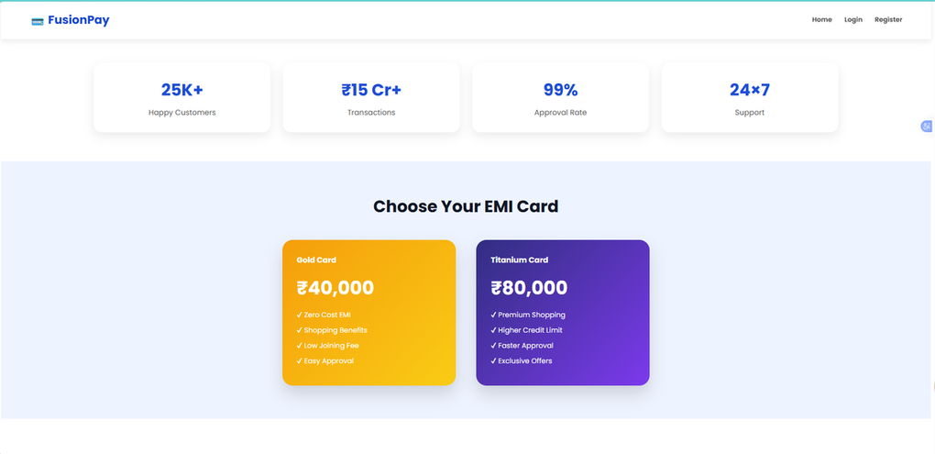
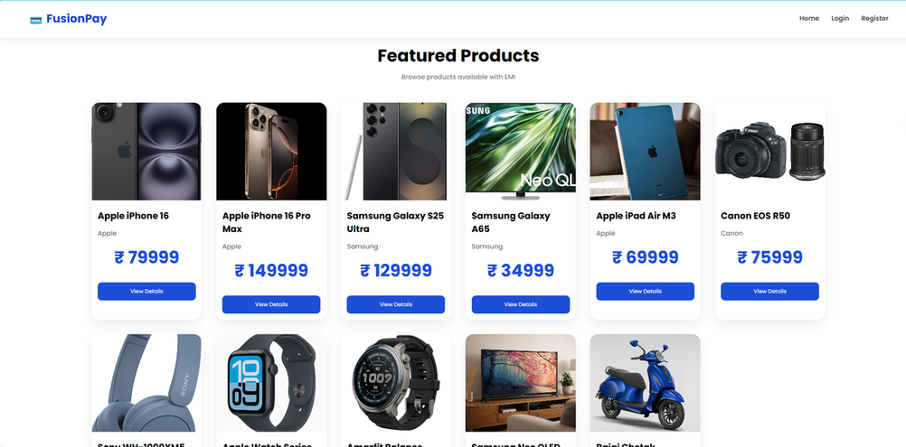
16 • PRODUCT UI
Shopping & EMI experience
Two views show how users choose financing and browse products.
EMI CARDS
PRODUCT CATALOG
FusionPay • Finance Management System
Spring Boot • Microservices • Angular • MySQL

Slide 18
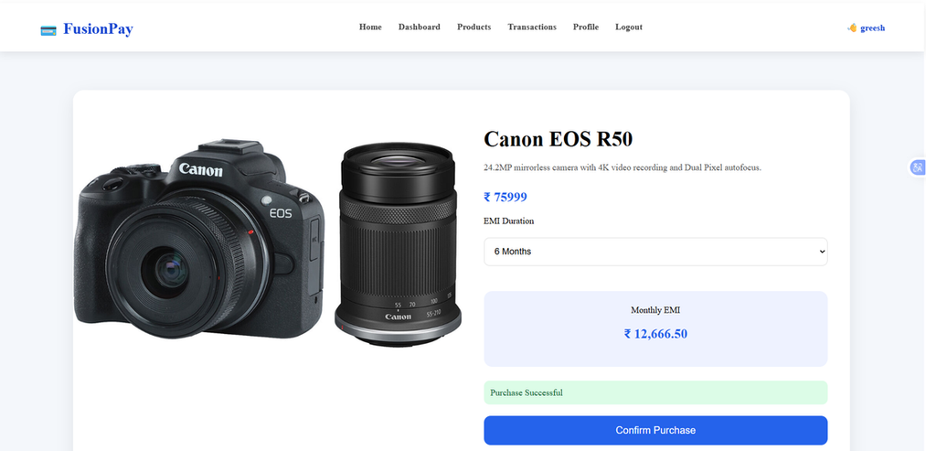
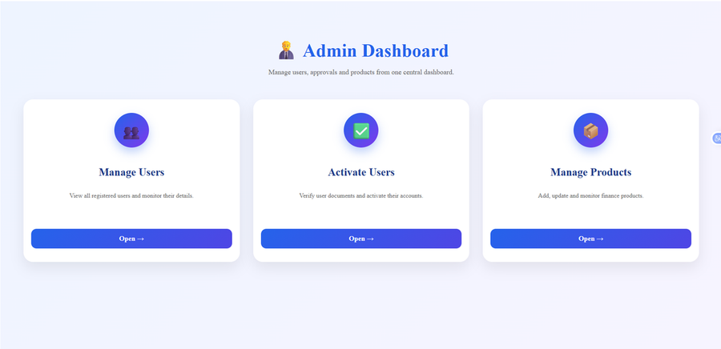
17 • ADMIN & ACCOUNT
Product details and administration
The interface connects product selection with administrative visibility.
PRODUCT DETAILS
ADMIN DASHBOARD
FusionPay • Finance Management System
Spring Boot • Microservices • Angular • MySQL

Slide 19

18 • CONCLUSION
FusionPay brings the finance workflow together.
A full-stack Finance Management System connecting users, products, purchases and administration through Spring Cloud infrastructure.
Modular
Discoverable
Connected
User-facing
Independent service responsibilities
Eureka-based service registration
OpenFeign inter-service calls
Angular purchase + finance flow
Spring Boot • Microservices • Angular • MySQL
FusionPay • Finance Management System
Spring Boot • Microservices • Angular • MySQL

Slide 20









FUSIONPAY
QUESTIONS & DISCUSSION
•
Thank
You
API GATEWAY
Questions & Discussion
Thank you for your time and attention.
USER
FUSIONPAY
PRODUCT
ONE PLATFORM • FOUR SERVICES
User • Product • Finance • Admin
Connected through an API Gateway and service discovery.
FINANCE
ADMIN
Spring Boot • Angular • MySQL • Eureka
FusionPay • Finance Management System
Questions & Discussion

