Slide 1
TIES4911
Task 3 - Extra
Hannu Sirén

Slide 2
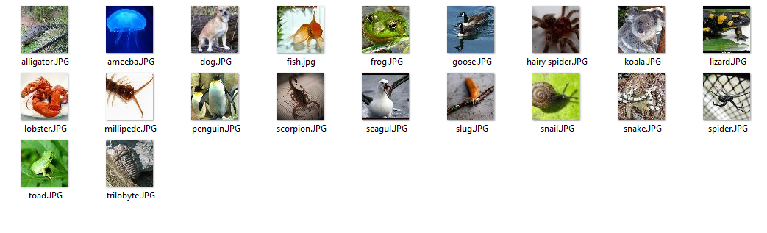
ImageNet – Tiny data set

Slide 3
Training
python retrain.py --bottleneck_dir=bottlenecks --how_many_training_steps 500 --model_dir=model_dir --output_graph=retrained_graph.pb --output_labels=retrained_labels.txt --summaries_dir=retrain_logs --image_dir=images
…
2018-03-01 19:48:55.495076: Step 499: Train accuracy = 95.0%
2018-03-01 19:48:55.495575: Step 499: Cross entropy = 0.114200
2018-03-01 19:48:55.706657: Step 499: Validation accuracy = 95.0%
Final test accuracy = 95.0%
Converted 2 variables to const ops.

Slide 4
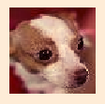
Test
python label_image.py "D:\Training datas\Imagenet\Tiny\tiny-imagenet-200\train\n02085620\images\n02085620_21.JPEG“
dog (score = 0.15187)
fish (score = 0.11041)
lobster (score = 0.09606)
slug (score = 0.08639)
spider (score = 0.08516)
scorpion (score = 0.08373)
alligator (score = 0.08130)
goose (score = 0.08020)
toad (score = 0.07992)
snake (score = 0.07775)
ameeba (score = 0.07746)
hairy spider (score = 0.07472)
snail (score = 0.07166)
penguin (score = 0.07135)
frog (score = 0.06989)
koala (score = 0.06970)
trilobyte (score = 0.06885)
millipede (score = 0.06785)
seagul (score = 0.03694)
lizard (score = 0.03682)

Slide 5
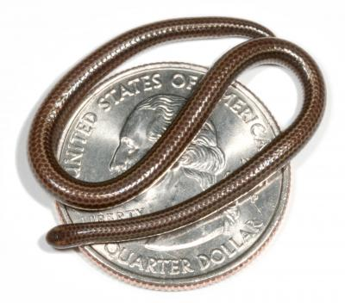
API
"result": [
{
"class": "slug",
"score": "0.17148"
},
{
"class": "snail",
"score": "0.14746"
},
{
"class": "alligator",
"score": "0.13962"
},
{
"class": "scorpion",
"score": "0.13926"
},
{
"class": "trilobyte",
"score": "0.13288"
},
{
"class": "spider",
"score": "0.12876"
},
…

