Slide 1
TIES4911 Task 3
Hannu Sirén

Slide 2
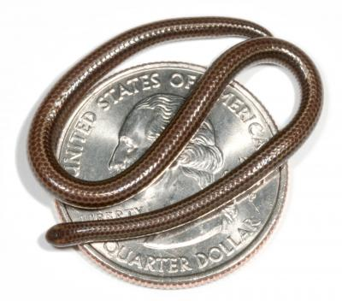
https://upload.wikimedia.org/wikipedia/commons/e/e7/Leptotyphlops_carlae.jpg

Slide 3
Training Data
Image-net.org
Part of Tiny data set
20 labels
500 pictures each
64x64 dimension
Step 3999: Train accuracy = 90.0%
Step 3999: Cross entropy = 0.437803
Step 3999: Validation accuracy = 77.0% (N=100)
INFO:tensorflow:Final test accuracy = 80.2% (N=2054)

Slide 4
{
"result": [
{
"class": "n01784675 - centipede",
"score": "0.59463"
},
{
"class": "n01945685 - slug",
"score": "0.15623"
},
{
"class": "n01944390 - snail",
"score": "0.05583"
},
{
"class": "n01950731 - octopus?",
"score": "0.02974"
},
{
"class": "n01917289 - (coral plant ?)",
"score": "0.02593"
},
{
"class": "n01768244 - trilobite",
"score": "0.02195"
},
…

