Slide 1
空间分析入门
李丁
中国人民大学社会与人口学院
中国人民大学国家发展与战略研究院
Notes:
本PPT大量参考使用了孟天广、李锋的讲义。

Slide 2
内容提要
1 简介
Why use spatial methods?
The spatial autoregressive data generating process
2 空间数据与可视化in R
点（Points）
面（Polygons）
线（Grids）
3 空间自相关（Spatial Autocorrelation）
4 空间权重（Spatial Weights）
5 点分析（Point Processes）
6 空间统计（Geostatistics）
7 空间回归 （Spatial Regression）
Models for continuous dependent variables
Models for categorical dependent variables
Spatiotemporal models

Slide 3
为什么使用空间分析
Independence assumption not valid
The attributes of observation i may influence the attributes of j.
Spatial heterogeneity
The magnitude and direction of a treatment effect may vary across space.
Omitted variable bias
There may be some unobserved or latent influences shared by geographical or network “neighbors”.

Slide 4
空间分析实例
流行病学 Epidemiology
How to model the spread of a contagious disease?
犯罪学 Criminology
How to identify crime hot spots?
固定资产 Real estate
How to predict housing prices?
战争、镇反 Counterinsurgency
“Oil spot” modeling and clear-hold-build
组织学习与网络传播 Organizational learning and network diffusion
How to model the adoption of an innovation?

Slide 5
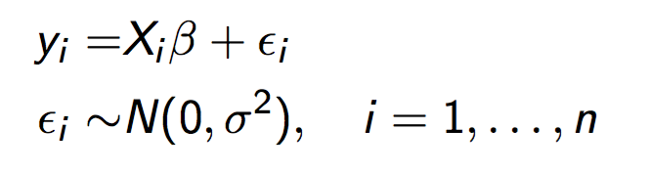

空间自相关产生过程
线性模型
假定 Assumptions
Observed values at location i independent of those at location j
Residuals are independent
The independence assumption greatly simplifies the model, but may be difficult to justify in some contexts...

Slide 6
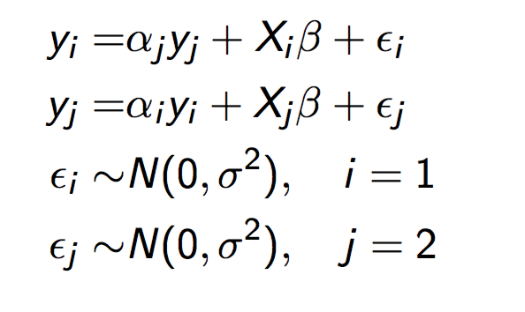
空间自相关产生过程
对于两个相邻对象 two neighbors i and j:
假定
Observed values at location i depend on those at location j, and vice versa
Data generating process is “simultaneous” (more on this later)

Slide 7
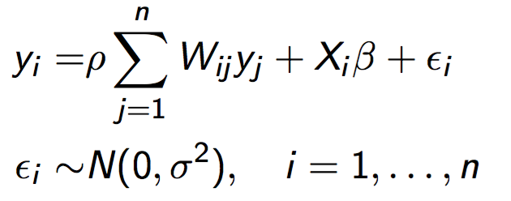
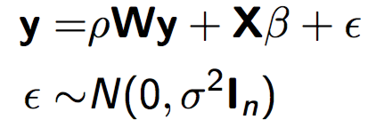
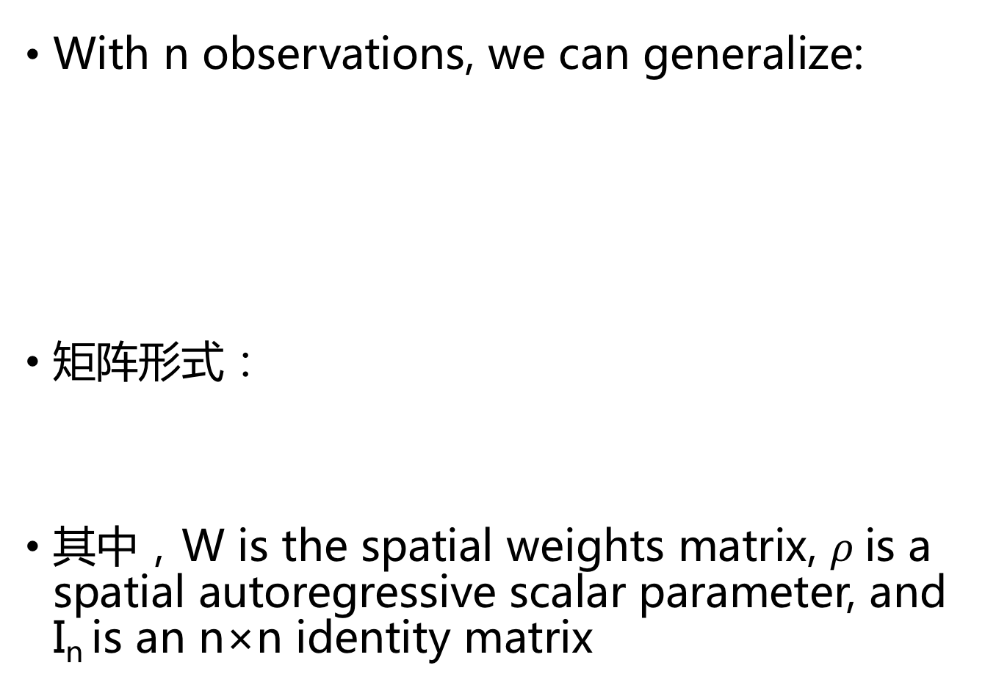
空间自相关产生过程
With n observations, we can generalize:
矩阵形式：
其中，W is the spatial weights matrix, $ρ$is a spatial autoregressive scalar parameter, and I_{n} is an n×n identity matrix

Slide 8
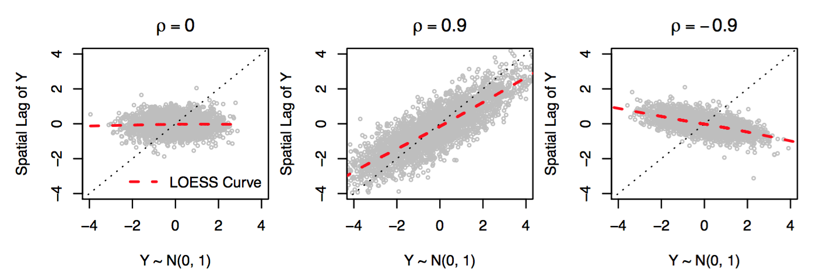

空间自相关产生过程
When $ρ$= 0, the variable in not spatially autocorrelated. Information about a measurement in one location gives us no information about the value in neighboring locations (spatial independence).
When $ρ$> 0, the variable in positively spatially autocorrelated. Neighboring values tend to be similar to each other (clustering).
When $ρ$ < 0, the variable in negatively spatially autocorrelated. Neighboring values tend to be different to each other (segregation).

Slide 9
如何理解空间自相关

Slide 10
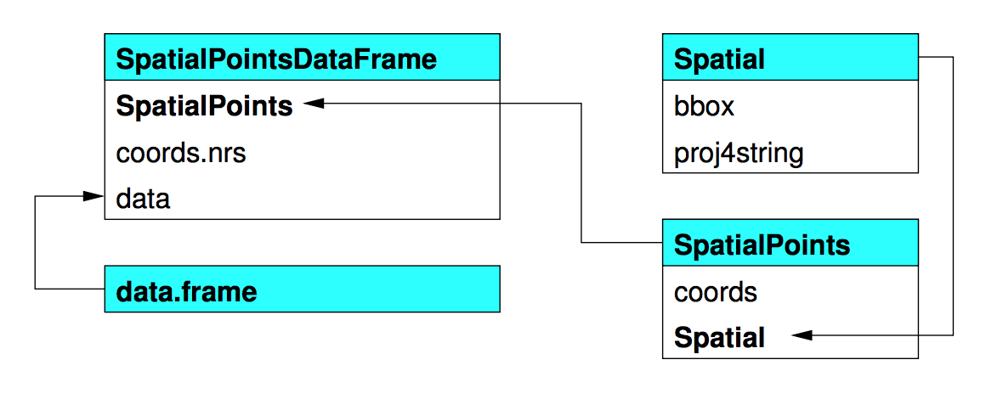
点对象的结构

Slide 11
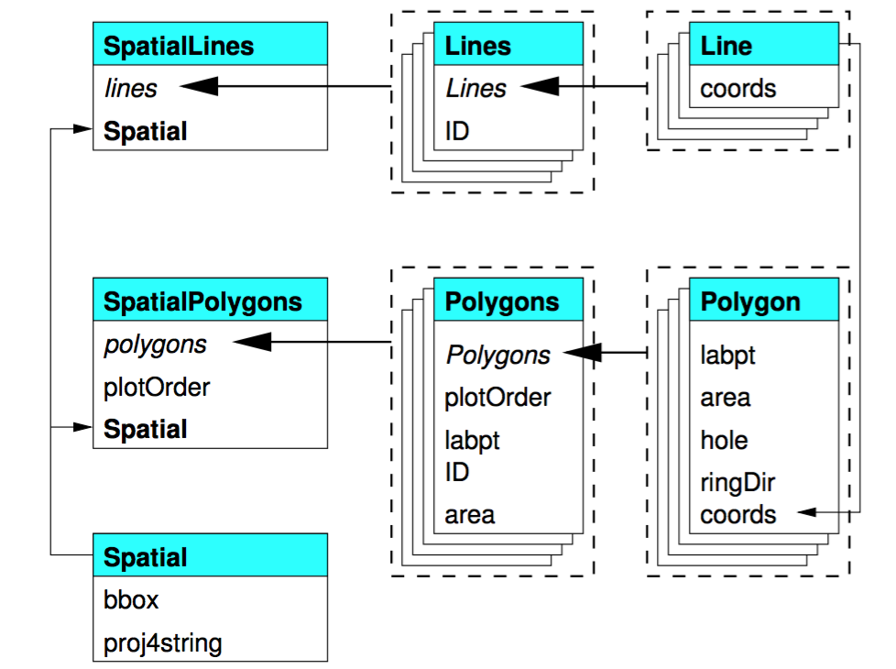
面对象的结构

Slide 12
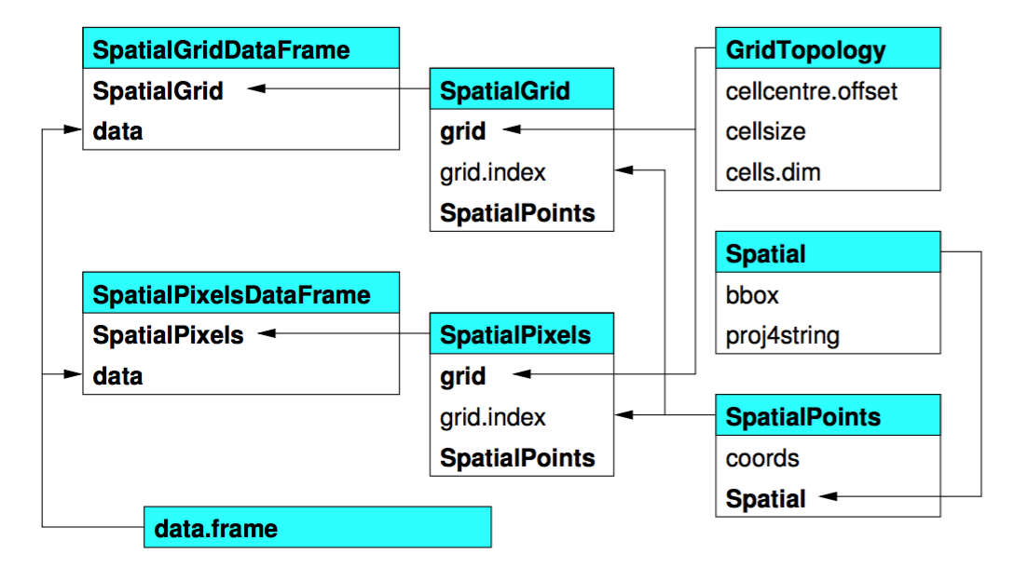
网格对象

Slide 13
投影系统的基本概念
地球椭球体(Ellipsoid)
大地基准面(Datum)
地图投影(Projection)
https://www.cnblogs.com/rainbow70626/p/4382131.html
http://desktop.arcgis.com/zh-cn/arcmap/10.3/guide-books/map-projections/about-projected-coordinate-systems.htm

Slide 14
参考教材
教材：
https://geocompr.robinlovelace.net/
https://mgimond.github.io/Spatial/index.html
课程资料1：
http://adamwilson.us/SpatialDataScience/index.html
课程资料2：
http://www.people.fas.harvard.edu/~zhukov/spatial.html
Notes:
课程资料1 参考了 https://byuistats.github.io/M335/index.html

Slide 15
谢谢！ liding@ruc.edu.cn

