Slide 1
ELEVATE LABS · TASK 4
Financial Sales & Analysis Dashboard
Presented by: Hanny Rachel

Slide 2
DESIGN SUMMARY
Dashboard Overview
Created a 2-page interactive Power BI dashboard with slicers for Year, Country, Segment and Product.
$118.73M
$16.89M
349.5%
1M
Overall Sales
Total Profit
Sales Growth
Total Units Sold
Slicers available: Year · Country · Segment · Product
2

Slide 3
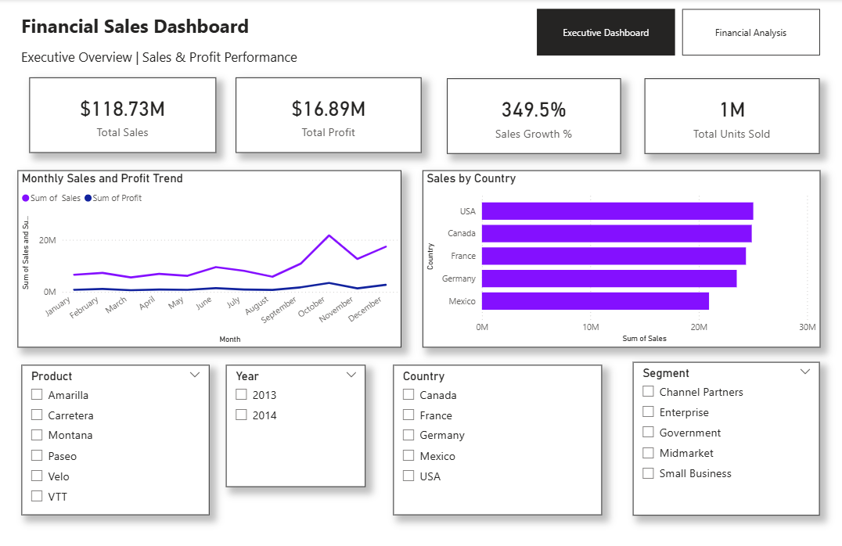
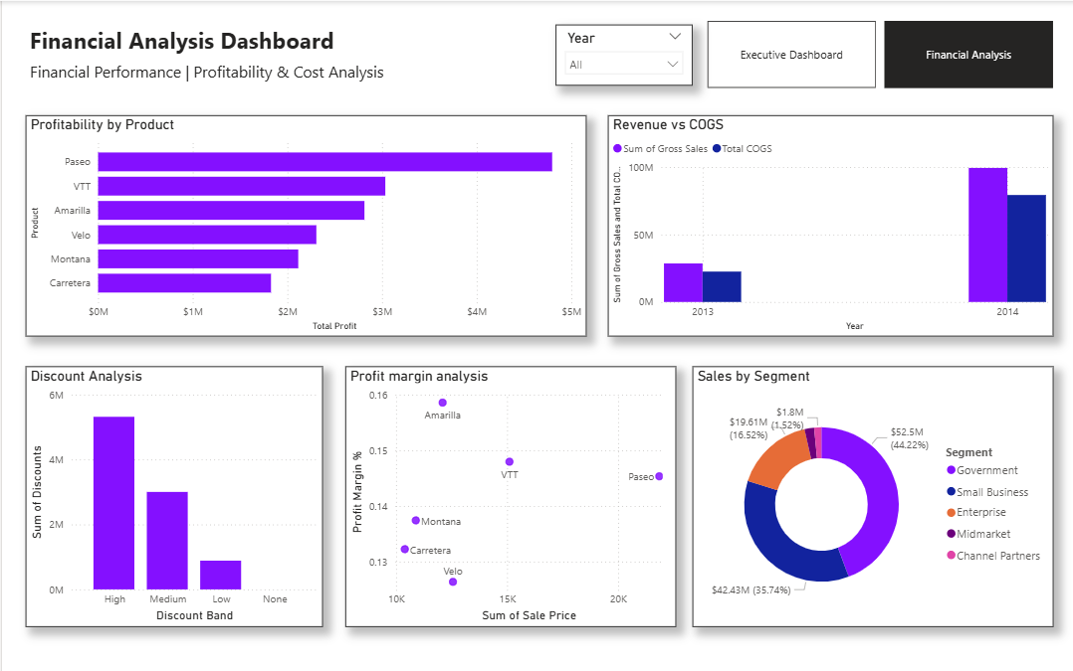
Dashboard Design
Executive Dashboard
Financial Analysis
KPI cards for key financial metrics
Monthly Sales & Profit Trend
Sales comparison across countries
Interactive slicers
Revenue vs COGS
Profitability by Product
Discount Analysis
Profit Margin Analysis
Sales by Segment
3

Slide 4
FINDINGS
Key Insights
Paseo generated the highest profit at approximately $4.8M.
Government was the largest sales segment with $52.5M (44.22%).
USA recorded the highest sales among the countries shown.
October recorded the highest monthly sales, while March and August were among the lowest.
High discount products accounted for the largest discount amount at approximately $5.3M.
Sales increased significantly from 2013 to 2014, with 2014 contributing the majority of revenue.
4

Slide 5
CONCLUSION
The dashboard provides a clear view of sales, profit and financial performance.
Product, country and segment analysis helps identify high-performing areas.
Revenue, COGS and discount analysis provides insight into cost and profitability patterns.
Interactive slicers allow users to explore the data and support data-driven decisions.
Thank You
Hanny Rachel · Data Analyst Internship · Elevate Labs

