Slide 1
面对面建群
打开雨课堂

Slide 2
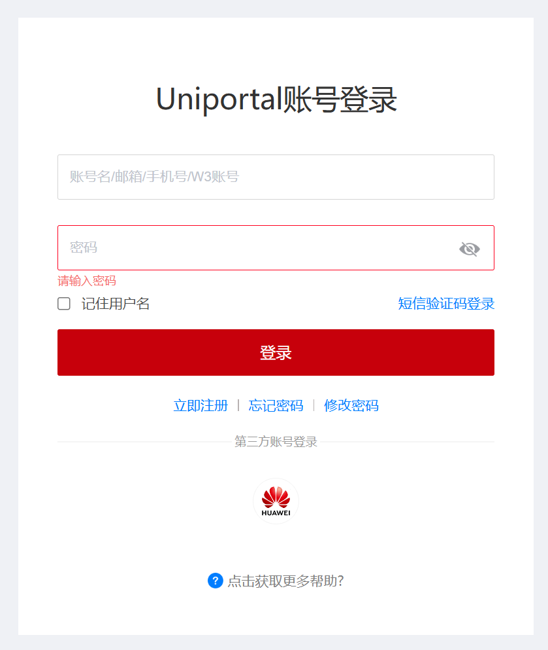
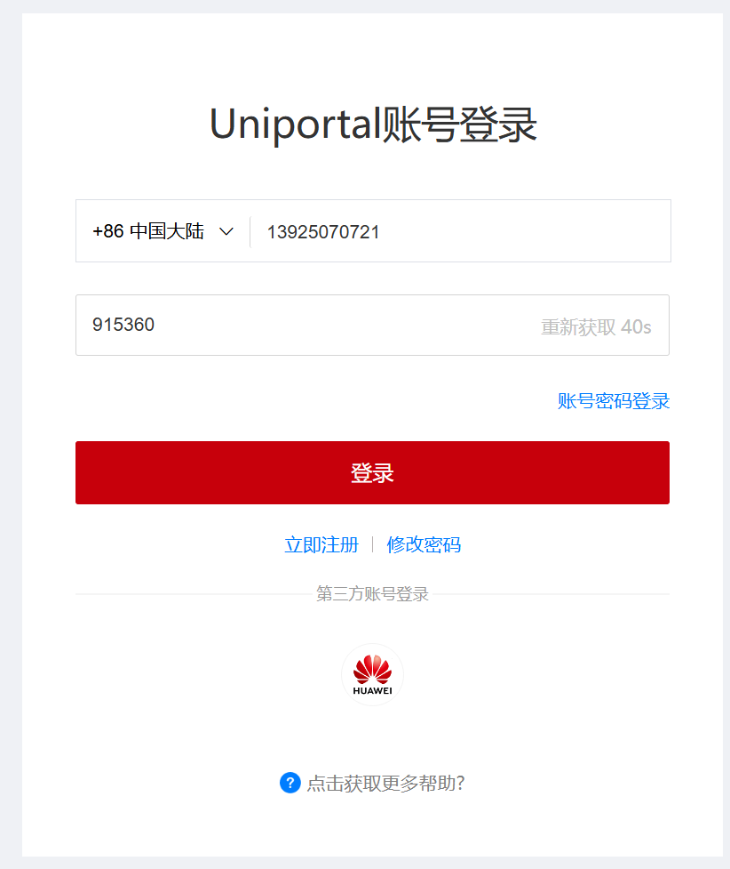
https://uniportal.huawei.com/uniportal1/login-pc.html?lang=zh_CN&redirect=https%3A%2F%2Fe.huawei.com%2Fcn%2Ftalent%2F%23%2F

Slide 3
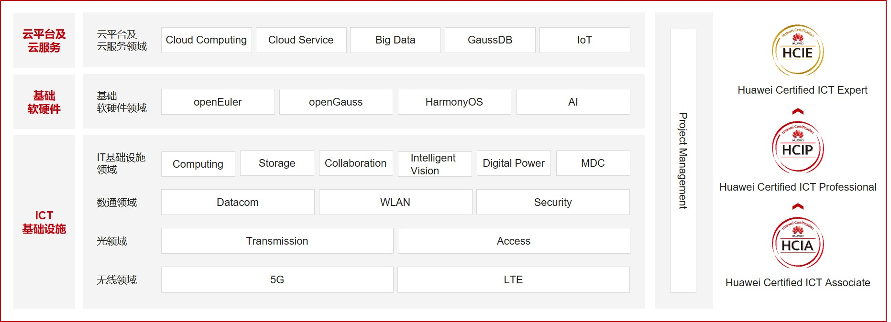
菜单：职业认证
职业认证 (huawei.com)

Slide 4
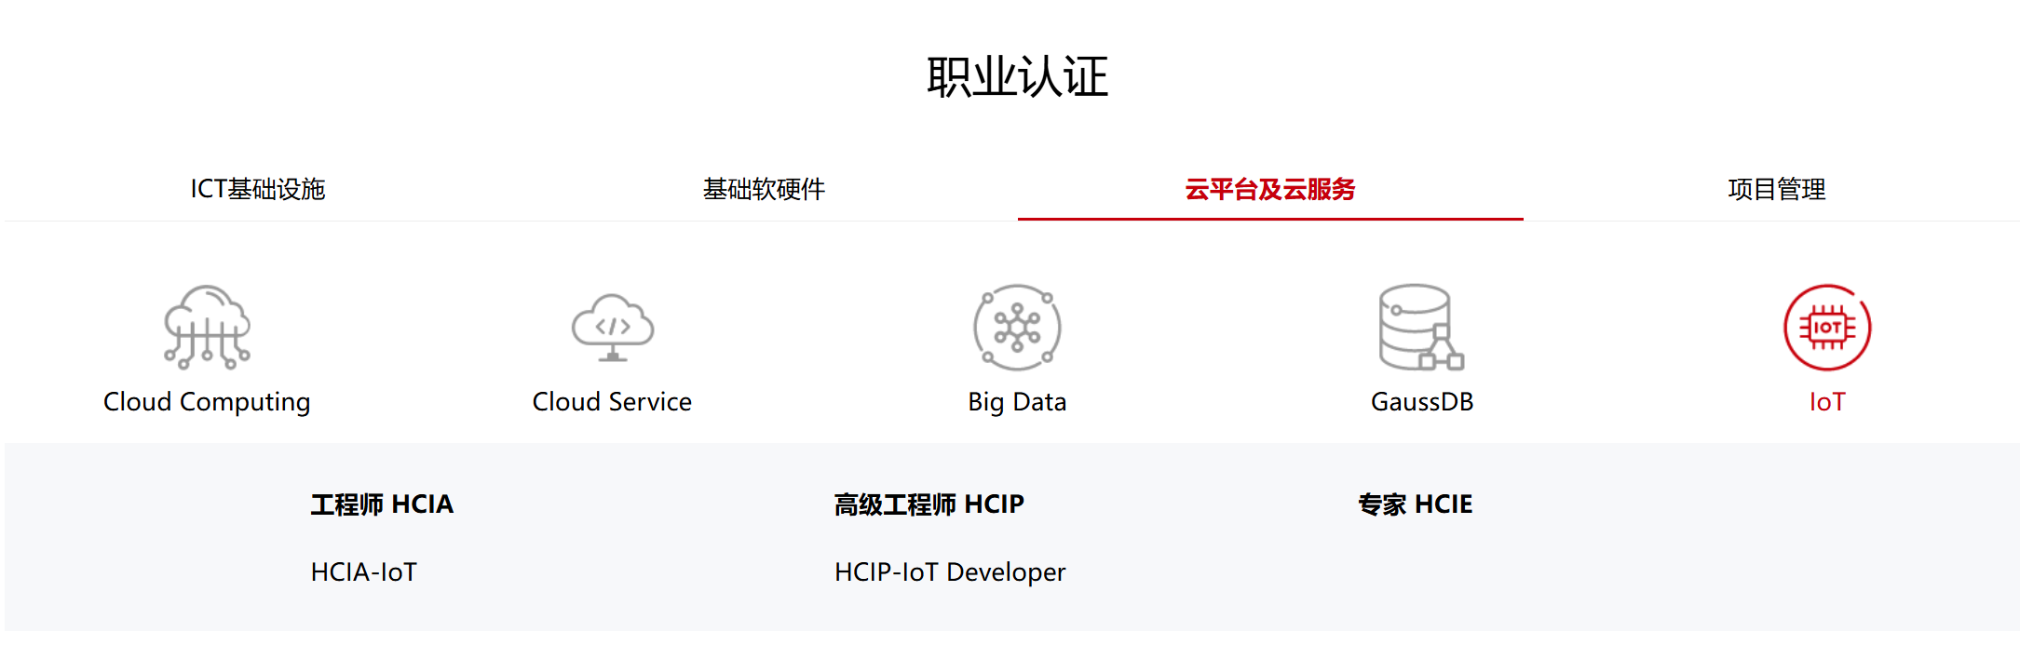
IOT

Slide 5
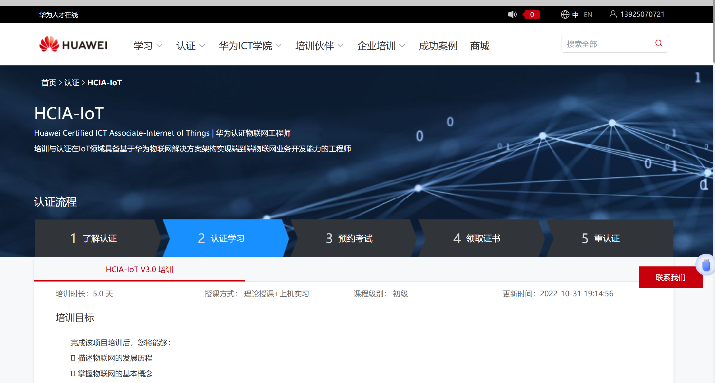

Slide 6
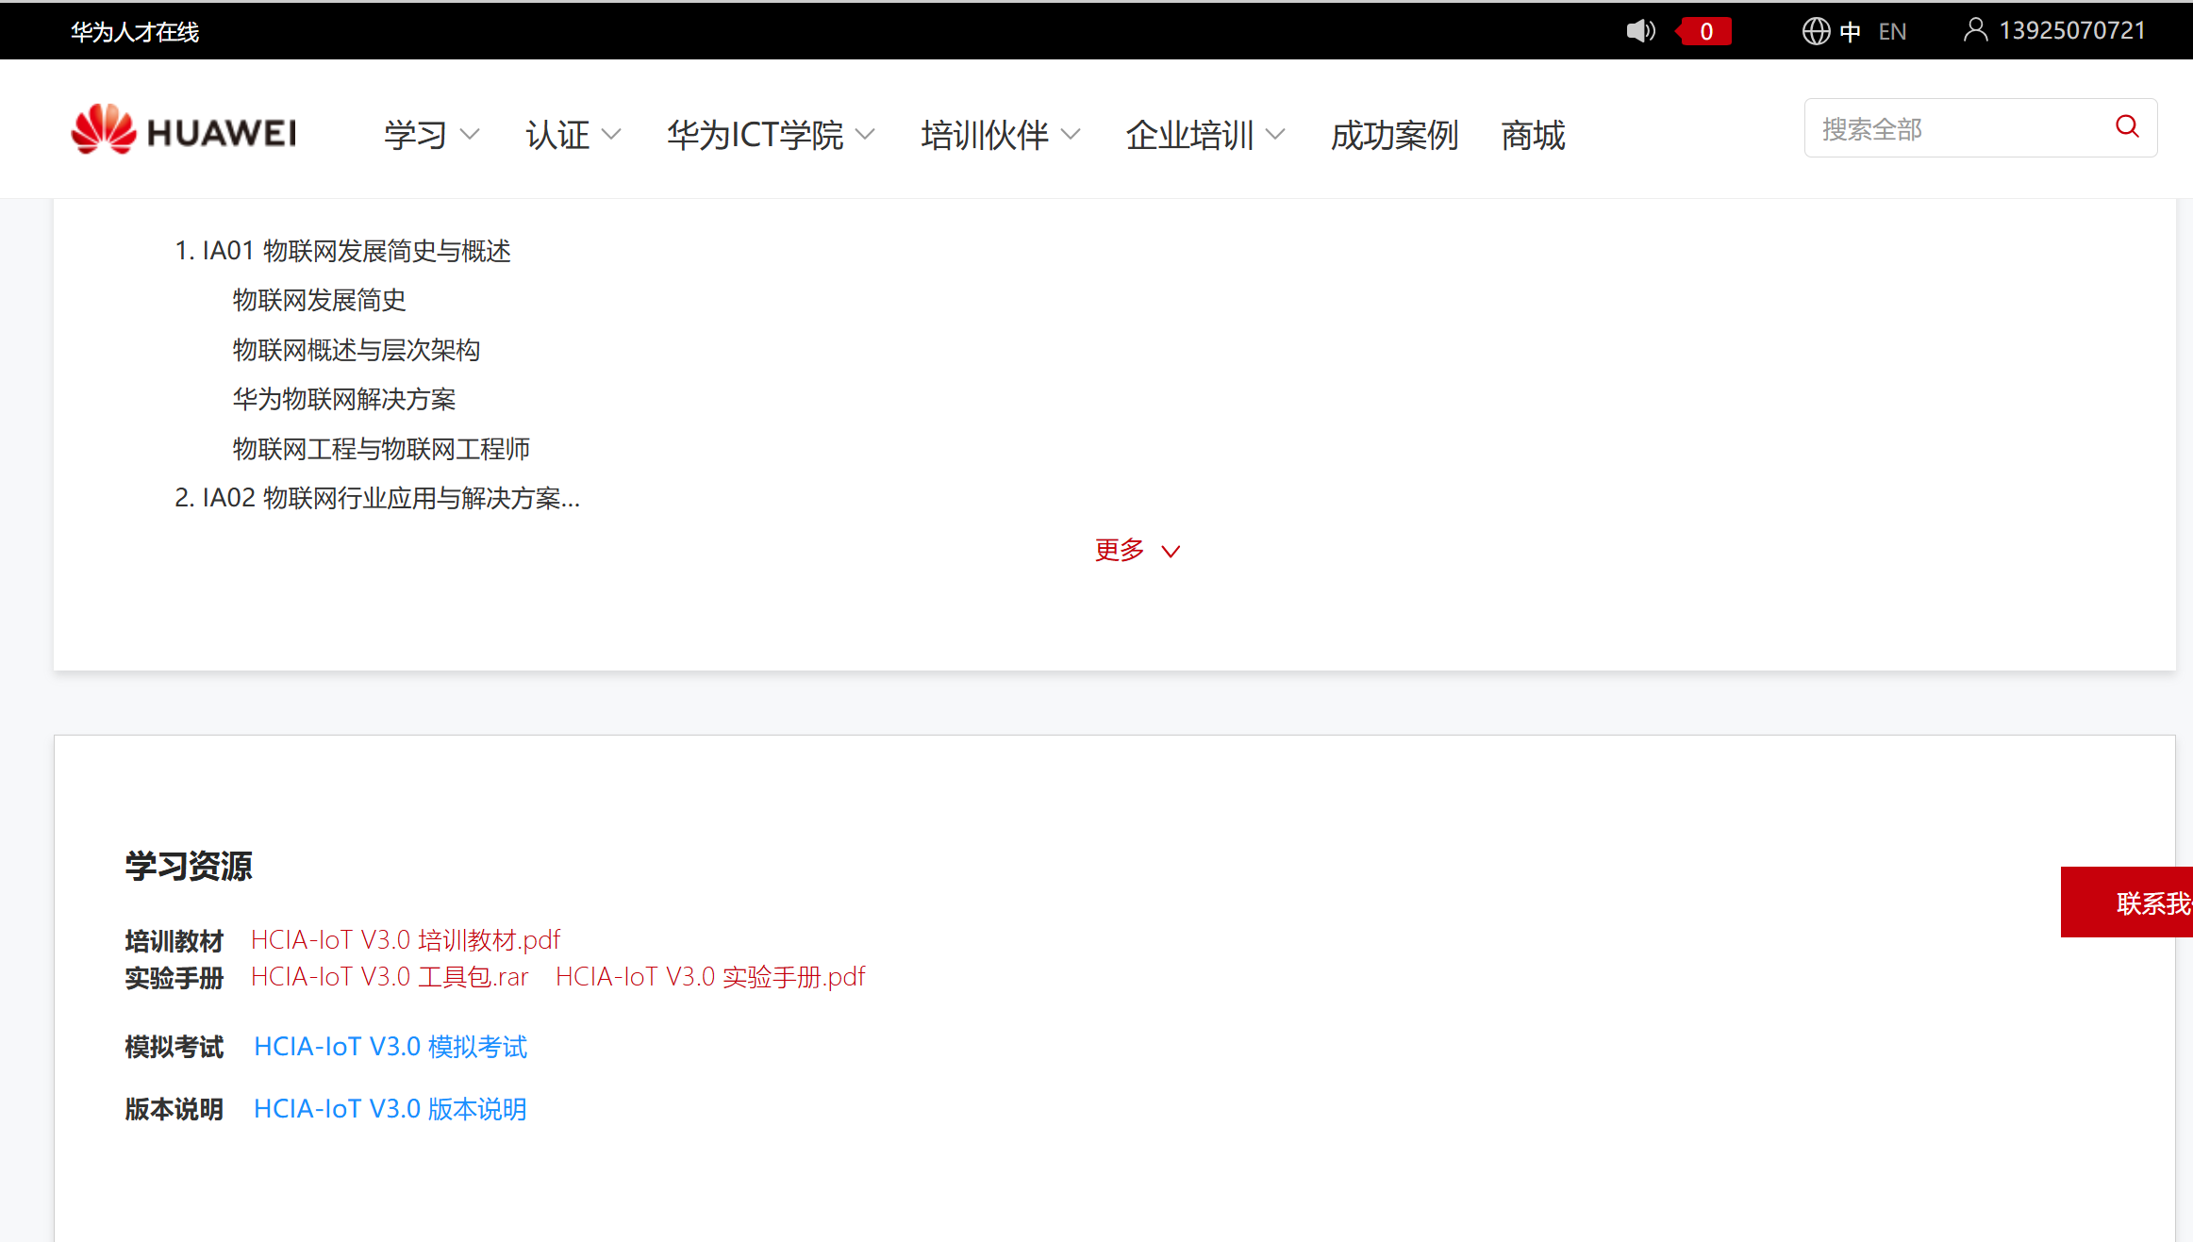

Slide 7
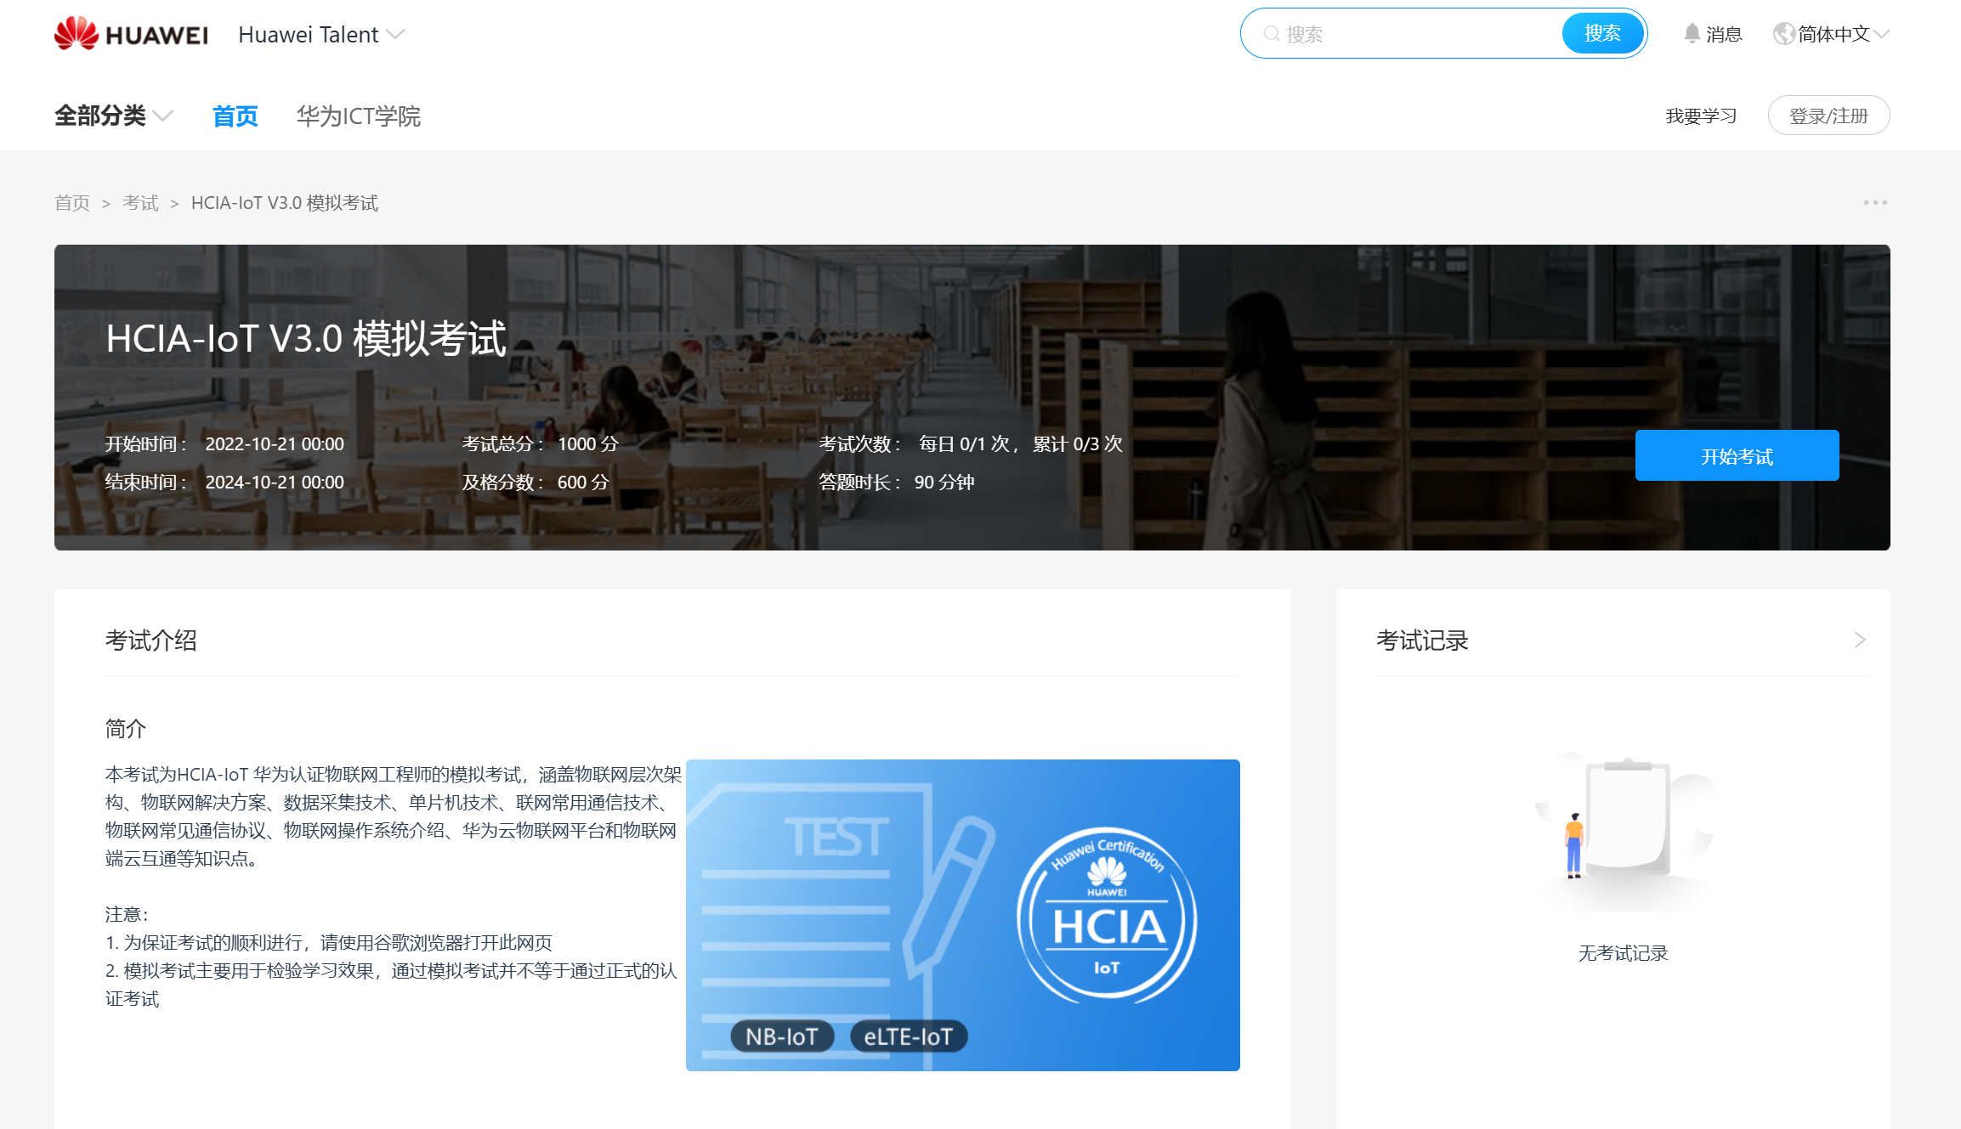

Slide 8
华为技术培训
harmonyOS APP
https://developer.huawei.com/consumer/cn/training/study-path/101667550095504391
harmonyOS Device
https://device.harmonyos.com/cn/docs/documentation/guide/service_introduction-0000001050166905
IOT
https://developer.huaweicloud.com/techfield/iot.html?utm_source=hdhome&utm_adplace=AdPlace063511

Slide 9
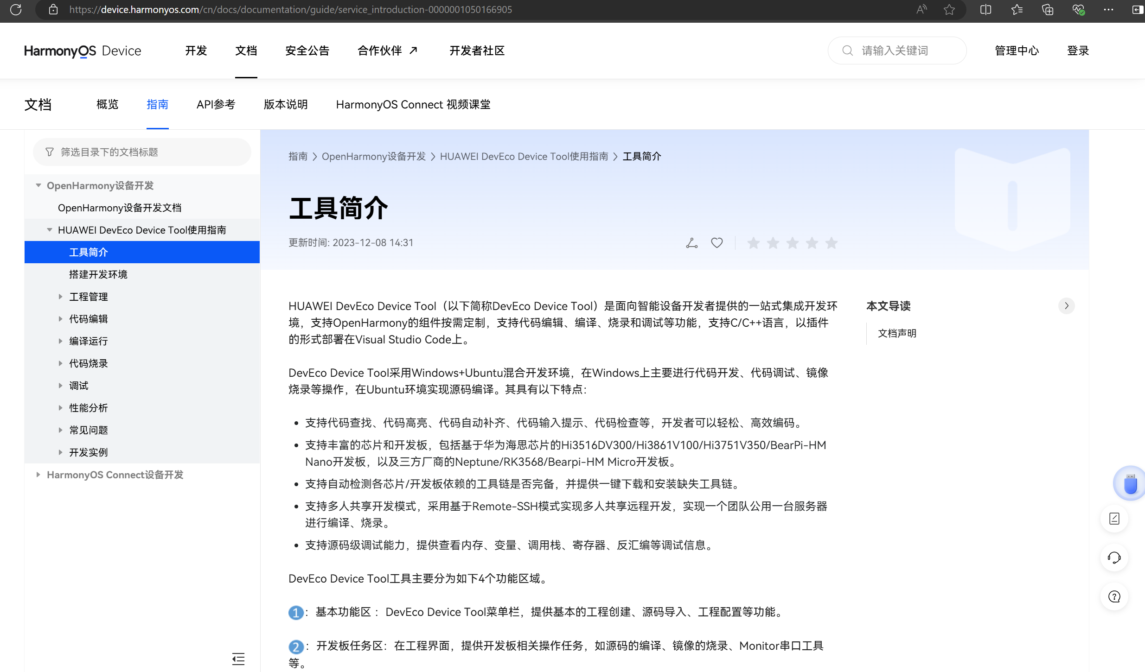

Slide 10
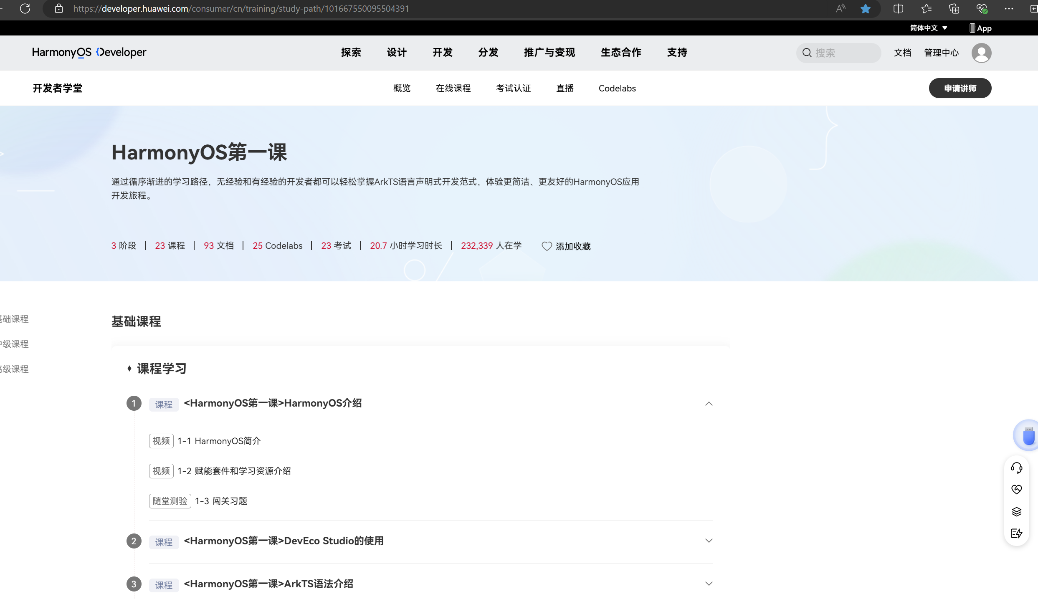

Slide 11
