Slide 1
Moonlight User Manual
2022-04-25

Slide 2
Inhalt
ArduMower Blockdiagramm & Schaltbild
Module:
Arduino, ESP01, SD Card, IMU, Rain, RTC,
Motor Driver, Bumperduino, Raspi
Free Wheel Sensor
Sunray Info
Räder, GPS-Antenna, Messer
Maps

Slide 3
Moonlight Firmware
Moonlight ist der Name meiner modifizerten Sunray firmware
Moonlight Features:
verbessertes Ausgabeformat für Logging
kann Kommandos über UDP verarbeiten
enthält einen Simulationsmodus der mit einem Arduino Due + SD Card + ESP8266 arbeitet
unterstützt zusätzliche Kommandos
unterstützt RTC (Logging Timestamp & SD Card File Date)

Slide 4
amcp – ArduMower Control Program
Moonlight wird über das Python-Programm amcp gesteuert
Aufruf im WinPython command: amcp.bat
amcp kann entweder über Tastatur-Kürzel gesteuert werden oder über Menü
Das Menü wird über ESC ein- und ausgeschaltet.
Die Tastatur-Kürzel sind nur verfügbar, wenn das Menü ausgechaltet ist

Slide 5
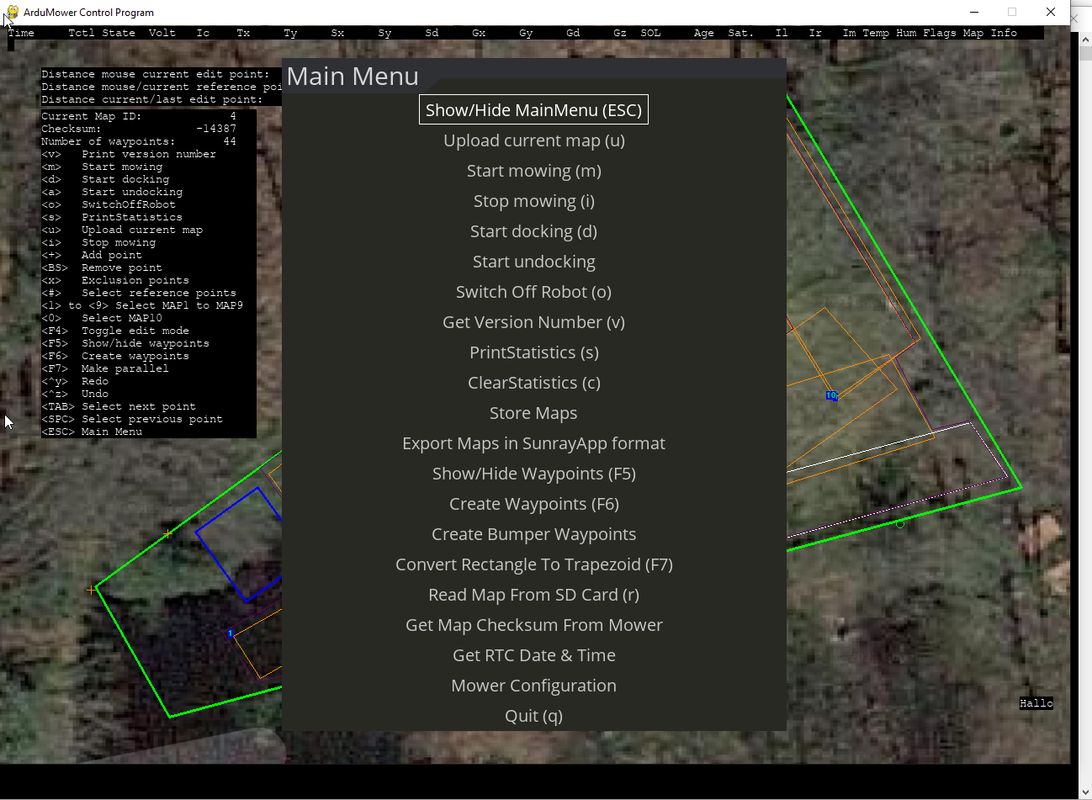
amcp – Main Menu

Slide 6
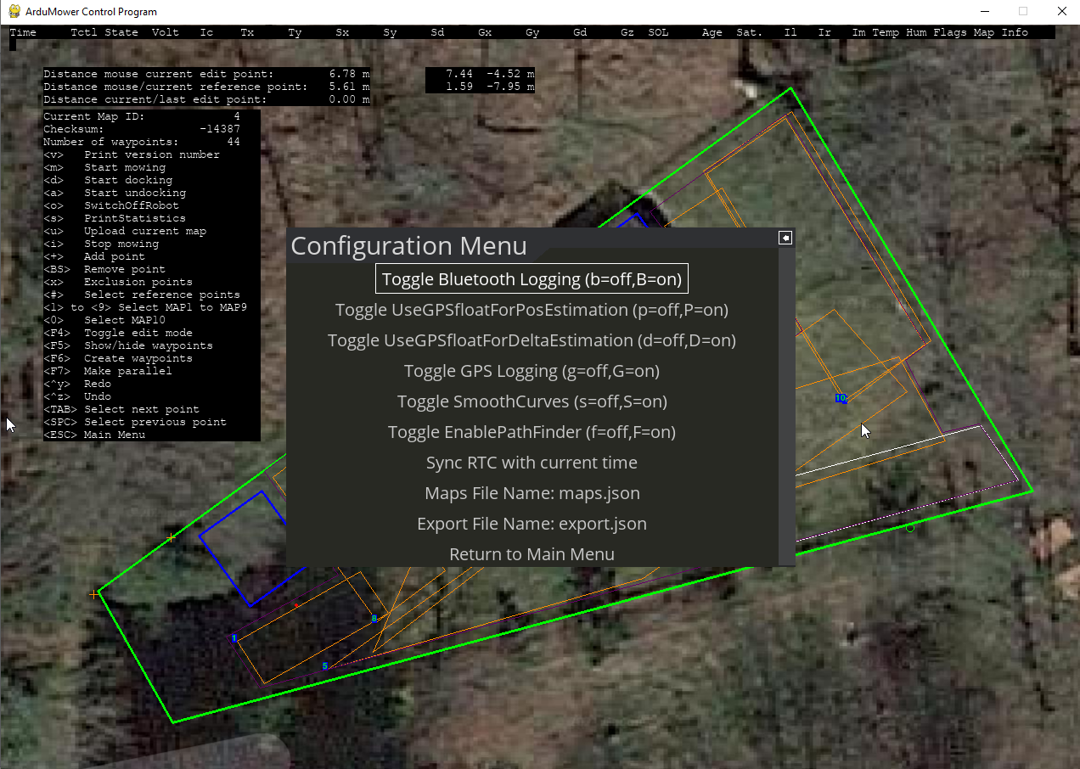
amcp – Configuration Menu

Slide 7
amcp Command Overview Sunray Commands
GUI | Command⁽¹⁾ | Short Description
 | AT+M, fLinear, fAngular | Set Motor Linear & Angular Speed
i,m, d,a⁽⁴⁾ | AT+C, bEnableMowMotor, iOperationType⁽²⁾, fSpeed, iFixTimeout, bFinishAndRestart, fMowingPointPercent, bSkipNextMowingPoint, bEnableSonar | Mower Control
 | AT+W, iIndex, fX, fY | Set Waypoint
 | AT+N, iWayPerimeter, iWayExclusion, iWayDock, iWayMow, iWayFree | Set Waypoints Count
 | AT+X, 0[, iExclusionLength0[, 1, iExclusionLength1[, …]]] | ExclusionCounts
 | AT+P, bAbsolutePosSource, fLongitude, fLatitude | Set Position
 | AT+S | Print Summary
v | AT+V | Print Version Number
s | AT+T | Print Statistics
 | AT+L | Clear Statistics
 | AT+E | Motor Test
 | AT+O | Trigger Obstacle
 | AT+F | Sensor Test
 | AT+G | Toggle GPS.Solution⁽³⁾
 | AT+K | Kidnapping Test
 | AT+Z | Stress Test
 | AT+Y | Trigger Watchdog Test
 | AT+Y2 | GNSS Reboot
Notes:
(1) Parameter naming convention: fName=float, iName=int, bName=bool (0 or 1)
(2) OperationType = OP_IDLE, OP_MOW, OP_CHARGE, OP_ERROR, OP_DOCK
(3) GPS.Solution = SOL_INVALID, SOL_FLOAT, SOL_FIXED
(4) i=Idle, m=start mowing, d=start docking, a=start undocking

Slide 8
Moonlight Command Overview Moonlight Extensions
GUI | Command⁽¹⁾ | Short Description
 | AT+U,CurrentMapIndex | Start Upload Map (informs Moonlight about CurrentMapIndex and initializes map file)
 | AT+D[,[yy]yy,mo,dd,hh,mi,ss,w] | Get/set RTC date and time (w=weekday 0-6; 0=Sunday)
o | AT+Y3 | Switch Off Robot
 | AT+Y4 | Trigger Raspi Shutdown
b | AT+Y5 | Toggle Bluetooth Logging
 | AT+YS | Toggle SMOOTH_CURVES
p | AT+YP | Toggle UseGPSfloatForPosEstimation
 | AT+YD | Toggle UseGPSfloatForDeltaEstimation
 | AT+YG | Toggle GPS Logging
 | AT+$L[,fileName] | Filesystem: ls fileName (‘*‘ can be used at end of filename as wildcard)
 | AT+$C,fileName | Filesystem: cat fileName
 | AT+$T | Filesystem: ls –R (list all files in folder tree; output to Serial only)
Notes:
(1) Parameter naming convention: fName=float, iName=int, bName=bool (0 or 1)
(2) OperationType = OP_IDLE, OP_MOW, OP_CHARGE, OP_ERROR, OP_DOCK
(3) GPS.Solution = SOL_INVALID, SOL_FLOAT, SOL_FIXED

Slide 9
Fix Mode
No fix: either there is not enough data to compute a navigation solution, or the computed solution is outside of the acceptable error criteria
3D: a position solution has been achieved with at least four satellites as compared with a 2D solution with only 3 satellites and altitude/vertical metrics locked to a preset value.
DGNSS: corrections are provided from a source that measures the differences between what pseudorange (signal time-of-flight approximately indicates distance using speed of light through a medium) values for each satellite should be at the precisely surveyed reference station compared to what is reported by its navigation computation. The differences are generally caused by time-varying ionospheric perturbations in the path from satellite to the reference station and the nearby rover. If the rover and reference are too far apart, the separate signal paths may have different perturbations and the correction data are less effective.
Float and fixed: in precise navigation, the receiver tries to lock on to carrier phase (within the 19 cm wavelength) to resolve the exact number of wavelengths and fractions to each satellite. If this exactitude is achieved, the status is "fixed" since phase markers can be locked. if precise wavelengths and fraction are not resolved, ambiguity persists, and the status is "float" since the carrier phase markers are not locked but "floating around" in the mathematical computation. The difference is mm of position accuracy with fixed compared with cm of accuracy with float.

