Slide 1


UNVEILING CONNECTIONS IN BHAGAVAD GITA
Using NLP and Graph Neural Networks to Map Character Relationships
under the supervision of
Dr. Amit Majumder
Presented By: Arekanti Hanook
Master of Computer Applications (MCA)
Reg.No: 2022PGCSCS093
NIT Jamshedpur

Slide 2
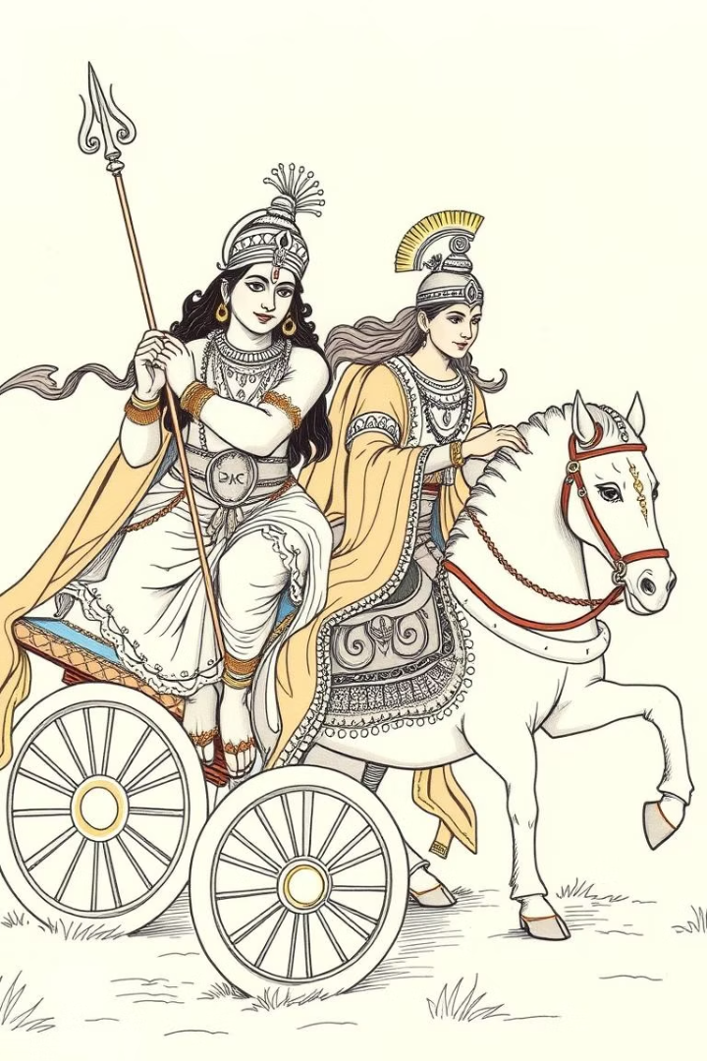
Introduction: Understanding the Bhagavad Gita
The Bhagavad Gita, a 700-verse philosophical dialogue within the epic Mahabharata, explores dharma and duty.
Relationships between key characters drive the narrative and illuminate central themes.
Project Goal: To extract and analyze character relationships within the Bhagavad Gita using Natural Language Processing (NLP) and Graph Neural Networks, providing computational insights into the text's literary dynamics and philosophical depth.
Overview
Key Characters
700-verse philosophical dialogue in Mahabharata.
Krishna (teacher), Arjuna (student), Bhima (brother), Dhritarashtra (father).
Relationships
Central to dharma (e.g., Arjuna-brother-Bhima, Abhimanyu is son of Subhadra).
Notes:
• The Bhagavad Gita is a 700-verse philosophical dialogue within the epic Mahabharata, centered around the relationship between Krishna and his student Arjuna. • Key characters include Krishna as the teacher, Arjuna as the student, as well as Bhima as Arjuna's brother and Dhritarashtra as their father. • The relationships between these characters, such as Krishna guiding Arjuna and Arjuna's familial bonds, are central to the narrative and the concept of dharma. • The goal of this project is to use natural language processing and graph neural networks to extract and predict the relationships between these characters, which can provide computational insights into the literary dynamics of the Bhagavad Gita. • This work is significant as it enhances literary analysis and digital humanities by offering scholars a new computational lens to study the narrative and philosophical depth of this ancient text.

Slide 3
Problems in Relation Extraction
Complex Narrative
Philosophical dialogues obscure relations (e.g., Krishna’s advice).
Chapter 1, Verse 2:
Sanjaya said: Having seen the army of the Pandavas drawn up in battle-array, King Duryodhana then approached his teacher Drona and spoke these words.
Chapter 1, Verse 16:
The strong Yodhamanyu and the brave Uttamaujas, the son of Subhadra (Abhimanyu, the son of Subhadra and Arjuna), and the sons of Draupadi, all of great chariots.
Decoded Relations:
chapter 1: verse 1
chapter 1: verse 16
1. Duryodhana is student of Drona
Abhimanyu is son of Subhadra → (Abhimanyu, son_of, Subhadra)
Abhimanyu is son of Arjuna → (Abhimanyu, son_of, Arjuna)
Sons of Draupadi (implies multiple) → (Shrutakarma, son_of, Draupadi) → (Sutasoma, son_of, Draupadi)
Ambiguity:
1) One person have a multiple name based on the situation.
Example: Arjuna = Partha = Kaunteya = Dhananjaya = Gudakesha
2) Based on situation person names changes.

Slide 4
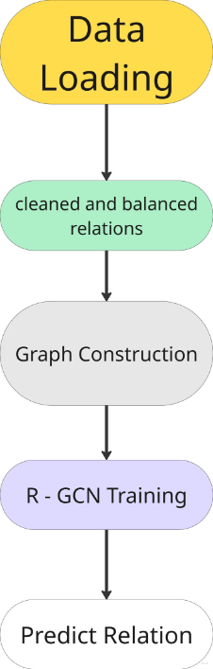
Project Overview
Objective: Extract and predict relationships (e.g., father, brother) between Bhagavad Gita characters using the Bhagavad Gita.
Pipeline:
1
Data Loading
2
cleaned and balanced relations
3
Graph Construction
4
R - GCN Training
5
Relationship prediction
Tools: Python, spaCy, NetworkX, PyTorch Geo.

Slide 5
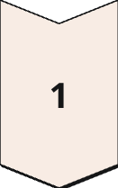
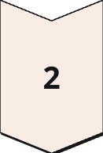
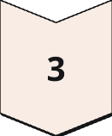
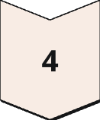
Dataset and Preprocessing
Bhagavad Gita csv file containing verses with Chapter, Verse numbers, and Text.
Tokenization
Raw text is converted into tagged tokens and raw extracted relations.
e.g., arjuna B-PER, said O, to O, krishna B-PER
cleaned and balanced relations
performs relation extraction, validates relationships by checking gender and priority rules, Checks for invalid relations, self-loops, and contradictions. present cleaned and balanced for accuracy and consistency.
Data Splits
splits the data into train, development, and test sets with a 70/15/15 ratio
Save data for Graph Construction
Outputs include tagged verses files (train/dev/test.txt) and relation annotations (train_relations_updated.txt, etc.).
Notes:
Dataset and Preprocessing Content: Dataset: Bhagwad_Gita.csv (verses with Chapter, Verse, Text). Cell 1: Loads data, defines entities (e.g., 'arjuna'), and sets up process_verse for NLP. Cell 2: Extracts relations, validates (gender, priority), balances classes, and splits into train/dev/test (70/15/15). Outputs: Tagged verses (train.txt, etc.), relations (train_relations_updated.txt, etc.). Visuals: Sample verse with tagged tokens (e.g., arjuna B-PER said O to O krishna B-PER). Bar chart of relation type distribution from Cell 2 logs. Enhancements: Show a snippet of name_to_canonical (e.g., 'partha' → 'arjuna') to illustrate normalization.

Slide 6
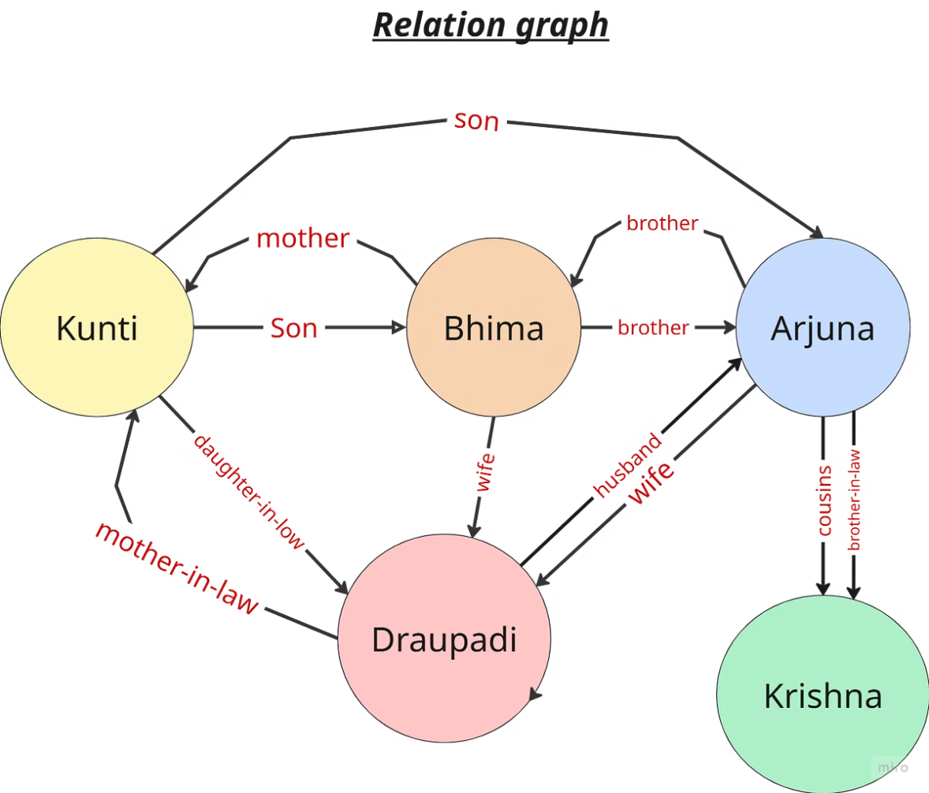
Graph Construction
Objective
Build a directed graph of character relationships representing connections extracted from the data files.
Process
Load relation data, construct a DiGraph, validate edges using gender and factual checks, and rebalance data splits for accuracy.
Nodes represent characters (e.g., 'arjuna', 'krishna').
Edges represent relations (e.g., 'father', 'brother') with direction (e.g., 'pandu' → 'arjuna').
Outputs: gita_graph.pkl (Serialized graph), family_tree.gml (Graph in GML format), updated relation files for GNN training.

Slide 7
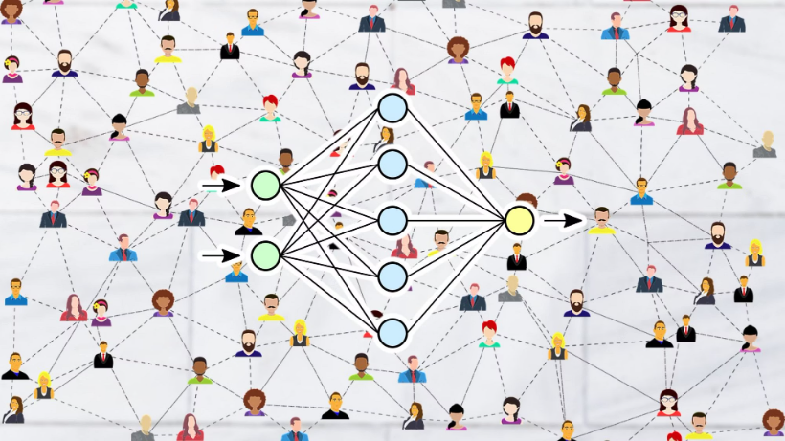
R-GCN Pipeline
Show the flow:
Input graph
Node features:degree, in-degree, out-degree, clustering coefficient, Gender{1(M),0(F),0.5(Un)}.
Edge embedding: source node, target node, relation.
R-GCN layers:Forward Propagation, Loss Calculation, Back Propagation
Model
Relation predictions

Slide 8

Future Work and Applications
Content:
Future Work:
Expand to full Mahabharata text for richer relations.
Incorporate contextual embeddings (e.g., BERT) for better verse processing.
Applications:
Literary analysis of epic texts.
Cultural heritage preservation.
Educational tools for teaching Mahabharata relationships.

Slide 9

Conclusion
Content:
Summary: Built a pipeline to extract, model, and predict Mahabharata relationships using NLP and R-GCN.
Key Achievements:
Cleaned dataset, validated graph, trained R-GCN with 75.0 test accuracy, enabled interactive predictions.
Takeaway:
1. This project shows how AI can uncover intricate relationships in historical texts, transforming literary analysis.
2.By bridging technology and cultural heritage, we’re paving the way for digital humanities research.

