Slide 1
GAMING ESSENTIALS MANAGEMENT SYSTEM
Team HYDRA
Reema Yadav
Hanoz Patel
Kevin Ketan Dedhia
Mayur Dnyaneshwar Darade

Slide 2
INTRODUCTION
Used for maintaining - records of gaming consoles, games, gaming accessories, merchandises
To store information about global scoreboards, consumer data, gaming competitions
Enables accessing and retrieving information - regarding the purchase of products and services
Project aims to set up the database management system to streamline the entire process of buying the required product or service
Enables the end-user to make auxiliary purchases

Slide 3
PROBLEM DEFINITION
Need of centralized system for all the essential components required in the gaming industry for different types of customers
Need a consolidated portal for the customer to not only purchase gaming consoles and related games but also enable them to stream their gameplay and participate in global competitions
Storing, retrieving, modification and management of data of the customers
To retrieve and get information on the complete gaming background of a customer for further analysis

Slide 4




PROPOSED SOLUTION
EASE OF PRODUCT ACCESSIBILITY FOR THE CUSTOMER
USING
GAMING MGMT SYSTEM
DETERMINING THE POPULAR PRODUCTS AMONGST CUSTOMER AND DEVISE A MARKETING STRATEGY
BASED ON DEMAND OF THE PRODUCT, SUPPLY MANAGEMENT FROM THE SUPPLIER CAN BE EFFICIENTLY DONE
HELP TO TRACK BRANCH RECORDS FOR BETTER INVENTORY CONTROL DUE TO CENTRALIZED DATABASE

Slide 5
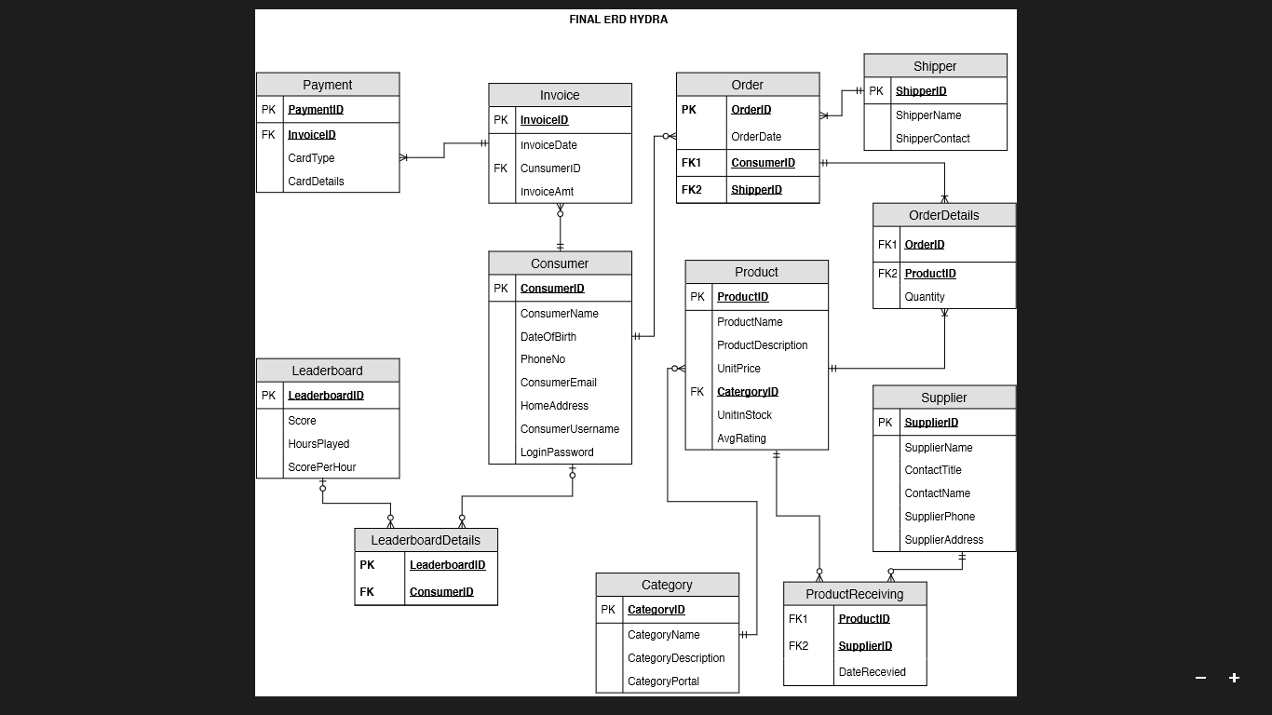
ERD DIAGRAM

Slide 6
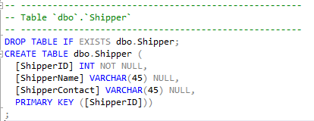
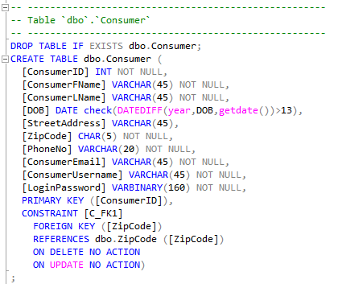
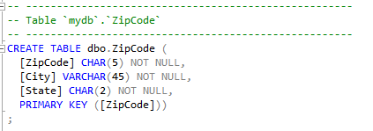
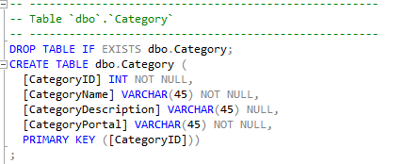
CREATING TABLES & INDEXES

Slide 7
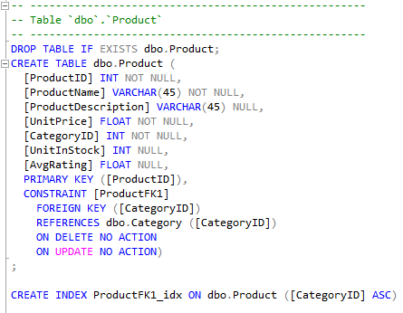
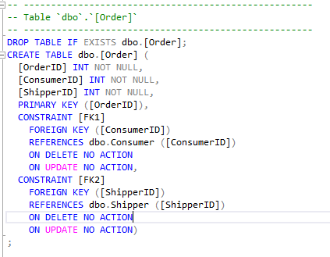
CREATING TABLES & INDEXES

Slide 8
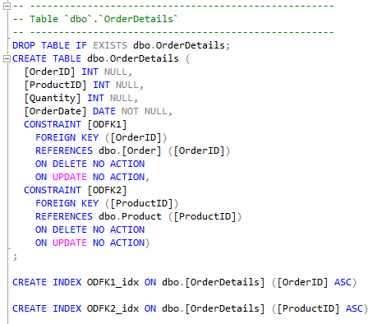
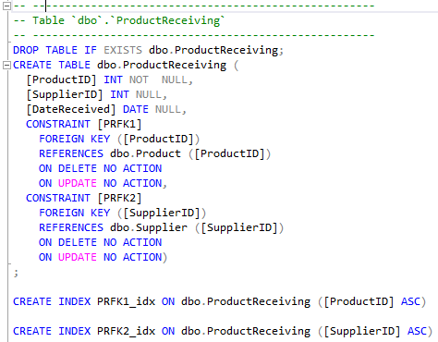
CREATING TABLES & INDEXES

Slide 9
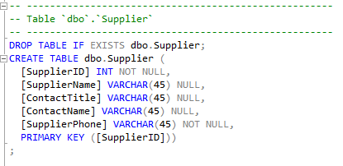
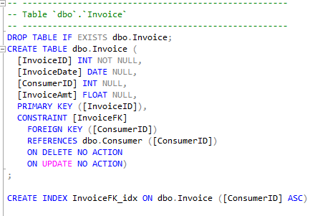
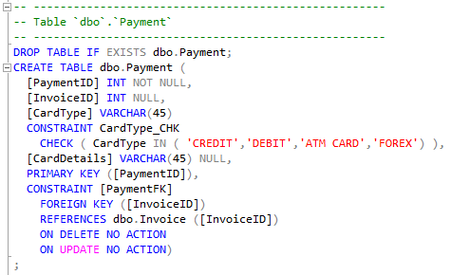
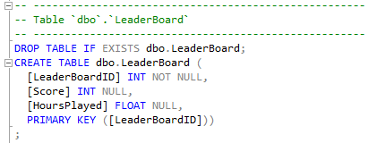
CREATING TABLES & INDEXES

Slide 10
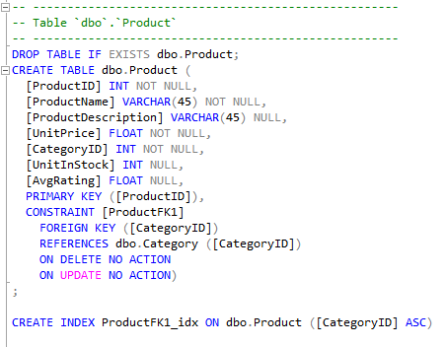
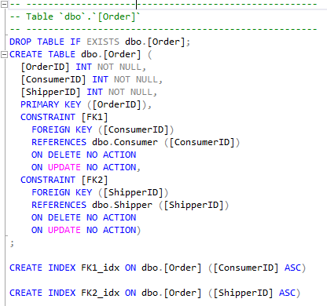
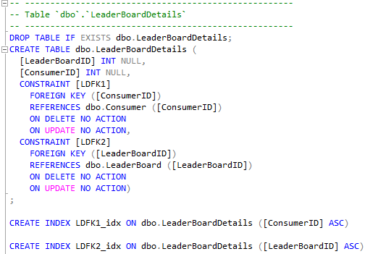
CREATING TABLES & INDEXES

Slide 11
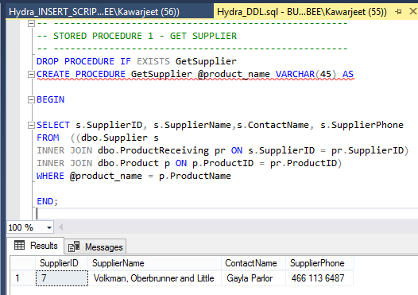
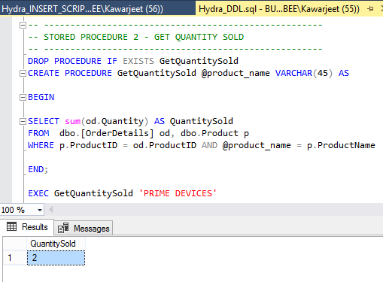
STORED PROCEDURE

Slide 12
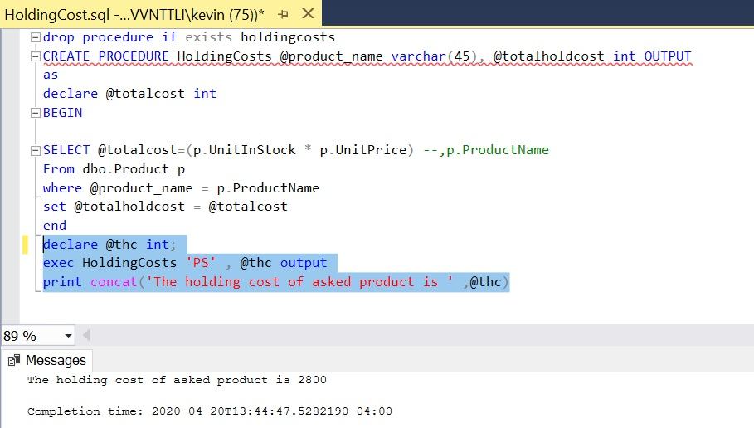
STORED PROCEDURE

Slide 13
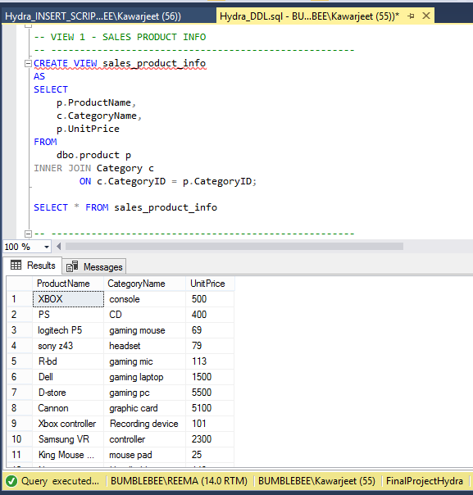
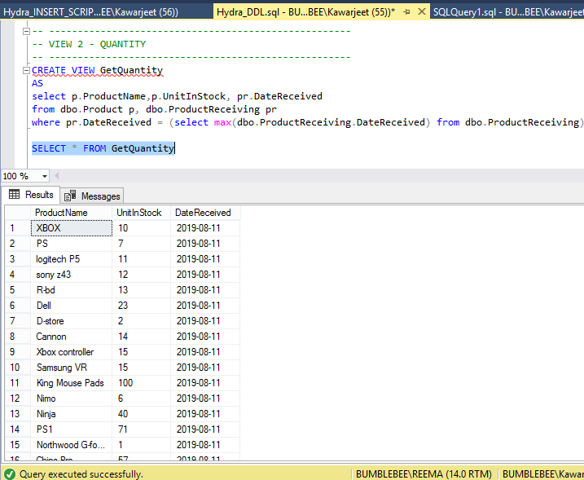
VIEWS

Slide 14
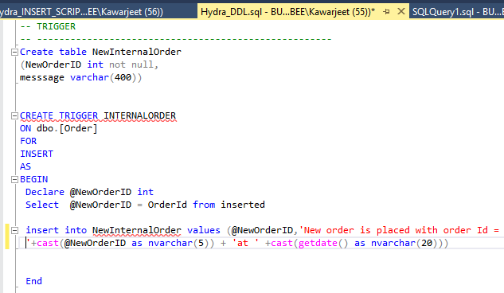
TRIGGER

Slide 15
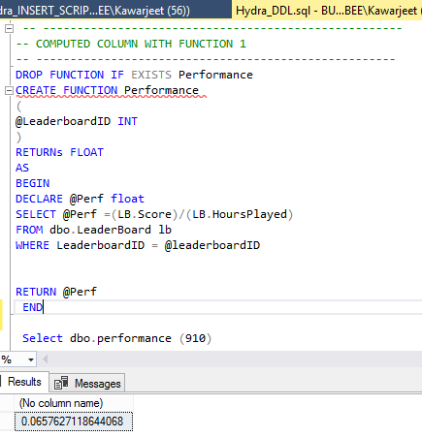
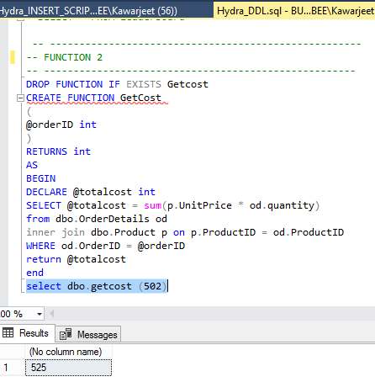
FUNCTION

Slide 16


DATA ENCRYPTION
Encryption is the process of obfuscating data by the use of a key or password.
It enhances security by limiting data loss even if access controls are bypassed. For example, if the database host computer is misconfigured and a hacker obtains sensitive data, that stolen information might be useless if it is encrypted.

Slide 17
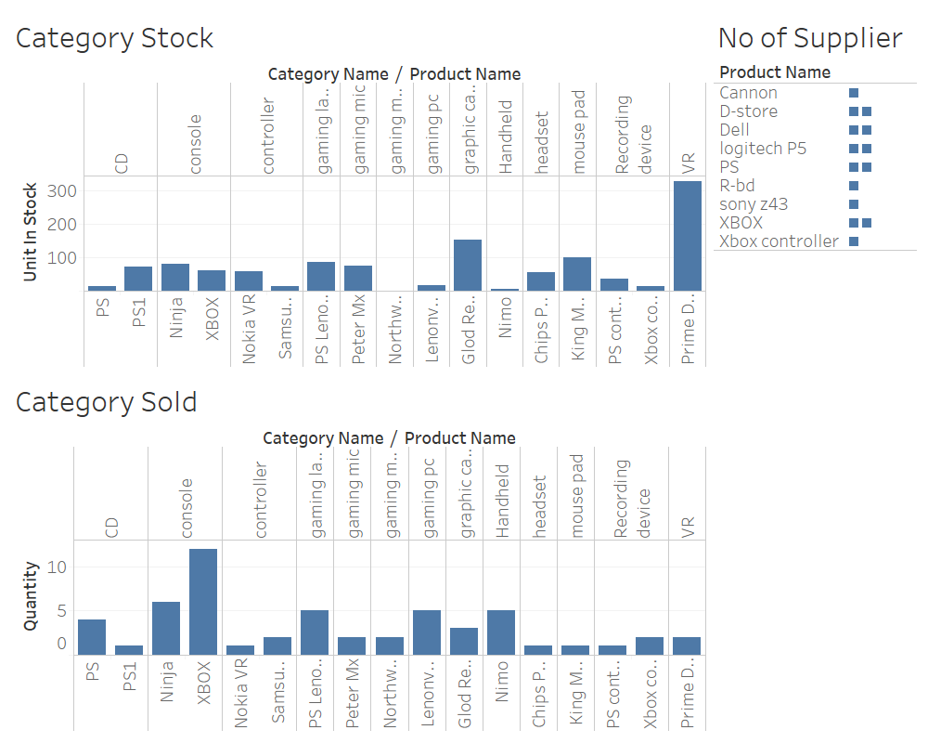
TABLEAU DASHBOARD

Slide 18

SCOPE
Game industry is estimated to grow up to $150 billion by 2022
There will be an increase in users up to 2.5 billion
Capable enough to incorporate additional concepts that are currently in their nascent stages
An ever-growing database of consumers’ gaming data across all platforms will be created so that players can track their progress

Slide 19
Thank You

