Slide 1
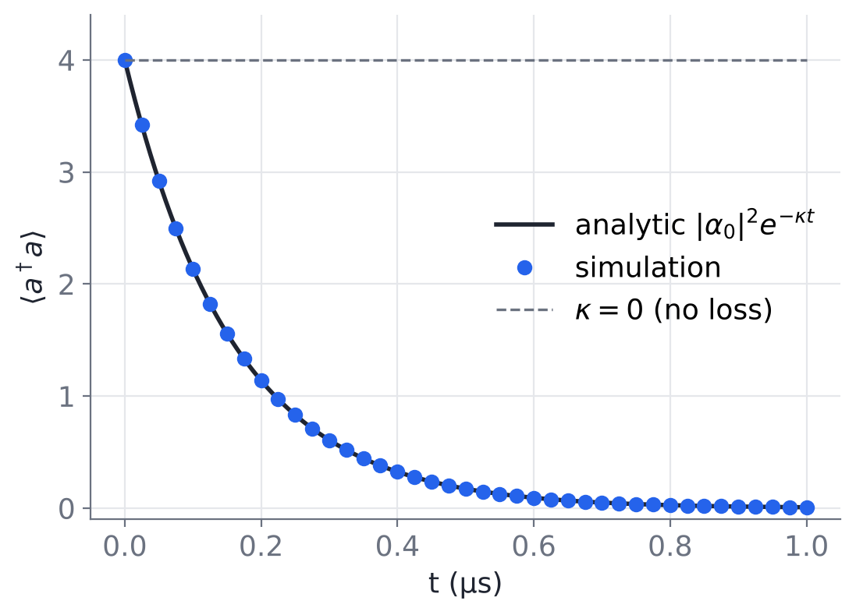
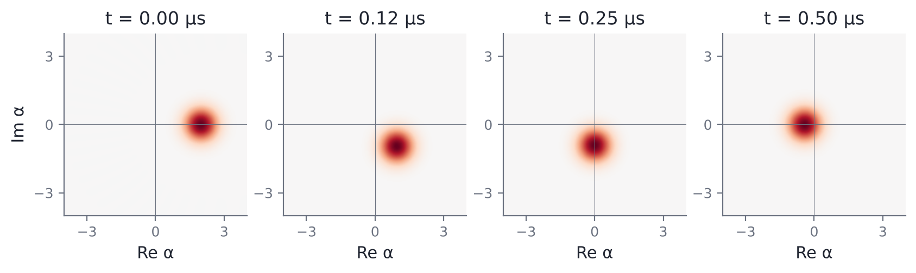
1.0(a) Single-photon loss: the state shrinks but stays coherent
H = Δ a†a, jump √κ a, Δ/2π = 1 MHz, κ/2π = 1 MHz (exaggerated), start |α₀ = 2⟩, 0 ≤ t ≤ 1 µs
Simulation sits on |α₀|² e^(−κt) to machine precision
Centre rotates at Δ (one turn per µs) and shrinks as e^(−κt/2): a spiral
It stays round because a|α⟩ = α|α⟩: losing a photon leaves a coherent state coherent
5 × 10⁻¹⁵
max |n_sim − n_analytic|
> 0.99999
fidelity with analytic coherent state
4 → 0.007
photons left after 1 µs
Notes:
Baseline: ordinary single-photon loss in physical units. We converted every frequency with omega = 2 pi f, so Delta = kappa = 2 pi rad/us. The simulated photon number lies exactly on 4 e^(-kappa t); the worst-case difference is 5e-15, i.e. numerical round-off, which also confirms we got the 2 pi right (forgetting it would make the decay 6x slower). In phase space the blob rotates once per microsecond and spirals in, but its shape never changes: the fidelity with the analytic coherent state alpha0 e^(-(i Delta + kappa/2) t) stays above 0.99999. Reason: a coherent state is an eigenstate of a, so a photon-loss jump does not change it. This is why single-photon loss alone can never flip +alpha to -alpha.

Slide 2
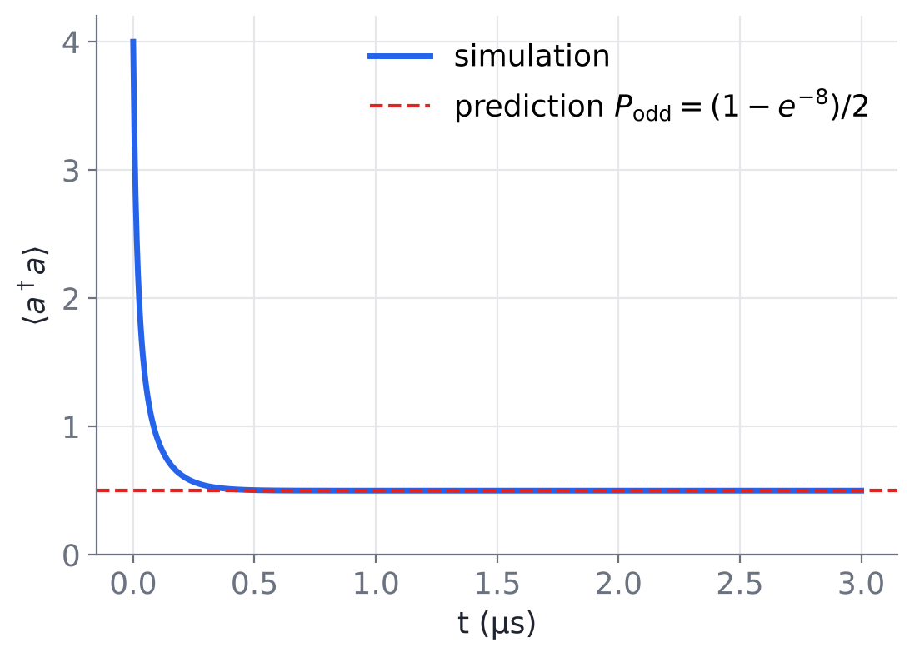
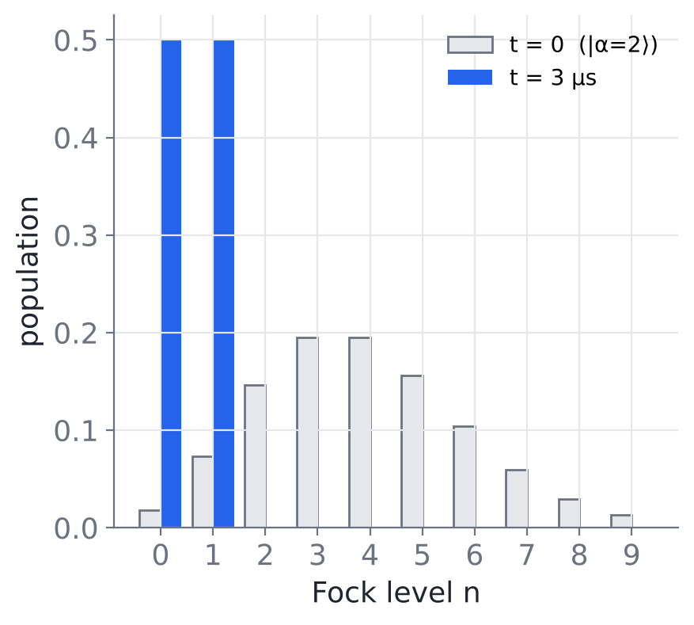
1.0(b) Pure two-photon loss: the photon number stalls at ½
H = 0, jump √κ₂ a², κ₂ = 4g₂²/κ_b = 2π × 0.896 MHz = 5.63 rad/µs, start |α₀ = 2⟩, 0 ≤ t ≤ 3 µs
Why it stops at ≈ 0.5
a² removes photons only in pairs, so parity is conserved.
a²|0⟩ = a²|1⟩ = 0: these two are dark. Even part → |0⟩, odd part → |1⟩.
⟨n⟩∞ = P_odd = (1 − e^(−2|α|²))/2
0.49983
simulated ⟨n⟩ at t = 3 µs
0.49983
predicted P_odd (analytic)
1 × 10⁻¹⁵
drift in ⟨parity⟩ over 3 µs
Notes:
Now the engineered ingredient alone: only two-photon loss, with kappa2 = 4 g2^2 / kappa_b from the provided parameters (5.63 rad/us). The photon number falls fast at first (rate ~ kappa2 n^2) and then stops dead near 0.5, already by about 1 us. Answer to the prompt's question: a^2 kills |0> and |1>, so they are dark states. Removing photons in pairs never changes parity, so all the even-photon weight of |alpha=2> ends in |0> and all the odd weight ends in |1>. The final <n> is therefore exactly the odd-parity probability of the initial coherent state, (1 - e^(-8))/2 = 0.49983, and our simulation gives 0.49983 to 5 digits. Parity stays constant to 1e-15. This conserved parity comes back in Task 1.3.

Slide 3
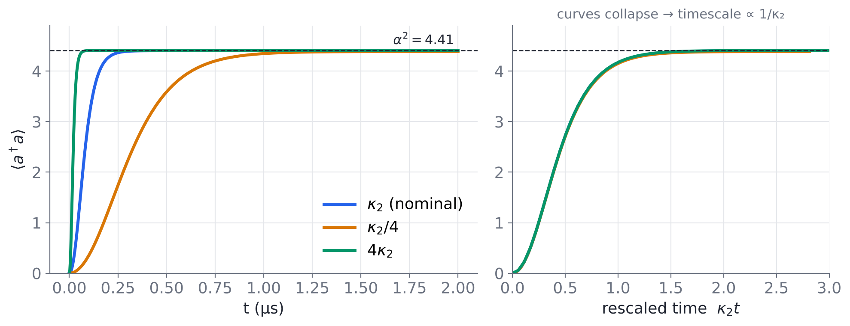
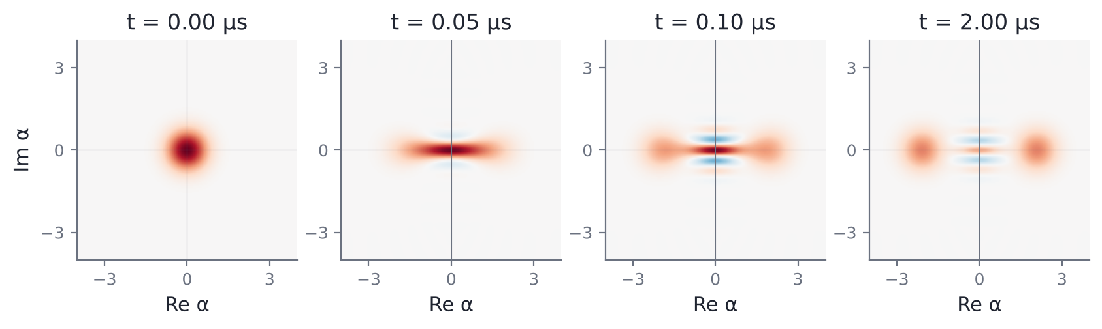
1.0(c) Two-photon loss + drive: a stabilized cat at α² = 4.41
H = 0, jumps √κ₂ (a² − α²) and √κ_a a, α = 2.1, κ_a/2π = 9.3 kHz, start in vacuum |0⟩, κ₂ swept over ×¼, ×1, ×4
Time to settle within 1 % of α²
rate | t_settle | κ₂ · t_settle
κ₂ / 4 | 1.11 µs | 1.55
κ₂ | 0.25 µs | 1.42
4 κ₂ | 0.06 µs | 1.41
Same destination, speed ∝ κ₂. Small residual spread at κ₂/4 comes from κ_a.
⟨n⟩ rises monotonically to 4.40 ≈ α² for every κ₂; no overshoot in the effective model
With κ_a = 0 the only rate is κ₂, so dynamics depend on κ₂t alone: exactly ∝ 1/κ₂
Vacuum is even, so we inflate into the even cat |C₊⟩; by 2 µs κ_a has cut parity to 0.37
Notes:
Full effective model: two-photon loss plus two-photon drive gives the jump operator sqrt(kappa2)(a^2 - alpha^2), whose dark states are |+alpha> and |-alpha>. Starting from vacuum, the photon number climbs smoothly to alpha^2 = 4.41 in about 0.25 us at the nominal rate, and the Wigner function splits into two blobs at +-2.1 with fringes in between. Sweeping kappa2 by a factor 16 changes how fast we get there, not where: on the right panel, plotted against kappa2 t, the three curves collapse. If kappa_a = 0 this collapse is exact because the master equation is kappa2 times a fixed superoperator, so time only appears as kappa2 t. With kappa_a on, steady state is 4.404 rather than 4.41, and the kappa2/4 curve lags slightly. Because vacuum has even parity and pair processes preserve it, we land in the even cat C+, not a single codeword. Single-photon loss then causes phase flips: parity decays at about 2 kappa_a alpha^2 = 0.51 per us, so by 2 us it is 0.37 and the fringes are visibly fainter. That is the ideal reference for the two-mode model in Task 1.1.

